Slide 1

DEVELOPMENTAL DISORDERS
Chapter C.3
School Underachievement and Specific Learning Difficulties
Sonali Nag & Margaret Snowling
Companion PowerPoint Presentation
Adapted by Madeline DiGiovanni and Julie Chilton

Slide 2
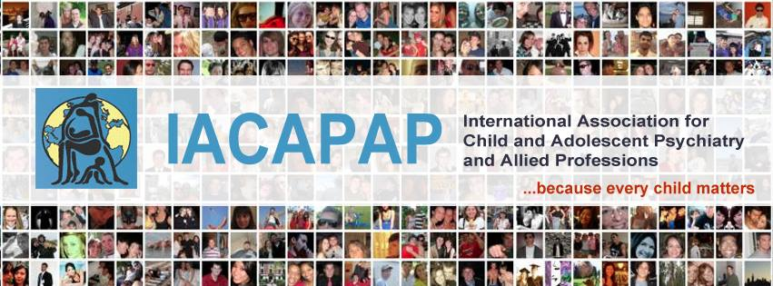
The “IACAPAP Textbook of Child and Adolescent Mental Health” is available at the IACAPAP website http://iacapap.org/iacapap-textbook-of-child-and-adolescent-mental-health
Please note that this book and its companion powerpoint are:
· Free and no registration is required to read or download it
· This is an open-access publication under the Creative Commons Attribution Non- commercial License. According to this, use, distribution and reproduction in any medium are allowed without prior permission provided the original work is properly cited and the use is non-commercial.

Slide 3
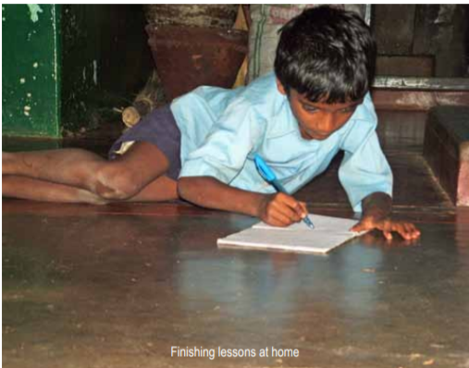
School Underachievement & Specific Learning Difficulties
Outline
Introduction
Definition and Classification
Literacy Learning
Literacy Difficulties
Aetiology
Assessment
Intervention
Secondary Underachievement
Conclusion

Slide 4

School Underachievement & Specific Learning Difficulties
Introduction
Underachievement:
  Cognitive, emotional, social difficulties
  Common reason for specialist referral
Literacy
  derive and communicate knowledge and meaning from written language
Core constructs:
  Dimensionality: continuum vs categorical
  Learning environment
  Comorbidities (e.g. attention disorders)
  Difficulties change
  Consider children’s strengths and difficulties
Notes:
A child struggling in school causes concern. Difficulties with school tasks can leave children frustrated and parents and teachers wondering about the barriers that are preventing learning. Indeed, school underachievement is one of the most common reasons for referral to a visiting specialist in school or to a child guidance clinic.
Underachievement may however be a symptom of any number of cognitive, emotional and social difficulties. In this chapter we will first review definitions of learning disorders and discuss issues surrounding their diagnosis.
Learning difficulties are a dimensional construct – children with difficulties fall along a continuum, some show less difficulty and others more
The criteria used for the diagnosis of learning difficulties are moderated by the learning context
SLDs can be present with other co-occurring problems or comorbidities. Examples of co-morbid problems include speech and sound disorders, attention deficit disorders and emotional disorders.
The manifestations of a learning difficulty can change over development. What appears to be mild at one age can become a significant problem in another life stage.
A child’s performance can be examined in relation to each of the multiple foundations. We can expect the child’s profile of skills to show a mix of strengths and difficulties
When children’s development is delayed in relation to at least one of the factors contributing to learning, they may be considered at risk for a learning difficulty. Conversely, when skills are generally available or present to above average levels, they may act as protective factors

Slide 5
School Underachievement & Specific Learning Difficulties
Definition & Classification
Discrepancy criteria: historical approach
  Attainment below cognitive ability
  Seen in ICD-10 and DSM-IV
Response to intervention criteria: emerging approach
  Continued struggle after help
  Proposed for DSM-V
Notes:
For many years, the most popular approach to identifying specific learning difficulties (SLDs) was to use discrepancy criteria – that is, to identify a child as having an SLD if their attainment was below that to be expected based on general cognitive ability. Indeed, the two main classification systems used in clinical practice at the time of writing – ICD-10 (World Health Organization) and DSMIV (American Psychiatric Association) – follow the discrepancy model to classify children with learning difficulties. However, the use of the discrepancy approach in educational settings has gradually declined because there is little evidence of differences in etiology or prognosis for children with SLDs who have higher or lower IQ (Snowling, 2008). Accordingly, the proposal for DSM-5, which we will discuss below, moves away from this approach. An alternative approach to classification, known as the response to intervention approach, is gaining interest and because there are merits in this approach for low and middle income countries, it will also be considered.

Slide 6
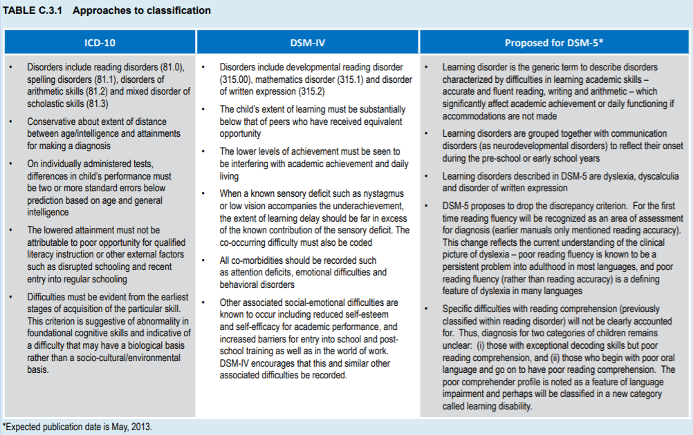
School Underachievement & Specific Learning Difficulties
Definition & Classification
Notes:
The diagnostic systems differ in their approach to the identification of SLDs (see Table C.3.1). When compared to ICD-10, DSM-IV is less explicit about the extent of delay that must be recorded before a diagnosis is considered, and in DSM-5 it is proposed that the discrepancy formula be abandoned altogether. Diagnostic systems also differ in their treatment of co-morbidities. In DSMIV and DSM-5, co-occurring difficulties receive parallel diagnoses. In ICD-10 co-occurring difficulties are placed on a hierarchy with the diagnosis pegged to one nodal difficulty or cluster of difficulties. Sometimes the status given to a co-occurring difficulty has implications for understanding the etiology of the difficulty (e.g., literacy difficulties and language difficulties occurring in parallel, or one following from the other)

Slide 7
School Underachievement & Specific Learning Difficulties
Definition & Classification
Discrepancy criteria – Concerns
Cultural context
Socioeconomic conditions
Potentially no localized standardized tests
Discrepancy between intelligence and attainment
Not grounded in educational practice/instruction
Notes:
Cultural context: For example, some children learn to read in their home language, others in a neighborhood language or a language imposed by sociopolitical forces, yet others achieve literacy in an entirely foreign language, having heard very little of the language at home, in the community and sometimes even in school. In other instances, children may learn to read in two or three languages, and become bi-scriptal or multi-scriptal. Learning how to read and write these multiple languages may happen simultaneously or sequentially, with children being introduced to additional languages at different stages in their school career.
Socioeconomic conditions: In a survey of 672 high school children in the UK tested during the standardization of the York Assessment of Reading and Comprehension, a clear association was found between reading ability and social deprivation…About 33% of children in the deprived neighborhoods were poor readers, close to double when compared to the more advantaged neighborhoods, where between 5% and 18% of children were classified as poor readers.
Standardized testing: In such contexts, test results can be difficult to interpret and there is a genuine concern that test findings can mislead. In other words, test results in the absence of normative data are an unreliable metric for deciding who has a learning difficulty and who is free of learning problems.
Intelligence: Evidence is now available from several large scale studies that the correlation between IQ and reading skill is modest, thus the simple intelligence-reading attainment discrepancy formula is not very useful and it is unclear what exactly a discrepancy index based on IQ can say about the nature of a learning difficulty.

Slide 8
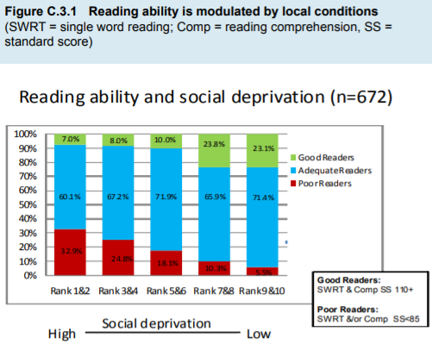
School Underachievement & Specific Learning Difficulties
Definition & Classification
Notes:
Cultural context: For example, some children learn to read in their home language, others in a neighborhood language or a language imposed by sociopolitical forces, yet others achieve literacy in an entirely foreign language, having heard very little of the language at home, in the community and sometimes even in school. In other instances, children may learn to read in two or three languages, and become bi-scriptal or multi-scriptal. Learning how to read and write these multiple languages may happen simultaneously or sequentially, with children being introduced to additional languages at different stages in their school career.
Socioeconomic conditions: In a survey of 672 high school children in the UK tested during the standardization of the York Assessment of Reading and Comprehension, a clear association was found between reading ability and social deprivation…About 33% of children in the deprived neighborhoods were poor readers, close to double when compared to the more advantaged neighborhoods, where between 5% and 18% of children were classified as poor readers.
Standardized testing: In such contexts, test results can be difficult to interpret and there is a genuine concern that test findings can mislead. In other words, test results in the absence of normative data are an unreliable metric for deciding who has a learning difficulty and who is free of learning problems.
Intelligence: Evidence is now available from several large scale studies that the correlation between IQ and reading skill is modest, thus the simple intelligence-reading attainment discrepancy formula is not very useful and it is unclear what exactly a discrepancy index based on IQ can say about the nature of a learning difficulty.

Slide 9
School Underachievement & Specific Learning Difficulties
Definition & Classification
Response to Intervention
Individualized
Continuous monitoring
Diagnosis postponed until after proven intervention
  Concerns:
    Expensive
    Relies on quality of intervention
    Inadvertent neglect of other skills
Notes:
Individualized: The term individualized help means any teaching program motivated by the child’s specific learning needs. The individualizing of the program can be at the level of worksheets, teaching targets, time given to the child to finish an assignment and the ways in which the assignment is assessed; may be mainstream (general ed classroom) or remedial in small groups, 1:1
Continuous monitoring: The term continuous monitoring means that there is a predetermined time plan for repeated evaluation of the child’s skills and attainments. This could be at the end of every school term or every academic year or at any other natural transition point in the school system.
Concerns: One concern about the response to intervention approach is that it is expensive. Another concern is whether the intervention on offer is indeed the best suited for the child. This is mainly because any intervention, by its very attempt to be focused and specific in its targets, may inadvertently neglect an important domain that needs remediation and skill-building.

Slide 10
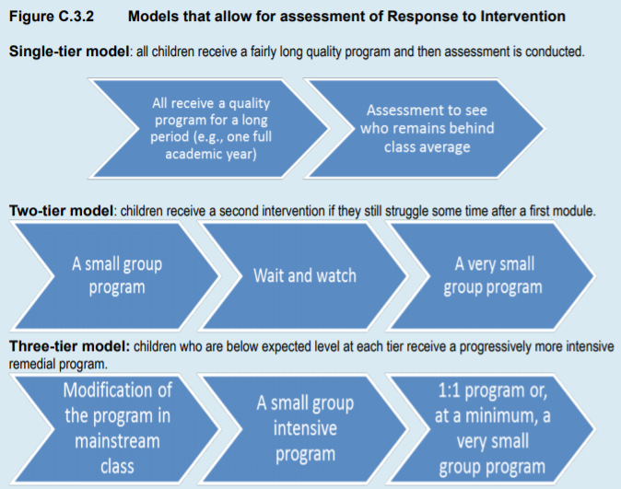
Notes:
Individualized: The term individualized help means any teaching program motivated by the child’s specific learning needs. The individualizing of the program can be at the level of worksheets, teaching targets, time given to the child to finish an assignment and the ways in which the assignment is assessed; may be mainstream (general ed classroom) or remedial in small groups, 1:1
Continuous monitoring: The term continuous monitoring means that there is a predetermined time plan for repeated evaluation of the child’s skills and attainments. This could be at the end of every school term or every academic year or at any other natural transition point in the school system.
Concerns: One concern about the response to intervention approach is that it is expensive. Another concern is whether the intervention on offer is indeed the best suited for the child. This is mainly because any intervention, by its very attempt to be focused and specific in its targets, may inadvertently neglect an important domain that needs remediation and skill-building.

Slide 11
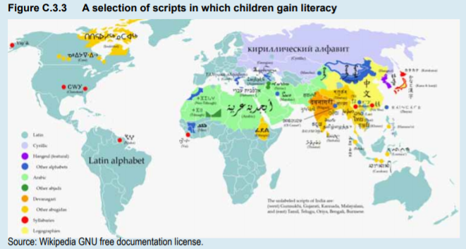
School Underachievement & Specific Learning Difficulties
Literacy Learning
Directly depends on the writing system that a child is taught
Example of script diversity:
Writing Systems: Defining Features
  Direction of writing
  Number of symbols in the system
  Level of spoken language encoded by symbols
Notes:
Literacy learning is directly dependent on the writing system that a child is taught. Figure C.3.3 shows a map locating some of the scripts in which children are learning to be literate across the world.
This list is by no means exhaustive (for example, some children are learning through the tactile modality – Braille), but underlines the sheer diversity in scripts and how easy it is to overlook the fact that understanding how specific learning difficulties impact literacy requires an understanding of the writing system of a region.

Slide 12
School Underachievement & Specific Learning Difficulties
Literacy Learning
Writing Systems: Defining Features
  Direction of writing
    Left to right Right to left Top-down
  Number of symbols in the system
    Letters, characters, akshara…
    Contained vs extensive orthographies
  Level of spoken language encoded by symbols
    Primary function of written language is to capture words/meanings of spoken language
      Alphabet (phonemes)
      Alphasyllabary (symbols deconstruct into phonemes)
      Syllabary (symbols cannot deconstruct to phonemes)
      Character (logographs, morphemes)
Notes:
Modern day writing mostly lays out the symbols left to right (e.g., Bengali, English, German and Tamil), right to left (e.g., Arabic, Divehi, Hebrew and Urdu) or top-down (some forms of Chinese and Japanese).
Symbols: The symbol units in English, French and Italian are called letters, the Bengali, Hindi and Tamil symbols are called akshara and the Chinese symbols, characters. The symbol sets in each of these and other systems have unique contours and visual features that distinguish them from others.
Orthographies: We refer to the small symbol registers as contained orthographies and those with hundreds of symbols as extensive orthographies. The pace of learning the different number of symbols varies as a consequence. Among contained systems, children quickly master the basic symbol set, typically within one school year. Among the extensive systems, new symbols continue to be learnt in middle and high school, and beyond.
The differences between contained and extensive orthographies have another outcome that is of direct interest to understanding children who fall behind in literacy. In the extensive systems, because new symbol learning takes place over a protracted period of time, children vary in their level of symbol knowledge in middle school and even high school. Symbol knowledge thus becomes a robust concurrent predictor of individual differences in literacy development (for Indian akshara systems: Nag, 2007; for Chinese: Tong et al, 2010). Children who begin with lesser symbol knowledge are less accurate in reading words correctly and quickly (reading accuracy and reading speed). In the contained systems however, knowledge about the small number of symbols is easily gained by all children. Individual variations in letter knowledge disappear after an exceptionally short time, often confined to the first year of literacy instruction.
Alphabet: captures dounf at the level of small sub-syllabic sound units called phonemes; e.g. English; correspondence between symbols (letters, graphemes) and phonemic sounds
Alphasyllabary: dual representation – symbols are syllable-level sounds but can segment to reveal phonemic sound; e.g. /ko/ into /k/ and /o/; Indic scripts
Syllabary: symbols map onto sounds only at the level of the syllable; e.g. Cherokee script and Japanese hinagana
Character: represent abstract ideas; carry specific lexical information; symbols are meaning-bearing units rather than merely notations of the sounds of a language; e.g. Chinese

Slide 13
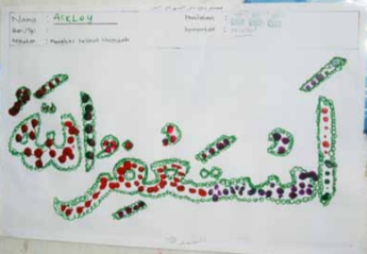

School Underachievement & Specific Learning Difficulties
Literacy Learning
Foundations for learning to read
  Oral language: “speaking and listening help reading
  and writing”
    Phonology, semantics, syntax, pragmatic
  Word recognition
    Strategies for exception words and morpheme phonology
    Understanding polymorphemic words and inflections
    Native vs loan word pronunciation
  Spelling
    Morphemic knowledge: homophones, related words, conjugation
    Phonological values of symbols may change depending on context
  Reading comprehension
    Closely linked to listening comprehension
    Role of prediction in sentence processing
Notes:
Oral language: Oral language supports several aspects of literacy including decoding words, making meaning of texts, and expressive writing. There is also evidence to show that when teaching specifically focuses on improving oral language, the gains are twofold: children get better at multiple skills associated with oral language and they show improvement in their literacy skills.
Skill domains:
Phonology refers to the speech sound system and how it maps to meaning,
semantics refers to the meaning relationships between words (how our vocabulary knowledge is structured),
grammar to the formal structure of the language (syntax and morphology)
and pragmatics to the use of various cues which make communication meaningful (e.g., use of information, intonation, emphasis and gesture).
Exception words: Exception words are words that do not show predictable symbol-sound associations. Examples of exception words in English are ‘knife’ with a silent ‘k’ and ‘whistle’ with an unusual letter string for the ending sounds.
Polymorphemic words: Polymorphemic words are words with more than one meaning unit yoked together. Broader oral language skills help decode polymorphemic words probably because better oral language allows children to “see” the embedded morphemic units more readily. E.g. sunshine, butterfly, combing, amusement; common in Chinese - We now have good evidence to show that those children who have insights into the internal morphemic structure of Chinese words are better at word reading.
Inflections: Inflections include case markers and person-number-gender markers which are either attached or closely associated with specific nouns, verbs and other grammatical units in sentences. In these languages, knowledge of inflections (inflectional morphology) helps to predict upcoming information in sentences and thus may facilitate word decoding.
Loan words: The same symbol (called kanji) is the first symbol in flower and in pollen, but they each have a different pronunciation: /hana/ and /kafun/ (Wydell, 2003). The underlying rule for choice of sound has to do with whether the word is a native Japanese word (called Kun-reading) or a loan word from Chinese (called On-reading).
Spelling:
Examples of other words in English, for which derivational rules make spelling simpler, are words with suffixes –ment (involvement), – ness (wetness), –ion (connection).
In some languages, different word forms are homophones (words with same sound but different spelling). It is only knowledge of how morphology maps to the written form of the word (meaning-symbol linkages) that can assure correct spelling
In French for example, conjugations of the verb manger (eat) are pronounced in the same manner even though they have different spellings: je mange (I eat); tu manges (you eat); ils mangent (they eat)
Morphological knowledge has been found to be particularly useful in languages such as Arabic, Japanese and Bengali where phonological values of symbols change depending on context. In Bengali for example, word medial consonant clusters are realized in spoken form quite differently from the written spelling - the word podda (lotus) is written as padma and sotto (truth) as satya.

Slide 14
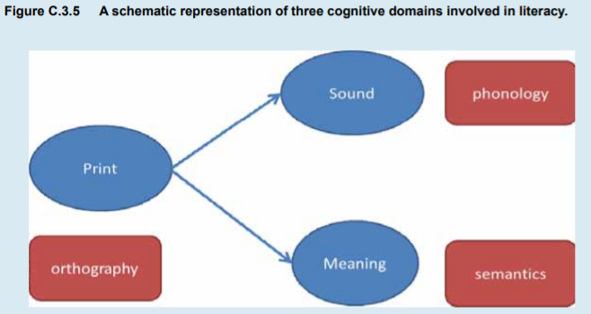
School Underachievement & Specific Learning Difficulties
Literacy Learning
Mapping between cognitive domains
  More consistent mapping (increased transparency) → faster learning
  Phonological awareness is key
  Note: visuo-motor and visual processing skills also important for some languages (Japanese, Chinese, etc.)
Notes:
The process of learning to read entails becoming skilled at mapping the symbols of the writing system (orthography) on to the sounds that they represent in the language (phonology). In addition, written words and sentences need to be mapped on to meanings (semantics). The schematic drawing in Figure C.3.5 is a simple illustration of how the three cognitive domains interact
Transparent languages: The difference between English and Finnish is one of “transparency”, which refers to that feature of writings systems “where it is approximately true that individual letters correspond reliably to individual sounds” (Seymour, 2005 p299). Finnish is a transparent language whereas English is an opaque language.
We now know that when the mappings are regular, consistent and hence transparent, children learn to read faster
Cross-linguistic study - initiated by a network of European researchers, the COST A8 Consortium (1995-1999)
While decoding of words can draw upon both sound-symbol linkages as well as semantic knowledge, reading of non-words cannot draw upon meaning or context related strategies, and is thus often considered a pure indicator of phonological decoding skills, requiring detailed knowledge of what sounds the individual letters map on to. The comparison across countries confirmed the advantage that transparency of a writing system brings to the process of learning to read.
Transparent systems have a straight forward mapping which allows for faster grasp of the symbol-sound linkages. This is essentially statistical association learning between visual and verbal codes.
Phonology:
Awareness of phonemes, for example, is a robust predictor of single-word reading attainment in several alphabetic and alphasyllabic languages – for example, English (Muter et al, 2004), Arabic (Abu-Rabia et al, 2003) and Kannada (Nag, 2007). Importantly, difficulties with phonological skills are a defining characteristic of many poor readers, in different types of writing systems and languages and across age groups into adulthood.

Slide 15
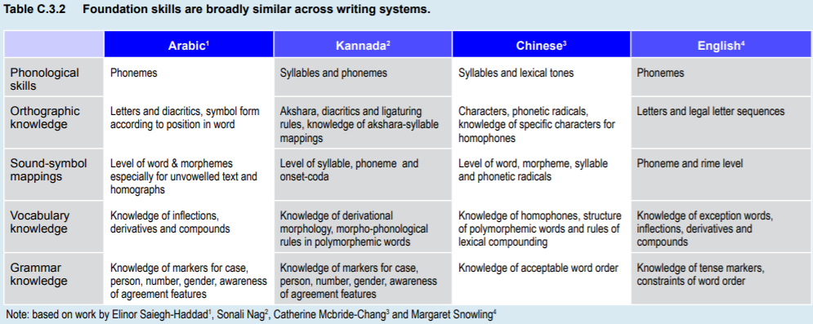
School Underachievement & Specific Learning Difficulties
Literacy Learning
Foundation skill comparison
Notes:
Table C.3.2 opposite lists the broadly similar foundation skills across writing systems, but note the specificities of each of the typologically very different systems.

Slide 16
School Underachievement & Specific Learning Difficulties
Outline
Introduction
Definition and Classification
Literacy Learning
Literacy Difficulties
Aetiology
Assessment
Intervention
Secondary Underachievement
Conclusion

Slide 17
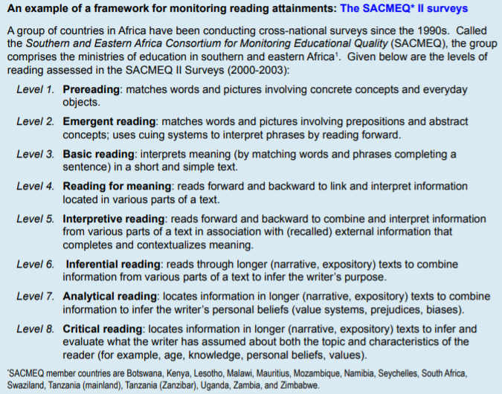
School Underachievement & Specific Learning Difficulties
Literacy Difficulties
Epidemiology
  Similar trends across countries as criteria/cut-offs adjusted
  Incidence rates increase over early school years (peak ~8-10yo)
  Note: data sensitive to local conditions!
    Most data from high income countries – not fully representative
    Advised to begin with brief survey if representative data not available
Sample framework representing local criteria/context
Notes:
In this section we will review what we know about literacy difficulties: how common are they in the population, what their clinical picture is and what we know about their etiology. We will also discuss current trends in assessment and intervention
A review of published epidemiological studies suggests similar trends across countries; this is not surprising since prevalence rates depend upon the precise criteria used to define these disorders and different studies tend to adopt similar cut-offs – e.g., lowest 5% or 15%: USA (Shaywitz, 1998), India (Nag, 2000; Nag & Snowling, 2010).
Incidence rates appear to increase over the early school years, with estimates showing a peak around the end of primary school (age 8-10 years), and new “cases” continuing to be identified through middle and high school, higher education and beyond.
It is important also to note that most currently available epidemiological information is from high income countries. What this means is that data come from a particular type of schooling environment that typically subscribes to a mono-grade organization and strict age-grade stratification, class sizes are small to moderate and teacher: student ratios are healthy. Many of these schools are able to offer literacy instruction in the child’s home language, or have well developed bridge programs for transition from the home language into the school language. However, in many low and middle income countries, school arrangements may be quite different.

Slide 18
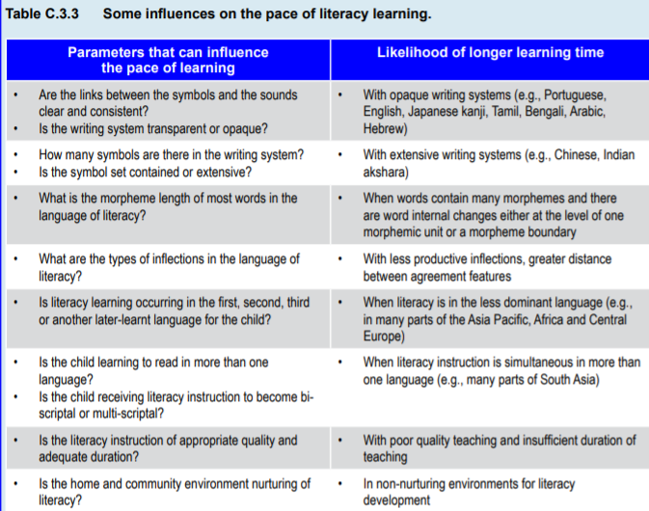
School Underachievement & Specific Learning Difficulties
Literacy Difficulties
Notes:
Further complicating the picture are the multiple sources of influence on the pace of literacy learning. The nature of the writing system, the child’s proficiency in the language of literacy instruction and the effectiveness of the instruction program can all change the rate at which children become skilled in literacy. The variable trajectories of literacy learning need to be factored in when making definitions of who has a literacy difficulty. Table C.3.3 lists some of the parameters that can change the estimates of school learning and therefore define the local conceptualization of school underachievement.

Slide 19
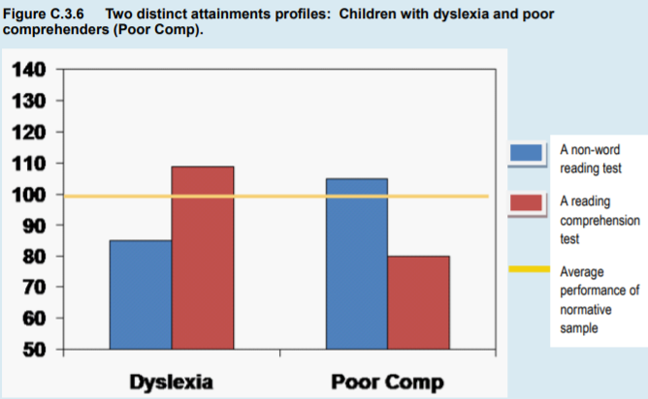
School Underachievement & Specific Learning Difficulties
Literacy Difficulties
Clinical Picture:
  Two groups of reading difficulty
    Compromised decoding, intact comprehension (dyslexia)
    Intact decoding, compromised comprehension (poor comprehenders)
Notes:
In dyslexia the clinical picture is characterized by compromised decoding skills while comprehension skills are intact (either appropriate or above expectation for the child’s age, grade or general abilities). There is however a second group of struggling readers who are poor in reading comprehension. While their decoding skills are appropriate for age, grade and general ability, they lag behind in comprehension skills. Figure C.3.6 below shows the difference in the attainment profiles of the two groups. There is converging evidence from several cross-linguistic studies that such discrete profiles are often seen among poor readers. This suggests a double dissociation between phonological skills for reading (decoding) and semantic skills for reading (comprehension).

Slide 20
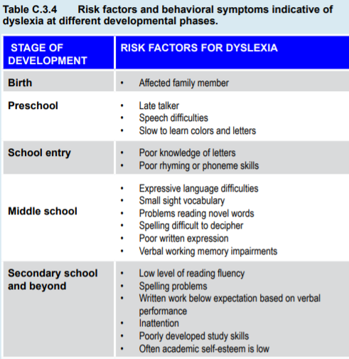
School Underachievement & Specific Learning Difficulties
Literacy Difficulties
Dyslexia
Multi-factorial deficits (Ho et al., 2002; Kannada, Nag, and Snowling, 2011)
40% risk in first-degree relatives
Debated gender difference (M > F)
Notes:
More information for a multi-factorial understanding of the dimensions and risk factors in dyslexia comes from surveys. In Chinese, Ho et al (2002) found that more than 50% of poor readers had cognitive deficits in three or four domains while less than 25% of poor readers had difficulty in just one domain. Similarly, for Kannada, Nag and Snowling (2011) found that 13.8% of all poor readers had deficits in the five domains examined in the survey: oral language and speed of processing, and the orthographic, phonological and visual processing domains.
It has been known for many years that dyslexia runs in families and recent studies suggest there is about a 40% risk of dyslexia in first degree relatives.
Although debated, there appears to be a greater likelihood of a boy being affected than a girl, perhaps because dyslexia is associated with developmental language problems which are more common in males.

Slide 21
School Underachievement & Specific Learning Difficulties
Literacy Difficulties
“Poor Comprehenders”
  Less studied than children with dyslexia
  “Hidden” disability
  Difficulty with higher-level text processing:
    Verbal working memory
    Knowledge of story structure
    Comprehension monitoring
  Cognitive profile stable over time
  Note: bi/multilingual readers at risk of comprehension impairment in non-native language
Notes:
As a group, poor comprehenders have been much less studied than children with dyslexia and the condition is not well recognized by teachers even though, in alphabetic contexts, studies suggest that between 6% and 10% of primary school pupils appear to be affected (see Hulme & Snowling, 2010 for a review).
They also show a range of difficulties in higher-level text processing, such as problems with making inferences, especially across large sections of text where verbal working memory is involved, knowledge of story structure and comprehension monitoring. The findings of a small number of prospective longitudinal studies of poor comprehenders suggest that their cognitive profile is stable over time and the skills which they bring to the task of reading include well developed phonological skills coupled with vocabulary impairments.
Turning to bilingual and multilingual children, we now know that some aspects of the broader oral language develop faster than others in the languages learnt later – sometimes referred to as profile effects (Oller et al, 2007). In SpanishEnglish and Turkish-English bilinguals for example, English vocabulary and the complex grammar such as seen in passive sentences are slower to develop than simple grammar (Bodman et al, 2010; Chondrogianni & Marinis, 2011; Oller et al, 2007). It follows that many children who are learning to read in a non-native language will be at risk of reading comprehension impairment associated with their limited command of the language of instruction

Slide 22
School Underachievement & Specific Learning Difficulties
Outline
Introduction
Definition and Classification
Literacy Learning
Literacy Difficulties
Aetiology
Assessment
Intervention
Secondary Underachievement
Conclusion

Slide 23
School Underachievement & Specific Learning Difficulties
Aetiology
Dyslexia
  Genetic link (Chr 6 short arm)
  Activation patterns: (Richlan et al., 2011)
    Under-activation in multiple left hemisphere regions
    Abnormalities in inferior frontal gyrus
    Overactivation in primary motor cortex, anterior insula
  Next step: neuroimaging
Comprehension Impairment
  Much less clear, suggestion of genetic component
  Potential gender differences (more equal than in dyslexia)
Social/Environmental Influences
  Family structure and birth order
  Home literacy
  “Print exposure” – reading practice
Notes:
Studies of the molecular basis of genetic influences on reading have used a variety of methods. To date, the strongest evidence for linkage with dyslexia (in terms of number of replications) is a site on the short arm of chromosome 6, and currently molecular biologists are having some success in identifying candidate genes. It is important to remember, however, that genetic influences are probabilistic; disorders like dyslexia depend on the combined effect of many genes, as well as on environmental influences
Notwithstanding these concerns, a recent meta-analysis (Richlan et al, 2011) reported underactivation in inferior parietal, superior temporal, middle and inferior temporal and fusiform regions of the left hemisphere in people with dyslexia during reading or reading-related tasks. In addition, there were left frontal abnormalities in the inferior frontal gyrus accompanied by overactivation in the primary motor cortex and the anterior insula.
The use of neuroimaging to identify which brain systems might be impaired in dyslexia holds great promise, although there are still methodological issues to resolve
Much less is known about the etiology of reading comprehension impairment. The gender ratio appears to be more equal than in dyslexia but epidemiological data are sparse. It seems probable, given its association with language impairment, that genetic influences on reading comprehension impairment will be substantial. Preliminary data from behavior genetics suggest this is indeed the case but findings are in need of replication.
Evidence indicates that reading disorders show a strong social gradient and surveys suggest that poor readers often come from large families, where later-born children may face delays in language development. Direct reading instruction in the home is also important, as different styles of home literacy are associated with individual differences in the pre-reading skills which children bring to school (Senechal & LeFevre, 2002)
One variable that can have a significant impact on the behavioral manifestations of a reading disorder is reading practice which, in turn, depends on “print exposure”. Indeed, the effects of low exposure are cumulative, causing differences in reading competence to become magnified over time.

Slide 24
School Underachievement & Specific Learning Difficulties
Outline
Introduction
Definition and Classification
Literacy Learning
Literacy Difficulties
Aetiology
Assessment
Intervention
Secondary Underachievement
Conclusion

Slide 25
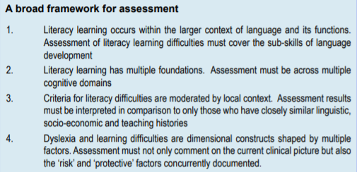
School Underachievement & Specific Learning Difficulties
Assessment
Comprehensive literacy assessment:
  Letter knowledge
  Reading accuracy
  Reading speed
  Reading comprehension
  Spelling accuracy
  Rate of writing
  Quality of written expression
  *General abilities
  *Non-verbal processing
  *Visual processing + speed
Notes:
This section lists these domains and gives examples of tasks that have been shown to be useful for assessment.
A framework is described in the box below that draws upon a multi-factorial view of literacy development, a dimensional view of learning difficulties and the acknowledgement that the cut-off for diagnosis is externally negotiated based on the local context. Apart from these theoretical underpinnings, it is also important to recall two trends in diagnosis: the use of discrepancy criteria is increasingly falling out of favor and the use of a response to intervention approach is particularly relevant when children have had low opportunity for quality instruction.
On the other hand, an assessment of the supporting foundations for literacy needs to cover both language and cognitive domains. The language domains of interest are the broader skills associated with semantics, morphology, syntax and pragmatics as well as the more basic skills associated with phonological processing. Other domains of interest are general abilities and non-verbal processing, visual processing and speed of processing.

Slide 26
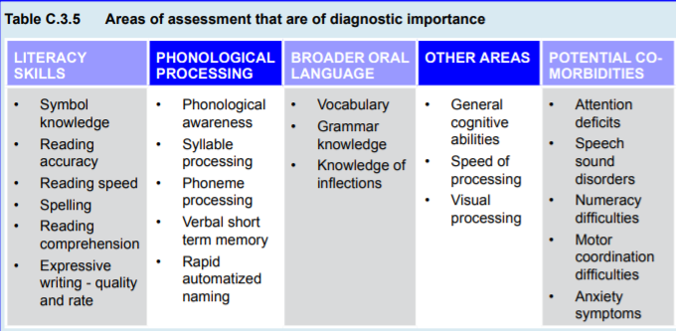
School Underachievement & Specific Learning Difficulties
Assessment
Notes:
Table C.3.5 gives the domains that must be assessed and Tables C.3.6 to C.3.8 show the tasks that can be used.

Slide 27
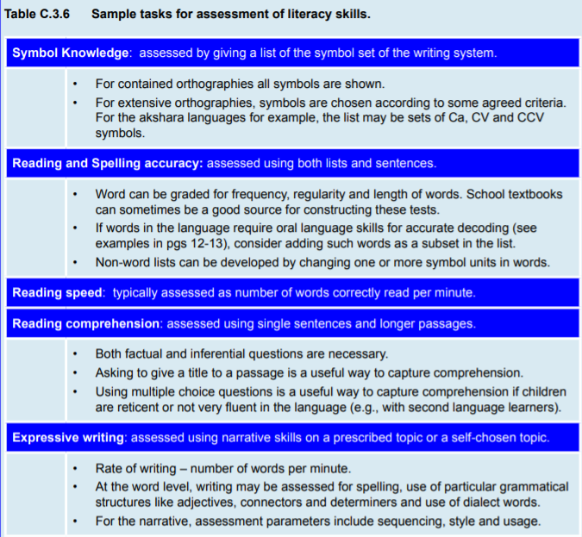
School Underachievement & Specific Learning Difficulties
Assessment
Notes:
Table C.3.5 gives the domains that must be assessed and Tables C.3.6 to C.3.8 show the tasks that can be used.

Slide 28
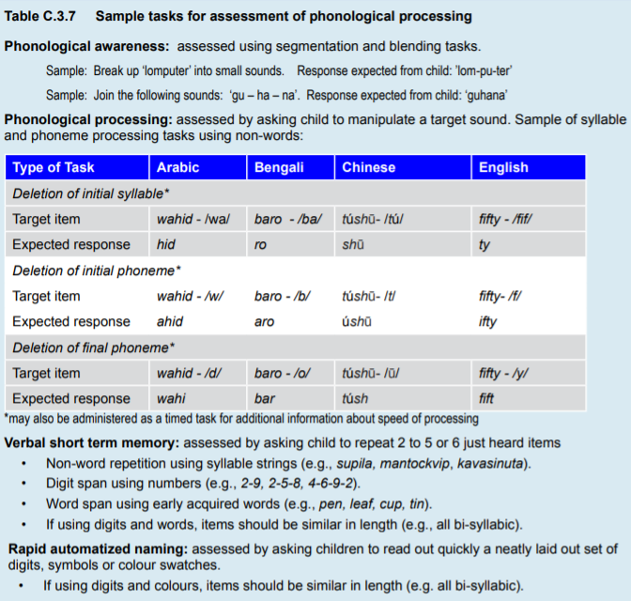
School Underachievement & Specific Learning Difficulties
Assessment
Notes:
- Literacy performance assessment: More specific tests linked to literacy performance include the rapid automatized naming task and timed tasks of phonological manipulation (examples in Table C.3.7)

Slide 29
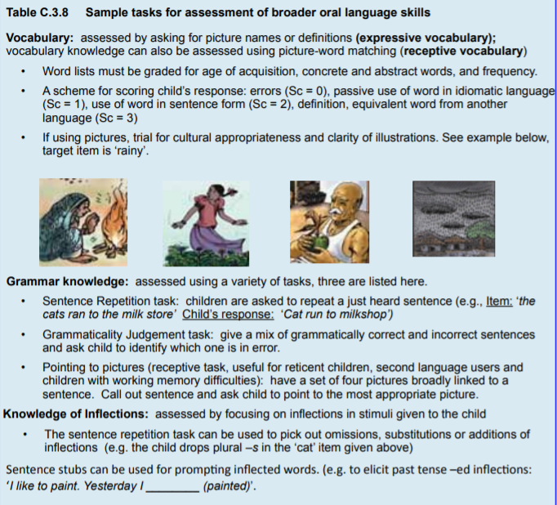
School Underachievement & Specific Learning Difficulties
Assessment
Notes:
Table C.3.5 gives the domains that must be assessed and Tables C.3.6 to C.3.8 show the tasks that can be used.

Slide 30
School Underachievement & Specific Learning Difficulties
Assessment
Consideration of general cognitive and perceptual skills
  General abilities:
    Tough to find culture-fair tests; Raven’s Progressive Matrices most used
  Speed of processing:
    Timing performance, such as in Wechsler; see Table C.3.7
  Visual processing:
    Short term memory, sequential memory
  Attention:
    Potential common genetic basis with dyslexia
    Seek input from parents, teachers (rating scales); behavioral observation
    Can screen with Strengths and Difficulties Questionnaire (SDQ; Goodman, 1997)
  Motor coordination (dyspraxia)
  Number skills (dyscalculia)
  Anxiety and coping
    Self esteem often lowered with literacy problems; can use SDQ
Notes:
Visual processing: The use of visual processing tasks in literacy assessment is gaining interest for languages with extensive, visuo-spatially complex symbol sets. There are several ways in which visual processing has been assessed. One set of tasks targets visual short term memory, where children have to recall just shown visuals of different orientations and degree of detail. Another set of tests assesses visual sequential memory where strings of visuals are shown and children have to recall the target string from a set of distracter sequences
Anxiety and coping: The SDQ (Goodman, 1997) is a useful tool for understanding children’s emotional and behavioral difficulties. This is a 25 item questionnaire covering emotional behavioral problems, conduct problems, hyperactivity/inattention, issues with relationships especially with peers and the strength of positive social behaviors
Attention:
However, there is a strong tendency for dyslexia to co-occur with symptoms of inattention and recent genetic data suggest a common genetic basis.
Ideally, information should be sought from parents and teachers and in this regard rating scales are popular.
The Strengths and Difficulties Questionnaire (SDQ, Goodman, 1997) includes 5 questions pertaining to attention and can provide a screen for “hyperactivity” and poor attention. It is also useful to supplement these data with behavioral observation in the classroom
Motor: Developmental coordination disorder (also called dyspraxia) is one of the most common co-morbid conditions of childhood; key for pencil control, quality of writing, copying skills, diagrams, scissors, etc.
Number skills: Many children with dyslexia struggle to learn number facts, especially multiplication tables, but may be good mathematicians. In contrast, the poor comprehender profile has been reported to be associated with poor mathematics in the face of well-developed arithmetic skills.

Slide 31
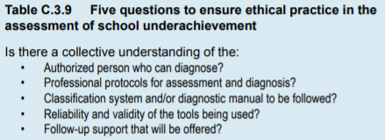
School Underachievement & Specific Learning Difficulties
Assessment
Practical considerations
  Poor quality assessment can mislead/harm the child!
  Ask Table C.3.9 to set agenda
  Gold standard: individually administered test, sound psychometric properties (expensive, resource-intensive)
    1) locally-sourced informal graded tests
    2) identify most vulnerable
    3) develop the standardized tests
Notes:
When a child is taken for assessment, some key requirements are the availability of skilled professionals, reliable testing tools and quality support services; in many middle and low income countries, access to all three of these basic requirements is either patchy or minimal. This is problematic because a poor quality assessment has the potential to mislead or, worse, cause harm to the child.
A gold standard for assessment is an individually administered test that has sound psychometric properties. This is often an expensive proposition, requiring not just theoretical expertise but also large numbers of personnel to collect and analyze the standardization data.
A first step could however be to develop informal graded tests. These tests are based on locally sourced materials which are not expensive to collate (e.g., textbooks, recordings of children’s speech and local stories).
A second step would be to identify who are the most vulnerable. This can be done through collecting local data and using an arbitrary cut-off. A useful cut-off for identifying the most vulnerable is to pick all those children whose scores fall below 1.5 standard deviations of the mean score on a test
A logical next step would be to develop standardized tools. Such an enterprise should follow from a theoretical model of how literacy is acquired in the language of interest, and a good grasp of the sample characteristics of the region.

Slide 32
School Underachievement & Specific Learning Difficulties
Outline
Introduction
Definition and Classification
Literacy Learning
Literacy Difficulties
Aetiology
Assessment
Intervention
Secondary Underachievement
Conclusion

Slide 33
School Underachievement & Specific Learning Difficulties
Intervention
To start: must understand the causes of the reading disorder
Growing number of evidence-based interventions
  (see UK’s ‘Intervention for Literacy” website)
Good interventions:
  Systematic, well-structured, multi-sensory
  Incorporate direct teaching-learning
  Incorporate time for consolidation
  Account for limited attention, learning difficulties
Distinguish between dyslexia and poor comprehension
Note: may require visuo-motor training
Notes:
For the alphabetic languages, a number of meta-analyses have guided the development of good practice for the teaching of reading, notably that of the US National Reading Panel and by the National Early Literacy Panel
For dyslexia in the alphabetic languages, effective interventions should include training in letter-sounds, phoneme awareness, linking letter and phonemes through writing and reading from texts at the appropriate level to reinforce emerging skills. In contrast, poor comprehenders require a different “diet” attuned to their needs and can benefit from training in oral language skills particularly vocabulary training, the development of inferencing skills and work on story structure and narrative.
For dyslexia in the alphabetic languages, effective interventions should include training in letter-sounds, phoneme awareness, linking letter and phonemes through writing and reading from texts at the appropriate level to reinforce emerging skills. In contrast, poor comprehenders require a different “diet” attuned to their needs and can benefit from training in oral language skills particularly vocabulary training, the development of inferencing skills and work on story structure and narrative.

Slide 34
School Underachievement & Specific Learning Difficulties
Outline
Introduction
Definition and Classification
Literacy Learning
Literacy Difficulties
Aetiology
Assessment
Intervention
Secondary Underachievement
Conclusion

Slide 35
School Underachievement & Specific Learning Difficulties
Secondary Underachievement
Consider underlying reason for school underachievement:
  Childhood psychiatric disorder:
    Interference with attendance
    Symptom interference with lessons, studying, exams
  Neurodevelopmental disorders
  Sensory impairment
    Vision
    Hearing
What accommodations do schools or communities have in place for underlying challenges?
Notes:
Psychiatric disorders: One reason why academic underachievement may co-occur with psychiatric disorder is because of the disorder interfering with school attendance. Other reasons could be symptoms of the disorder disrupting concentration during lessons, study time and exams. Some of the main reasons for dropping school grades are transient adjustments and post-traumatic stress disorders. These may follow life experiences such as abuse, the loss of a parent or events such as war or natural disaster
Neurodevelopmental: genetic, nutritional, prenatal, perinatal, postnatal, childhood infections, toxic exposure, brain injury, chronic disadvantage from poverty, economic backwardness, severe malnutrition, social deprivation, absence of cognitive stimulation
Sensory:
Vision: For example, about 10% of all primary school children in low income communities have eyesight problems (Bundy et al, 2003), and many among them go undetected.
Hearing; If children are unable to hear what their teacher says and is in too big a class for lip-reading to be useful, then they will be left behind in all areas of the curriculum. More subtle impairments will affect attention to auditory information and the development of literacy skills.

Slide 36
School Underachievement & Specific Learning Difficulties
Outline
Introduction
Definition and Classification
Literacy Learning
Literacy Difficulties
Aetiology
Assessment
Intervention
Secondary Underachievement
Conclusion

Slide 37


School Underachievement & Specific Learning Difficulties
Conclusion
Classification
  Response to intervention > discrepancy model
  Context-specific assessment tools
  Language and phonological skills as foundational
Instruction
  Quality of instruction determines response to intervention
  Must address co-morbidities
  Targeted interventions should focus on dimensions underpinning literacy
What to invest in
  Preventative > curative approaches
  Screening tools and risk determination
  Prioritizing high need/at-risk groups
  Nuanced picture of social/environmental context

Slide 38

Medication:
ADHD
School Underachievement & Specific Learning Difficulties Thank You!
Notes:
--American Academy of Child and Adolescent Psychiatry has an excellent ADHD Resource center

