Slide 1
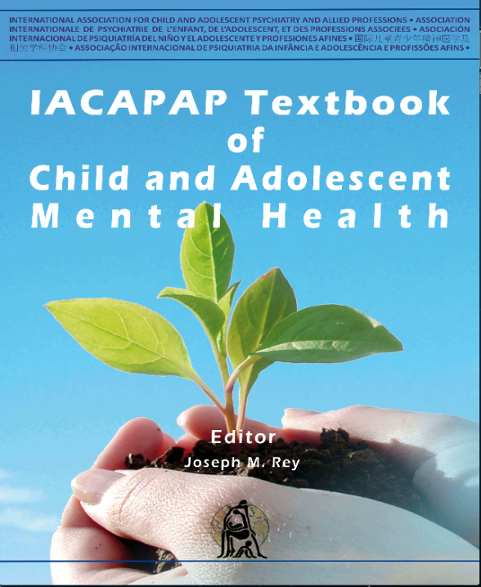
Introduction
Chapter A.6
Evidence-Based Practice in Child and Adolescent Mental Health
John Hamilton &
Füsun Çuhadaroğlu-Çetin
DEPRESSION IN CHILDREN AND
ADOLESCENTS
Companion Powerpoint Presentation
Adapted by Henrikje Klasen

Slide 2

The “IACAPAP Textbook of Child and Adolescent Mental Health” is available at the IACAPAP website http://iacapap.org/iacapap-textbook-of-child-and-adolescent-mental-health Please note that this book and its companion powerpoint are: · Free and no registration is required to read or download it · This is an open-access publication under the Creative Commons Attribution Non- commercial License. According to this, use, distribution and reproduction in any medium are allowed without prior permission provided the original work is properly cited and the use is non-commercial.

Slide 3

Evidence-Based Practice Learning objectives
Understand the statistical concepts relevant to align your clinical work with good evidence
Use good interviewing techniques to show whether a youth meets diagnostic criteria
Choosing a treatment
Search databases electronically available at no cost to anyone with an Internet connection
Translate clinical questions and dilemmas into answerable (PICO) questions
Find treatments most likely to help your patient

Slide 4

Evidence-Based Practice Statistical Concepts The biggest enemies of truth: random error and bias
Random errors are due to unknown and/or unpredictable changes in measuring instrument or environment
Diminished by larger sample sizes
Bias (=systematic error) are inaccuracies that are consistently in the same direction
An ever present risk!

Slide 5
Evidence-Based Practice Statistical Concepts The biggest enemies of truth: random error and bias

Slide 6
Evidence-Based Practice Statistical Concepts A few useful basic concepts (i)
Mean (μ):
the most common value in a normal distribution
Standard deviation (SD): measures variability
Effect size: standardized difference between groups

Slide 7
Evidence-Based Practice Statistical Concepts A few useful basic concepts (ii)
Absolute risk reduction (ARR): how much does one treatment reduce the risk of a bad outcome compared to an alternative (treatment or placebo)
Confidence Interval (CI): an indication of the precision/imprecision of the study sample as an estimate of the true population value
Number needed to treat (NNT): number of people we must treat to prevent one additional bad outcome
Number needed to harm (NNH): quantifies the risk of harmful side effects

Slide 8
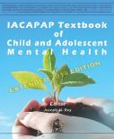
Evidence-Based Practice Statistical Concepts Got that? Examples:
After 12 weeks on the TADS study 65% of patients on placebo were not improved compared to 39% of patients on fluoxetine.
What is the ARR? What is the NNT?
In the same study 12% of those treated with fluoxetine reported some harm-related event, compared to 5% of those on placebo.
What is the NNH?
Would you use this treatment?
Notes:
Idea for MOOC video/lecture: Show calculation to be done in notebook, on blackboard or calculator.
Point out that this information is not yet enough to decide on the usefulness of the treatment. Important factors to consider are for example the seriousness of the disease compared to the seriousness of the harmful event…

Slide 9

Evidence-Based Practice Statistical Concepts Understanding a study by looking at its statistics (i)
Child/Adolescent Anxiety Multimodal Study (CAMS)
Comparing:
Placebo
CBT alone
Sertraline alone
CBT + Sertraline
Graph shows scores for PARS (Pediatric Anxiety Rating Scale)
- Note error bars

Slide 10

Evidence-Based Practice Statistical Concepts Understanding a study by looking at its statistics (ii)
Effect size (based on improvements in PARS):
CBT alone: 0.31 (small/medium effect)
Sertraline alone: 0.45 (medium effect)
Combination: 0.86 (large effect)
NNT: based on improvement (very much improved)
CBT alone 3
Sertraline alone 3
Combination: 2 (that is low = encouraging)

Slide 11
Evidence-Based Practice A valid and reliable diagnosis The foundation of evidence based medicine (EBM)
To make good use of EBM, diagnoses need to be aligned between research and practice
Reliability: consistency of a measuring instrument across time, individuals and clinicians
Test-retest reliability
Inter-rater reliability
Validity: the extent by which a diagnostic instrument measures what it claims to measure
Often measured indirectly, prediction of course, outcome
Correlation coefficients, factor loading can quantify
Notes:
Point 1 is important so that we all talk about the same type of patient when speaking about for example someone with MDD
Point out that unstructured interviews do poorly on reliability and validity

Slide 12
Evidence-Based Practice A valid and reliable diagnosis The foundation of evidence based medicine (EBM)
N. B. Most instruments have only been tested in the US and Europe

Slide 13
Evidence-Based Practice A valid and reliable diagnosis The foundation of evidence based medicine (EBM)
Screening questions and homing in:
E.g., semi-structured interviews such as K-SADS
Interviewers do not have to ask each question.
If probing questions are answered negatively the rest of the section can be skipped
Clear thresholds for when to count a symptom as present or absent and when to home in (e.g., 2 alcoholic drinks per week for past 4 weeks)
Using the interview requires specific training! Probing questions are useful anyway.

Slide 14
Evidence-Based Practice Choosing a treatment The pyramid of evidence

Slide 15
Evidence-Based Practice Search databases electronically
Using the Internet and the pyramid
Remain curious when doing clinical work
Ask questions relevant to the patients you see
Use the Internet to find answers to improve the care of your patients
Aim for a practical result, what is good enough within time and resources available
Pubmed, PsychINFO (both US based) are free and good places to start
CENTRAL from the Cochrane Library is good on RCTs
EMBASE is good on European publications

Slide 16
Evidence-Based Practice Search databases electronically
Using the Internet and the pyramid: example
Terry is 10 years old and has ADHD-I (inattentive type). He was helped by methylphenidate 15mg three times/day, but lost a lot of weight. Stimulants and atomoxetine both suppress appetite. Guanfacine is known to help ADHD combined type, but is it also effective for ADHD-I?
What is the evidence that Guanfacine is effective in a 10 year old with ADHD-I?
If effective, what is the effect size?

Slide 17

Evidence-Based Practice Search databases electronically
Using the Internet and the pyramid: example*
Begin with PubMed. Click on “Advanced”, select “ADHD” from the MeSH terms, then “search”
There are too many hits – over 16 000
Now repeat the previous steps for “guanfacine” “AND” and “ALL FIELDS”, then “search” (94 hits)
Click “Limits” and select “meta-analysis” (2 hits), but both do not apply to your patient
Change your limits to “RCT” (9 hits), 2 of them applicable to a 10 year old with ADHD without tics
1 article is free, but funded by pharmaceutical companies (possible bias?) and concerns extended release guanfacine
*These data were accurate at the time of writing the chapter; it is bound to be different now.
Notes:
If internet is available the search should be performed life on the computer.
For the MOOC it will also be performed life and the example will be adapted: Stimulants and Atomoxetine is not available in your country. What is the evidence that Clonidine/Imipramine can help

Slide 18

Evidence-Based Practice Search databases electronically
Using the Internet and the pyramid: example
Half life guanfacine: 13-14 hours, so twice-daily dose might mimic extended release form
Effect size? Depending on dose between 0.58 and 1.34 for ADHD total scores
And for inattention specifically?
No effect size given, but reductions in absolute scores on a rating scale are bigger for inattention than for hyperactivity
Result: It is reasonable to conclude that a 10 year old with ADHD-I may significantly improve with guanfacine at a dose of 1-2mg twice/day
Notes:
If internet is available the search should be performed life on the computer.
For the MOOC it will also be performed life and the example will be adapted: Stimulants and Atomoxetine is not available in your country. What is the evidence that Clonidine/Imipramine can help
There now follows a second example in the book. In settings where internet is available in the lecture hall that could maybe be done as a self directed learning excersise in small groups. If not it could be done as homework. If you want I can make slides for it.

Slide 19
Evidence-Based Practice Search databases electronically
Using the Internet and the pyramid
Take home message:
Keep search strategies transparent and clear and always monitor how many hits result; these data allow you to be continually adjusting your search to your purposes, time and interest.

Slide 20
Evidence-Based Practice Classic EBM and “the answerable question”
Finding the best treatment for your patient
What is the evidence that…
P - A specific patient or problem
I - treated with a specific intervention
C - yields in comparison to alternative treatment
O - what outcome?
Search for answer using PICO questions
Critically appraise the evidence found
Integrate with clinical expertise and patient values
Evaluate the results

Slide 21
Evidence-Based Practice Classic EBM and “the answerable question”
Finding the best treatment for your patient
Check each step of a paper for its standard

Slide 22
Evidence-Based Practice Evidence based practice and local culture The role of clinician is integration
Beliefs and values
Understanding explanatory models (including your own) regarding the treatment of mental illness is crucial for a good therapeutic relationship
Assumptions in child-rearing practices
How should boys behave? What is normal/abnormal?
Role of the extended family
Sometimes parents don’t take the decisions.
Influence of the Internet
Can inform as well as misinform

