Slide 1

OTHER DISORDERS
Chapter H.5.1
Using Antipsychotic Medication for the Treatment of Schizophrenia in in Children and Adolescents
Maite Ferrin, Helen Gosney, Arianna Marconi & Joseph M Rey
Companion Powerpoint Presentation
Adapted by Julie Chilton

Slide 2
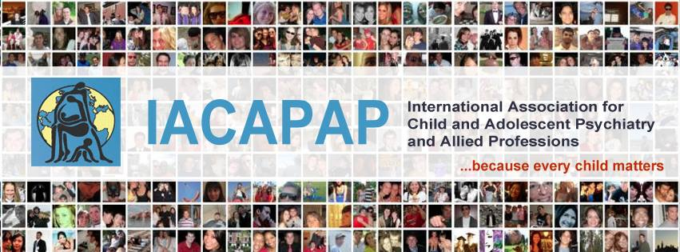
The “IACAPAP Textbook of Child and Adolescent Mental Health” is available at the IACAPAP website http://iacapap.org/iacapap-textbook-of-child-and-adolescent-mental-health
Please note that this book and its companion powerpoint are:
· Free and no registration is required to read or download it
· This is an open-access publication under the Creative Commons Attribution Non- commercial License. According to this, use, distribution and reproduction in any medium are allowed without prior permission provided the original work is properly cited and the use is non-commercial.

Slide 3
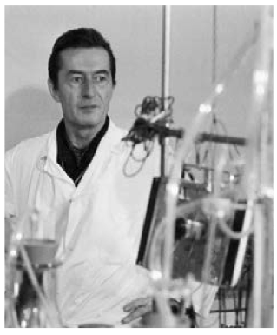

Using Antipsychotic Medication for the Treatment of Schizophrenia in Children and Adolescents
Outline
The Basics
Mechanism of Action
Effectiveness & Side Effects
Long Acting Injectables (LAIs)
Choosing a Medication
Adjunctive Treatments
Treatment Maintenance
Misuse and Overuse
The Costs
Organization of Services
Rural and Low Income Regions
Prevention and High Risk
Henri Laborit (1914-1995)
Notes:
Henri Laborit (1914-1995), a French physician, writer and philosopher, the first to recognize the potential use of chlorpromazine in psychiatric disorders, which opened the door to the psychopharmacology revolution of the 2nd half of the 20th century.

Slide 4

Using Antipsychotic Medication for the Treatment of Schizophrenia in Children and Adolescents
The Basics of Psychotic Illnesses
Group of heterogeneous conditions
Multifactorial causes
  Prenatal insults
  Late genetic factors
  Late environmental factors
3 symptom clusters
  Positive
  Negative
  Cognitive
https://www.youtube.com/watch?v=Rws1niDxqK8/
Notes:
There is wide agreement that psychotic illnesses, including schizophrenia, are a group of heterogeneous conditions with multi-factorial causes (Howes & Kapur, 2009). A neurodevelopmental model hypothesizes that psychosis is the result of a deviation in neurodevelopmental processes that begins long before the onset of symptoms and is caused by a combination of environmental and genetic factors (Rapoport et al, 2005). In addition to prenatal insults, both late genetic and late environmental factors could explain the different ages of onset.
Symptoms of psychosis are typically classified in three clusters: positive (hallucinations, delusions), negative (poverty of thought and speech, impairment in social interactions, blunted affect) and cognitive (cognitive decline, impairment of executive functions).
Click on the image to view a 17-year-old high school student talk about his experiences with schizophrenia.

Slide 5
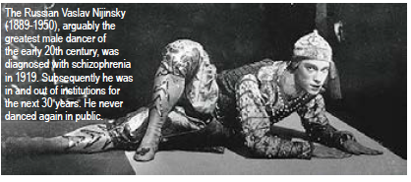
Using Antipsychotic Medication for the Treatment of Schizophrenia in Children and Adolescents
Important Distinctions
Very Early Onset Psychosis
before 13
Early Onset Psychosis
before 16
Schizophrenia
later onset
Notes:
The Russian Vaslav Nijinsky (1889-1950), arguably the greatest male dancer of the early 20th century, was diagnosed with schizophrenia in 1919. Subsequently he was in and out of institutions for the next 30 years. He never danced again in public.

Slide 6
Using Antipsychotic Medication for the Treatment of Schizophrenia in Children and Adolescents
Important Distinctions
Early and Very
Early Onset Psychosis
(Later Onset)
Schizophrenia
Rare
Similar gender ratio
No gender difference in age of onset
Poorer prognosis
More common
Earlier onset in men than women
Better prognosis
Notes:
Early onset psychosis and very early onset psychosis are rare and differ from schizophrenia in several ways. For example, the early onset ones have a similar gender ratio and there is no difference between boys and girls in age at onset (Remschidt, 2002), while later onset schizophrenia is more common and has an earlier onset in men. There is much continuity between very early onset psychosis, early onset psychosis and schizophrenia in adulthood; however prognosis of the early onset disorders is poorer.

Slide 7
Using Antipsychotic Medication for the Treatment of Schizophrenia in Children and Adolescents
Core Principles of Intervention Programs for Early Onset Psychosis
Raising Awareness
Specific Early Intervention Training
Assessment
Pharmacological treatment
Care coordination
Psychosocial interventions
Education and employment
Promoting recovery
Notes:
Raising Awareness—to raise knowledge about the importance of early detection and management
Specific Early Intervention Training—to detect psychosis as early as possible
Assessment—to do a comprehensive assessment and ongoing assessment of comorbid disorders including depression and anxiety
Pharmacological treatment—symptom reduction, careful titration, monitoring side effects
Care coordination—rapid allocation of key workers/care coordinators, care plans focused on risk management, recovery and prevention of relapse
Psychosocial interventions—identification, psychoeducation to young people and their families, to make available family therapy and CBT, to consider housing and income support
Education and employment—undertake an education assessment, provide support into education, training and employment
Promoting recovery—aspire to full recovery and support sufferers in regaining full participation in society
As highlighted in Chapter H.5, the treatment of psychosis in young people requires a coordinated and integrated approach based on different components of care tailored to the individuals’ and their families’ needs. Optimal management of young people with psychosis requires a multimodal approach that includes psychoeducation, psychotherapy, family therapy, specific rehabilitation and re-integration measures (Clark & Lewis, 1998; NICE, 2013). There is also growing evidence that treating individuals with first episode psychosis with a specific multimodal team-based, coordinated approach results in better clinical and functional outcomes than typical community care, particularly if this treatment begins soon after the onset of psychotic symptoms (Kane et al, 2015). The principles of treatment are summarised in Table H.5.1.1.

Slide 8
Using Antipsychotic Medication for the Treatment of Schizophrenia in Children and Adolescents
Antipsychotic Drugs
The mainstay of treatment
Many patients on med regimens inconsistent with guidelines
Divided by
  Chemical structure
  Type of receptor binding
  Clinical profile
2 main groups:
  1st generation
  2nd generation
Notes:
Pharmacotherapy is the mainstay of treatment (Meuser & McGurk, 2004; McClellan & Stock, 2013) and is the focus of this chapter. It is of note that many patients with first-episode psychosis still receive medications inconsistent with current guidelines, even in high income Western countries. For example a US study found that almost 40% of people with first-episode psychosis in community mental health clinics could benefit from changes to their medication (Robinson et al, 2015).
ANTIPSYCHOTIC DRUGS
Antipsychotic medications can be divided according to chemical structure, type of receptor binding, and clinical profile into two main groups: first generation and second generation. Some of the more commonly used antipsychotics are summarised in Table H.5.1.2.
The first antipsychotic drug, chlorpromazine, was introduced in 1952. Many other dopamine antagonists with antipsychotic properties were synthesized subsequently: between 1954 and 1975, about 40 new antipsychotic drugs were introduced worldwide—these were the first generation, typical or traditional antipsychotics.
A new group of antipsychotics (second generation or atypical) emerged in the 1980s. The second generation antipsychotics showed similar effectiveness but fewer extrapyramidal effects.
Clozapine, the first atypical antipsychotic, was introduced in Europe in 1971. It was withdrawn by the manufacturer in 1975 because it could cause agranulocytosis. Its use with the appropriate monitoring was approved in 1989 after having been shown to be effective in treatment-resistant schizophrenia and in reducing suicide rate in patients with schizophrenia.

Slide 9
Using Antipsychotic Medication for the Treatment of Schizophrenia in Children and Adolescents
Antipsychotic Drugs: Mechanism of Action
Second Generation:
Vary in receptor affinity
Fewer extrapyramidal symptoms
Unclear if better at
reducing negative
symptoms
Weight gain,
dyslipidemia,
type II diabetes
First Generation:
Block D2 receptors
Reduce positive symptoms and agitation and aggression
Elevated prolactin secretion
Extrapyramidal side effects
Neuroleptic malignant syndrome
Notes:
All antipsychotic drugs interact with a variety of neurotransmitter systems. First generation antipsychotics typically block dopamine receptors (especially D2 receptors). They reduce positive symptoms, such as delusions, hallucinations, formal thought disorder, as well as other non-specific symptoms such as agitation and aggressiveness. They are also associated with elevated prolactin secretion, extrapyramidal side effects such as tremor, dystonia and tardive dyskinesia, and with rare but potentially fatal side effects such as neuroleptic malignant syndrome. Figure H.5.1.1 shows the main dopamine pathways and effects of antipsychotic medication according to pathway.
Second generation antipsychotics vary in their receptor affinity, targeting mainly serotoninergic (5HT2A) as well as D2 and other receptors (e.g., M1, D4, D5). It was believed initially that second generation antipsychotics were effective in reducing negative symptoms. However, evidence of this is inconclusive. Because extrapyramidal symptoms can exacerbate negative symptoms and because second generation antipsychotics have fewer extrapyramidal effects, this can give the false impression of a reduction in negative symptoms with atypical antipsychotics. Second generation antipsychotics mainly cause weight gain, dyslipidaemia, and type II diabetes.

Slide 10
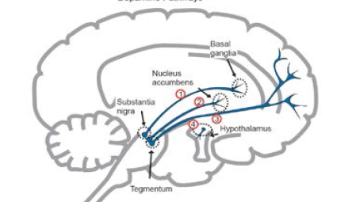
Using Antipsychotic Medication for the Treatment of Schizophrenia in Children and Adolescents
Dopamine Pathways
Notes:
Figure H.5.1.1 shows the main dopamine pathways in the brain

Slide 11
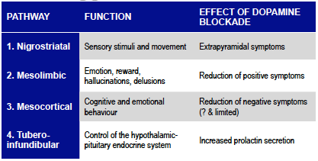
Using Antipsychotic Medication for the Treatment of Schizophrenia in Children and Adolescents
Dopamine Pathways
Notes:
Figure H.5.1.1 shows the effects of antipsychotic medication according to pathway.

Slide 12
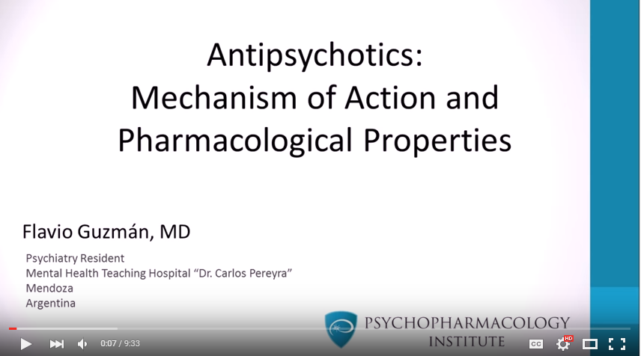
Using Antipsychotic Medication for the Treatment of Schizophrenia in Children and Adolescents
Antipsychotic Drugs: Mechanism of Action
https://www.youtube.com/watch?v=weV0IEWQ9NI
Notes:
All antipsychotic drugs interact with a variety of neurotransmitter systems. First generation antipsychotics typically block dopamine receptors (especially D2 receptors). They reduce positive symptoms, such as delusions, hallucinations, formal thought disorder, as well as other non-specific symptoms such as agitation and aggressiveness. They are also associated with elevated prolactin secretion, extrapyramidal side effects such as tremor, dystonia and tardive dyskinesia, and with rare but potentially fatal side effects such as neuroleptic malignant syndrome.
Second generation antipsychotics vary in their receptor affinity, targeting mainly serotoninergic (5HT2A) as well as D2 and other receptors (e.g., M1, D4, D5). It was believed initially that second generation antipsychotics were effective in reducing negative symptoms. However, evidence of this is inconclusive. Because extrapyramidal symptoms can exacerbate negative symptoms and because second generation antipsychotics have fewer extrapyramidal effects, this can give the false impression of a reduction in negative symptoms with atypical antipsychotics. Second generation antipsychotics mainly cause weight gain, dyslipidaemia, and type II diabetes.

Slide 13
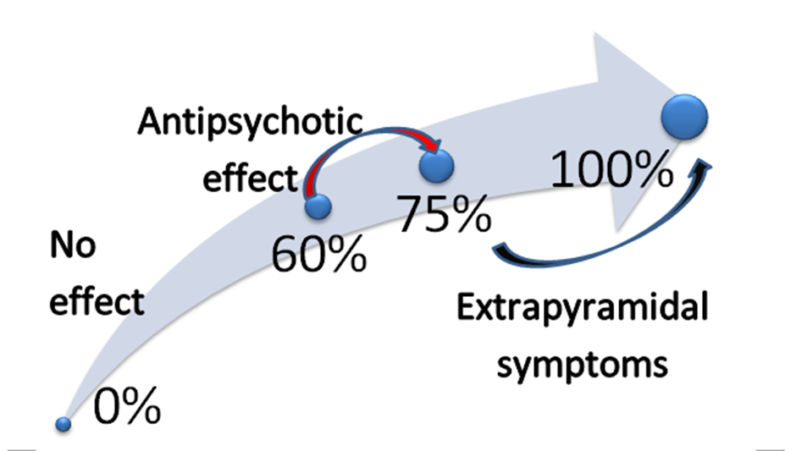
Using Antipsychotic Medication for the Treatment of Schizophrenia in Children and Adolescents
D2 Receptor Occupancy and Clinical Effect
Notes:
Antipsychotic effect is achieved when 60% to 75% of D2 receptors have been blocked, while extrapyramidal side effects appear when 80% or more D2 receptors have been blocked. This suggests that unnecessarily increasing the dose or using two antipsychotics concurrently is likely to result in more side effects rather than in symptom improvement

Slide 14
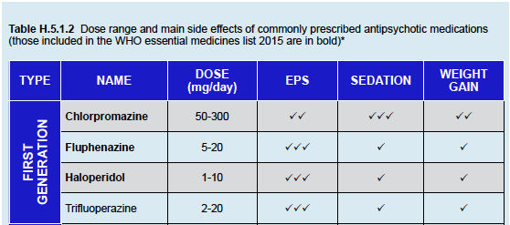

Using Antipsychotic Medication for the Treatment of Schizophrenia in Children and Adolescents
First generation Antipsychotics
Notes:
WHO
ESSENTIAL MEDICINES LIST 2015
The WHO Model List of Essential Medicines serves as a guide for the development of national and institutional essential medicine lists. It is updated and revised every two years. According to the WHO, essential medicines are drugs that satisfy the health care needs of the majority of the population. Thus, they should be available for prescription and at a price the community can afford. Medicines not in this list are less likely to be available in low and middle income countries.
Antipsychotic drugs included in the 2015 edition of the list are:
Chlorpromazine
Fluphenazine
Haloperidol
Risperidone
Clozapine

Slide 15
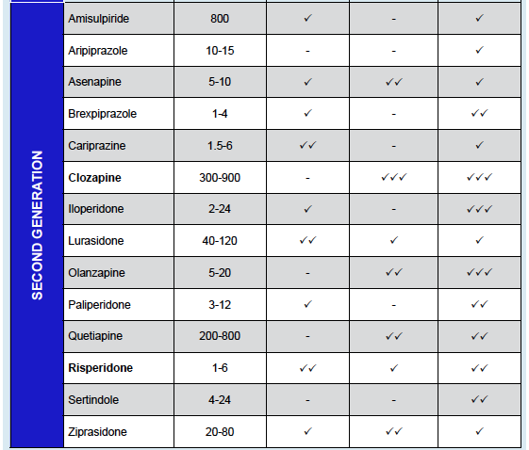
Using Antipsychotic Medication for the Treatment of Schizophrenia in Children and Adolescents
Second Generation Antipsychotics
Notes:
The lower propensity of second generation antipsychotics to cause extrapyramidal symptoms has been attributed to a weaker occupancy of D2 receptors—that rapidly falls off within 24 hours, in contrast to that for traditional antipsychotics (e.g., haloperidol), which maintains its D2 occupancy constant over 24 hours—or to 5HT2A blockade or both (Seeman, 2004). That is, one explanation of the difference in side effects between typical and atypical antipsychotics is that the atypical antipsychotics bind more loosely to D2 receptors than does dopamine itself (i.e., are displaced by dopamine), while the first generation antipsychotics bind more tightly than dopamine—and are less likely to be displaced by dopamine.

Slide 16
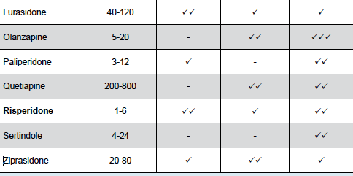
Using Antipsychotic Medication for the Treatment of Schizophrenia in Children and Adolescents
Second Generation Antipsychotics

Slide 17
Using Antipsychotic Medication for the Treatment of Schizophrenia in Children and Adolescents
Choosing an Antipsychotic
Not much data for kids and teens
Most data extrapolated from adult studies
Unclear efficacy in typical vs atypical
Choice of right antipsychotic mostly trial and error
Most guidelines recommend atypical first
If not available, start haloperidol or chlorpromazine low and slow to minimize EPS
Notes:
There are not much data regarding the efficacy and safety of pharmacological interventions in psychosis and schizophrenia in children, adolescents and young adults. A review of 27 trials including 3,067 participants found that antipsychotic treatment produced a large improvement in symptoms measured by the Clinical Global Impressions Scale, suggesting that efficacy of antipsychotics is similar in children, adolescents and young adults (Stafford et al, 2015). Nevertheless, much of the data about treatment is still extrapolated from studies in adults.
Recent meta-analyses have failed to find superiority in clinical efficacy between typical and atypical antipsychotic medication (Crossley, 2010). Yet different people respond to different antipsychotics. Currently we are unable to predict response of specific individuals to specific antipsychotics. That is, treatment is largely based on trial-and-error.
Given that young people seem to have a higher risk of extrapyramidal side effects and more resistance to accept treatment, most guidelines recommend atypical antipsychotics as first line treatment. If second generation antipsychotics cannot be used because they are not available, for instance in some low income countries, first generation antipsychotics should be commenced at low doses (e.g., 1–2mg haloperidol or 100 mg of chlorpromazine) and titrated slowly UP to 4-6mg of haloperidol or equivalent in order to minimise undesirable extrapyramidal side effects (International Early Psychosis Association Writing Group, 2005). Antiparkinsonian medication can be considered/used if necessary (see “antiparkinsonian pharmacotherapy” below).

Slide 18
Using Antipsychotic Medication for the Treatment of Schizophrenia in Children and Adolescents
Effectiveness
Treatment of 1st episode psychosis:
  80 % better first antipsychotic
  5% better with different antipsychotic
  15% treatment resistant
    ¾ of these better on clozapine
Recurrence common
Important to prevent exacerbations given major life tasks of young adulthood
Notes:
However, up to 80% of patients with a first episode psychosis are expected to show a significant improvement with appropriate antipsychotic treatment. Of the 20% who do not improve, about one quarter is likely to respond to a different antipsychotic; the rest (15%) can be considered “treatment resistant”. A further three quarters of those resistant to treatment are likely to benefit from clozapine. This does not mean, however, that these outcomes persist over time; recurrence of symptoms due to relapse, poor adherence to treatment and to other factors is common. A meta-analysis including 65 trials comprising 6,493 patients found that antipsychotic drugs significantly reduced relapse at one year from 64% in those taking a placebo to 27% in those taking medication (number needed to treat to benefit = 3, see Chapter A.6, page 7 of the eTextbook) (Leucht K et al, 2012).
“Psychotic exacerbation is undesirable for any patient, but it is particularly important to prevent psychotic exacerbations for recent-onset patients. Early relapse may disrupt important life tasks typically accomplished during adolescence or early adulthood, such as completing schooling, starting a career, and establishing social relationships outside one’s family of origin” (Robinson, 2011).

Slide 19
Using Antipsychotic Medication for the Treatment of Schizophrenia in Children and Adolescents
Long-Acting Injectable Antipsychotics
Aka depot antipsychotics
Developed to enhance adherence
1st= fluphenazine enanthate and decanoate
Clinician concerns
  Association with worse side effects?
  Patients’ acceptance?
  Reduced patient autonomy?
  Nursing involvement?
  Less fashionable?
  Less knowledge and experience?
  Cost?
Notes:
Not taking antipsychotic medication is the single largest modifiable risk factor for the recurrence of positive symptoms of schizophrenia (Subotnik et al, 2015). Long-acting injectable antipsychotics (LAIs)—also known as depot antipsychotics—were developed to enhance adherence at a time of extensive psychiatric hospital deinstitutionalisation of patients and the need for an effective community-based treatment (see Table H.5.1.3). The first LAIs—fluphenazine enanthate and decanoate—were introduced in 1966. Yet, LAIs have been underused in the treatment of schizophrenia largely due to clinicians’ unjustified negative perceptions and service barriers.
Clinicians are often anxious about using LAIs because of:
The belief that LAIs are associated with worse side-effects (despite lack of evidence supporting this)
Concerns regarding patients’ acceptance of LAIs (patients on this formulation often prefer it)
Apprehension regarding reduced patient autonomy
Worries about nursing staff involvement in administering LAIs, training and time pressures on staff—so that they can adequately and routinely monitor symptoms and side-effects
Preferential attention to more fashionable medications
Lower prescriber knowledge about and experience with LAIs
Cost.

Slide 20
Using Antipsychotic Medication for the Treatment of Schizophrenia in Children and Adolescents
Long-Acting Injectable Antipsychotics
Oral Formulations:
Rapid discontinuation
Enhanced autonomy
Less frequent visits
Injectables:
Detection of relapse
Relapse prevention
Less hospitalization
Stable concentrations
Less poisoning risk
Efficacy vs Adherence
EQUAL EFFICACY
Notes:
Oral formulations have advantages over LAIs such as:
rapid discontinuation in case of serious side-effects
enhanced sense of autonomy in patients
less frequent clinic attendance.
However, LAIs also have advantages over oral formulations in that they result in:
Easier early detection of relapse
Improved relapse prevention
Reduced rehospitalisation rates
More stable serum concentrations
Reduced risk of accidental or deliberate self-poisoning
Better ability to distinguish between lack of efficacy and poor adherence.

Slide 21
Using Antipsychotic Medication for the Treatment of Schizophrenia in Children and Adolescents
LAI’s in First Episode Psychosis
NOT for short-term therapy < 3 months
SHOULD be considered in any patient requiring long term treatment
CONSIDER for any patient with schizophrenia and risk factors for non-adherence
Issue of consent very important to doctor-patient relationship
NOT indicated in bipolar disorder
Notes:
Traditionally the main reason for the prescription of LAIs was poor adherence to medication. However, it is being increasingly recognised that LAIs can have a place at various stages in the treatment of the illness and should be one of the options discussed with any patient requiring long-term treatment, even during the first episode. Patients with a first episode of schizophrenia who have responded well to antipsychotic medication, even if they understand that they have a mental disorder, very often doubt whether medication continues to be necessary, leading to stopping the medication prematurely, poor adherence and worse outcomes (Subotnik et al, 2015). For example, the French Association for Biological Psychiatry and Neuropsychopharmacology suggests that most patients that require long-term antipsychotic treatment should be offered a LAI (Llorca et al, 2013).
Long acting injectable antipsychotics are not indicated for short-term therapy (e.g., less than three months). The issues of patent consent (and/or family when appropriate) need to be dealt with carefully and sensitively to minimise harming the doctor-patient relationship. LAIs may be considered for patients with confirmed schizophrenia and with risk factors for medication non-adherence: history of non-adherence, severe symptoms, comorbid substance use, cognitive impairment, ambivalence or negative attitudes towards medication, and poor insight. LAIs are not indicated in bipolar disorder.

Slide 22
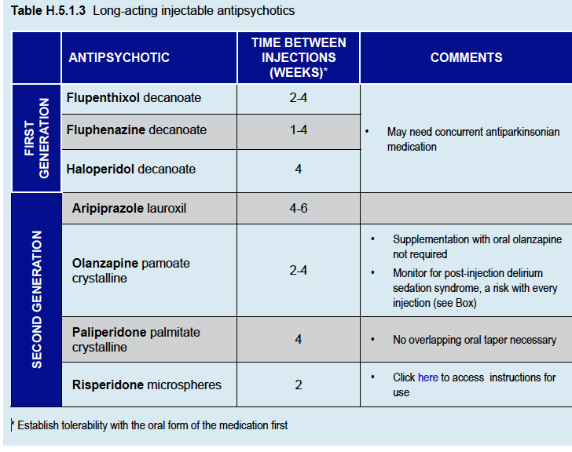
Notes:
LAIs are as effective as oral antipsychotics and efficacy of first and second generation LAIs is similar. However, clozapine rather than LAIs should be used for patients whose clinical instability is due to treatment-resistant illness rather than medication non-adherence (Castillo & Stroup, 2015).
When selecting a LAI, take into account patient’s preferences, health status, experience with prior antipsychotic medication, and the side-effect profiles of different medications (Castillo & Stroup, 2015).

Slide 23
Using Antipsychotic Medication for the Treatment of Schizophrenia in Children and Adolescents
When Using LAI’s
Switch to the short-acting version of the LAI to establish response and tolerability
Use recommended injection technique
  Usually IM in gluteus maximus or deltoids
Use initial test dose first
Use therapeutic dose while oral medication tapered
Olanzapine: monitor every 30 minutes x 3hrs for Post-Injection Delirium Sedation Syndrome
Notes:
When using LAIs you should read about the specific recommendations for the use of each compound. In general, it is advisable to:
Switch to the short-acting, oral preparation of the medication—if the patient is not already taking it—to establish response and tolerability
Use the recommended injection technique for the particular drug— usually intramuscular injection in the gluteus maximus or deltoids
Use an initial test dose and then an appropriate therapeutic dose while the oral medication is reduced and stopped.
Olanzapine Post-Injection Delirium Sedation Syndrome
Post-injection delirium/ sedation syndrome (PDSS) is a potentially serious adverse event observed in about 7 per 10,000 injections of long-acting olanzapine. PDSS is characterized by excessive sedation or delirium that occurs shortly after the injection—similar to what is observed in an overdose of olanzapine.
The most likely explanation for PDSS is that a portion of the olanzapine pamoate injected accidentally enters the bloodstream resulting in an intravascular injection of a limited amount of the medication (McDonnell et al, 2014). It is recommended to monitor for alertness every 30 minutes for at least 3 hours after every injection.

Slide 24
Using Antipsychotic Medication for the Treatment of Schizophrenia in Children and Adolescents
Side Effects of Antipsychotic Medications
Extrapyramidal Symptoms (EPS)
Neuroleptic Malignant Syndrome (NMS)
Sedation
Weight gain
Metabolic syndrome
Endocrinological
Haematological
Seizures
Cardiovascular
Notes:
While the efficacy of antipsychotics appears to be similar in children, adolescents and adults, side effects are greater in the young (Stafford et al, 2015). Preventing, minimising, and treating side effects are key elements in the management of these patients, which may result in treatment success or failure and their long-term consequences.

Slide 25
Using Antipsychotic Medication for the Treatment of Schizophrenia in Children and Adolescents
Dystonic Reactions to Antipsychotic Medications
Not uncommon in emergency room
Often seen in young patients
Metoclopramide, prochlorperazine or antipsychotics
Several different possible manifestations
  Oculogyric crisis
  Torticollis’opisthotonos
  Macroglossia
  Buccolingual crisis
  Laryngospasm
Differential diagnosis: tetanus and strychnine poisoning, hyperventilation, hypocalcemia, hypomagnesemia, Wison’s Disease, catatonia
Notes:
Dystonic reactions are not uncommon presentations in the emergency room, often seen in young patients taking metoclopramide, prochlorperazine (anti-emetics) or antipsychotic medications, particularly first generation ones. Clinical manifestations of acute dystonic reactions are listed below.
Differential diagnosis of dystonic reactions include tetanus and strychnine poisoning, hyperventilation (carpopedal spasm is usually more prominent than in acute dystonic reactions), hypocalcaemia and hypomagnesaemia, neurological illnesses such as Wilson’s disease, and catatonia (Campbell, 2001).

Slide 26
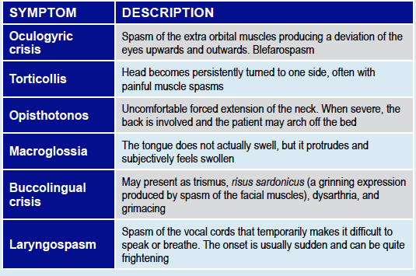

Slide 27

Using Antipsychotic Medication for the Treatment of Schizophrenia in Children and Adolescents
Treatment for Dystonic Reactions
Anticholinergic drugs (eg benztropine 1-2mg slow IV) or Antihistaminics (eg diphenhydramine)
Likely response after 5 mins and sx free by 15 mins
  Can be repeated after 10 mins if IV
Children:
  IM or IV benztropine
  0.02mg/kg to max of 1mg
  Wait 30 mins to repeat if IM
If no improvement, diagnosis probably wrong
https://www.youtube.com/watch?v=2krwEbm5hBo
Notes:
Dystonia responds promptly to anticholinergic drugs (e.g., benztropine 1-2mg by slow intravenous injection) or antihistaminics (e.g., diphenhydramine). Children should be given parenteral benztropine (0.02mg/kg to a maximum of 1mg), either intramuscularly or intravenously. Most patients respond within 5 minutes and are symptom-free by 15 minutes (see video clip). If there is no response the dose can be repeated after 10 minutes (or 30 minutes in children if intramuscularly). If the dystonic reaction does not improve, the diagnosis is probably wrong.

Slide 28
Using Antipsychotic Medication for the Treatment of Schizophrenia in Children and Adolescents
Side Effects of Antipsychotic Medications
Neuroleptic Malignant Syndrome (NMS)
Hyperthermia, muscular rigidity, tachycardia, hyper or hypotension, autonomic instability, rhabdomyolysis, confusion
Increased creatine phosphokinase and leukocytes
More common in first weeks of treatment
Increased risk with higher doses, multiple drugs, male, and young
Can lead to loss of consciousness and death
Misdiagnosis: catatonia, EPS, serotonin syndrome, infectious disease
Supportive management and stop drug
Notes:
This syndrome is characterised by hyperthermia, muscular rigidity, tachycardia, hyper- or hypotension, autonomic instability, rhabdomyolysis and altered mental state (confusion) (see Box)
An elevation of creatine phosphokinase (CPK) and/or leucocytosis is usually observed. NMS should be suspected in any patient taking dopamine antagonists with raised CPK
NMS is more common during the first weeks of antipsychotic treatment, but it can occur at any time and has been reported with both first and second generation antipsychotics (Masi et al, 2011)
Risks for NMS include higher doses of antipsychotics, multiple drugs, young age and male gender
• If not recognised, NMS can lead to loss of consciousness and even death
• Misdiagnosis can occur with catatonia, extrapyramidal side effects, serotonin syndrome or infectious diseases
• Management (preferably in an intensive care unit setting with cardio-respiratory monitoring) is mainly supportive. The main intervention is stopping the neuroleptic agents. The benefits of other interventions (e.g., dopamine agonists such as bromocriptine) are still unclear.

Slide 29
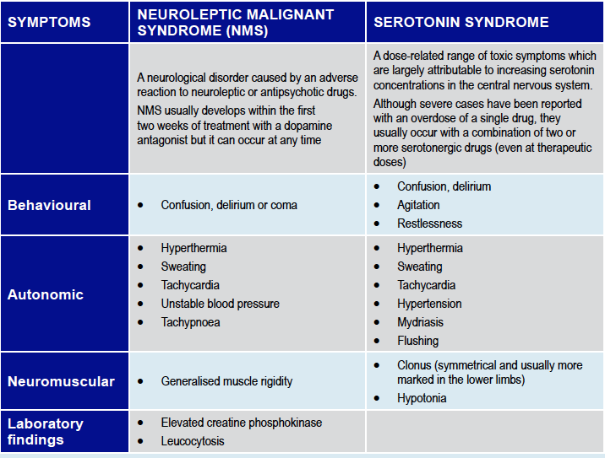
)
Notes:
NEUROLEPTIC MALIGNANT SYNDROME (NMS) AND SEROTONIN SYNDROME
Distinguishing between NMS and serotonin syndrome can be difficult, particularly in milder cases or in patients taking both dopamine antagonists and serotonergic drugs (including over-the-counter and alternative medicines such as St Johns wort).

Slide 30
Using Antipsychotic Medication for the Treatment of Schizophrenia in Children and Adolescents
Side Effects of Antipsychotic Medications
Sedation
Frequent and dose dependent
Tolerance may develop
May be a wanted effect in agitated patients
More sedating agents
  Chlorpromazine
  Clozapine
  Quetiapine
Notes:
Sedation is a frequent and usually dose-dependent effect, although tolerance may be developed with time
Table H.5.1.1 describes the relative sedating effects of commonly used antipsychotics
Sedation may be a sought after effect in severely agitated patients; in these cases a more sedating drug (e.g., chlorpromazine, quetiapine) should be chosen.

Slide 31
Using Antipsychotic Medication for the Treatment of Schizophrenia in Children and Adolescents
Side Effects of Antipsychotic Medications
Weight Gain
Most common long term adverse effect of atypicals
5% weight gain in 1st 3 months or 0.5 increase in BMI concerning
Dyslipidemia, metabolic syndrome, diabetes mellitus, hypertension, polycystic ovary,
Social withdrawal, treatment discontinuation, self esteem
Metabolic Syndrome
Obesity, hypertriglyceridemia, low HDL, hypertension, hyperclycemia
Precursor = weight gain
Insulin secretion problems
Especially clozapine and olanzapine
Notes:
Weight gain is the most common long term adverse effect of atypical antipsychotics (see Table H.5.1.2 for the relative likelihood of weight gain)
Compared with baseline, a weight gain of 5% during the first 3 months of treatment, or an increase of 0.5 in body mass index (BMI) in a longer period should raise concern (Masi et al, 2011)
Negative effects associated with weight gain include dyslipidaemia, metabolic syndrome, diabetes mellitus, hypertension, polycystic ovary, and osteoarthritis
Social withdrawal, treatment discontinuation and low self-esteem are some of the psychological consequences
Metabolic syndrome is characterized by obesity, hyper-triglyceridaemia, low high-density lipoprotein (HDL) cholesterol levels, hypertension and hyperglycaemia
• Weight gain is probably the most important precursor of a general metabolic dysregulation, the metabolic syndrome. However, there may also be direct effects on insulin secretion in a dysregulated hypothalamic pituitary axes
• All antipsychotics are associated with metabolic
syndrome, particularly clozapine and olanzapine (Masi et al, 2011).

Slide 32
Using Antipsychotic Medication for the Treatment of Schizophrenia in Children and Adolescents
Side Effects of Antipsychotic Medications
Preventing Weight Gain and Metabolic Syndrome:
Goal: healthy eating, BMI<25, exercise
Clinically Monitor
  Weight, waist circumference, fasting glucose/lipids
Provide dietary and exercise advice
  Small, frequent, slow meals with water
  Reduce sugar, saturated fat, processed white flour
  Increase fiber, fruits, vegetables
  Exercise 30-60 minutes each day
Notes:
Some young people taking antipsychotics can gain a substantial amount of weight very quickly. Once gained it is much harder to lose than to prevent it from happening in the first place. Because of the likelihood of significant weight gain with most second generation antipsychotics (see Table H.5.1.2) clinicians need to be proactive from the start by informing patients and families of this risk and ways of preventing it. The goal would be to achieve healthy eating, to maintain a body mass index (BMI) of less than 25 and an adequate level of physical exercise. Apart from regular monitoring of weight, waist circumference, fasting glucose and lipids (see Table H.5.1.4) clinicians ought to provide dietary and exercise advice, which should be monitored and reinforced at each consultation, recommending, for example to (Women’s and Children’s Health Network, 2007)
Eat every 3 to 4 hours, with no more than 2 meals in the evening or at night
Eat small portions at meals
Eat breakfast every morning
Eat slowly, drink an ample amount of water between bites and take second helpings only after a delay
Eat no more than one fast food meal per week
Avoid fried foods
Replace all drinks containing sugar (e.g., soft drinks, cordial, juice), “diet” drinks, and whole milk with at least 2L of water a day and moderate amounts of unsweetened tea or low fat milk.
Replace foods made with refined white flour and processed sugar and eat instead whole-grain foods and other food items that have a low glycaemic index (i.e. ≤ 55).
Do not snack when full and replace high-fat, high-calorie snacks with fruit and vegetables
Limit saturated fat intake
Eat at least 25-30g per day of soluble fibre from fruits, vegetables and whole grains
Limit watching television or playing computer/video games to less than 2 hours per day
Perform moderate to vigorous physical activity for at least 30 to 60 minutes per day.

Slide 33
Using Antipsychotic Medication for the Treatment of Schizophrenia in Children and Adolescents
Side Effects of Antipsychotic Medications
Hyperprolactinemia
  Amenorrhea, menstrual cycle disorders, breast enlargement, galactorrhea, sexual effects
  children and adolescents>adults
  esp post-pubertal girls
  Dose dependent
  Related to D2receptor affinity
  Higher in 1st generation as a class
  2nd generation: amisulpride, risperidone, paliperidone
  Quetiapine ~neutral
  Aripiprazole-- decreased prolactin
Notes:
Hyperprolactinaemia seems to be more common in children and adolescents than in adults. Post-pubertal girls may be more sensitive, as
oestrogen stimulates prolactin synthesis
The main effects of hyperprolactinaemia are amenorrhoea, menstrual cycle disorders, breast enlargement, galactorrhoea (both in males and females) and sexual effects (decreased libido, erectile difficulties)
Hyperprolactinemia with antipsychotics is dose dependant and related to the drugs’ affinity to D2 receptors. Overall, it is higher in first generation antipsychotics but there are second generation antipsychotics with a high potential for prolactin elevation (e.g., amisulpride, risperidone and paliperidone). Quetiapine has little effect on prolactin secretion. Aripiprazole may be associated with a small decrease of prolactin levels (Correll & Carlson 2006)
If hyperprolactinemia becomes a concern, antipsychotic should be changed to quetiapine or aripiprazole.

Slide 34
Using Antipsychotic Medication for the Treatment of Schizophrenia in Children and Adolescents
Side Effects of Antipsychotic Medications
Haematological
Mild leukopenia common to all
Agranulocytosis and neutropenia infrequent
  If occurs, avoid drug
Highest risk in clozapine
  Especially at beginning
  Also late effect
Notes:
Dystonia responds promptly to anticholinergic drugs (e.g., benztropine 1-2mg by slow intravenous injection) or antihistaminics (e.g., diphenhydramine). Children should be given parenteral benztropine (0.02mg/kg to a maximum of 1mg), either intramuscularly or intravenously. Most patients respond within 5 minutes and are symptom-free by 15 minutes (see video clip). If there is no response the dose can be repeated after 10 minutes (or 30 minutes in children if intramuscularly). If the dystonic reaction does not improve, the diagnosis is probably wrong.

Slide 35
Using Antipsychotic Medication for the Treatment of Schizophrenia in Children and Adolescents
Side Effects of Antipsychotic Medications
Seizures
EEG abnormalities vary between antipsychotics
  Clozapine—high risk—up to 4% adolescents
  Olanzapine—high risk
  Risperidone—moderate risk
  Typical neuroleptics—moderate risk
  Quetiapine—low risk
If a seizure occurs
First rule out other causes
Possible options
  Switch antipsychotics
  Stop medication briefly
  Reduce Dose or use anticonvulsant
Notes:
Antipsychotics may produce EEG abnormalities but risk varies widely among specific antipsychotics. Risk is particularly high with clozapine (up to 4% of the cases in studies with adolescents; Freedman et al, 1994) and olanzapine, moderate with risperidone and typical neuroleptics, and low with quetiapine
• Once other causes of the seizures are excluded, management may entail switching antipsychotic, stopping the medication briefly, reduce the dose or use an anticonvulsant.

Slide 36
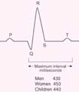
Using Antipsychotic Medication for the Treatment of Schizophrenia in Children and Adolescents
Side Effects of Antipsychotic Medications
Cardiovascular: Orthostatic hypotension, increased heart rate, dizziness, reduced ST interval, longer Qtc Interval
Antipsychotics:
Risperidone
Fluphenazine
Haloperidol
Clozapine
Ziprasidone
Pimozide
Droperidol
Quetiapine
Antidepressants:
Amitriptyline
Clomipramine
Imipramine
Dothiepin
Doxepin
Venlafaxine
Notes:
Cardiovascular adverse effects include orthostatic hypotension, increased heart rate, dizziness, and ECG changes (longer QTc interval, reduced ST interval)
Adverse cardiovascular effects are more frequent with atypical antipsychotics, although ziprasidone has the greater risk (Masi et al, 2011)
Transient increases in heart rate have been reported in children and adolescents but they have little clinical significance
• Prolongation of the QTc interval (more than 500ms) is of greater concern because of the increased risk of ventricular arrhythmias and sudden death. Many drugs may lengthen the QT interval increasing the risk of torsade de pointes, which becomes more of a problem when patients are taking several medications concurrently
• An ECG at baseline and during follow-up is recommended if poly-pharmacy is used or if there is family history of sudden cardiac death as part of the monitoring process.

Slide 37
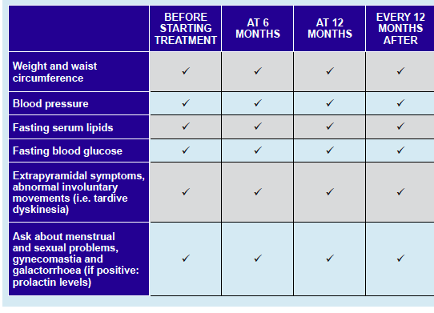
Suggested monitoring for people taking antipsychotics
Notes:
Suggested monitoring for people taking antipsychotics
Regular monitoring by blood test is required when using clozapine (see clozapine on Chapter H.5, p.16)

Slide 38
Using Antipsychotic Medication for the Treatment of Schizophrenia in Children and Adolescents
Choosing an Antipsychotic Medication
First, define goals
Choose atypical antipsychotic
  not clozapine or olanzapine
Take into account:
  Side effects
  Patient’s drug response history
  Patient’s family history of drug response
  Availability
  Clinician’s familiarity
  Price
Notes:
The first step is to define the goals of treatment in conjunction with the patient—and family when appropriate or if the patient is not well enough or old enough to participate in this process—and discuss the main options with their benefits and risks.
“Antipsychotic medications, other than clozapine and olanzapine (due to their side effects) are recommended as first-line treatment for persons with schizophrenia experiencing their first acute positive symptom episode” (Buchanan et al, 2010) . Overall, a second generation antipsychotic is preferred. The choice would be made taking into account:
Their side effect profile
The patient’s history of drug response (if known)
The patient’s family history of drug response (if a family member has schizophrenia)
Availability of the medication
Clinician’s familiarity with the drug, and
Price. Since schizophrenia is a chronic condition, in some countries price may be the most important factor to ensure or undermine adherence.

Slide 39
Using Antipsychotic Medication for the Treatment of Schizophrenia in Children and Adolescents
Dosage of Antipsychotic Medication
Patients having a first episode vs. multi-episode:
Better response to treatment
Greater likelihood of side effects
Require lower doses
  Except quetiapine (500-600mg/day)
Start low and go slow
Notes:
People with a first-episode show better response to treatment and a greater likelihood of side effects than patients with multi-episode schizophrenia. The Schizophrenia Patient Outcomes Research Team (Lehman & Steinwachs, 1998) recommended that patients presenting with a first psychotic episode should be treated with lower doses of antipsychotic medication than those recommended for patients with multi-episode schizophrenia (see Table H.5.1.2). Available research suggests that lower doses of antipsychotics are as effective as higher doses in patients experiencing a first episode but are better tolerated. That is, the goal should be to maintain the medication at the lowest effective dose to minimise potential adverse events. Quetiapine is an exception; it often requires titration to 500–600 mg/day (Buchanan et al, 2010; Lachman, 2014). Evidence suggests that “starting low, and going slow” during the titration phase is the most effective approach to minimise side effects.

Slide 40
Using Antipsychotic Medication for the Treatment of Schizophrenia in Children and Adolescents
Adequate Antipsychotic Trial
No consensus
Majority agree on 4-6 weeks
  If not→ switch antipsychotics
½ to 2/3 experience reduced positive symptoms in 3 weeks at initial dose
  If not→ increase dose
If increased too quickly to too high of drug
  No increased effectiveness
  More side effects
  Poor adherence
  Poor longterm outcomes
Notes:
There is no consensus among experts about what constitutes an “adequate” trial. The majority agrees that treatment for 4-6 weeks (longer if dose increases are slow), achieving optimal dose and ensuring adherence would be an adequate trial.
It is expected that half to two-thirds of patients will experience a reduction in positive symptoms within three weeks at the initial dose; if not, the dose should be increased. In many countries, due to the need for hospital beds, lack of resources and the high cost of hospitalization, there is pressure on clinicians to achieve improvement or to discharge patients quickly. This often results in unnecessarily high doses of medication or a combination of drugs being used, which will not increase effectiveness but will cause more side effects, poor adherence to treatment, and poorer long term outcomes.
If after about 4 weeks at an adequate dose of antipsychotic medication there is no improvement, it would be appropriate to switch antipsychotics. Another antipsychotic from the same or a different type can be tried. A second generation antipsychotic should be the first choice in most young patients. While in general terms all antipsychotics appear to be similarly effective, some individuals may respond to some antipsychotics and not to others.

Slide 41
Using Antipsychotic Medication for the Treatment of Schizophrenia in Children and Adolescents
Treatment Resistance
No improvement with 2 adequate trials
  →clozapine trial
But first consider
  Poor adherence→LAI before clozapine
  Psychological treatments: family intervention, CBT)
  Comorbid substance use, other prescribed medication, physical illness
Clozapine trial
  At least 8 weeks
  300-800 mg/day
  Blood level>350ng/ml
Notes:
Patients who show no improvement with two adequate trials of antipsychotics are described as treatment resistant and should be treated with clozapine. Before concluding that a patient is treatment resistant, several issues need to be considered, namely:
Adherence to antipsychotic medication. Up to half of the patients with schizophrenia are partially or totally non-adherent to their antipsychotic regimen. In cases of poor adherence a trial with long-acting injectable antipsychotics should be considered before using clozapine
Engagement with and use of psychological treatments (family intervention, CBT)
Other causes of non-response, which should be excluded: comorbid substance misuse (including alcohol), concurrent use of other prescribed medication or physical illness.
A trial of clozapine should last at least 8 weeks at a dosage from 300 to 800mg/day. If possible, clozapine levels should be obtained in cases of inadequate response. If the blood level is less than 350ng/ml, then the dosage should be increased as far as side effects are tolerated, to achieve a blood level above 350ng/ ml (Buchanan et al, 2010).
A trial of clozapine should also be considered when, in spite of treatment, aggressiveness and hostility persist or if there are marked and persistent suicidal thoughts or behaviors (Buchanan et al, 2010). For further issues in the treatment with clozapine, please go to Chapter H.5, page 16.

Slide 42
Using Antipsychotic Medication for the Treatment of Schizophrenia in Children and Adolescents
Antipsychotics and Pregnancy
Cross placenta
Exposure during 3rd trimester→possible EPS and/or withdrawal after delivery
Does NOT increase risk for important short term maternal medical and perinatal outcomes
  E.g., gestational diabetes
Notes:
Antipsychotic medications cross the placenta. Neonates exposed to antipsychotic medications during the third trimester of pregnancy may be at risk for EPS and/or withdrawal symptoms following delivery. However, the current evidence is that taking antipsychotic medication during pregnancy does not independently increase risk for important short term maternal medical (e.g., gestational diabetes) and perinatal outcomes (Vigod et al, 2015).

Slide 43
Using Antipsychotic Medication for the Treatment of Schizophrenia in Children and Adolescents
Augmentation and Adjunctive Treatments
Incomplete reduction in positive symptoms:
No evidence for second antipsychotic
Little evidence for adding lithium or anticonvulsants (unless bipolar)
No evidence for benzodiazepines
Insufficient evidence for adding antidepressant
ECT effective but no advantage over antipsychotics
rTMS effective for refractory auditory hallucinations
Growing evidence for concurrent CBT
Notes:
A small proportion of people with a first episode of schizophrenia (more frequent among those with recurrent episodes) show an incomplete reduction of positive symptoms with antipsychotic monotherapy. In these patients, augmentation and adjunctive treatments are often used (Buchanan et al, 2010):
There is no evidence that adding a second antipsychotic drug improves response (and increases the risk of unwanted effects)
There is little evidence to support the benefit of adding lithium or anticonvulsants (e.g., carbamazepine, sodium valproate, lamotrigine) in the absence of clear bipolarity
Benzodiazepines have been used to treat symptoms of anxiety, depression, or hostility in people with schizophrenia. There is no evidence supporting this use and there is considerable risk of dependence developing
So far, there is insufficient evidence supporting the use of antidepressants for the treatment of co-occurring depression in schizophrenia
ECT can be effective in reducing acute positive psychotic symptoms but shows no advantage compared with carefully chosen and administered antipsychotic medications
Low-frequency rTMS (repetitive Transcranial Magnetic Stimulation), over the left temporoparietal cortex, has been found to be effective in the acute treatment of auditory hallucinations that have not responded to antipsychotics (Tranulis et al, 2008).
There is growing evidence that concurrent psychotherapy, particularly CBT, is effective (NICE, 2009).

Slide 44
Using Antipsychotic Medication for the Treatment of Schizophrenia in Children and Adolescents
Treatment Maintenance and Duration in First Episode Psychosis
¼ patients--complete recovery after first episode
Most guidelines--treatment for 1-3 years
If sustained remission--reduce slowly/monitor frequently
Continue at minimal dose
Consequences of relapse:
  Social/family/education/vocation
  Increased treatment resistance
  Psychological distress
Notes:
Once psychosis has achieved a sustained remission, a slow reduction of antipsychotic medication should be tried in order to determine the minimal dose required by the patient. Maintaining antipsychotic medication reduces the risk of relapse in the early years after a first episode. Relapse is distressing, may interfere with social, family and educational/vocational outcomes, and may increase the risk of treatment resistance.
One of the most challenging issues that confront clinicians and patients is deciding for how long antipsychotic treatment should continue after a first psychotic episode. Although schizophrenia is a chronic illness, in about one quarter of the cases there is a complete recovery without further episodes (Stafford et al, 2015). On the one hand, given the significant side effects of medication, pharmacological treatment should not be continued unless it is necessary. On the other hand, recurrence occurs in a substantial proportion of sufferers even if taking medication. The optimal duration of maintenance antipsychotic treatment to minimise the risk of recurrence remains controversial. In general, most guidelines recommend continuing treatment for 1-3 years (NICE, 2013; Royal Australian and New Zealand College of Psychiatrists, 2005).
Medication should always be reduced gradually, over a period of weeks or months. Individuals who elect against advice to stop taking medication should continue to be monitored frequently and receive ongoing support. In all cases, families should be provided with continuing assistance and psychoeducation about the risks and possible manifestations of recurrence, accompanied by frequent review and support with unhindered access to early psychiatric treatment in the event of recurrence. Depression, suicide risk, substance misuse and social anxiety in the patient should be identified and actively treated.

Slide 45
Using Antipsychotic Medication for the Treatment of Schizophrenia in Children and Adolescents
Considerations in Reducing Antipsychotic Medication
Reliability of diagnosis
Existence of mood disorder
Duration of episode
Nature of episode
Recovery complete or persistent symptoms
Patient insight and treatment adherence
Comorbid conditions
Age of onset
Previous episodes
Important transitions happening
Availability of support and monitoring
Medication side effects
Notes:
The reliability of diagnosis: whether there is a high or low certainty about the diagnosis of schizophrenia
• Whether there is reasonable evidence suggesting the existence of a mood disorders (e.g., antipsychotic treatment may not need to be prolonged in cases of psychotic depression)
• The duration of the psychotic episode (e.g., if it was brief, shorter than one month, or more prolonged)
• The nature of the psychotic episode (e.g., a drug-induced psychosis)
• Whether complete recovery was achieved or whether symptoms, particularly negative symptoms, persist. Most patients with the so-called chronic schizophrenia may need lifelong medication treatment
• Patient’s insight and adherence to treatment (e.g., if the patient is willing to be reviewed regularly and has a good understanding of the illness and of the initial symptoms of a recurrence)
• Presence of comorbid conditions such as depression or substance misuse
• Age at first episode (earlier onset has worse prognosis)
• Whether there have been previous episodes
• The life stage: it would be unwise to cease treatment during important life transitions (e.g., starting university) or stressful periods
• Whether there are relatives or social supports who can monitor early deterioration
• Severity of side effects of medication.

Slide 46
Using Antipsychotic Medication for the Treatment of Schizophrenia in Children and Adolescents
Misuse and Overuse of Antipsychotics
Use in youth increasing since 1990s, esp in US
Prescribed mainly off-label
Worrisome adverse effect burden
Prescribers often not trained in psychiatry
Other options with fewer side effects for:
  ADHD
  Disruptive behaviors
  Depression
  Anxiety
Notes:
Antipsychotic medication use in youth has been increasing since the mid-1990s. This development, most pronounced in the United States, has raised criticism about potential overuse because antipsychotics are prescribed mainly off-label, and their adverse effect burden for young people is worrisome […] Who are these young people prescribed antipsychotic treatment? All signs suggest that SGA [second generation antipsychotic] use among children is chiefly in those with aggression and behavioral dyscontrol, attention-deficit/hyperactivity disorder (ADHD), and disruptive behavior disorders (DBDs), but not for those with psychosis, bipolar mania, Tourette syndrome, or autism spectrum disorders” (Correll & Blader JC, 2015).
Misuse and overuse of antipsychotic medication in young people, often prescribed by professionals not trained in psychiatry, is becoming a growing problem globally. While antipsychotics are effective in reducing aggressive behaviours, their side effects, particularly with long-term use, are significant. Treating ADHD, disruptive behaviours, depression, and anxiety in youth with antipsychotic medications is problematic; other interventions with fewer side effects, when correctly used, can avoid the need for antipsychotic treatment (Correll & Blader JC, 2015). Frequently, antipsychotic drugs are also improperly used in people with intellectual disability.

Slide 47
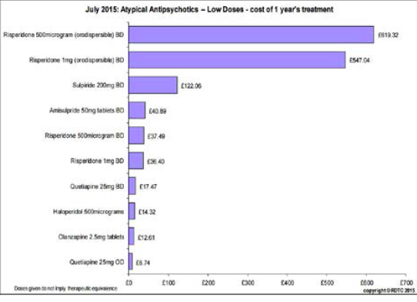
Notes:
Costs of a Psychotic Episodes
The personal and financial costs of a psychotic episode for the sufferer, the family and society as a whole are considerable. For example, it was estimated in 2013 that the cost of treating one person with schizophrenia in the UK was £50.000 per year (NICE, 2013). Suicide rates are nearly 15% among people with schizophrenia, and their unemployment in Western countries varies between 50%- 75%.
Figure H5.1.3 shows a comparison between different atypical antipsychotics and haloperidol according to the Regional Drug and Therapeutic Centre. The chart shows comparative costs of 1 year of treatment at a standard daily dose as of April 2015. Maintenance treatment in adults would usually require higher doses. In the UK a 1 month supply of haloperidol costs less than 2 pounds, compared to 100-120 pounds for atypical antipsychotics or 200 pounds for clozapine.

Slide 48
Using Antipsychotic Medication for the Treatment of Schizophrenia in Children and Adolescents
Organization of Services
Phase specific services
Coordinated and individualized care
Minimize inpatient care through:
  Increasing outpatient visits
  Outreach treatment teams
  Access to emergency services
  Supported housing or residential care
  Acute day-stay services or early intervention programs
Notes:
Optimally, care for patients with a first episode of psychosis should be coordinated and individualized, provided through services that are specific for each phase of the illness (Ministry of Health, Province of British Columbia, 2010; International Early Psychosis Association Writing Group (2005). For example, minimising in-patient hospitalization during the acute phase should be a goal— young people often find their initial inpatient experience traumatizing (McGorry et al, 1991). Treatment should be provided in an outpatient setting or the home when possible. Ways to avoid hospitalization include:
Increasing the number of outpatient visits
If available, outreach treatment team follow-up
Access to emergency services when required, and
Supported housing or residential care.
The level of intervention (inpatient, outpatient) depends largely on the degree of family, community and health services support rather than on the degree of psychopathology itself. Acute day-stay services and early intervention programs may be appropriate alternatives to in-patient care.

Slide 49

Using Antipsychotic Medication for the Treatment of Schizophrenia in Children and Adolescents
Organization of Services
Consider inpatient hospitalization if:
  Youth not engaged in treatment and actively psychotic
      → May necessitate involuntary hospitalization
  Significant risk to self or others
  Insufficient community support
  Crisis too severe to manage
Notes:
Hospitalization may be required if there is a significant risk to self or to others, if the level of support in the community is insufficient, or if the severity of the crisis is too high for the family to manage. If the attempts to engage the youth in treatment fail and the young person remains actively psychotic, involuntary treatment should be considered according to the requirements of local mental health legislation. When hospitalization is necessary, it should be as short as possible (McGorry et al, 1991).
Adolescent inpatient units should be small in size and adequately staffed so that nursing of highly distressed or agitated young people is possible. A secure area is necessary so that care can be provided for aggressive or agitated patients without harming or disturbing others. Photo: ITV News

Slide 50
Using Antipsychotic Medication for the Treatment of Schizophrenia in Children and Adolescents
Early Intervention Programs
Seek to ensure continuity of care from hospital to community
Reduce inappropriate emergency service use
Reduce early rehospitalization
Increase frequency of contacts (at least weekly in first year)
Adjust medication dosage
Offer family education and support
Notes:
Early intervention programs seek to ensure continuity of care from the hospital to the community. These programs can reduce inappropriate use of emergency services or early re-hospitalization by increasing the frequency of contacts or adjusting medication dosage. Early intervention programs should also offer family education and support. The Ministry of Health Services Province of British Columbia (2010) recommends that in the first year the minimum frequency of contact with the young persons and their families should be once weekly during the acute or relapse phases; after that, once monthly. After acute symptoms improve, it is recommended that young people not be transferred to primary care without the supervision of a specialist mental health team or professional.

Slide 51
Using Antipsychotic Medication for the Treatment of Schizophrenia in Children and Adolescents
First Episode Psychosis in Rural Communities and Low Income Countries
Issues to consider
Geographic and demographic barriers
Limited resources
Stigma and lower tolerance of eccentricity
Possible consequences
Longer duration of untreated psychosis
Treatment discontinuation
Higher rates of alcohol and drug misuse
Possible solutions:
Telemedicine
Close cooperation with primary care
Cooperation and education of elders and religious figures
Notes:
Service provision in rural areas and in low income countries differs significantly from those described. A number of issues must be considered, including:
Geographic and demographic barriers (widely disperse rural communities, long distances to travel to access services, heterogeneity of the population)
Limited resources (lack of trained mental health professionals in most low income countries, reduced staff and capacity of existing services, isolation of clinicians, less availability of employment, education and social opportunities for sufferers)
Other barriers (stigma, lower tolerance of eccentricity).
These factors may result in longer duration of untreated psychosis, treatment discontinuation, higher stigma, and higher rates of alcohol and drug misuse (Welch & Welch, 2007; Kelly et al, 2007; Ministry of Health Services Province of British Columbia, 2010). These difficulties highlight the need for contemporary technologies (e.g., telemedicine), and for a close cooperation with primary care, drug and alcohol services, community supports and education (e.g., cooperation and education of elders and religious figures).

Slide 52

Using Antipsychotic Medication for the Treatment of Schizophrenia in Children and Adolescents
Prevention and High Risk for Psychosis
Prodrome or at risk mental state
https://www.youtube.com/watch?v=wgXUFPnfb9Q&feature=youtu.be
Notes:
There is much interest and argument about whether young people who show some psychotic symptoms but who do not yet have a diagnosable illness can be identified and treated to prevent the development of schizophrenia. Psychotic episodes are usually preceded by a period of variable length in which a number of changes are detected—the “prodromal” phase—typically characterised by a sustained and clinically significant deterioration from the premorbid level of functioning, thinking, and behaviour. These changes include either subtle or more dramatic alterations in behaviour and emotions such as suspiciousness, social or family withdrawal, deteriorating self-care, and transient and attenuated hallucinations and delusions.
One model—the staging model—conceptualises two stages of the prodrome: a stage of mild or nonspecific psychotic symptoms, and a stage of increased symptom activity but which still does not fulfil criteria for diagnosis of a psychotic episode. This period is often called the “at risk mental state” rather than the “prodrome”, as this period can only be definitively identified as the prodrome in retrospect.
Click on the image to view a 2013 lecture by Patrick McGorry on “Early intervention for psychosis: A new architecture and culture of care” (1:03:34)

Slide 53
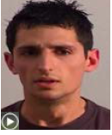
Using Antipsychotic Medication for the Treatment of Schizophrenia in Children and Adolescents
Prevention and High Risk for Psychosis
Ultra High Risk for Psychosis Model
https://www.youtube.com/watch?v=wgXUFPnfb9Q&feature=youtu.be
Notes:
Click on the image to view a video clip questioning the validity of the “ultra highrisk for psychosis “ model (2 parts)
The purpose of identifying this high risk group is to prevent the development of a full-blown psychosis by early treatment. However, recent studies have found that the likelihood of transition to a full blown psychosis in this group of patients is only 16%, compared with earlier estimates of up to 60%.
A third approach focuses on the so called “basic symptoms”, such as subtle disturbances of thought, speech, and perception which may be altered years prior to the onset of frank psychosis. The Bonn Scale for the Assessment of Basic Symptoms (BSABS; Huber & Gross, 1989) has shown that presence of such basic symptoms predicts the development of schizophrenia with a probability of 70% over 10 years, while their absence excluded schizophrenia with a probability of 96%. Particular disturbances, such as thought interference, disturbances of receptive language, or visual distortions, predicted later schizophrenia with a probability of up to 91% (Klosterkotter et al, 2001). The BSABS is thought to detect individuals in an “early” prodromal phase characterized by the negative or deficit-like symptoms as well as neurocognitive deficits, while the “ultra-high risk” approach is more likely to identify youth in the late stage of the prodrome.

Slide 54
Using Antipsychotic Medication for the Treatment of Schizophrenia in Children and Adolescents
When to Consider a Psychotic Disorder
Deteriorating psychosocial functioning
Socially withdrawn
Performing worse at school or work
Increased distress or agitation without trigger
USE PSYCHOLOGICAL TREATMENTS, NOT ANTIPSYCHOTICS, IN AT RISK YOUTH
Unless rapid deterioration, severe suicide risk, or severe aggression, then consider time limited therapeutic trial
Notes:
The possibility of a psychotic disorder should be considered in a young person who shows a deteriorating psychosocial functioning, is becoming socially withdrawn, performing worse for a sustained period at school or at work, or who is becoming more distressed or agitated without an adequate trigger. However, evidence of the effectiveness of different treatments, including antipsychotics, in reducing the likelihood of transition to psychosis is still lacking. Evidence is growing that psychological treatments, particularly CBT, may prevent or delay transition to psychosis in identified high risk populations. Given the limited evidence and the risks of antipsychotic treatment, the use of antipsychostics is not recommended in at risk youth. In some cases, for example, if there is a rapid deterioration, severe suicide risk, or if there is severe aggression or hostility, a time-limited “therapeutic trial” may be appropriate.

Slide 55

Anxiety Disorders in Children and Adolescents
Thank You!
Using Antipsychotic Medication for the Treatment of Schizophrenia in Children and Adolescents
Thank You!

