Slide 1
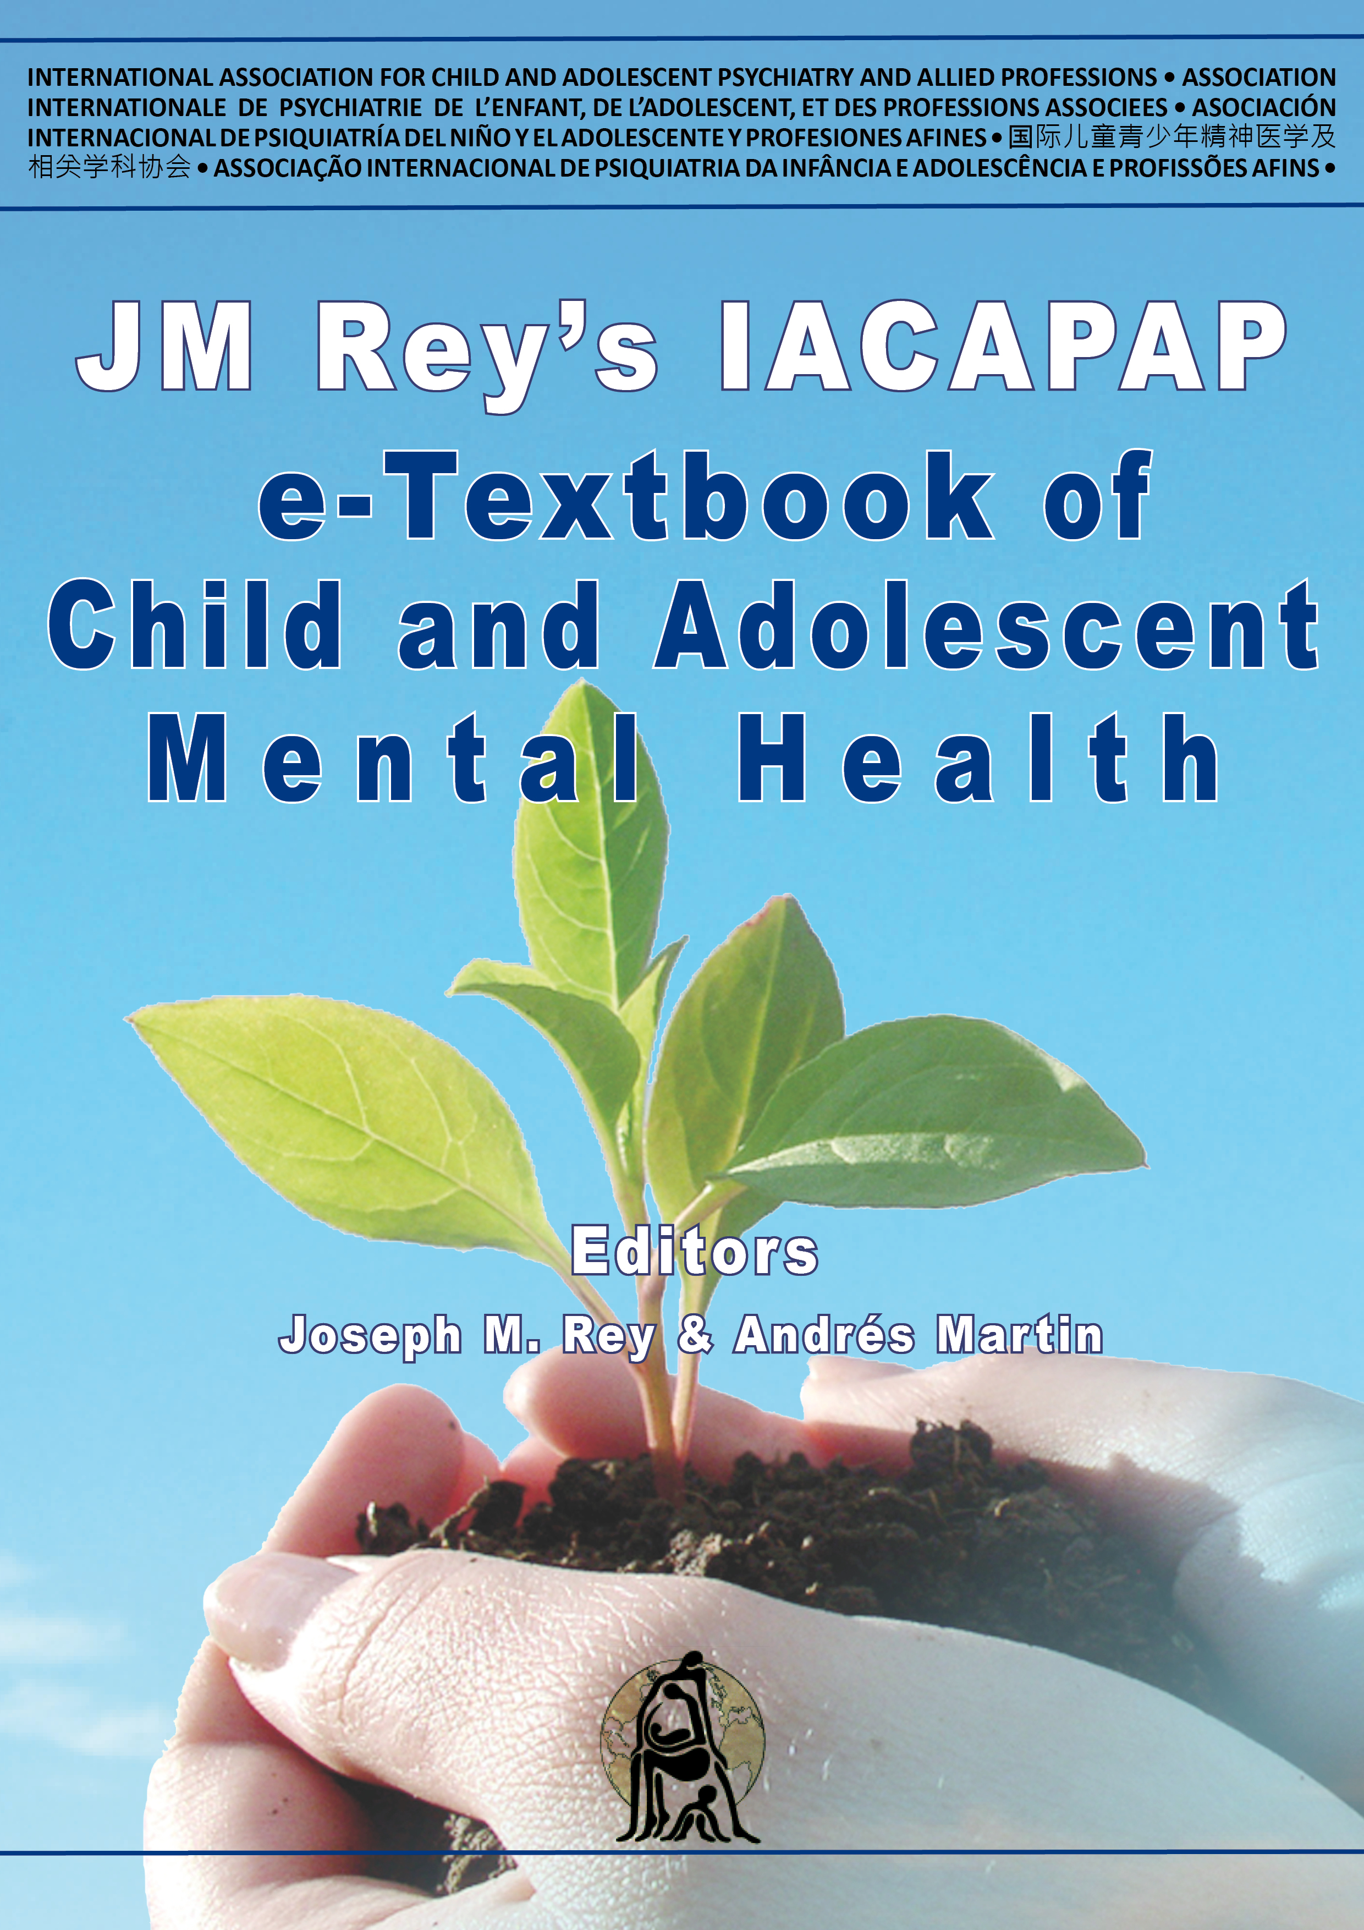
INTRODUCTION
Chapter A.7
PRINCIPLES IN USING
PSYCHOTROPIC MEDICATION
IN CHILDREN AND
ADOLESCENTS
DEPRESSION IN CHILDREN AND
ADOLESCENTS
Boris Lorberg, Chiara Davico, Dmytro Martsenkovskyi &
Benedetto Vitiello
Companion PowerPoint Presentation
Adapted by Oscar Gerdner & Julie Chilton

Slide 2
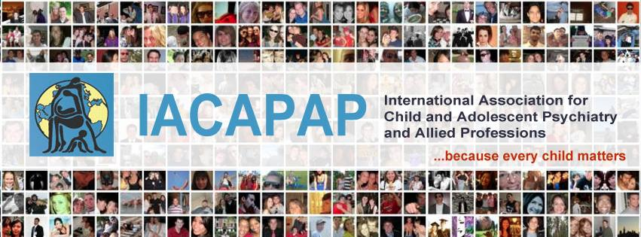
The “IACAPAP Textbook of Child and Adolescent Mental Health” is available at the IACAPAP website http://iacapap.org/iacapap-textbook-of-child-and-adolescent-mental-health
Please note that this book and its companion powerpoint are:
· Free and no registration is required to read or download it
· This is an open-access publication under the Creative Commons Attribution Non- commercial License. According to this, use, distribution and reproduction in any medium are allowed without prior permission provided the original work is properly cited and the use is non-commercial.

Slide 3

Principles in Using Psychotropic Medication in Children & Adolescents
Outline
Historical Context
Core Questions
When to Use?
Pharmacokinetics
Pharmacodynamics
Efficacy
Ethical and Regulatory Considerations
Clinical Practice
Challenges
Conclusions
Notes:
With the notable exception of medications for ADHD—which were first introduced in pediatric population and subsequently extended to adults—most psychotropic medications were first developed to treat psychiatric conditions in adults, and only later extended to children. Appropriate concerns have been raised about both the validity of applying adult diagnostic categories to children and the validity of extrapolating safety and efficacy information collected in adults to children.
Growing research has provided a better understanding of the benefits and risks of the pediatric use of some psychotropics. For many others, however, the current knowledge base is incomplete. This inadequacy is especially evident with respect to their long-term use. In psychiatry, medications are seldom curative and long-term treatment is often required, thus raising concerns about both the persistence of the therapeutic effect and the safety of prolonged exposure to psychotropic agents at a time of rapid development. A related question is whether treatment in childhood will lead to better functional outcomes later in life. Unfortunately, controlled clinical trials are usually brief, and studying long-term treatment effects is methodologically difficult.
Medications to treat mental conditions (psychotropics) have become increasingly used in child and adolescent psychiatry around the world. From the serendipitous discovery by Bradley of the effects of amphetamines on child hyperactivity in 1937 to the multisite clinical trials of the 21st century, pediatric psychopharmacology has evolved from an area of research to a standard of clinical care (Vitiello & Davico, 2018). Nevertheless, the role of pharmacotherapy in pediatric mental health remains the object of debate and controversy.

Slide 4
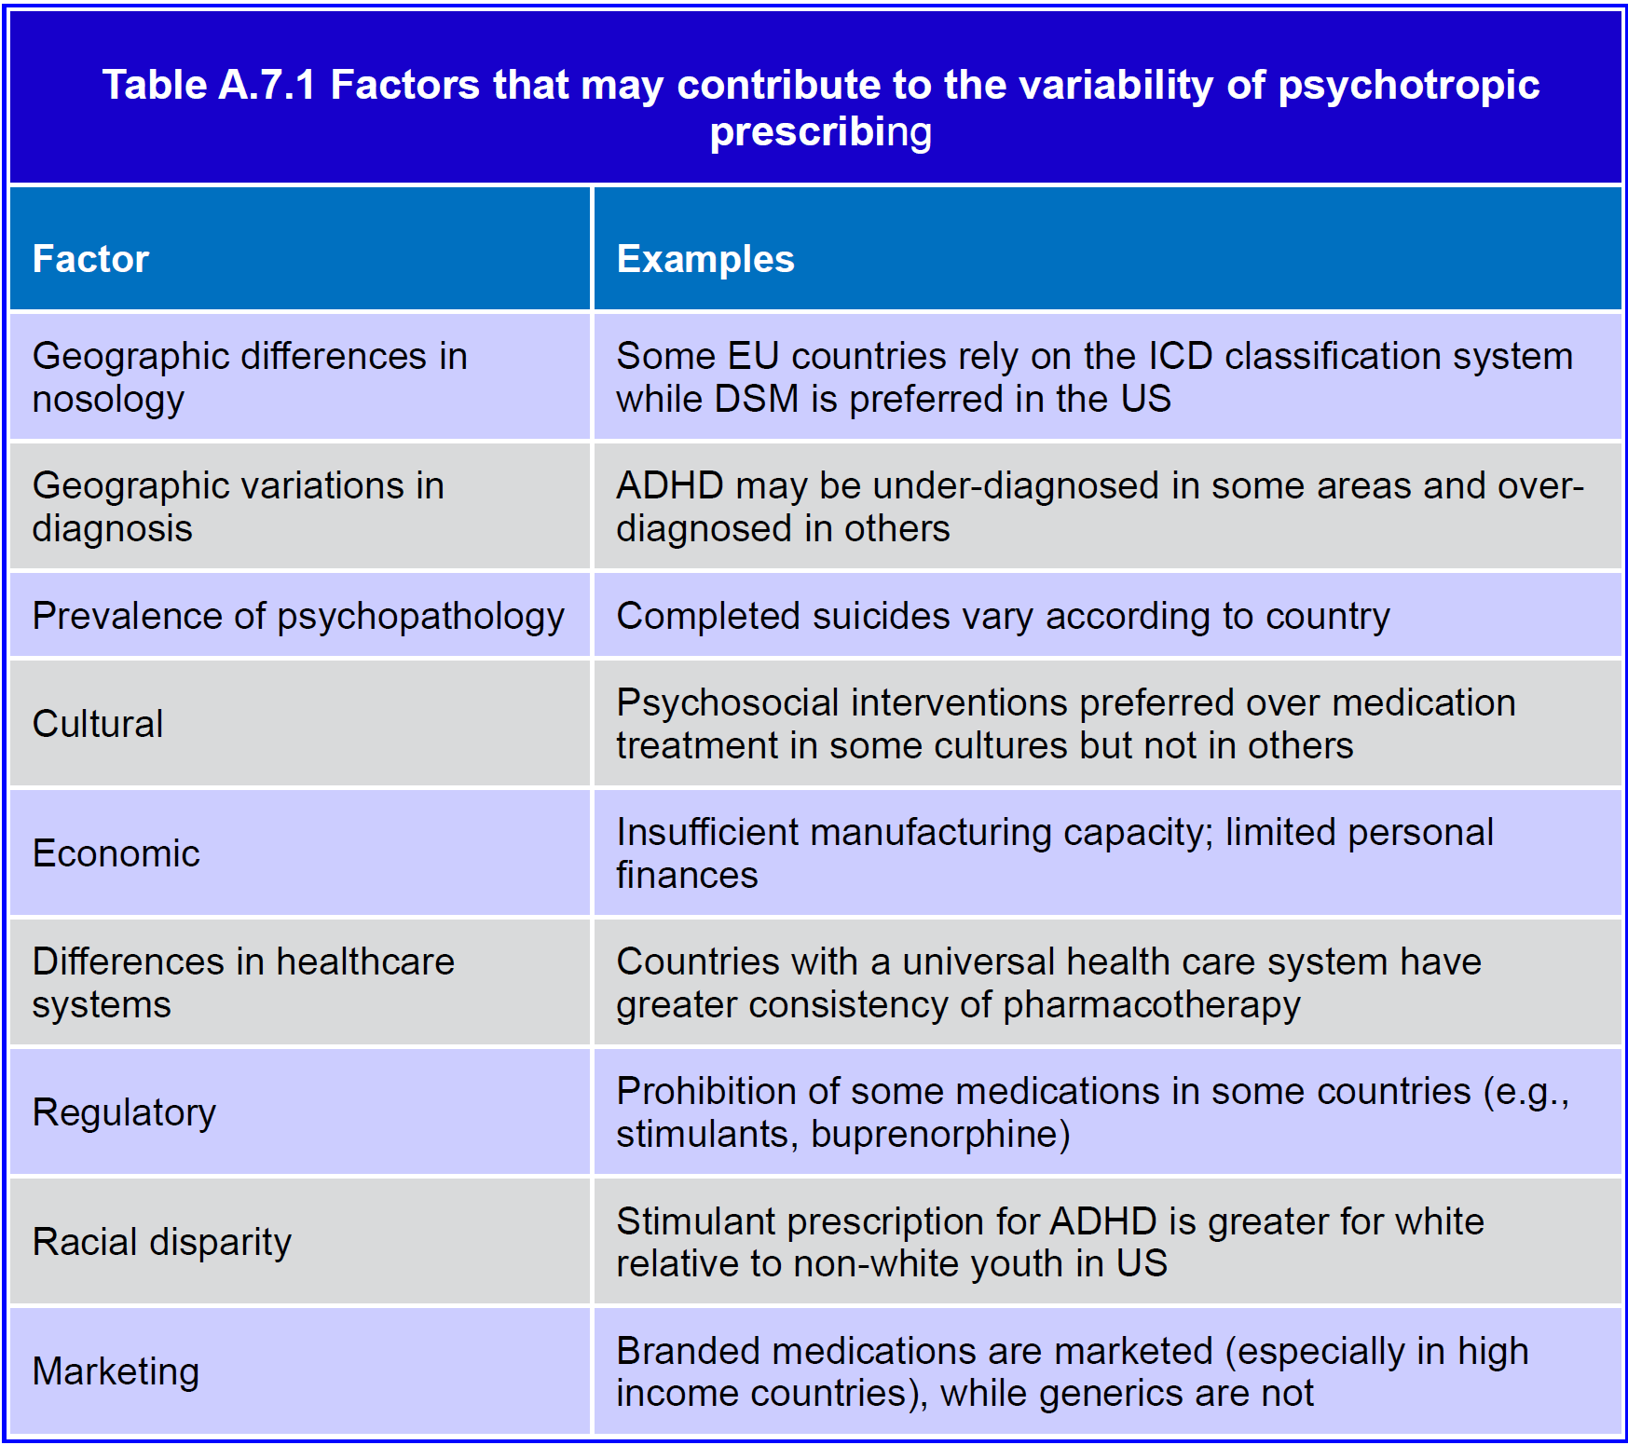
Notes:
Lack of adequate and fair access to pediatric mental health care has long been a sad and universal phenomenon. According to a 2003 WHO report, 44%-70% of youth with mental illness in high income countries did not receive mental health treatment in any given year. In low- and middle-income countries (LAMICs), this gap was closer to 90%. Over 90% of LAMICs had no mental health policies that included children and adolescents (WHO, 2003).
Notwithstanding the above generalizations, psychopharmacotherapy is practiced within the context of regional mental health care systems. Prescribing varies widely, both across and within countries. This variability cannot be fully explained by differences in nosology or illness prevalence, thus suggesting that cultural, geographic, economic, regulatory, and other factors play a major role in prescribing practices (Vitiello, 2008) (see Table A.7.1).
Relative to other areas of medicine, perception of psychiatric disorders appears to be more influenced by cultural values. For example, use of stimulants for ADHD in the US is greater among the white population than among children of African American or Hispanic background (Cohen et al, 2013). Stimulant medication use is lower in the US West Coast than in the rest of the country (Zuvekas & Vitiello, 2012) These ethnic differences appear to be independent of
economic factors. Levels of parental concern about risks of adolescent addiction are different across cultures with parents of African and Hispanic children expressing more concerns than parents of white children (Zhu at al, 2009).
Relative to other high-income countries, use of psychotropic medications is substantially higher in the US; for example, it has more than 80% of the world usage of psychostimulants. It is estimated that about 3.5% of US children are treated with stimulant medication for ADHD, and use has been consistently increasing over the years (Zuvekas & Vitiello, 2012). Likewise, antidepressant and antipsychotic use is many times greater in the US than in other countries (Fegert et al, 2006).
Differences in prescription rates appear to be influenced by economic factors also. For example, there is a significant variation among countries in prescriptions for the treatment of comorbidities associated with autism spectrum disorder, with a correlation between per capita gross domestic product and prescription rates (Hsia et al, 2014). It is likely that pharmaceutical industry’s marketing efforts play a significant role in prescribing practices.
Overall, approaches to mental health care vary considerably based on cultural factors. The implications of this variability for disease outcome and patient prognosis are serious and yet to be understood.

Slide 5

Principles in Using Psychotropic Medication in Children & Adolescents
Historical Context & Some Core Questions
“Problem” children in 1937
dl-amphetamine for headaches
Improvements in:
  school performance
  social interactions
  emotional responses
21st century multisite clinical trials
Standard of care but uncertainties about effectiveness & safety
Charles Bradley
Notes:
With the notable exception of medications for ADHD—which were first introduced in pediatric population and subsequently extended to adults—most psychotropic medications were first developed to treat psychiatric conditions in adults, and only later extended to children. Appropriate concerns have been raised about both the validity of applying adult diagnostic categories to children and the validity of extrapolating safety and efficacy information collected in adults to children.
Growing research has provided a better understanding of the benefits and risks of the pediatric use of some psychotropics. For many others, however, the current knowledge base is incomplete. This inadequacy is especially evident with respect to their long-term use. In psychiatry, medications are seldom curative and long-term treatment is often required, thus raising concerns about both the persistence of the therapeutic effect and the safety of prolonged exposure to psychotropic agents at a time of rapid development. A related question is whether treatment in childhood will lead to better functional outcomes later in life. Unfortunately, controlled clinical trials are usually brief, and studying long-term treatment effects is methodologically difficult.
Medications to treat mental conditions (psychotropics) have become increasingly used in child and adolescent psychiatry around the world. From the serendipitous discovery by Bradley of the effects of amphetamines on child hyperactivity in 1937 to the multisite clinical trials of the 21st century, pediatric psychopharmacology has evolved from an area of research to a standard of clinical care (Vitiello & Davico, 2018). Nevertheless, the role of pharmacotherapy in pediatric mental health remains the object of debate and controversy.
In 1937, Charles Bradley, a psychiatrist, administered dlamphetamine to “problem” children at the Bradley Home in Providence, Rhode Island (US), in an attempt to alleviate headaches. Bradley noticed an unexpected effect: improved school performance, social interactions, and emotional responses. Bradley’s studies went largely ignored for nearly 25 years. However, they proved to be an important precursor to studies on the use of amphetamines in ADHD (Strohl, 2011).

Slide 6
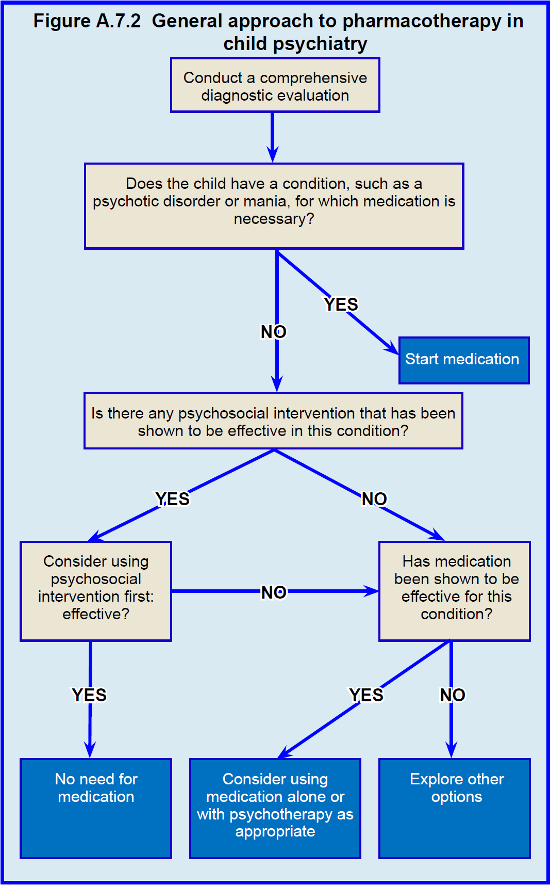

Slide 7
Principles in Using Psychotropic Medication in Children & Adolescents
When to Use Psychotropics in Youth?
Step 1: comprehensive diagnostic evaluation and psychosocial formulation
Non-pharmacologic intervention first
Psychotherapy & medications combined
Notes:
A comprehensive diagnostic evaluation and psychosocial formulation is the necessary first step (Figure A.7.2). Patients with psychotic disorders often require pharmacological treatment as a first step to control symptoms and restore functioning. For more details on pharmacological treatment of psychosis, see Chapter H.5.1.
Patients with non-psychotic disorders may often be successfully treated with non-pharmacological interventions first. For example, behavioral therapy can be an effective first step in the management of patients with mild major depression, OCD, and anxiety disorders. Not all children, however, improve with purely
psychosocial interventions and, for them, medication may be necessary to improve their functioning. Of note, psychotherapy and medication are not mutually exclusive: in many conditions, such as depression and anxiety, combined use as been found to be more beneficial than monotherapy (Vitiello, 2009a).

Slide 8
Principles in Using Psychotropic Medication in Children & Adolescents
When to Use Psychotropics in Youth?
Consider strength of evidence supporting efficacy & safety
Most data for short-term efficacy
Strongest evidence (Type I): > 1 systematic review of multiple, well-designed RCT’s
Weaker evidence (Type II): > 1 RCT
Notes:
Thanks to clinical research conducted since the 1990’s, there is a growing body of evidence for the short-term efficacy of many medications (summarized in Table A.7.3). Much less strong is the evidence of their long-term effectiveness and safety. For more details on assessment of treatment evidence see Chapter A.6 and Figure A.6.8. Several placebo-controlled discontinuation studies have shown that longterm treatment can be effective in maintaining improvement and preventing symptom recurrence. For example, in youth suffering from depression, continuing antidepressant treatment significantly reduces the risk of relapse (Emslie et al, 2008). Likewise, discontinuing risperidone in children with autism and severe behavioral disturbances increases the risk of recurrence of aggression, self-injury, and tantrums compared with continuing treatment (Research Units on Pediatric Psychopharmacology Autism Network, 2005a). In addition, a number of naturalistic follow-up studies provide useful information on the long-term outcome of youths treated for several years, even though treatment effects are difficult to determine due to the lack of a control condition.

Slide 9
Principles in Using Psychotropic Medication in Children & Adolescents
When to Use Psychotropics in Youth?
Know
  drug regulatory environment
  sociocultural & economic factors
Regulatory approval vs. level of evidence
  e.g. methylphenidate, sertraline, haloperidol in preschoolers
Notes:
Beyond the level of evidence for each medication, prescribers also need to understand their regulatory environment. Some psychotropics have received approval for pediatric indications by drug regulatory agencies (i.e., the FDA in the US or the EMA in the European Union), while others are used off-label.
In the US, many medications that have a high level of evidence also carry an FDA approval—for example, methylphenidate is FDA approved for ADHD in children aged 6 and older (see Table A.7.3). On the one hand there are medications that have a high level of evidence but do not have FDA approval—for example, sertraline has Type I level of evidence for efficacy in anxiety disorders in childhood, but no FDA indication. On the other hand, there are medications that have a low level of evidence, yet have FDA approval—for example, haloperidol has little evidence of efficacy among preschoolers, but it has an FDA indication for pediatric use starting at age 3.
Likewise, controlled clinical trials support the efficacy of methylphenidate in preschoolers (age 3-6 years) with ADHD but it does not have an FDA indication for use before the age of 6 years, while amphetamines, which have not been adequately evaluated in controlled studies under age 6, have FDA approval starting at age 3. Thus, the on-label vs. off-label status of medications results from evidence of effectiveness as well as other factors, including the historical and regulatory context of their introduction.

Slide 10
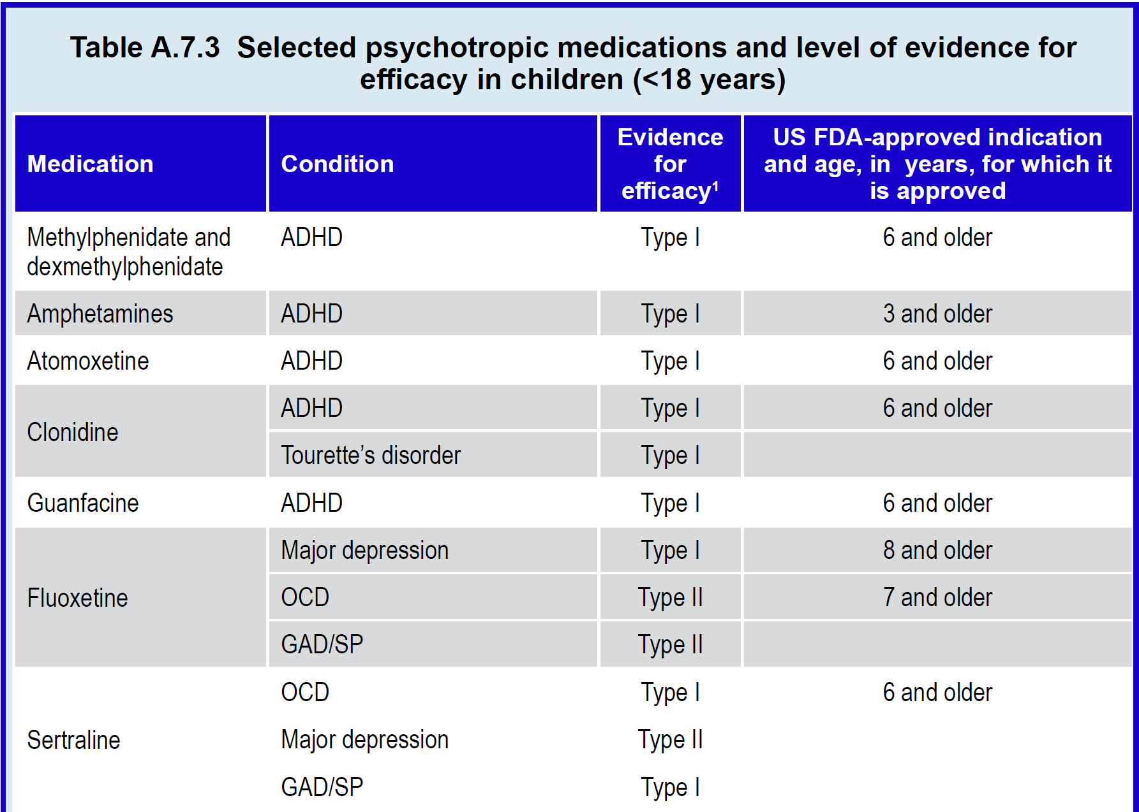
Notes:
ADHD: attention deficit hyperactivity disorder; OCD: obsessive compulsive disorder; GAD: generalized anxiety disorder; SP: social phobia. 1 Strength of the evidence: Type I: strong evidence from at least one systematic review of multiple well-designed randomized controlled trials. Type II: strong evidence from at least one properly designed randomized controlled trial. Type III: evidence from well-designed trials without randomization, single group, pre-post, cohort, time series or matched case-control studies. Type IV: evidence from well-designed non-experimental studies from more than one center or research group. Type V: opinions of respected authorities, based on clinical evidence, descriptive studies or reports of expert committees (Gray, 1997). 2 Approved for the treatment of epilepsy from infancy.
These inconsistencies are largely due to the fact that the FDA approval process was not designed to regulate clinical practice. Instead, it reflected the US legislative efforts to regulate the marketing and sale by pharmaceutical companies of new patented medications.

Slide 11
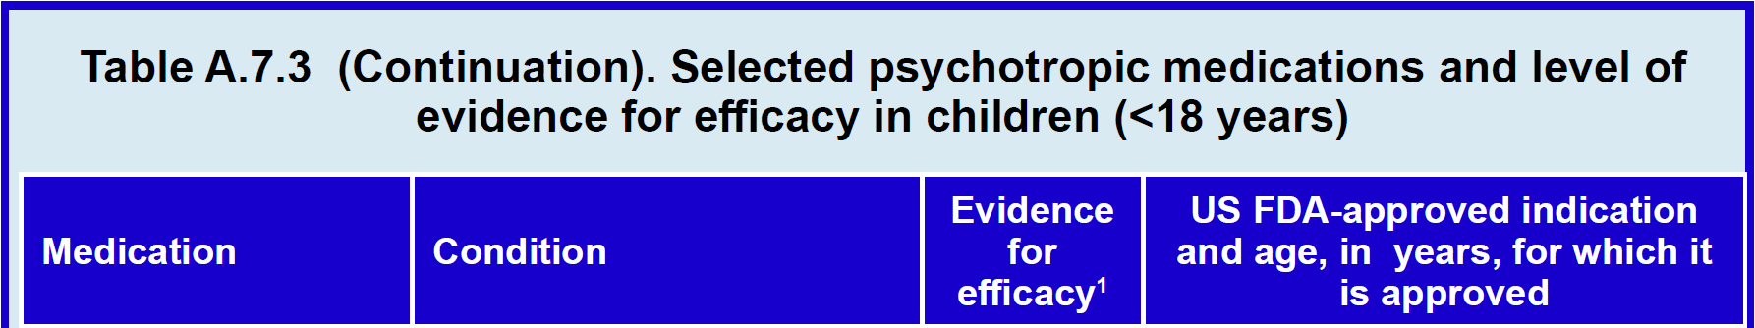
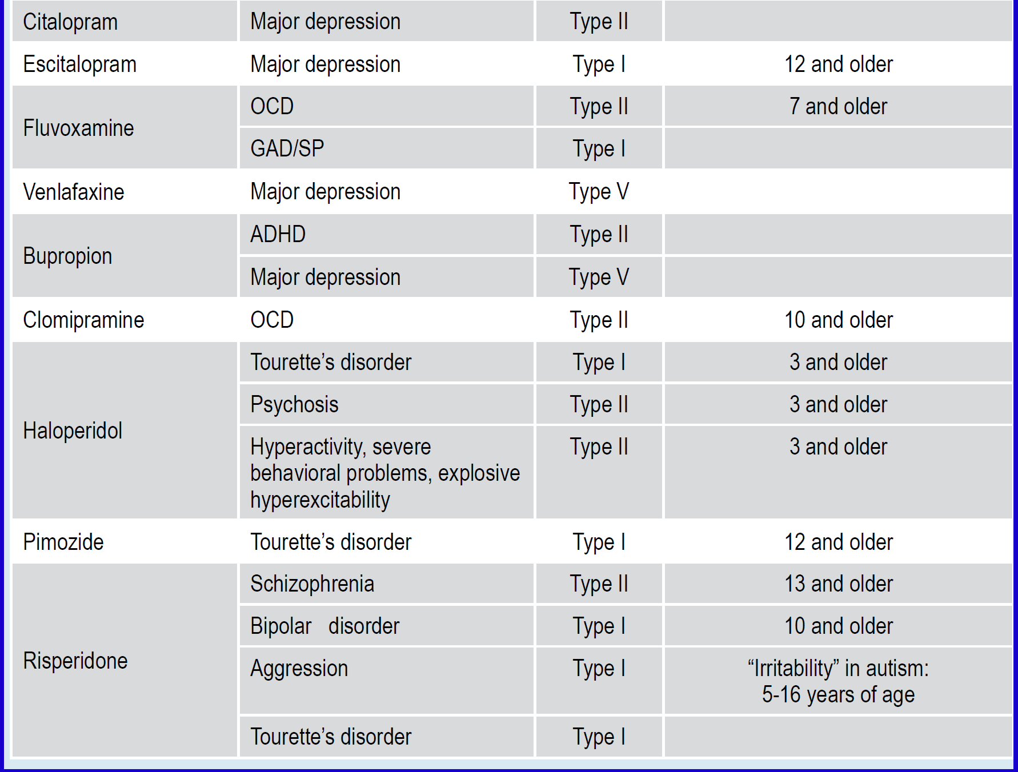
Notes:
ADHD: attention deficit hyperactivity disorder; OCD: obsessive compulsive disorder; GAD: generalized anxiety disorder; SP: social phobia. 1 Strength of the evidence: Type I: strong evidence from at least one systematic review of multiple well-designed randomized controlled trials. Type II: strong evidence from at least one properly designed randomized controlled trial. Type III: evidence from well-designed trials without randomization, single group, pre-post, cohort, time series or matched case-control studies. Type IV: evidence from well-designed non-experimental studies from more than one center or research group. Type V: opinions of respected authorities, based on clinical evidence, descriptive studies or reports of expert committees (Gray, 1997). 2 Approved for the treatment of epilepsy from infancy.
These inconsistencies are largely due to the fact that the FDA approval process was not designed to regulate clinical practice. Instead, it reflected the US legislative efforts to regulate the marketing and sale by pharmaceutical companies of new patented medications.

Slide 12
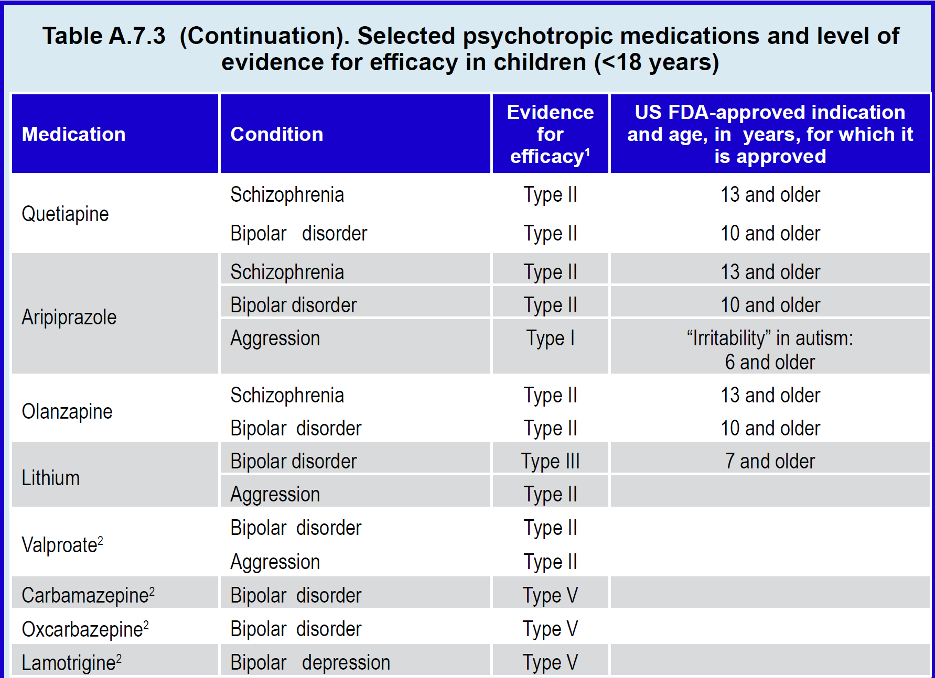
Notes:
ADHD: attention deficit hyperactivity disorder; OCD: obsessive compulsive disorder; GAD: generalized anxiety disorder; SP: social phobia. 1 Strength of the evidence: Type I: strong evidence from at least one systematic review of multiple well-designed randomized controlled trials. Type II: strong evidence from at least one properly designed randomized controlled trial. Type III: evidence from well-designed trials without randomization, single group, pre-post, cohort, time series or matched case-control studies. Type IV: evidence from well-designed non-experimental studies from more than one center or research group. Type V: opinions of respected authorities, based on clinical evidence, descriptive studies or reports of expert committees (Gray, 1997). 2 Approved for the treatment of epilepsy from infancy.

Slide 13
Principles in Using Psychotropic Medication in Children & Adolescents
When to Use Psychotropics in Youth?
Regulatory environment:
  Historical
  Economic
  Important to explain to patients, legislators
Some countries base own regulations on FDA
Notes:
FDA approval processes underwent many changes since its inception in the 1940s. Older medications, such as haloperidol, had a much less transparent and more expert-driven approval process with unclear impact of evidence. With respect to sertraline, it became “generic” (its patent duration expired) before the evidence for pediatric generalized anxiety disorder was shown. Once a medication becomes generic, applying for FDA approval (or “label”) no longer makes financial sense for the manufacturers since it carries great administrative costs with no returns for the pharmaceutical companies. As a result, the vast majority of medications used in clinical practice in both medicine and psychiatry, for both adults and children, are
used “off-label.” Use of a medicine off-label is not in itself an inappropriate practice as it is often supported by considerable empirical evidence and may be consistent with treatment guidelines.
These concepts are important to understand and explain not only to parents, but also to policy-makers. For example, officials in many countries make decisions to purchase medications based on FDA approval status—or of its counterpart, the European Medicines Agency—and not on the overall evidence of efficacy and safety.

Slide 14
Principles in Using Psychotropic Medication in Children & Adolescents
When to Use Psychotropics in Youth?
Drug availability
  economic factors
  political factors
Lack of drug availability may lead to ineffective,
harmful treatments
Notes:
Availability (status of manufacturing, trade, etc) also impacts prescribing practice. Examples range from the transient intramuscular lorazepam shortages in the US due to supply chain problems to the virtual lack of psychostimulants in Ukraine due to the complexities of introducing a controlled substance into a developing democracy. Lack of effective medications can encourage growth of alternative treatments that either have no evidence of efficacy or have evidence of causing harm.

Slide 15
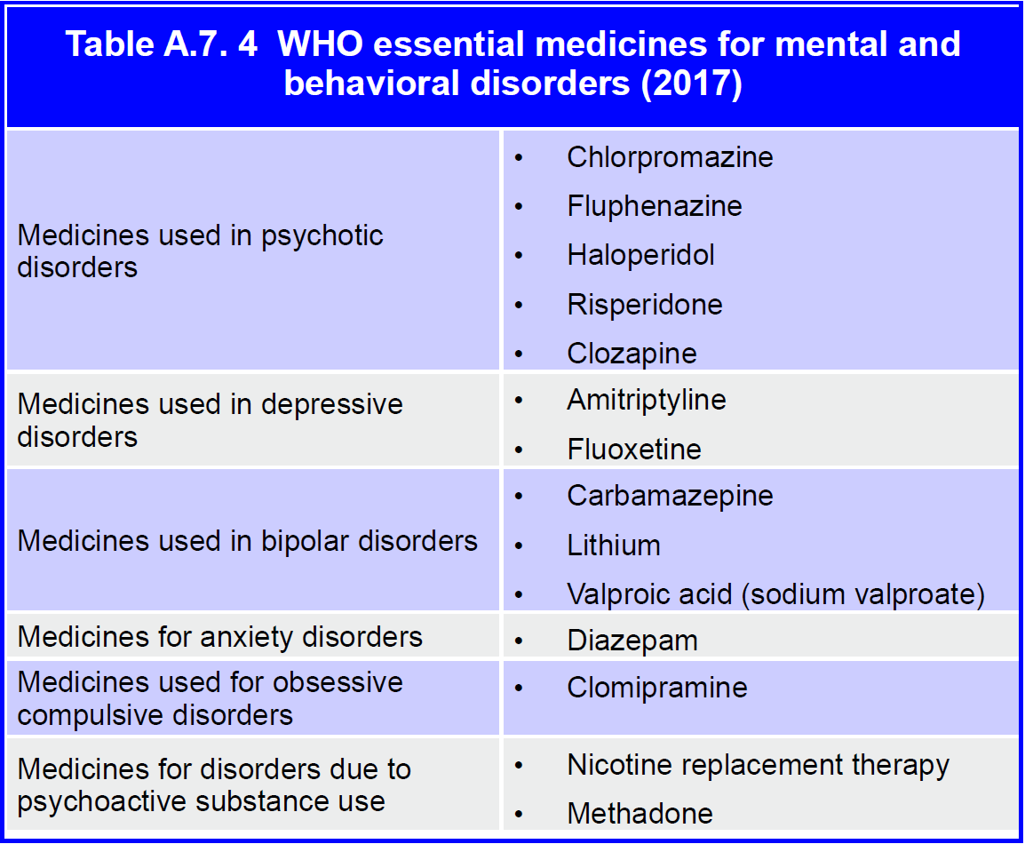
Notes:
In another example, the WHO list of essential medicines for mental and behavioral disorders includes both medications that have a high degree of efficacy and safety (for example, fluoxetine for depression, anxiety, and OCD) as well as others that lack evidence for efficacy, safety, or both. For example, diazepam is not effective for the long-term treatment of pediatric anxiety and amitriptyline is not effective for pediatric depression (see Table A.7.4).

Slide 16
Principles in Using Psychotropic Medication in Children & Adolescents
Pharmacokinetics
Over development, changes in medication
  Absorption
  Distribution
  Metabolism
  Excretion
Cannot simply extrapolate dosing for children based on adult data
Notes:
Pharmacokinetics What the body does to the drug: absorption, distribution, metabolism, and excretion.
Pharmacodynamics What the drug does to the body: the biochemical and physiological effects of drugs on the body.
Half life The time required to reduce the plasma concentration to one half of its initial value
Plasma steady state Steady state occurs when the rate of drug absorption into the blood equals the rate of elimination from it. The time to reach steadystate concentrations is dependent on the half-life of the drug.
Drug absorption, distribution, metabolism, and excretion all change during child development. As a result, extrapolation of doses and frequency of administration for children based on data obtained from adults can lead to inappropriate treatment.
As a result of the [following] differences, children have greater drug extraction during the first pass through the liver, lower bioavailability, and faster metabolism and elimination. This means that simply decreasing adult doses based on child weight may result in under-treatment

Slide 17
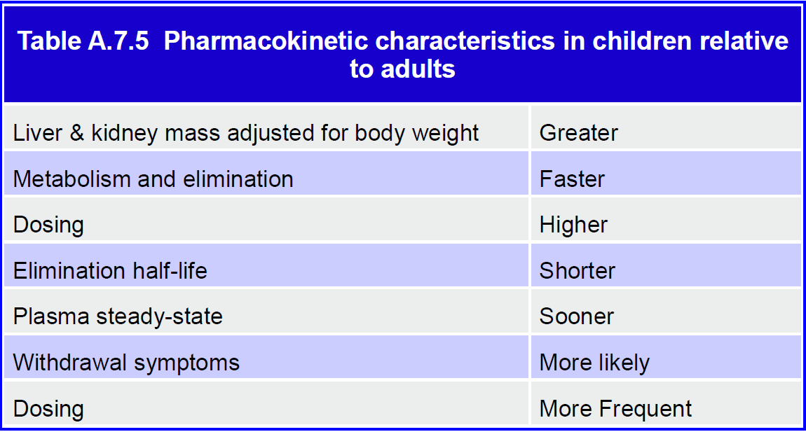
Notes:
Although children have smaller absolute body size, the relative mass of their liver and kidney tissue is greater than in adults when adjusted for body weight. Children also have relatively more body water, less fat, and less plasma albumin to which drugs can bind. Consequently, the volume of distribution of a medication tends to be greater in children than in adults.

Slide 18
Principles in Using Psychotropic Medication in Children & Adolescents
Pharmacokinetics
Phase I metabolism via hepatic CYP450 enzymes
CYP’s 3A4 and 2D6 (also 2C9 & 2C19) in youth
Inhibition or induction of CYP’s 🡪
  Increased or decreased levels
  Medication interactions
Notes:
Once absorbed, most drugs undergo biotransformation (metabolism) that turn the parent compound into more polar, and therefore easier to eliminate, byproducts (metabolites). Typically, medications undergo first an enzymatic oxidative or hydrolytic transformation (phase I), and then are conjugated with glucuronic acid, sulfate, glutathione, or acetate to form products that are eliminated via the kidneys or bile.
The phase I oxidative processes are mediated by cytochrome 450 (CYP450) microsomal enzymes, which are concentrated primarily in the liver. The CYP450 system is immature at birth, but its metabolizing capacity increases rapidly, so that by one month of age it is already about 20% of the mature level, which is achieved by three years of age. Because children have proportionally more liver parenchyma than adults, they have greater weight-adjusted metabolic capacity.
The two most important CYP450 enzymes in pediatric psychopharmacology are the CYP3A4 and the CYP2D6, which are involved in the metabolism of most psychotropics, as well as CYP2C9 and CYP2C19. For example, the 3A4 system metabolizes sertraline, citalopram, escitalopram, bupropion, mirtazapine,
aripiprazole, quetiapine, ziprasidone, lurasidone, cariprazine, alprazolam, zolpidem, and oral contraceptives. The 2D6 system metabolizes fluoxetine, trazodone, atomoxetine, tricyclic antidepressants, risperidone, olanzapine, chlorpromazine, and haloperidol.
Some psychotropics can also act as inhibitors of these enzymes so that concurrent administration of another drug that is a substrate for the enzyme results in reduced metabolism and higher medication concentration in the body. For example, 3A4 metabolized enzymes can be inhibited by fluoxetine or fluvoxamine. Concomitant administration of fluvoxamine (inhibitor of 3A4) and quetiapine or aripiprazole (metabolized by 3A4) could lead to higher levels of quetiapine or aripiprazole and prolongation of the QTc interval.
An additional complexity is that some medications, such as carbamazepine and phenobarbital, can induce CYP3A4 activity, thus potentiating its metabolizing capacity. The concomitant administration of carbamazepine and a medication metabolized by CYP3A4 can result in lower blood levels of many anticonvulsants, antipsychotics, tricyclic antidepressants, clonazepam, and oral contraceptives. In females, use of oral contraceptives can also induce CYP enzymes and thus increase lamotrigine metabolism and elimination resulting in decreased lamotrigine serum concentration.

Slide 19
Principles in Using Psychotropic Medication in Children & Adolescents
Pharmacokinetics
CYP polymorphisms: “poor metabolizers” of medications
FDA on pharmacogenomic testing:
  1) Don’t make changes based on pharmacogenomic tests unsupported by evidence
  2) Limited number of cases with some evidence for correlation between polymorphism & medication levels
Notes:
Genetic polymorphisms have been identified for CYP 450 enzymes. About 7-10% of Caucasians, 1-8% of Africans, and 1-3% of East Asians are poor CYP2D6 metabolizers of specific medications. Poor metabolizers have higher drug concentrations in plasma and other body tissues. For example, the mean elimination half-life of atomoxetine is about 5 hours in children or adults who are fast metabolizers, but 22 hours in poor metabolizers (Sauer et al, 2005). While these metabolic differences do not appear to be clinically significant for atomoxetine, some cases of toxicity have been reported with other psychotropics. For example, one case of death in a child with a 2D6 genetic deficiency was associated with unusually high plasma levels of fluoxetine (Sallee et al, 2000).
Technological advances in the 2010’s have enabled affordable testing of genetic variants potentially relevant to medication metabolism and response. With direct-to-consumer advertising of commercially available pharmacogenomic testing. Many parents ask to use such tests for decision-making about prescription. While future advances are promising, the evidence to support this practice is insufficient at this time.
On November 1, 2018, the FDA published the following warning: “The FDA has become aware of genetic tests with claims to predict how a person will respond to specific medications in cases where the relationship between genetic (DNA) variations and the medication’s effects has not been determined. For example, the FDA is aware of genetic tests that claim results can be used to help physicians identify which antidepressant medication would have increased effectiveness or side effects compared to other antidepressant medications. However, the relationship between DNA variations and the effectiveness of antidepressant medication has never been established. Patients and health care providers should not make changes to a patient’s medication regimen based on the results from genetic tests that claim to predict a patient’s response to specific medications, but are not supported by sufficient scientific or clinical evidence to support this use, because doing so may put the patient at risk for potentially serious health consequences. There are a limited number of cases for which at least some evidence does exist to support a correlation between a genetic variant and drug levels within the body, and this is described in the labeling of FDA cleared or approved genetic tests and FDA approved medications.”

Slide 20
Principles in Using Psychotropic Medication in Children & Adolescents
Pharmacokinetics
Currently, pharmacogenomic testing:
Insufficient evidence to support clinical use
Consider for those
  Not responding to adequate medication doses
  Presenting with unusual medication reactions
Notes:
While testing for genetic polymorphism is not routinely done in current child psychiatry practice, it may be considered for individual patients who do not respond to adequate doses of medication, or present with unusual reactions to medications metabolized by enzymes with genetic polymorphism (e.g., 2D6 and 2C19).

Slide 21
Principles in Using Psychotropic Medication in Children & Adolescents
Pharmacokinetics
↑clearance & ↓ half-life in children
  Plasma steady-state reached sooner
  More withdrawal symptoms on discontinuation
  Dose medications more frequently
Differences between medications
Usefulness of extended-release medications
Notes:
The main route of drug elimination is through the kidneys. Absolute clearance is usually lower in children than in adults, but weight-adjusted clearance is greater. Because of the faster elimination, the drug plasma half-life can be shorter in children than in adults (Daviss et al, 2005). A shorter elimination half-life means that plasma steady-state is reached sooner during repeated administration, and that withdrawal symptoms upon discontinuation are more likely. In these cases, a more frequent administration is needed to maintain consistent therapeutic levels and prevent withdrawal symptoms between doses. For some medications, the dose and duration of treatment can influence pharmacokinetics. After a single dose of sertraline 50 mg in adolescents, the mean half-life is about 27 hours but after repeated administration it decreased to about 15 hours (Axelson et al, 2002). Moreover, the steady-state half-life is longer (about 20 hours) after administration of higher doses (100-150 mg). Based on these data, lower doses (50 mg/day) of sertraline should be given twice a day to ensure consistent treatment and prevent withdrawal, while higher (100-150 mg) doses can be given once a day.
The pharmacokinetics of many psychotropics has been studied in children and adolescents. For escitalopram, aripiprazole, quetiapine, risperidone, and lithium, pharmacokinetics was found to be similar in youth and adults (Rao, 2007; Findling et al, 2008; Thyssen et al, 2010; Findling et al, 2010). However, considerable inter-subject variability was observed, so that major individual differences in the time-course of pharmacological effects can occur in clinical practice. For methylphenidate and amphetamines, whose short half-life results in short duration of action and in the need for multiple daily administrations, a variety of extended release formulations have been developed and require prescribers to continue to keep up their learning.

Slide 22
Principles in Using Psychotropic Medication in Children & Adolescents
Pharmacodynamics
Developmental pharmacodynamic changes influence psychotropic effects
Neurotransmitter receptor density:
  peaks in preschool years
  declines toward adult levels in late adolescence
Notes:
Most psychotropics act through neurotransmitters, such as dopamine, serotonin, glutamate, GABA, and norepinephrine, whose receptors undergo major changes during development. Receptor density peaks in the preschool years and then gradually declines toward adult levels in late adolescence (Chugani et al, 2001). The impact of these developmental changes on drug activity, efficacy, and safety are still not well understood. However, observed differences between children and adults in efficacy and safety suggest that development can significantly influence the effects of psychotropics (summarized in Table A.7.6).

Slide 23
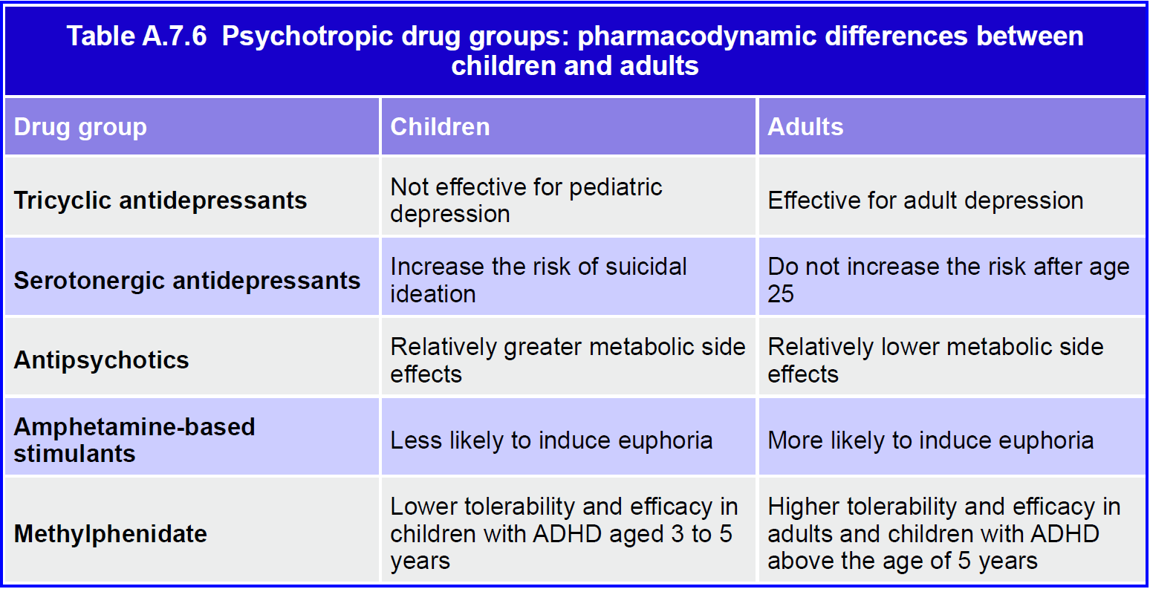
Notes:
For example, tricyclic antidepressants, though proven effective in adult depression, have no demonstrable antidepressant effect in children (Hazell et al, 1995); amphetamine-based stimulants are more likely to induce euphoria in adults than in children; antipsychotics have stronger metabolic effects in youth than in adults (Correll et al, 2009); and serotonergic antidepressants increase the risk for suicidal ideation in children, adolescents, and young adults, but not in the middle-aged or the elderly (Hammad et al, 2006; Stone et al, 2009).
The developmental stage influences the response to a number of psychotropics. This is evident also in the lower tolerability and efficacy of methylphenidate in children with ADHD between 3 and 5 years of age as compared with older children (Greenhill et al, 2006). Abnormal brain development, such as in autism, impacts medication response, as shown by the lack of benefit from SSRIs for compulsive and repetitive behaviors in autism (King et al, 2009). Thus, information derived from adolescents may not be applicable to younger children or to those who suffer from pervasive disorders of development. This underscores the need for research in specific patient populations.

Slide 24
Principles in Using Psychotropic Medication in Children & Adolescents
Efficacy
Efficacy vs. effectiveness
“Effective” for what?
  Symptoms reduction
  Symptomatic remission, recovery
  Functional recovery
  Relapse prevention
Limited data for long-term effectiveness, changes in prognoses
Notes:
The term efficacy is used to describe treatments with a demonstrated
therapeutic benefit when tested under controlled experimental conditions, usually
involving carefully selected samples of patients. Effectiveness refers to treatments
that have demonstrated benefit in non-experimental clinical settings with patients
broadly representative of the population likely to receive the treatment. Often,
however, these two terms are used interchangeably.
Double-blind trials are methodologically more persuasive than open studies
because they control for placebo effects. A number of well-designed placebo controlled
clinical trials have been conducted in pediatric psychopharmacology. The
results of these studies provide the foundation for evidence-based pharmacotherapyin child psychiatry, summarized in evolving practice guidelines and treatment
algorithms (e.g., National Institute for Health and Clinical Excellence, 2005 and
2008; Pliszka et al, 2007; Birmaher & Brent, 2007; McClellan et al, 2007). One
critical element in evaluating the efficacy of a treatment is the chosen outcome. A
treatment can be effective at:
• Decreasing symptoms (improvement)
• Eliminating the key manifestations of the disorder (remission, in the
short-term, and recovery, if sustained over time)
• Restoring functioning (functional recovery)
• Decreasing the risk for relapse or recurrence of the symptoms.
functional manifestations
of mental dysfunction. In the absence of direct biological markers of disease and
treatment effects, clinicians must rely on symptoms and indirect signs to gauge
treatment response. Rating scales have been developed for all of the conditions in
child mental health (see Chapter A.5).
These scales can be divided into those that are completed by the clinician
based on both direct observation and informants (clinician-rated), and those
that are completed directly by informants (self, parent, teacher). A distinctive
characteristic of pediatric psychopharmacology is that, in addition to the child,
clinical information is usually derived from parents and teachers. Since clinicians
must collect and integrate information from multiple sources, assessing and
monitoring medication effects is more complex and time consuming in children.
When comparing treatments, it is useful to quantify the size of the treatment
effect (see also Chapter A.6). Using data from controlled trials, the magnitude of
the treatment effect relative to a control can be expressed in standard deviation
units. The most commonly used ways of computing effect size are Cohen’s d or
Hedges’ g—the difference in the means of the outcome measure between the study
groups (active treatment and control) divided by the pooled standard deviation
(Rosenthal et al, 2000).
Compared with placebo, stimulants have a large effect size (0.8 and above),
while non-stimulants (clonidine, guanfacine, atomoxetine) have small to moderate
effect sizes (0.25-0.5) in decreasing symptoms of ADHD (Greenhill et al, 2001).
In trials that have detected a separation between SSRI and placebo, the SSRIs had
a moderate effect size (0.5-0.7) in the treatment of major depression (TADS Team,
2004) or obsessive-compulsive disorder (Pediatric OCD Treatment Study, 2004).
However, meta-analyses of all available clinical trials in pediatric depression (both
positive and negative) indicated that the effect size of antidepressant medication vs. placebo was small (0.25, 95% C.I. 0.16-0.34) (Bridge at al, 2007).
Effect size can also be used to quantify pre-post treatment difference within
the same group of patients, rather than the difference between treatment and
control groups. However, due to the lack of a parallel control group, the effect due
to the treatment cannot be separated from the effect of the mere passage of time
as well as of patient’s expectations, classical conditioning, and other non-specific
components of the placebo effect. For this reason, a within-group pre-post effect
size is expected to over-estimate the effect of treatment and reflect the combined
effects of placebo and specific treatment.
It is also useful to quantify the therapeutic benefit using the number needed
to treat (NNT)—the number of patients who need to receive the treatment in
order to add one more improved patient to those who improve in the control
condition. NNT is a type of effect size and is the inverse of the absolute risk
reduction (ARR). ARR is the difference between outcome incidence in the treated
and control groups. Thus, in the Treatment for Adolescents with Depression Study
(TADS), 61% of patients treated with fluoxetine improved at the at 12 weeks,
compared with 35% of the placebo patients (TADS Team, 2004). Based on the
absolute difference of 26% (ie, 61- 35) observed, the NNT for fluoxetine is 4 (i.e.,
100/26 = 3.9), which indicates that one needs to treat on average 4 patients to
improve one patient more than the placebo condition.
The smaller the NNT the greater the efficacy of the treatment. The NNTs of
psychotropic medications, though variable among studies, are often quite favorable
when compared with other non-psychiatric drugs used in pediatrics. For example,
NNT for antibiotics for pain reduction in case of acute otitis media in children
is 16 (Sanders et al, 2004). Most of what is currently known about the effects
of treatments is limited to the short- (i.e., weeks) and intermediate-term (i.e.,
months) (see also Chapter A.6).
Relatively few studies have addressed the long-term effectiveness of
pharmacotherapy in childhood mental disorders (MTA Cooperative Group, 2004;
TADS Team, 2007; Vitiello et al, 2011; Findling et al. 2010). More research is
needed to determine whether reduction of symptoms leads to better prognosis. For
example, it would be important to know if improved ADHD symptoms translate
into a lower risk for motor vehicle accidents, higher academic and occupational
achievement, and better social adjustment, in the same way that the control of
hypertension has been found to decrease cardiovascular morbidity and mortality.
Unfortunately, we have yet to obtain data to answer these questions. Studying
the long-term effects of treatments poses many challenges from practical and
methodological perspectives. Long-term randomized controlled trials are difficult
to implement, while observational studies are insufficient to prove causality.

Slide 25
Principles in Using Psychotropic Medication in Children & Adolescents
Efficacy
Measure & track symptoms, functioning
Rating scales
  Clinician-rated
  Patient-rated
  Collateral informants
Effect sizes
  Between groups vs. within groups
  Number needed to treat (NNT)
Notes:
The term efficacy is used to describe treatments with a demonstrated
therapeutic benefit when tested under controlled experimental conditions, usually
involving carefully selected samples of patients. Effectiveness refers to treatments
that have demonstrated benefit in non-experimental clinical settings with patients
broadly representative of the population likely to receive the treatment. Often,
however, these two terms are used interchangeably.
Double-blind trials are methodologically more persuasive than open studies
because they control for placebo effects. A number of well-designed placebo controlled
clinical trials have been conducted in pediatric psychopharmacology. The
results of these studies provide the foundation for evidence-based pharmacotherapyin child psychiatry, summarized in evolving practice guidelines and treatment
algorithms (e.g., National Institute for Health and Clinical Excellence, 2005 and
2008; Pliszka et al, 2007; Birmaher & Brent, 2007; McClellan et al, 2007). One
critical element in evaluating the efficacy of a treatment is the chosen outcome. A
treatment can be effective at:
• Decreasing symptoms (improvement)
• Eliminating the key manifestations of the disorder (remission, in the
short-term, and recovery, if sustained over time)
• Restoring functioning (functional recovery)
• Decreasing the risk for relapse or recurrence of the symptoms.
functional manifestations
of mental dysfunction. In the absence of direct biological markers of disease and
treatment effects, clinicians must rely on symptoms and indirect signs to gauge
treatment response. Rating scales have been developed for all of the conditions in
child mental health (see Chapter A.5).
These scales can be divided into those that are completed by the clinician
based on both direct observation and informants (clinician-rated), and those
that are completed directly by informants (self, parent, teacher). A distinctive
characteristic of pediatric psychopharmacology is that, in addition to the child,
clinical information is usually derived from parents and teachers. Since clinicians
must collect and integrate information from multiple sources, assessing and
monitoring medication effects is more complex and time consuming in children.
When comparing treatments, it is useful to quantify the size of the treatment
effect (see also Chapter A.6). Using data from controlled trials, the magnitude of
the treatment effect relative to a control can be expressed in standard deviation
units. The most commonly used ways of computing effect size are Cohen’s d or
Hedges’ g—the difference in the means of the outcome measure between the study
groups (active treatment and control) divided by the pooled standard deviation
(Rosenthal et al, 2000).
Compared with placebo, stimulants have a large effect size (0.8 and above),
while non-stimulants (clonidine, guanfacine, atomoxetine) have small to moderate
effect sizes (0.25-0.5) in decreasing symptoms of ADHD (Greenhill et al, 2001).
In trials that have detected a separation between SSRI and placebo, the SSRIs had
a moderate effect size (0.5-0.7) in the treatment of major depression (TADS Team,
2004) or obsessive-compulsive disorder (Pediatric OCD Treatment Study, 2004).
However, meta-analyses of all available clinical trials in pediatric depression (both
positive and negative) indicated that the effect size of antidepressant medication vs. placebo was small (0.25, 95% C.I. 0.16-0.34) (Bridge at al, 2007).
Effect size can also be used to quantify pre-post treatment difference within
the same group of patients, rather than the difference between treatment and
control groups. However, due to the lack of a parallel control group, the effect due
to the treatment cannot be separated from the effect of the mere passage of time
as well as of patient’s expectations, classical conditioning, and other non-specific
components of the placebo effect. For this reason, a within-group pre-post effect
size is expected to over-estimate the effect of treatment and reflect the combined
effects of placebo and specific treatment.
It is also useful to quantify the therapeutic benefit using the number needed
to treat (NNT)—the number of patients who need to receive the treatment in
order to add one more improved patient to those who improve in the control
condition. NNT is a type of effect size and is the inverse of the absolute risk
reduction (ARR). ARR is the difference between outcome incidence in the treated
and control groups. Thus, in the Treatment for Adolescents with Depression Study
(TADS), 61% of patients treated with fluoxetine improved at the at 12 weeks,
compared with 35% of the placebo patients (TADS Team, 2004). Based on the
absolute difference of 26% (ie, 61- 35) observed, the NNT for fluoxetine is 4 (i.e.,
100/26 = 3.9), which indicates that one needs to treat on average 4 patients to
improve one patient more than the placebo condition.
The smaller the NNT the greater the efficacy of the treatment. The NNTs of
psychotropic medications, though variable among studies, are often quite favorable
when compared with other non-psychiatric drugs used in pediatrics. For example,
NNT for antibiotics for pain reduction in case of acute otitis media in children
is 16 (Sanders et al, 2004). Most of what is currently known about the effects
of treatments is limited to the short- (i.e., weeks) and intermediate-term (i.e.,
months) (see also Chapter A.6).
Relatively few studies have addressed the long-term effectiveness of
pharmacotherapy in childhood mental disorders (MTA Cooperative Group, 2004;
TADS Team, 2007; Vitiello et al, 2011; Findling et al. 2010). More research is
needed to determine whether reduction of symptoms leads to better prognosis. For
example, it would be important to know if improved ADHD symptoms translate
into a lower risk for motor vehicle accidents, higher academic and occupational
achievement, and better social adjustment, in the same way that the control of
hypertension has been found to decrease cardiovascular morbidity and mortality.
Unfortunately, we have yet to obtain data to answer these questions. Studying
the long-term effects of treatments poses many challenges from practical and
methodological perspectives. Long-term randomized controlled trials are difficult
to implement, while observational studies are insufficient to prove causality.

Slide 26
Principles in Using Psychotropic Medication in Children & Adolescents
Safety
Do psychotropics interfere with normal development & lead to adverse long-term changes?
Limited data
Caution especially in young children or long-term treatment
Notes:
Ensuring safety is especially important when treating children.
Pharmacological treatment during human development may result in toxicities that
are not seen in adults. A general concern is that agents acting on neurotransmitter
systems during rapid development may interfere with normal processes and result
in unwanted long-lasting changes.
Studies in developing animals have been informative. For example,
fluoxetine given to newborn mice transiently inhibits the serotonin transporter
during early development; this is associated with behavioral abnormalities such
as reduced exploratory behavior and slower adaptation to novel environments or
stimuli in adult age (Ansorge et al, 2004). Even though the relevance of these data
to children is unclear, a high level of concern is warranted when treating children
with medication, especially when the treatment is at an early age (under age 6) or
long-term.
Medications may cause a variety of adverse effects (Vitiello et al, 2003a).
Some, such as dystonias with anti-dopaminergic agents or appetite suppression
with stimulants, become evident after hours to days, while others, such as tardive
dyskinesia or metabolic syndrome with antipsychotics, emerge slowly with
treatment over months to years. Some adverse effects are related to elevated plasma
concentrations, such as lithium-induced tremor, while others emerge after drug
discontinuation, such as antipsychotic withdrawal dyskinesias. Some adverse
effects can be anticipated based on the mechanism of action of the medication
(e.g., sedation with antipsychotics). Other adverse effects are paradoxical, such as
increased suicidality with antidepressant treatment.
Assessment of safety largely relies on monitoring and reporting by
responsible adults. Identification of adverse effects is contingent on a thorough
evaluation by a clinician. In recent years, more information has become available
on the long-term safety of several psychotropics in children. For example, it is
now recognized that stimulants, such methylphenidate and amphetamines, can
cause a dose-related delay in physical growth, in both weight and height. After 14
months of treatment, children treated with stimulant medication for ADHD grew
on average 1.4 cm less in height than peers treated with behavior therapy (MTA
Cooperative Group, 2004). A growth deficit was found to persist in future years
in children who were medicated for three years (Swanson et al, 2007). The effect
on height appears to be more evident in children who started stimulant treatment
before the onset of puberty (Díez-Suárez et al, 2017). The mechanism underlying
the interference of stimulants with skeletal growth is still unclear.
Because stimulants have adrenergic activity, concern has been raised about
unwanted cardiovascular outcomes, including sudden death (Gould et al, 2009).
However, analyses of large patient population data have not identified an association
between therapeutic use of stimulants and increased cardiac death or cardiac events
leading to emergency department visits (Cooper et al, 2011; Schelleman et al,
2011). Moreover, a prospective study of children treated for up to 10 years did not
find an increased risk for hypertension, although stimulants have a small detectable
acute effect on heart rate and blood pressure (Vitiello et al, 2012).
As stimulants have abuse potential, concerns have also been raised about the
possibility that treatment in childhood may sensitize the brain and thus increase the
risk of substance abuse in adulthood (Vitiello, 2001). The feasibility of mounting
randomized, well-controlled studies to address this issue is questionable, and
researchers have relied on naturalistically treated samples. Available prospective
studies have not found increased risk of adult substance abuse associated with
childhood treatment with stimulants (Volkow & Swanson, 2008; Biederman et al,
2008; Wilens et al, 2008).
Differences in tolerability have been observed across age and type of
development. Preschoolers with ADHD show lower tolerability to methylphenidate
than older children (Greenhill et al, 2006; Wigal et al, 2006). Likewise, children
with autism spectrum disorder and comorbid ADHD symptoms were more
sensitive to the adverse effects of methylphenidate as indicated by an 18%
treatment discontinuation due to adverse events (most commonly irritability) as
compared with less than 5% in children with ADHD without ASD (Research
Units on Pediatric Psychopharmacology Autism Network, 2005b).
Youth exposed to second generation antipsychotics are more prone to
gaining weight than adults (Correll et al, 2009). Antidepressants have been found
to increase the risk for suicide-related events, such as thoughts about suicide
and suicidal behaviors, although an effect on completed suicide has not been
determined (Hammad et al, 2006). In a meta-analysis including 13 placebocontrolled
trials in children and adolescents with major depression, the suicidality
rate (thoughts, attempts, and self-harm) was 3% on antidepressant and 2% on
placebo (Bridge et al, 2007). A similar meta-analysis in adults documented an
interaction between age and risk of suicidality with antidepressant use: risk was
increased for individuals under age 25, not affected between 25 and 64 years,
and actually decreased in patients over 64 (Stone et al, 2009). These data provide
an example of interaction between development and pharmacological effect, even
though the biological underpinning of this interaction remains unknown.
The mechanism through which antidepressants may trigger suicidality
remains a matter of speculation. It is possible that some youth become abnormally
activated by the antidepressant, with akathisia, agitation, anxiety, insomnia, and
impulsivity. However, this explanation, based on anecdotal reports, remains a
theory as systematic analyses of treated patients have not confirmed it (Vitiello
et al, 2009b). A related explanation includes unmasking or triggering a bipolar
disorder, but this also lacks experimental evidence.
Safety is a relative concept and the risks of pharmacotherapy must be weighed
against the risks of an untreated illness. Decisions about prescribing medication
must also take into account the availability of effective nonpharmacological
interventions. Though generally found less effective at decreasing acute and severe
symptoms in most conditions, psychotherapy should always be considered in lieu
of, or in combination with medication. Psychotherapy, used either sequentially
(i.e., start first with psychotherapy, then add medication if insufficient) or in
combination (i.e., start both psychotherapy and medication concurrently), may be
able to shorten time to recovery and reduce the total dose of medication needed to
control symptoms (TADS Team 2007; MTA Cooperative Group, 1999).

Slide 27
Principles in Using Psychotropic Medication in Children & Adolescents
Safety
Adverse effects
  Acute vs. chronic
  Supratherapeutic vs. discontinuation
  Anticipated vs. paradoxical
Monitoring for adverse effects
  Differences in tolerability across populations
  Overall, youth more vulnerable
Weigh risks vs. risks of untreated illness
Notes:
Ensuring safety is especially important when treating children.
Pharmacological treatment during human development may result in toxicities that
are not seen in adults. A general concern is that agents acting on neurotransmitter
systems during rapid development may interfere with normal processes and result
in unwanted long-lasting changes.
Studies in developing animals have been informative. For example,
fluoxetine given to newborn mice transiently inhibits the serotonin transporter
during early development; this is associated with behavioral abnormalities such
as reduced exploratory behavior and slower adaptation to novel environments or
stimuli in adult age (Ansorge et al, 2004). Even though the relevance of these data
to children is unclear, a high level of concern is warranted when treating children
with medication, especially when the treatment is at an early age (under age 6) or
long-term.
Medications may cause a variety of adverse effects (Vitiello et al, 2003a).
Some, such as dystonias with anti-dopaminergic agents or appetite suppression
with stimulants, become evident after hours to days, while others, such as tardive
dyskinesia or metabolic syndrome with antipsychotics, emerge slowly with
treatment over months to years. Some adverse effects are related to elevated plasma
concentrations, such as lithium-induced tremor, while others emerge after drug
discontinuation, such as antipsychotic withdrawal dyskinesias. Some adverse
effects can be anticipated based on the mechanism of action of the medication
(e.g., sedation with antipsychotics). Other adverse effects are paradoxical, such as
increased suicidality with antidepressant treatment.
Assessment of safety largely relies on monitoring and reporting by
responsible adults. Identification of adverse effects is contingent on a thorough
evaluation by a clinician. In recent years, more information has become available
on the long-term safety of several psychotropics in children. For example, it is
now recognized that stimulants, such methylphenidate and amphetamines, can
cause a dose-related delay in physical growth, in both weight and height. After 14
months of treatment, children treated with stimulant medication for ADHD grew
on average 1.4 cm less in height than peers treated with behavior therapy (MTA
Cooperative Group, 2004). A growth deficit was found to persist in future years
in children who were medicated for three years (Swanson et al, 2007). The effect
on height appears to be more evident in children who started stimulant treatment
before the onset of puberty (Díez-Suárez et al, 2017). The mechanism underlying
the interference of stimulants with skeletal growth is still unclear.
Because stimulants have adrenergic activity, concern has been raised about
unwanted cardiovascular outcomes, including sudden death (Gould et al, 2009).
However, analyses of large patient population data have not identified an association
between therapeutic use of stimulants and increased cardiac death or cardiac events
leading to emergency department visits (Cooper et al, 2011; Schelleman et al,
2011). Moreover, a prospective study of children treated for up to 10 years did not
find an increased risk for hypertension, although stimulants have a small detectable
acute effect on heart rate and blood pressure (Vitiello et al, 2012).
As stimulants have abuse potential, concerns have also been raised about the
possibility that treatment in childhood may sensitize the brain and thus increase the
risk of substance abuse in adulthood (Vitiello, 2001). The feasibility of mounting
randomized, well-controlled studies to address this issue is questionable, and
researchers have relied on naturalistically treated samples. Available prospective
studies have not found increased risk of adult substance abuse associated with
childhood treatment with stimulants (Volkow & Swanson, 2008; Biederman et al,
2008; Wilens et al, 2008).
Differences in tolerability have been observed across age and type of
development. Preschoolers with ADHD show lower tolerability to methylphenidate
than older children (Greenhill et al, 2006; Wigal et al, 2006). Likewise, children
with autism spectrum disorder and comorbid ADHD symptoms were more
sensitive to the adverse effects of methylphenidate as indicated by an 18%
treatment discontinuation due to adverse events (most commonly irritability) as
compared with less than 5% in children with ADHD without ASD (Research
Units on Pediatric Psychopharmacology Autism Network, 2005b).
Youth exposed to second generation antipsychotics are more prone to
gaining weight than adults (Correll et al, 2009). Antidepressants have been found
to increase the risk for suicide-related events, such as thoughts about suicide
and suicidal behaviors, although an effect on completed suicide has not been
determined (Hammad et al, 2006). In a meta-analysis including 13 placebocontrolled
trials in children and adolescents with major depression, the suicidality
rate (thoughts, attempts, and self-harm) was 3% on antidepressant and 2% on
placebo (Bridge et al, 2007). A similar meta-analysis in adults documented an
interaction between age and risk of suicidality with antidepressant use: risk was
increased for individuals under age 25, not affected between 25 and 64 years,
and actually decreased in patients over 64 (Stone et al, 2009). These data provide
an example of interaction between development and pharmacological effect, even
though the biological underpinning of this interaction remains unknown.
The mechanism through which antidepressants may trigger suicidality
remains a matter of speculation. It is possible that some youth become abnormally
activated by the antidepressant, with akathisia, agitation, anxiety, insomnia, and
impulsivity. However, this explanation, based on anecdotal reports, remains a
theory as systematic analyses of treated patients have not confirmed it (Vitiello
et al, 2009b). A related explanation includes unmasking or triggering a bipolar
disorder, but this also lacks experimental evidence.
Safety is a relative concept and the risks of pharmacotherapy must be weighed
against the risks of an untreated illness. Decisions about prescribing medication
must also take into account the availability of effective nonpharmacological
interventions. Though generally found less effective at decreasing acute and severe
symptoms in most conditions, psychotherapy should always be considered in lieu
of, or in combination with medication. Psychotherapy, used either sequentially
(i.e., start first with psychotherapy, then add medication if insufficient) or in
combination (i.e., start both psychotherapy and medication concurrently), may be
able to shorten time to recovery and reduce the total dose of medication needed to
control symptoms (TADS Team 2007; MTA Cooperative Group, 1999).

Slide 28
Principles in Using Psychotropic Medication in Children & Adolescents
Ethical and Regulatory Considerations
Educate youths about their conditions, treatments
Informed consent from guardian
Assent from child > 7 yrs
Ethical research:
  Scientifically sound
  “Direct benefit” and “minimal risk”
  Risk/benefit ratio
  Placebo
Notes:
Children should be able to learn about their condition and the possible
treatments to the extent allowed by their cognitive and emotional development.
However, before the age of 14, 16, or 18 years (the legal age for consent to treatment
varies according to country; see Chapter A.1), they cannot give legal permission
for treatment, which must come from their guardians. It is the responsibility of the
prescribing clinician to inform the parents of the expected benefits and risks of the
medication. Parents are also instrumental for implementing pharmacotherapy by
ensuring appropriate administration of prescribed medication and for reporting
treatment-emergent adverse effects.
Research in children
Progress in pediatric psychopharmacology depends on the participation of
children in research (see also Chapter J.7). In the US and some other countries,
research involving children is subject to special regulations in addition to those
for adults participating in research (United States Department of Health and
Human Services; Food and Drug Administration, 2001). Only scientifically sound
research that utilizes valid methodology and is posited to add new knowledge about
important health issues may be ethically acceptable (Vitiello, 2003b).
Pediatric research can be divided into two broad categories based on whether
it does or does not have the prospect of direct benefit to the individual participant.
“Prospect of direct benefit” means that each participant has the potential of deriving a health benefit from participation. General acquisition of knowledge
relevant to the child’s condition does not satisfy the requirement of direct benefit.
To be ethically acceptable, research with prospect of direct benefit must also have
a favorable balance between anticipated benefits and foreseeable harms. Usually,
studies of treatment efficacy have potential for direct benefit to the research
participants. In these cases, the main criterion for determining ethical acceptability
is the risk/benefit ratio. The inclusion of a placebo arm in randomized clinical trial
is usually considered acceptable. Placebo does not necessarily mean absence of
treatment and has been associated with substantial improvement, especially in the
case of mood and anxiety disorders.
Pharmacological research that does not offer a prospect of direct benefit
includes pharmacokinetic and pharmacodynamic studies. In order to be acceptable,
such research must have potential for generating essential knowledge relevant to
the disorder or condition of the participant. If the information is not relevant to
the child’s disorder or condition (e.g., a pharmacokinetic study in healthy children
at no increased risk for the condition being targeted by the treatment), the research
can be conducted only if it entails no more than minimal risk.
Minimal risk is defined as “risk for harm not greater than ordinarily
encountered in daily life, or during routine physical or psychological examinations
or tests” (section 46.102(i) in U.S. Department of Health and Human Subjects
1991). The prevailing interpretation is that the daily life exams and tests of a normal
child is to be used as reference, but a precise quantification of risk in ordinary daily
life is not easy and remains a matter of discussion.
If the study aims to acquire information relevant to the child’s condition
(e.g., pharmacokinetics of a medication for ADHD being studied in children with
ADHD), the research risk cannot be greater than a minor increase of minimal risk.
The process of informing parents and children about the aims, procedures,
potential risks and benefits of research participation, existence of alternative
treatments, and the rights of research participants is critical for obtaining their
informed consent and assent. In general, children age 7 and above are able to provide
assent, which is often documented in writing within an appropriate “research
participation assent form.” By age 16, adolescents have a level of understanding
similar to that of their parents (Vitiello et al, 2007).

Slide 29

Principles in Using Psychotropic Medication in Children & Adolescents
YouTube Video: Talking About Medications
https://youtu.be/sd1goY_NRsk
Notes:
“Kaitlin Bell Barnett interviewed many young adults who took psychotropic medication as children and teenagers for her book Dosed: The Medication Generation Grows Up. In the book she explores their experiences with medication, and the effect it had on their identities.
In this video Barnett, a Brooklyn-based journalist and writer, offers advice to parents gleaned from what she learned in those interviews, and from her own experience as a teenager on antidepressants. She focuses on the importance of explaining to children, in an age-appropriate way, why they are taking medication and how it can help them. And listening well can be as valuable as talking openly: close attention to their thoughts and feelings about the medication not only gives you valuable information, it helps give them some sense of ownership of the experience...” (from https://childmind.org/article/talking-to-kids-about-medication/)

Slide 30
Principles in Using Psychotropic Medication in Children & Adolescents
Pediatric Psychopharm in Clinical Practice
Evidence-based pharmacotherapy:
  Developmental psychopathology
  Pharmacology
  Current local regulatory policies
  Bioethics
  Psychosocial interventions
Adapt guidelines informed by group-level research to individual treatment
Notes:
Practicing evidence-based pharmacotherapy in child and adolescent psychiatry requires the integration of knowledge and expertise at different levels, including developmental psychopathology, pharmacology, current regulatory policies for prescribing—that vary from country to country—bioethics relevant to vulnerable patients, and at least enough familiarity with psychosocial interventions to allow an informed and balanced decision-making process. Research typically provides information at the group level. This is certainly useful for preparing general practice guidelines and algorithms, but the information needs to be interpreted and adapted to the needs of the individual child, a process that relies on the skills of the clinician.

Slide 31
Principles in Using Psychotropic Medication in Children & Adolescents
Pediatric Psychopharm in Clinical Practice
Acute phase of treatment:
If, and at which dose, a medication is effective & tolerated
Frequent monitoring
Response vs. non-response (change treatment)
Notes:
The first few weeks of treatment are devoted to determining if and at which dose the medication is effective and tolerated. During this phase (acute treatment), frequent monitoring is needed in order to titrate the dose based on clinical response (Table A.7.7). Depending on the type of medication, clinical response can take just a few days to emerge or may require several weeks. As previously discussed, the use of standardized rating scales is especially useful in this phase. Even for the most effective medications, such as stimulants in ADHD, the chance that an individual patient will derive a clinically significant benefit is about 70%, thus leaving about a third of patients without sufficient improvement. This means that the clinician must be ready to recognize non-response and change the treatment plan accordingly. In many cases, a second-step medication should be considered. For example, if a child with ADHD has not improved from methylphenidate, an amphetamine product may be effective. Likewise, depressed adolescents who have not improved on one antidepressant have about a 50% chance to respond to another antidepressant (Brent et al, 2008).

Slide 32
Principles in Using Psychotropic Medication in Children & Adolescents
Pediatric Psychopharm in Clinical Practice
Continuation phase of treatment:
  Optimizing therapy
  Symptomatic remission
  Functional recovery
Maintenance phase of treatment:
  Preventing relapse
  Duration of treatment: consider natural history, patient’s history of illness
Notes:
Once a medication has been found to be of benefit and well tolerated by the patient, the treatment continues with the goals of optimizing it, achieving remission and functional recovery (continuation phase). After achieving recovery, the treatment typically continues with the purpose of maintaining improvement and preventing relapse or recurrence (maintenance phase). The duration of maintenance treatment depends on the condition being treated and the history of illness of the individual patient. For example, ADHD is a chronic condition, so that long-term treatment is usually indicated. However, the phenotypic manifestations of ADHD may change with time, as hyperactivity tends to decrease in adolescence or young adulthood, so that periodic reassessment of the need for pharmacological treatment is advisable on an annual basis or so.
In the case of MDD, it is recommended that effective treatment be continued for 6 to12 months after reaching remission, after which a gradual tapering off of the medication over a 2-3 months period can be considered (Hughes et al, 2007). For patients who had had recurrent episodes of depression, a proportionately prolonged treatment is usually advisable.

Slide 33
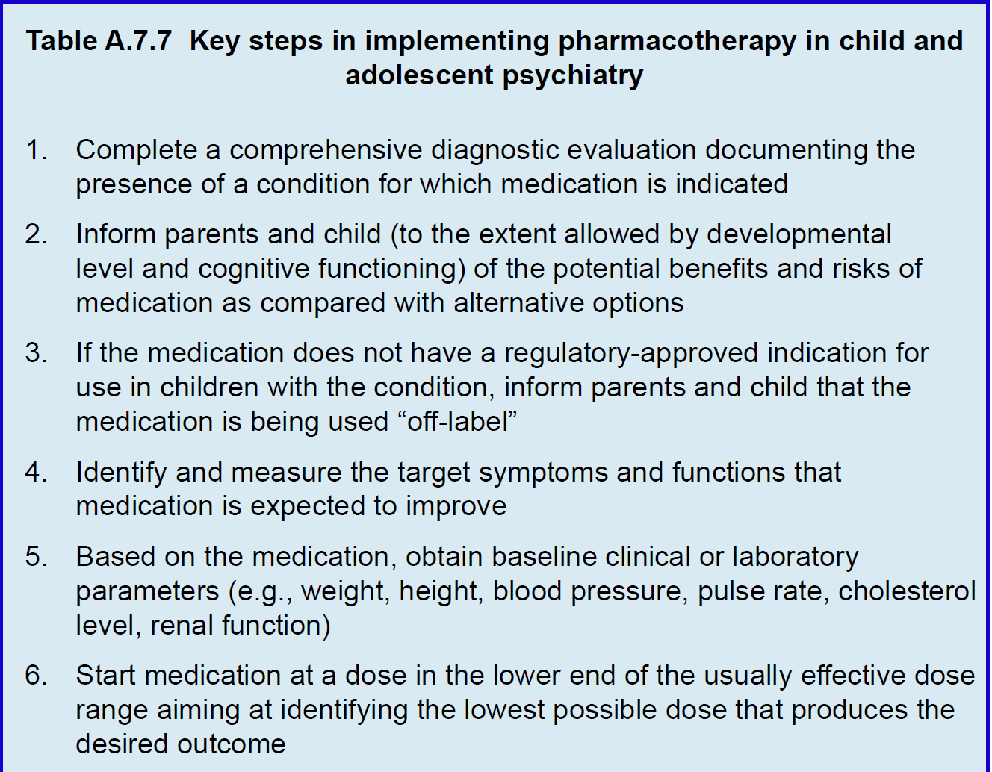

Slide 34
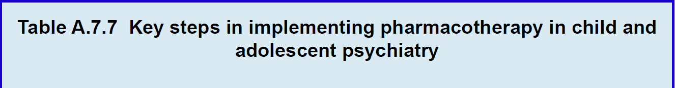
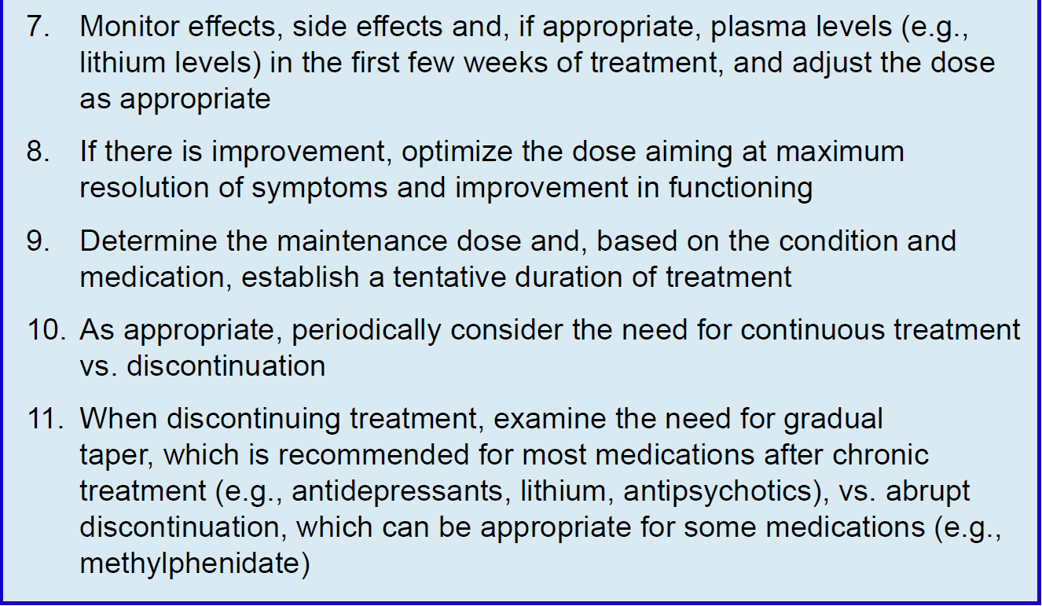

Slide 35
Principles in Using Psychotropic Medication in Children & Adolescents
Challenges
High-income countries:
Prescriber shortages
Excessive reliance on medications
Polypharmacy & over-prescribing
Problematic pharmacogenomic testing
Sham treatments
Low- & middle-income:
(Extreme) prescriber shortages
Medication shortages
Unethical research
Sham treatments
Notes:
While insufficient access to competent prescribers and integrated systems of care is virtually universal, countries across the globe also face great region-specific challenges. In high income countries, such as the US, polypharmacy practice has become increasingly prevalent even though evidence for its efficacy and safety is lagging. Shortage of prescribers and excessive reliance on medications in the absence of effective psychosocial interventions exacerbate this problem. There is a concern that insufficient training and team integration of “mid-level physician extenders” may lead to “over-prescribing.” Responsible approaches to deprescribing are still in early stages of development.
Another emerging challenge in high income countries has to do with the growing commercial use of pharmacogenomic testing before it has gathered sufficient scientific evidence.

Slide 36
Principles in Using Psychotropic Medication in Children & Adolescents
Conclusions
Medications have an important role
More research needed on long-term effects
Rapidly developing field: clinicians need to stay informed
Notes:
When properly used, medications have an important role in the treatment of youth with severe mental disorders. There is evidence that some medications can help not only manage symptoms, but also improve functioning and hasten recovery. A thorough and complete diagnostic evaluation before considering medication is critical, as well as the need for consistent monitoring during treatment. The therapeutic value of a number of psychotropics is now well documented in both the short and intermediate-term, while more research is needed to better understand the long-term impact of pharmacotherapy. Pediatric psychopharmacology continues to develop rapidly, and clinicians must remain informed as new data become available.

Slide 37

Principles in Using Psychotropic Medication in Children & Adolescents
Thank You!

