Slide 1
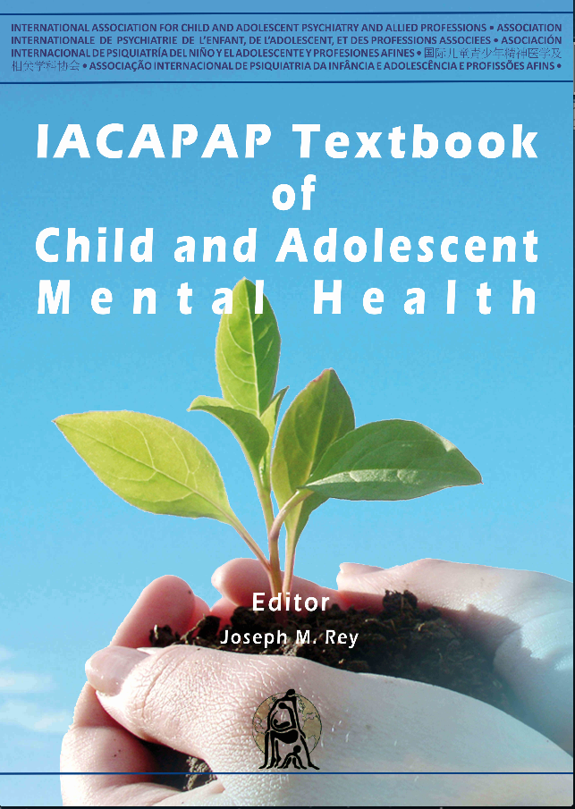
INTRODUCTION
Chapter A.12
PARENTING PROGRAMS
Divna Haslam, Anilena Mejia, Matthew R Sanders
& Petrus J de Vries
DEPRESSION IN CHILDREN AND
ADOLESCENTS
Companion PowerPoint Presentation
Adapted by Julie Chilton

Slide 2

The “IACAPAP Textbook of Child and Adolescent Mental Health” is available at the IACAPAP website http://iacapap.org/iacapap-textbook-of-child-and-adolescent-mental-health
Please note that this book and its companion powerpoint are:
· Free and no registration is required to read or download it
· This is an open-access publication under the Creative Commons Attribution Non- commercial License. According to this, use, distribution and reproduction in any medium are allowed without prior permission provided the original work is properly cited and the use is non-commercial.

Slide 3


Parenting Programs
Outline
Theoretical background
Types of problems targeted
Types of parenting
programs
Common goals
Key components
Effectiveness
Practical issues
Cross-cultural implementation
Training of facilitators
Notes:
By the end of this presentation, you should understand the following about parenting programs

Slide 4
Parenting Programs
Theoretical Background
1960s: Parents can influence children’s behavior
New theories: behavioral modification, social cognitive models, coercive family interactions
Different foci: behavior management, self efficacy, knowledge
Include manuals, training materials, accreditation systems
“The Incredible Years,” the “Triple P—Positive Parenting Program,” Parent Management Training—The Oregon Model
Notes:
Before the 1960s, problematic child behaviors were typically addressed
using therapeutic methods directed at the child or adolescent (e.g., individual
psychoanalysis/psychotherapy or child institutionalization). The late 1960s were
marked by a shift in the field of child psychology and psychiatry. Around this
time, interventions started to focus on changing parents’ behaviors and making
them active participants in therapeutic interventions. This shift was due to a
growing understanding of how parents can influence children’s behavior. Theories
on behavioral modification (Skinner, 1965), social cognitive models (Bandura, 1977)
and those having to do with coercive family interactions (Patterson, 1982) shaped
the development of what became known as parenting programs. Table A.12.1
presents a brief synthesis of each of these theories and their contribution to the
development of parenting programs.
Parenting programs have proliferated since the 1960s with different
programs focusing on developing different types of skills in parents (e.g., behavior
management, self-efficacy, and/or knowledge). There are now several meta-analyses
on the effectiveness of these interventions and comparing those with different
theoretical orientations (e.g., Lundahl et al, 2006). However, the programs most
widely used are those based on behavioral and social cognitive models (i.e., the
theories described in Table A.12.1). Typically these programs are manualized and
have manuals, training materials and accreditation systems. They are commonly
known as “behavioral family interventions” or “parenting training programs”.
Examples include The Incredible Years (Webster-Stratton & Reid, 2015), The
Triple P—Positive Parenting Program (Sanders, 2012), and Parent Management
Training—The Oregon Model (Forgatch, 1994).

Slide 5
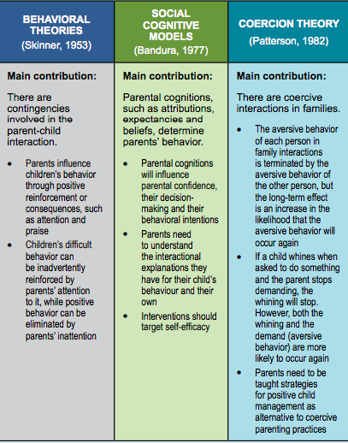
Notes:
Before the 1960s, problematic child behaviors were typically addressed
using therapeutic methods directed at the child or adolescent (e.g., individual
psychoanalysis/psychotherapy or child institutionalization). The late 1960s were
marked by a shift in the field of child psychology and psychiatry. Around this
time, interventions started to focus on changing parents’ behaviors and making
them active participants in therapeutic interventions. This shift was due to a
growing understanding of how parents can influence children’s behavior. Theories
on behavioral modification (Skinner, 1965), social cognitive models (Bandura, 1977)
and those having to do with coercive family interactions (Patterson, 1982) shaped
the development of what became known as parenting programs. Table A.12.1
presents a brief synthesis of each of these theories and their contribution to the
development of parenting programs.
Parenting programs have proliferated since the 1960s with different
programs focusing on developing different types of skills in parents (e.g., behavior
management, self-efficacy, and/or knowledge). There are now several meta-analyses
on the effectiveness of these interventions and comparing those with different
theoretical orientations (e.g., Lundahl et al, 2006). However, the programs most
widely used are those based on behavioral and social cognitive models (i.e., the
theories described in Table A.12.1). Typically these programs are manualized and
have manuals, training materials and accreditation systems. They are commonly
known as “behavioral family interventions” or “parenting training programs”.
Examples include The Incredible Years (Webster-Stratton & Reid, 2015), The
Triple P—Positive Parenting Program (Sanders, 2012), and Parent Management
Training—The Oregon Model (Forgatch, 1994).

Slide 6
Parenting Programs
Types of Problems Targeted
Externalizing behaviors: oppositional, aggressive, impulsive
Internalizing problems: depression, anxiety
Subclinical and clinical levels of problems
Also Oppositional Defiant Disorder (ODD), Conduct Disorder, Attention Deficit Hyperactivity Disorder, Mood Disorders, Neurodevelopmental and Learning Disorders
Notes:
Parenting programs are recommended for the prevention and treatment of
externalizing (e.g., oppositional, aggressive, or impulsive behaviors, such as noncompliance,
disobedience, fighting, aggression and answering back) (Furlong et al, 2012), and internalizing problems (e.g., depression, anxiety) in children (Kendall
et al., 2008). Research suggests that both sub-clinical and clinical levels of problems
decrease when these interventions are properly implemented (Dretzke et al, 2009).
Many clinical presentations, such as oppositional defiant disorder and conduct
disorder, can be treated with focused parenting interventions (Kazdin, 1997).
Parenting programs can also be very useful as adjunctive treatment for
children with attention deficit hyperactivity disorder (ADHD), mood disorders,
or neurodevelopmental and learning disorders (Petrenko, 2013; Skotarczak &
Lee, 2015). In these cases, they typically focus on managing behavioral problems
associated with the primary condition. For example, a child with ADHD may
benefit from a combined therapeutic approach comprising medication for the child
(if required) and a parenting program. Similarly, a child with a diagnosis of an
autism spectrum disorder may benefit from a combination of individually applied
behavioral therapy and social skills training, while their parents may benefit from parenting training (Tellegen & Sanders, 2013). The parenting component would
focus on teaching parents skills to manage behavioral problems (e.g., difficulty
with change in routines) that occur in the context of the primary disorder.
In addition to the prevention and treatment of childhood disorders, many
parenting programs are also used to prevent the development of more serious
problems in adolescence and early adulthood. Some problems that might be
prevented include teenage delinquency, truancy, antisocial behavior in adolescence,
early sexual activity, risky sexual behavior, substance misuse, and adult criminality
(Haggerty et al, 2013). For example, some parenting programs have been used
as part of broader population interventions to reduce risky sexual activity and
the prevalence of HIV-AIDS (Prado et al, 2007). Note that in this example the
intervention is not intending to change the primary outcome (e.g., HIV-AIDS),
but rather used to halt negative developmental trajectories that might result in
becoming infected later on.

Slide 7
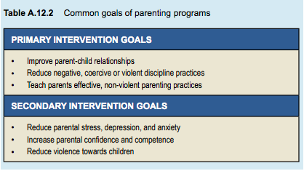
Parenting Programs
Common Goals
Notes:
Parenting programs are interventions that aim to improve child and family
outcomes by equipping parents with effective parenting skills. They differ from
parent education training or psychoeducation—which focus on increasing parent
knowledge about developmental stages or certain conditions—in that parenting
programs include active skills training. They are designed to increase competence
and confidence in parents, allowing them to raise children in a loving, consistent,
predictable, and non-harmful environment. Research suggests that improvements
in parenting style are associated with reductions in child socio-emotional and
behavioral problems (Sanders & Woolley, 2005). Effective programs aim to reduce
known risk factors for poor child and family outcomes such as harsh disciplinary
practices, and strengthen protective factors (i.e., factors that predict positive family
outcomes). See Table A.12.2 for the typical goals of most programs.

Slide 8

Parenting Programs
Types of Parenting Programs
Prevention
  Lower intensity
  Easier and cheaper to implement
Treatment
  Most effective early
  More intensive
  High need/high risk factor families
Blended approaches
  Broader
  Variants as needed
  “The Incredible Years,” “Positive Parenting Program (Triple P)”
Notes:
Parenting programs are interventions that aim to improve child and family
outcomes by equipping parents with effective parenting skills. They differ from
parent education training or psychoeducation—which focus on increasing parent
knowledge about developmental stages or certain conditions—in that parenting
programs include active skills training. They are designed to increase competence
and confidence in parents, allowing them to raise children in a loving, consistent,
predictable, and non-harmful environment. Research suggests that improvements
in parenting style are associated with reductions in child socio-emotional and
behavioral problems (Sanders & Woolley, 2005). Effective programs aim to reduce
known risk factors for poor child and family outcomes such as harsh disciplinary
practices, and strengthen protective factors (i.e., factors that predict positive family
outcomes). See Table A.12.2 for the typical goals of most programs.
According to their primary focus, they can be broadly divided into
prevention, treatment, and blended programs:
• Prevention programs are designed to avoid the development of serious
behavior or emotional problems in children through the acquisition of
parenting skills before problems develop or at the first sign of problems.
Typically, these are lower intensity interventions, thus easier and
cheaper to implement. They work in a way similar to regular tooth
brushing to prevent cavities. When parents are taught effective, safe,
non-violent discipline strategies, children are less likely to develop
emotional and behavioral problems (Forgatch & DeGarmo, 1999).
• Treatment programs seek to reduce problem behaviors after they
have developed. To continue with the dental hygiene analogy, these
are similar to going to the dentist to get a cavity filled. Like with
prevention programs, they are most effective when implemented as
early as possible (before the cavity becomes large or the tooth is lost),
but they can also be effective even when problems are longstanding or
severe. They are often more intensive in terms of time and cost than
prevention programs given that they cover more content and provide
additional support to families. These programs are best suited to
families with higher levels of need or with many risk factors (Kazdin &
Whitley, 2003).
• Blended approaches are broader than focused prevention and treatment
programs; they can be conceptualized as suites of interventions. Blended
programs often have a range of variants that can be deployed as needed.
For example The Incredible Years has a school-based variant aimed at
preventing problems in the classroom, as well as intensive parenting
interventions for implementation at home. Triple P is also a blended
program with five levels of intervention, ranging from media strategies
targeting whole populations to intensive individual services for families
with complex comorbidities (Prinz et al, 2009).
Most research on the topic has targeted treatment-focused programs for
children with behavioral or emotional problems at the clinical level or those at
high risk for the development of such problems. Allowing for between-country
variance, only 10% to 15% of children have problems at this level (Jaffee et al,
2005). Without early intervention, subclinical levels of problems may escalate into
clinical presentations that are harder to treat. For this reason, prevention programs
and blended approaches can be beneficial in reducing the number of cases at a
whole population level.

Slide 9

Parenting Programs
YouTube Video: The Incredible Years
https://www.youtube.com/watch?v=5KZRqMcrl_k

Slide 10

Parenting Programs
YouTube Video: Triple P
https://www.youtube.com/playlist?list=PLBF49556FC1389911

Slide 11
Parenting Programs
Key Components
Increase positive parent-child interactions
Parental consistency
Practice new skills
Appropriate use of consequences
Problem solving
Increase parent sensitivity and nurturing
Models positive behavior
Practice in session
Emotional communication skills
Notes:
Research indicates that programs that include a number of key active
ingredients are most likely to work. For a review of key components of parenting
interventions see the meta-analysis by Kaminski and colleagues (2008).
Components can be broadly classified in those that:
• Teach parents to respond consistently (e.g., praising their child)
• Teach parents strategies to manage difficult behavior (e.g., use of time
out), and
• Use active parent participation during training (e.g., role play for
parents to practice skills).
A summary of key ingredients that seem to contribute to the effectiveness of
these programs is listed in the Box.
The program:
• Provides strategies for increasing positive parent-child interactions
• Focuses on parental consistency
• Allows parents to practice new skills with their own child
• Teaches the appropriate use of consequences, such as time-out (i.e., the temporary withdrawal of parental attention in response to problem behavior)
• Teaches problem solving to parents
• Increases parental sensitivity and nurturing
• Models (or shows) positive behavior
• Provides opportunities for parents to practice strategies in the session via role play
• Teaches emotional communication skills

Slide 12
Parenting Programs
Assessment: Key Questions to Ask
Which is the target problem
Where and when it occurs
Parents’ explanation of causes
Past unsuccessful strategies
Parents’ current goals
Notes:
You can also collect in-depth information through an interview. Make sure to gather information on:
• The target problem
• Where and when is it most likely to occur (i.e., contextual details about the problem)
• Parent’s explanation of the cause of the problem
• Strategies tried in the past without success
• Parent’s current goals.

Slide 13
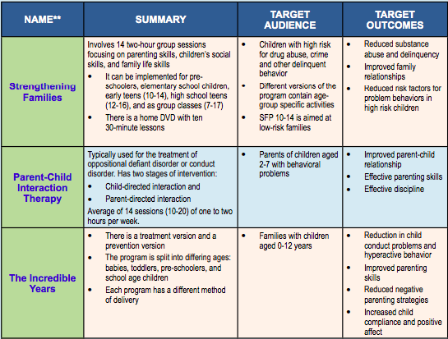
Parenting Programs
Evaluating Effectiveness
Notes:
In the previous section key elements or active ingredients of parenting
programs were discussed. However, it is important to keep in mind that many
programs are promoted or implemented without evidence that they work. Those
with evidence of efficacy gathered through a body of empirical research (usually
including randomized controlled trials) are known as evidence-based programs.
Clinicians have the ethical responsibility to ensure that interventions offered to
families have some evidence of effectiveness—a core principle of evidence-based
practice. However, it is also necessary to maximize resources, particularly when
working in low-income settings. It can be tempting to make programs up (i.e.,
develop them from scratch), with the risk that they might be ineffective and a
waste of resources.
A number of programs have been found to be effective after rigorous
evaluation (Haggerty et al, 2013). These include The Incredible Years (WebsterStratton
& Reid, 2015); Parent-Child Interaction Therapy (Brinkmeyer & Eyberg,
2003); Triple P—Positive Parenting Program (Sanders, 2012); Nurse Family
Partnership (Olds et al, 2003); and Strengthening Families Program (Kumpfer et
al, 1996). More information about these can be found in Table A.12.3. Many
international bodies, such as the United Nations Office on Drugs and Crime
(UNODC, 2009), have lists of evidence-based parenting interventions.

Slide 14
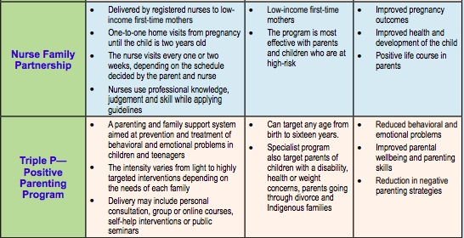
Parenting Programs
Evaluating Effectiveness
Notes:
In the previous section key elements or active ingredients of parenting
programs were discussed. However, it is important to keep in mind that many
programs are promoted or implemented without evidence that they work. Those
with evidence of efficacy gathered through a body of empirical research (usually
including randomized controlled trials) are known as evidence-based programs.
Clinicians have the ethical responsibility to ensure that interventions offered to
families have some evidence of effectiveness—a core principle of evidence-based
practice. However, it is also necessary to maximize resources, particularly when
working in low-income settings. It can be tempting to make programs up (i.e.,
develop them from scratch), with the risk that they might be ineffective and a
waste of resources.
A number of programs have been found to be effective after rigorous
evaluation (Haggerty et al, 2013). These include The Incredible Years (WebsterStratton
& Reid, 2015); Parent-Child Interaction Therapy (Brinkmeyer & Eyberg,
2003); Triple P—Positive Parenting Program (Sanders, 2012); Nurse Family
Partnership (Olds et al, 2003); and Strengthening Families Program (Kumpfer et
al, 1996). More information about these can be found in Table A.12.3. Many
international bodies, such as the United Nations Office on Drugs and Crime
(UNODC, 2009), have lists of evidence-based parenting interventions.

Slide 15
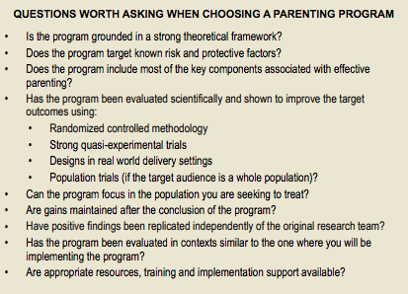
Notes:
It is beyond the scope of this chapter to review the key concepts of
evidence-based practice. However, guidelines on how to judge effectiveness of
interventions can be found in Chapter A.6 of the IACAPAP Textbook. Listed
in the Box 3 are some questions that can assist you in judging if the program
you are considering is likely to be effective

Slide 16


Parenting Programs
Evaluating Effectiveness
https://www.unodc.org/documents/prevention/family-compilation.pdf
http://apps.who.int/iris/bitstream/10665/85994/1/9789241505956_eng.pdf
Notes:
Many international bodies, such as the United Nations Office on Drugs and Crime
(UNODC, 2009), have lists of evidence-based parenting interventions.
More information about how to assess evidence of effectiveness can also be found in a summary by the World
Health Organization (2013) available here.

Slide 17
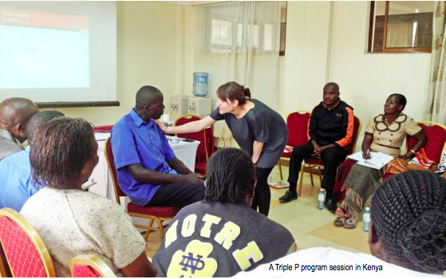
Parenting Programs
Practical Issues
Child protection
Parental mental health
Confidentiality
Specific problems
Poverty
Stigma and shame
Notes:
While parenting programs can be very useful, there are other aspects to consider, such as whether a parenting program is the treatment of choice, as well as delivery issues. These include:
• Child protection and safeguarding of children. It is possible that either during assessment or delivery of a parenting program, concerns about child safety may be raised. Safeguarding and protecting children has to be of paramount importance. Where child protection becomes a concern, this has to be dealt with as a priority. Facilitators will need to discuss concerns with their supervisor and, if appropriate, with parents, and swiftly take the necessary action.
• Parental mental health problems. There is much evidence that parental mental illness (e.g., depression) can adversely affect their ability to parent (Oyserman et al, 2000). However, when it is clear that a parent has a serious mental illness, such as a psychotic disorder, severe depression or anxiety, it may not be appropriate to offer a parenting program until the mental illness has been assessed and stabilized. Supporting parents to find appropriate treatment should therefore be the priority in these cases. On the other hand, if a parent has a low level mood or anxiety disturbance they may still be able to participate in the program while also seeking additional assistance. Clinicians should monitor parents’ mood and reactions throughout the course of the program and take appropriate action. For example, if a parent appears to be getting upset or teary in a group session, the practitioner should speak to the parent privately outside the group to determine if additional support is necessary.
• Privacy and confidentiality. It is important to conduct sessions in a room where discussions are private and where confidentiality can be maintained. When parenting programs are delivered in a group format, it is useful to explicitly state privacy expectations at the start of the group. This will allow parents to share their thoughts and experiences and facilitate group discussion. It is important to make clear that personal information discussed in a session should not be shared with others outside the session. Parents should also be informed that privacy and confidentiality will be upheld unless there is concern about risk to their children’s safety, to themselves or to others. This is part of the duty of care of all child health professionals.
• Parenting programs and specific child problems. While the general principles of parenting programs are helpful for all children, there are specialized programs where highly specific targets are included. For instance, in some programs for autism spectrum disorder, parents might be provided with specific training in turn-taking, stepping into the “attentional spotlight” of the child, how to arrange the environment to encourage communication and so on. For a review of “naturalistic developmental behavioral interventions”, many of which use parents as active treatment partners and include parent coaching, click here .In these programs there is often an emphasis on learning to understand the function of a particular behavior. For instance, a child with autism spectrum disorder may use a particular behavior not to get attention ,but rather to avoid attention. A time-out strategy would therefore not be appropriate in that instance. There is also a specialized approach to functional analysis of behavior in children with intellectual disability and specific genetic disorders, such as fragile X, Prader-Willi, Angelman or Cornelia de Lange syndromes, for instance. In many of these genetic disorders, specific behaviors may be associated with sensory sensitivities, pain, cognitive inflexibility, avoidance behaviors, or exaggerated need for behavioral reinforcement with eye contact. These are specialized scenarios for which specific modules or parenting approaches are required. For example, the Stepping Stones Triple P program has been evaluated with parents of children with a range of specific neurodevelopmental disorders (Tellegen & Sanders, 2013).
• Poverty and low socio-economic status. It is crucial to note that, particularly in low- and middle-income countries, parents may arrive at a parenting program with an empty stomach. Just as children can’t learn if they are hungry, parents can’t make use of training if they are hungry or thirsty. A drink and a biscuit can go a long way to help parents concentrate. Likewise, ensuring that parents have access to printed materials, baby sitting or transport will be helpful. For example, provide notepads, pens and copies of monitoring forms parents need to use at home rather than expecting them to make their own copies.
• Stigma and shame. Many come to the program having received the overt or covert message that they are not good enough parents or that they need to be “trained”. It is important that group leaders and facilitators keep in mind that parents may feel stigmatized and ashamed. It is important to acknowledge such feelings, and to use parents’ knowledge and experiences to assist in the program, rather than for facilitators to assume a position of exclusive expertise. The facilitator should explicitly acknowledge the expertise of the parents and empower them to achieve their own family goals. Many people would say that parenting is the most difficult job any parent will ever do!

Slide 18
Parenting Programs
Low and Middle Income Countries
Cultural relevance
Context-appropriate assessment
  Strength and Difficulties Questionnaire (SDQ)
  Eyberg Child Behavior Inventory (ECBI)
  Child Adjustment and Parent Efficacy Scale (CAPES)
  Parenting and Family Adjustment Scale (PAFAS)
Program fidelity
Adaptations to content
Notes:
This section discusses how to ensure parenting interventions are relevant to specific cultures, the adaptations that can be made to fit the context of low income countries, and how to enhance their value-for-money. Most parenting interventions have been developed, evaluated and implemented in western, English-speaking, high-income countries. However, meta-analytic reviews have indicated that evidence-based parenting programs implemented in other countries are at least as effective as in the country where they had originated (Gardner et al, 2015); only minimal adaptations being required. There are, however, a number of low-risk cultural and contextual adaptations that can help increase engagement and improve cultural appropriateness.
Cultural relevance
Parenting interventions have been tested in different countries and cultures(See Table A.12.4 for examples). Some of them have also been adapted following rigorous and systematic procedures to improve the fit for the target population. An example can be found in Baumann et al (2014) for the adaptation of the Parent Management Training—Oregon Model in Mexico. If you are intending to use a parenting intervention that has not been tested or adapted for the population you are working with, it might be beneficial to start by reflecting on the cultural relevance of the program. If you are familiar with the target group, make sure you anticipate potential cultural barriers in the implementation of specific strategies. For example, in some cultures, promoting independent problem solving in young children might not be accepted by parents. If you are not familiar with the target group, you could ask parents how they feel about implementing behavioral strategies such as time-out or descriptive praise. Does this strategy contradict their cultural values or typical communication practices? If so, how can the strategy be adapted to fit their culture?
Context-appropriate assessment
Before delivering a parenting intervention, it is recommended to get a sense of the main difficulties your target group is facing. This will allow you to tailor the intervention to their specific needs. In addition, parents around the world face very different challenges, thus a one-size-fits-all-approach will not work. Some parents might be facing other complex issues apart from their child’s behavioral and emotional difficulties, such as child maltreatment or domestic violence. These families should be referred to other services, if available; most parenting programs are not recommended for problems such as severe parental psychopathology, domestic violence, or child maltreatment.
In relation to child behavioral and emotional difficulties, parents might be struggling with disobedience, aggression, tantrums or conflict between siblings, for example. There are standardized questionnaires to help you assess the difficulties parents might be struggling with. Some of these questionnaires have been translated into different languages. For example, the Strengths and Difficulties Questionnaire(SDQ) has been translated to most languages and is available free. The SDQ provides information on both emotional problems, such as anxiety and depression, and behavioral problems, such as tantrums and aggressiveness (Goodman, 1997).The Eyberg Child Behavior Inventory (ECBI) is also widely-used also but requires payment of a licensing fee.
Two instruments for parent reports have been developed recently: the Child Adjustment and Parent Efficacy Scale (CAPES) (Morawska et al, 2014), and the Parenting and Family Adjustment Scale (PAFAS) (Sanders et al, 2014). The English version of these instruments can be found in Appendix A.12.2; there are also versions in Spanish, Portuguese, Turkish and Chinese, all freely available for use. Please contact the first author to receive a copy of these measures.
It is important to know that literacy levels in many low-income countries range from 30% to 80%. If parents are illiterate or if it is difficult to collect written data from them, the program leader can give parents a tally sheet (such as the one in Appendix A.12.1) so that parents can monitor their children’s behavior for a certain period of time and obtain an estimate of how frequently certain problem behavior occur. It is best to introduce monitoring before introducing strategies to obtain an accurate level of baseline behavior. Many programs ask parents to monitor child behavior between the first and second sessions. The parent can also complete a monitoring form after the intervention is complete to check problems have decreased. Alternatively you can ask parents to move stones from one jar to another each time a problem behavior occurs and then count the stones in each jar at the conclusion of the week to capture how frequent behavior problems occur. You can also collect in-depth information through an interview. Make sure to gather information on:
• The target problem
• Where and when is it most likely to occur (i.e., contextual details about the problem)
• Parent’s explanation of the cause of the problem
• Strategies tried in the past without success
• Parent’s current goals.
Program fidelity
Most evidence-based parenting programs include a practitioner manual(and often a certified training component). For this reason, they are known as “manualized” programs. Sticking to the manual in relation to the key concepts, content, and structure is known as program fidelity. Ensuring fidelity is important because programs are most effective when delivered as prescribed and might not work at all if not delivered with fidelity. However, it is also important to ensure a good fit between the content of the program and parents’ needs. Thus, it is crucial that practitioners achieve a balance between fidelity and flexibility during delivery (Mazzucchelli & Sanders, 2010). Later in this section we present examples of low and high risk adaptations that can be made to a program to achieve a balance between fidelity and flexibility.
Adaptations to content
When one has a clear understanding of the target problem, it is acceptable to make minor adaptations to the content of an existing manual to fit parents’ specific needs and cultural expectations. However, it is important that you are clear about which changes are low risk and which may be high risk. Low risk adaptations include minor changes that make the content locally relevant, such as modifying examples or including ice-breaking activities, which will not affect the core ingredients of the intervention. High risk adaptations are those that change core components of the intervention, such as excluding training in a particular skill (e.g., praise or time-out). See Table A.12.5 for guidelines and examples.
Given that most parenting interventions rely on written materials, it is also important to consider parents’ literacy level. Trials indicate that parents with low literacy or intellectual disability can benefit from modified parenting interventions(e.g., Glazemakers & Deboutte, 2013). When working with illiterate parents, consider using a program that relies on video materials dubbed into the local language. If you do not have access to videos, consider using role-plays to train parents on a particular skill and allow additional time for group discussion. You may also integrate key examples into family stories to make it easier for parents from storytelling cultures to remember. Where parents are literate but with low levels of education (i.e., primary school only) written materials can be adapted to make them briefer and easier to read.

Slide 19
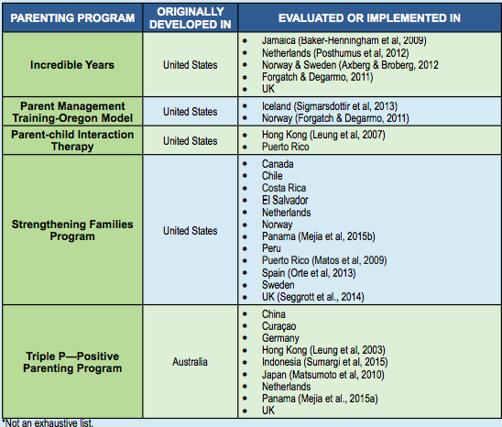

Slide 20

Parenting Programs
Testing a Program in a Low-Resource Setting
2012 Research project in Panama
Cultural relevance and efficacy of Triple P
Low-resource communities
Children age 3-12 with behavioral problems
Outcomes: culturally acceptable, less stressed and hostile parents, children following instructions better
https://www.youtube.com/watch?v=o1VA3RJaZM0

Slide 21
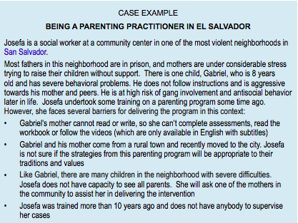

Slide 22
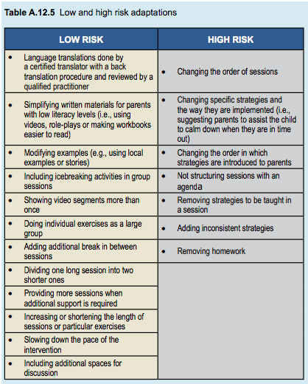
Notes:
Adaptations to content
When one has a clear understanding of the target problem, it is acceptable to make minor adaptations to the content of an existing manual to fit parents’ specific needs and cultural expectations. However, it is important that you are clear about which changes are low risk and which may be high risk. Low risk adaptations include minor changes that make the content locally relevant, such as modifying examples or including ice-breaking activities, which will not affect the core ingredients of the intervention. High risk adaptations are those that change core components of the intervention, such as excluding training in a particular skill (e.g., praise or time-out). See Table A.12.5 for guidelines and examples.

Slide 23
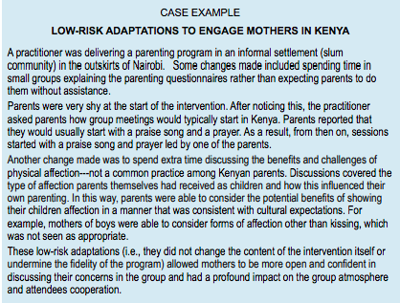
Notes:
Adaptations to content
When one has a clear understanding of the target problem, it is acceptable to make minor adaptations to the content of an existing manual to fit parents’ specific needs and cultural expectations. However, it is important that you are clear about which changes are low risk and which may be high risk. Low risk adaptations include minor changes that make the content locally relevant, such as modifying examples or including ice-breaking activities, which will not affect the core ingredients of the intervention. High risk adaptations are those that change core components of the intervention, such as excluding training in a particular skill (e.g., praise or time-out). See Table A.12.5 for guidelines and examples.

Slide 24
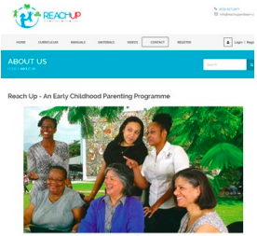
Parenting Programs
Training of Facilitators
Some require 3-4 days for accreditation
Some only require free online training
  Reach up
No evidence that health professionals are better than para-professionals
Value for money
  Blueprints website for US programs
  Large venues like schools or community centers
  Self-directed learning materials
  Utilize para-professionals
http://www.reachupandlearn.com/about-us/
Notes:
Most parenting interventions have a well established training to accredit professionals to deliver them. Only professionals that undergo this training (usually lasting 3 or 4 days) are accredited to deliver the intervention. This requirement aims to ensure the quality and fidelity of the intervention.
There are parenting interventions freely available online that do not require facilitators to be accredited by attending a course. One example is Reach Up, an early childhood parenting program. To be able to deliver the program, potential facilitators must go through a free online training. Reach Up is quite intensive and is delivered as part of home visits to help parents enhance their child’s development. There are several trials showing that Reach Up has been effective in Jamaica and there are versions available in English, Spanish, French and Bangla (Grantham-McGregor & Walker, 2015).
While most programs based on social-cognitive and behavioral theories only allow health professionals to be trained as facilitators, there are several examples documented in the literature of other parenting interventions that can be delivered by para-professionals or educated members of the community. There is no evidence that health professionals achieve better outcomes than para-professionals. Using para-professionals (also referred to as task-sharing—see Chapter J.5 of the Textbook) might be particularly attractive in low income countries where health professionals are scarce. A decision on the credentials needed for those who will deliver the intervention should be made based on the:
• Intervention chosen (e.g., whether the program requires that only health professionals be trained)
• Available resources (e.g., whether there are funds to pay facilitators)
• Number of families that need to be reached (e.g., if the aim is to reach a large number of families, using para-professionals or lay facilitators might be more feasible)
• Severity of the target population (e.g., psychologists, psychiatrists and health workers might be better equipped to deal with children with severe problems).
Value for money
Programs that are cost neutral (i.e., the costs of implementation are similar to the savings made by reducing children’s problems) or cost positive (i.e., the costs of implementation are lower than the savings made by reducing children’s problems) should be the first choice. The costs and return on investment of implementing specific parenting interventions can be found in websites such as Blueprints. However, these costs have been calculated for a specific set of programs in the US. To our knowledge, no cost-effectiveness studies have been conducted in low income countries. In the absence of such information, the following strategies can be used to maximize the impact of programs and increasing their value for money:
• Some programs can be offered as large seminars in schools and community settings. Providing parenting information to as many parents as possible in a single session reduces costs and can be a good strategy to identify those who need more intensive support
• Self-directed learning materials, such as brochures and videos, could also be used to reach parents with mild difficulties
• Some parenting interventions can be delivered by para-professionals

Slide 25
Parenting Programs
Conclusions
Assess each family’s unique situation
Target the known risk factors
Match program to level of difficulty
Make low-risk adaptations
Monitor progress
Provide additional help when relevant
Access peer support and supervision
Notes:
Parenting programs are increasingly perceived as a cost-effective means of preventing and treating emotional and behavioral problems in children. Their effectiveness is supported by a growing body of empirical research. When considering using a parenting program:
• Consider each family’s unique situation through a comprehensive assessment to determine if a parenting program will be helpful or appropriate
• Make sure the parenting program you choose targets known risk factors
• It is preferable to offer interventions to parents that are appropriate to their level of difficulty. In other words, if they have mild difficulties, you can offer a light-touch intervention of few sessions (i.e. brief and focused). If they have more severe difficulties, then you can offer individual support for several sessions.
• Make minor or low-risk adaptations to ensure cultural and contextual fit
• Monitor families’ progress throughout the course of the intervention using clinical judgment and appropriate measurement tools
• Provide additional assistance or refer those with other significant problems (e.g., parental depression, domestic violence) to other services• Access peer support and supervision.

Slide 26

Parenting Programs
Thank You!

