Slide 1
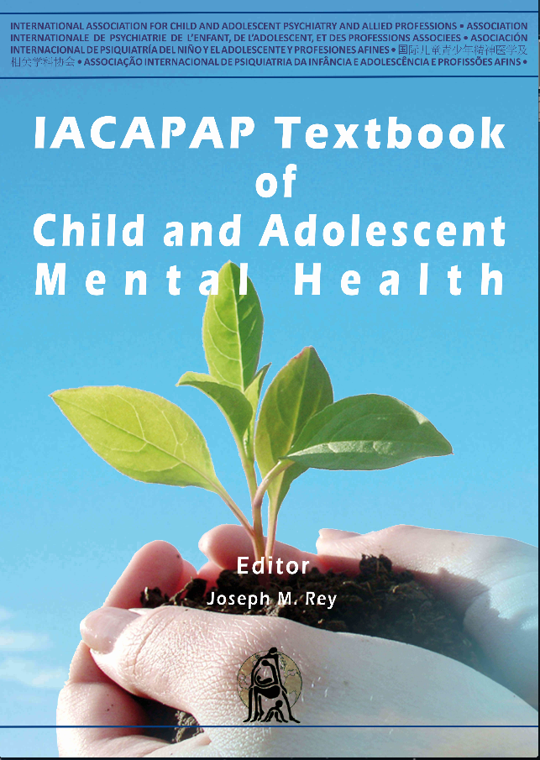
ANXIETY DISORDERS
Chapter F.5
SELECTIVE MUTISM
Beate Oerbeck,
Katharina Manassis,
Kristin Romvig Overgaard
& Hanne KristensesAND
ADOLESCENTS
Companion PowerPoint Presentation
Adapted by Julie Chilton

Slide 2
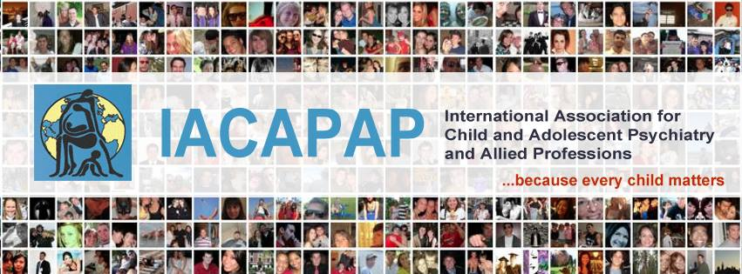
The “IACAPAP Textbook of Child and Adolescent Mental Health” is available at the IACAPAP website http://iacapap.org/iacapap-textbook-of-child-and-adolescent-mental-health
Please note that this book and its companion powerpoint are:
· Free and no registration is required to read or download it
· This is an open-access publication under the Creative Commons Attribution Non- commercial License. According to this, use, distribution and reproduction in any medium are allowed without prior permission provided the original work is properly cited and the use is non-commercial.

Slide 3

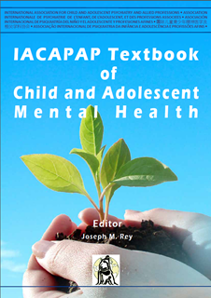
Selective Mutism
Outline
Introduction
Clinical Presentation
Prevalence & Course
Etiology
Diagnosis
Comorbidity
Differential Diagnosis
Assessment
Treatment
Culturally Specific Issues
Key Points
Notes:
This presentation reviews the clinical presentation, prevalence,
course, etiology, diagnosis, assessment, and treatment of SM with emphasis on
aspects relevant to practicing clinicians.

Slide 4
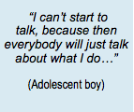
Selective Mutism
Introduction: Definition
A disorder characterized by a consistent failure to speak in specific settings (school, social situations) despite speaking normally in others (at home)
Significant social and academic impairment if left untreated
Rare but serious
Notes:
Selective mutism (SM) is a disorder characterized by a consistent failure to
speak in specific settings (e.g., school, social situations) despite speaking normally
in others (e.g., at home). SM is a relatively rare but serious condition that causes
significant social and academic impairment if left untreated.

Slide 5
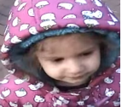
https://www.youtube.com/watch?v=NkXFULOtuns
Notes:
A video clip of a child with selective mutism

Slide 6
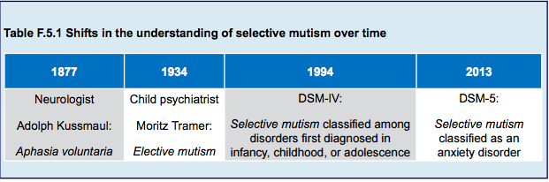
Selective Mutism
Introduction
Notes:
Since the publication
in 2013 of the Diagnostic and Statistical Manual of Mental Disorders (DSM-5)
(American Psychiatric Association, 2013), SM has been classified as an anxiety
disorder and the name changed from elective mutism to selective mutism, reflecting
a shift in the understanding of SM from an act of will to a lack of ability to speak
in specific situations.

Slide 7
Selective Mutism
Clinical Presentation
Context and person specific
Better with friendly, funny, talkative people
Easier to talk to other children
Some can whisper to a friend
Differ widely in non-verbal communication
School refusal rare
Comorbid: anxiety & language disorders
More common in immigrant, bilingual children
Onset between 2 and 5 years
Fear of mistakes and dislike attention
Notes:
The cardinal symptom of SM is the failure to speak in certain situations,
most notably in kindergarten or school. Thus, symptoms are typically context
specific. This discrepancy in speaking behavior is central to the disorder but it
often leads to misunderstandings and suspicion as both teachers and parents tend
to think that children behave in all situations the way they observe themselves (e.g.,
if a child does not speak at school the teacher may think that she does not speak
at home either). SM can also be person-specific (e.g., the child may be mute with
some persons but not with others). Different individuals may increase or lessen
symptoms considerably within the same situation. For example, friendly, funny
people who talk and keep the “conversation” going independent of the child’s
active participation, are helpful. Children with SM often find it easier to talk to
other children compared to adults. Some will occasionally be able to whisper to a
best friend at school. A feature of children with SM is that they differ widely in their ability
to use nonverbal communication (e.g., eye contact, gestures, nodding and
pointing). While some use nonverbal communication effectively, others are noncommunicative
and might not even laugh or cough in front of others. The latter
are often unable to express their needs (going to the toilet, hunger, thirst, or pain),
highlighting the potential seriousness of this condition.
In spite of the considerable stress experienced at school, school refusal is
rare. SM is often comorbid with other anxiety disorders, especially social anxiety
disorder, and with neurodevelopmental disorders, especially language disorders.
Immigrant, bilingual children are overrepresented.
The clinical vignette of Ann illustrates the temperamental traits often found
in children with SM. It also illustrates how inability to speak may be different in
different settings, which may cause frustration due to people thinking that mutism
is deliberate.
Typically SM has onset between 2 and 5 years of age but is usually not
recognized until children start school, where speaking is an integral part of the
learning and socialization processes. Children with SM are generally afraid to make
mistakes and dislike being the focus of attention. Their “solution”—muteness
and, sometimes, trying to be invisible—becomes part of the problem. When
they occasionally do talk, they get everybody’s attention, which they find anxietyprovoking,
perpetuating mutism in a vicious circle.
Children with SM are often asked why speaking is so difficult; they generally
find it hard to explain. Some older children with SM have described the feeling
of having a great lump in the throat hindering speech. Children with SM exhibit
significant social and academic impairment (Carbone et al, 2010; Remschmidt
et al, 2001; Bergman et al, 2002). A

Slide 8
Selective Mutism
Clinical Presentation
When they occasionally do talk they get everybody’s attention, which they find anxiety-provoking, perpetuating mutism in a vicious cycle

Slide 9
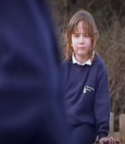
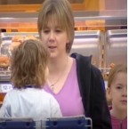
Selective Mutism
Clinical Presentation
https://www.youtube.com/watch?v=gn3CIGSsyK0
https://www.youtube.com/watch?v=SNPyXOPJonQ
Notes:
These are two clips, Part 1 and Part 2, from a documentary on selective mutism called Help Me to Speak. They illustrate the typical symptoms in two children, a boy and a girl.

Slide 10
Selective Mutism
Ann: A case example
5 year old girl
Mutism since kindergarten at age 3
Normal development
Shy temperament like her parents
Lively, happy, talkative at home
No speech with paternal grandparents
Parents speak for her outside the home
Only nonverbal communication at school after a few months
Included in play
Other children speak for her at school
Notes:
Ann, a 5-year-old girl, was referred to the mental health services because of
suspected SM. Her mutism had lasted since she started in kindergarten at age three. Both
her parents and teachers had hoped that her muteness would improve spontaneously and
thus postponed seeking help. Now, they worried that her lack of speech would continue at
school and wanted help.
Ann had developed normally but parents described her as shy and “slow to warm up”
in new situations and when meeting strangers. Both parents recognized this temperamental
trait in themselves and her mother still struggled with social anxiety.
At home, Ann was a lively and happy girl. She spoke freely with both parents, her
younger sister and a playmate. When the extended family was visiting, she talked to her
grandparents on her mother’s side but not to her father’s parents, making them unhappy.
They thought that her not speaking was deliberate and argued for putting more pressure on
her to speak, resulting in conflict with the parents.
Outside the home, Ann spoke to her parents when no one was within earshot, but her
parents had to speak for her in all situations, like in shops and at the dentist. When invited to
a friend’s party, she would go if a parent joined her but she did not talk.
In the kindergarten, Ann seemed happy but did not speak to either adults or children.
She talked to her parents in the cloakroom but got silent when others appeared. However,
she used gestures freely and communicated well with teachers and peers by nodding and
pointing. She was always included in play and the other children often spoke for her and did
not seem bothered by her lack of speech. This behavior stood in contrast with her first few
months in kindergarten. At that time she cried extensively when the parents left and did not
communicate with gestures. The increased nonverbal communication and general behavior
in the kindergarten raised hope of a spontaneous remission of her mutism.

Slide 11
Selective Mutism
Etiology
No single cause
Act of willfullness→ lack of ability
Interplay of causes
  Genetic
  Temperament
  Neurodevelopmental
  Environmental
Notes:
No single cause for SM has been found thus far. However, the understanding
of this disorder has changed over the years from an act of willfulness of the child,
to a lack of ability to speak in certain situations (see Table F.5.1). As for most
child psychiatric disorders, it should be hypothesized an interplay of genetic,
temperamental, neurodevelopmental and environmental factors, summarized
below (for an overview of SM and a thorough examination of its etiology, see
Cohan et al, 2006b; Muris & Ollendick, 2015; Hua & Major, 2016):
• Genetic factors. SM, social reticence and social anxiety run in families
(Black & Uhde, 1995). A specific gene variation has been found to be
associated with both SM and social anxiety disorder (Stein et al, 2011)
• Temperament. The behavioral inhibition trait (fearfulness and avoidance
in unfamiliar situations) is generally associated with a greater risk for
later anxiety disorders (Hirshfeld-Becker et al, 2007). Consistent
with the link between social anxiety disorder and SM, there is also an
association between SM and behavioral inhibition (Gensthaler et al,
2016a)
• Neurodevelopmental factors. Children with SM have higher rates of
several neurodevelopmental conditions. The most prevalent are speech
and language problems but elimination disorders and motor delay are
also common. There is a small overlap with autism spectrum disorders
and with lower intellectual capacity, although the majority of children
with SM have IQ within the normal range (Kristensen, 2000; Cohan
et al, 2006b)
• Environmental factors. Bilingual children are overrepresented in SM.
Transitions such as starting school and meeting new people may trigger
and are especially hard for children with SM. In contrast to shy children
who will warm up over time, children with SM continue to be mute
and withdrawn

Slide 12
Selective Mutism
Diagnostic Criteria: DSM-5 and ICD-11
Consistent failure to speak in specific settings despite talking normally in others
At least for one month
Not due to a lack of knowledge of or comfort with the required language
Not better explained by a communication disorder
Not occur during autism, schizophrenia or another psychotic disorder
Interferes with daily functioning at school
and in social situations
Notes:
• Selective mutism is characterized in DSM-5 by a consistent failure to
speak in specific settings (e.g., school, social situations) despite talking
normally in other settings (e.g., at home) (American Psychiatric
Association, 2013)
• DSM-5 specifies that the selective absence of speech should be present
for at least one month to establish the diagnosis. This does not apply to
the first month of school as many young children are silent when they
face a new situation, such as starting school
• Importantly, the failure to speak cannot be attributed to a lack of
knowledge of, or discomfort with the spoken language required in the
social situation
• The disturbance is not better explained by a communication disorder
(e.g., childhood-onset fluency disorder or stuttering) and does not
occur exclusively during the course of autism spectrum disorder,
schizophrenia, or another psychotic disorder
• Finally, the child’s lack of speech should interfere with daily functioning:
The absence of speech hinders the child’s capacity to function at school
or in social interactions.
SM is called elective mutism in ICD-10 and is included in the section
“behavioral and emotional disorders with onset usually occurring in childhood”
(World Health Organization, 1990). The ICD-10 exclusion criteria include
pervasive developmental disorders, schizophrenia, specific developmental disorders
of speech and language, and transient mutism as part of separation anxiety in
young children. The beta draft of ICD-11 available in August 2016 proposes to
change the name to selective mutism, is included in the section on “anxiety and
fear-related disorders”, and has a description similar to that in DSM-5.

Slide 13
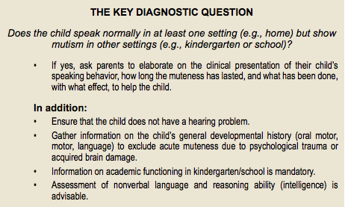

Slide 14
Selective Mutism
Diagnostic Challenges
Overlap with other disorders
“Consistent lack of speech” is unclear
Some speaking ok if still impaired
Bilingual children often overlooked
  Lasts longer than 6 months
  Is muteness due to lack of understanding new language?
  Are there comorbid speech and language disorders?
  Mutism prolonged or disproportionate to degree of new language knowledge and exposure
Notes:
The diagnostic overlap between SM and several other child psychiatric
disorders often found in the clinic can make the diagnosis of SM difficult. Neither
DSM, nor ICD specify whether the criterion “consistent lack of speech” means
speaking to adults. Of note, some children with SM speak or whisper to a “best
friend” in school. Another challenge is whether some speaking in class (like in
small groups of students, alone with a teacher, or with teachers and children in
small groups) still qualifies for a diagnosis. In these cases, support for and against
the diagnosis can be found in the degree of impairment the muteness creates.
However, more specific guidelines do not exist. Clinical judgement of impairment
must be used, and the decision is thus dependent upon the clinician’s skills and
experience.
Diagnosing SM in bilingual children is particularly difficult. They are often
overlooked—their muteness being attributed to a lack of understanding of the new
language. Often overlooked in this subgroup are comorbid speech and language
disorders, masked by the muteness and bilingualism. Getting information on, or
assessing language ability in the child’s native language is essential. For diagnosis,
the main point is that mutism must be prolonged or is disproportionate to the
degree of second language knowledge and exposure (Toppelberg et al, 2005).

Slide 15
Selective Mutism
Comorbidity
90 % comorbid social anxiety disorder
Separation anxiety but not school refusal
Neurodevelopmental disorders
  Speech and language problems
  Elimination disorders
  Motor delay
  Autism disorder <10% of cases
  ADHD rare
No longer viewed primarily as oppositional; just oppositional when pressured to speak
Notes:
Children with SM often present with symptoms of other anxiety disorders,
particularly social anxiety disorder. Studies have found this comorbidity in about
90 % of cases (Gensthaler et al, 2016b; Oerbeck et al, 2014).
Separation anxiety disorder is common, especially in younger children.
However, school refusal is rare. Neurodevelopmental conditions are frequent.
The most prevalent are speech and language problems, elimination disorders, and
motor delay. SM has been found comorbid with autism spectrum disorders in
<10% of cases. Attention deficit/hyperactivity disorder is rare (Kristensen, 2000).
There has been some controversy concerning the understanding of
oppositional behavior observed in some children with SM. Children with SM
have been described over the years as controlling, stubborn and oppositional, often
implying a primary problem in the family dynamics. The shift in DSM-5, where
SM is understood as an anxiety disorder rather than a manifestation of oppositional
behavior, is thus significant.
The largest study to date on children with SM (n=130) found that social
anxiety was the most prominent additional feature. Almost half also had borderline
clinical scores for speech and language problems—an important reminder as
these problems may easily go unnoticed in these children. Another 45% showed
borderline clinical scores on oppositional behavior. Only 12% had a “pure”
social anxiety (Cohan et al, 2008). The authors suggest that the oppositionality
shown by children with SM is often present only in situations that require verbal
communication. That is, they become oppositional and non-compliant when
pressured to speak when they are anxious about doing so.

Slide 16
Selective Mutism
Assessment
Information from both parents and teachers
  diagnostic interviews
    K-SADS-PL
    ADIS-IV-C/P
    PAPA
  questionnaires
  behavioral observations
Patient interview
  “yes” and “no” nods
  written questionnaires
  talking maps & feelings thermometers
Notes:
The diagnostic assessment of SM must be based on information from both
parents and teachers to ensure accurate information on the child’s failure to speak
appropriately in certain social situations. A multi-informant perspective is critical
due to the situational nature of the condition. Parents may in fact be unaware
for a long time of the child’s mutism at school. Evaluation generally includes a
combination of diagnostic interviews and questionnaires completed by parents
and teachers and behavioral observations of the young child. Older children can
be asked to nod to questions or complete written questionnaires. Some young
children with SM (aged 4 to 5 years) are able to complete “talking maps” with
the help of a parent. However, the degree to which children with SM can convey
information in this new, stressful situation, with unfamiliar adults is quite variable
and not essential for a diagnosis to be made. As SM is an anxiety disorder, the ADIS seems particularly relevant. The
ADIS assesses anxiety, mood, externalizing, tics, substance use and pervasive
developmental disorders according to the DSM. Very useful is a “feelings
thermometer” that allows the child and parents to quantify the severity of anxiety
symptoms and interference with the child’s functioning. Anxiety ratings are used
to assist in diagnostics. Further, they can be used for self-monitoring (in older
children) and parent-monitoring of anxiety, and to assess response to treatment
over time.
Younger children may be able to use simpler visual models such as hand
drawn or printed smiley and upset faces. An example of a talking map for the
school situation for younger children can be found below. Depending on age, one
can ask the child to point or to draw stars in situations they do talk. One can also
use colorful post-it notes: green for talking, yellow for non-verbal communication,
and red for muteness. Older children can also construct their own talking maps,
such as listing people they talk to, and people they will work on being able to talk
to in different settings. Clinicians need to be creative to engage the child in the
process.
The Schedule for Affective Disorders and Schizophrenia for School-Aged
Children: Present and Lifetime Version (K-SADS-PL) (Kaufman et al, 2013) and the
Anxiety Disorder Interview for DSM-IV Child and Parent Version (ADIS-IV-C/P)
(Albano & Silverman, 1996) are common interviews used. These interviews are
designed for children 6-18 years, but adequate diagnoses can be made in children
below age six as long as the behavioral concepts and the understanding of life
interference is adapted to be relevant to a preschool child (Birmaher et al, 2009).
Alternatively, the Preschool Age Psychiatric Evaluation (PAPA) (Egger & Angold,
2004) can be used.

Slide 17
Selective Mutism
Practical Issues in Assessment
Allow parents to join if child wishes
Before beginning, tell child they do not have to talk to you
Explain non verbal options: pointing, nodding or writing
Sit beside not opposite
No time limits on receptive vocabulary tests-Peabody Picture Vocabulary Test
For articulation evaluation, parents record speech at home for clinician
Pleasurable play activity for joint attention
Thinking aloud> questioning directly
Neutral conversation topics
Allow periods of silence to give time to answer
Continue dialogue even if no response
Calmly acknowledge eventual verbal response
Notes:
PRACTICAL ISSUES IN ASSESSMENT AND TREATMENT
• Most children with SM cooperate in a structured test situation if they are willing and well
prepared
• Parents can join in and assist in the presentation of items if the child wishes
• Before the testing starts, tell children that they do not have to talk to you
• Show the test material and explain alternative answering formats they can use, such as
pointing, nodding, or writing responses (older children)
• The child is to sit beside the clinician, not opposite, as is usual during testing, to avoid
direct eye contact that often makes these children uncomfortable. In this way both the
child and the clinician focus on the test material in front of them
• Untimed tests of receptive vocabulary are preferable as children with SM can be slow to
answer due to fear of making mistakes
• One useful test is the Peabody Picture Vocabulary Test (Dunn & Dunn, 2007) where
the clinician speaks a word and the child points to the corresponding picture among
alternatives. Other non-verbal tests intended to provide a quick estimate of verbal ability,
scholastic aptitude, and intelligence can also be used
• For evaluation of potential articulation problems and the child’s pragmatic language,
parents are encouraged to use a digital recorder to record speech in everyday situations
at home (e.g., playing, talking to a sibling or parent)
• Create joint attention using a pleasurable play activity rather than focusing on the child
• “Think aloud” when speaking (e.g., “I wonder if this will fit here?”) rather than questioning
the child directly
• Choose conversation topics connected to a pleasurable activity you do together or to
other neutral topics, rather than the child’s feelings or his/her personal issues
• Periods of silence are inevitable when working with these children. Some people find this
silence awkward and tend to chatter it away. Work on being relaxed and be sure to give
the child enough time to respond rather than chatter or talk for the child all the time
• After some time, calmly continue the “dialogue” even though the child may not respond
verbally, thereby taking pressure off the child to talk, increasing its comfort and moving
“the dialogue” forward
• Receive an eventual verbal response in a neutral, not too emotional way. Calmly
acknowledge what the child said, and carry on with what you were doing together.

Slide 18
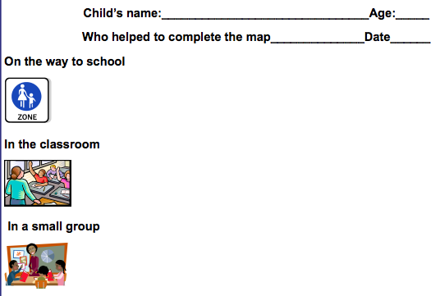
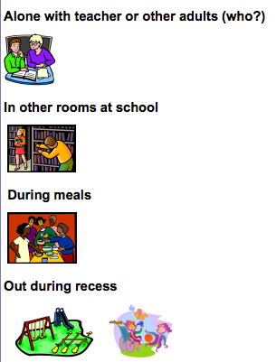
Notes:
EXAMPLE OF A TALKING MAP FOR YOUNGER CHILDREN, SCHOOL VERSION
The talking map is helpful in the assessment of selective mutism. Depending on the age, one can ask
the child to point or draw stars in situations they do talk, or use colorful post-it notes, for example green
for talking, yellow for nonverbal communication, and red for muteness. The map can provide information
on how the child views their speaking behavior in different situations. It can also be used to evaluate
change over time.

Slide 19
Selective Mutism
Rating Scales
Revised Children’s Anxiety & Depression Scale (RCADS)
The Selective Mutism Questionnaire (for parents)
School Speech Questionnaire (for teachers)
Social Communication Anxiety Inventory (S-CAI)
Notes:
General
Several rating scales for anxiety symptoms are available (see Chapter F.1
of the textbook). The free to use Revised Children’s Anxiety and Depression Scale
(RCADS) includes a screening item on speaking behavior:
Item 38. My child feels afraid if he/she has to talk in front of the class.
The response alternatives are “never”, “sometimes”, “often” and “always” and
a user’s guide is available at the website.
Selective mutism questionnaires
The most widely used standardized questionnaires were developed by
Lindsey Bergman and are included in her recent manual for the treatment of SM
(Bergman, 2013). A parent version, The Selective Mutism Questionnaire (Bergman
et al, 2008) and the teacher rated School Speech Questionnaire (Bergman et al,
2002) are available free at this website. Versions in other languages are available by
contacting the author.
Although an overall score can be obtained by adding the ratings as an
expression of the severity of the mutism, these questionnaires are quantitative
measures of severity only, there is no diagnostic cut-off score. Diagnosis should be
based on the clinical examination. SM questionnaires are helpful in the assessment
of SM symptoms before, during and after treatment. In the parent version ratings
are made for three different settings: school, home, and in social situations outside
school. Overall subscale scores and a total score can be obtained. The teacher
version rates speaking behavior in the school as assessed by the teacher.
The Social Communication Anxiety Inventory (S-CAI) by Elisa Shipon-Blum
highlights the variety of SM behaviors by increasing the response options: noncommunicative,
nonverbal, transitional and verbal stages (see example items for
the “home” situation below). A visual bridge illustrating the stages can be seen
here.

Slide 20
Selective Mutism
Treatment: Factors to consider
Vulnerability factors:
    genetics, temperament, social anxiety, behavioral inhibition, neurodevelopmental disorders
Triggering factors:
    transitions, starting kindergarten or school, migration, use of a new language
Sustaining factors:
    either too much acceptance of non-speech or too much pressure put on the child to speak
Notes:
It is helpful to conceptualize treatment taking into account three groups of
factors:
1. Vulnerability factors (genetics, temperament, social anxiety, behavioral
inhibition, and neurodevelopmental disorders). The focus of treatment
is not in changing temperament. If neurodevelopmental disorders are
present, adequate help for these must be implemented at school.
2. Triggering factors (transitions and unexpected events such as starting
kindergarten or school, migration, use of a new language). Children
with SM benefit from preparation, training, and by being allowed
more time to adjust to the new situation or transition, as well as from a
structured environment where they know what to expect.
3. Sustaining factors (the behavior of the people surrounding the mute
child). There are two opposite risks. One is to accept the child’s avoidance, speaking for them and accepting their inability to improve
their communication. The other is to expect communication that
the child is unable to meet in that situation. Although well intended,
both attitudes are not helpful, increase the child’s discomfort and can
aggravate symptoms (see text box below).

Slide 21
Selective Mutism
Treatment: Components
Cognitive Behavioral Therapy
  Decrease speech anxiety
  Graduated exposure tasks
  Rewards for speaking behavior
Psychosocial Treatments
  Psycho-educational literature for parents
  Coordination with teachers
Pharmacotherapy
Notes:
SM is widely considered hard to treat and there are few high quality studies
of effectiveness. The treatment literature has been dominated by case studies or case
series including a wide array of treatment approaches reflecting to a large extent the
theoretical orientation of the authors. Data are still scarce on treatment outcomes
and on predictors of these outcomes. The few existing long-term outcome studies
are retrospective, with little specific information about the treatment given at the
clinics years ago. In 2006, a review of the psychosocial treatment literature stated
with some caution that cognitive behavioral therapy was recommended (Cohan et
al, 2006a). In recent years, evidence based CBT interventions especially adapted
for children with SM have been developed (Klein et al, 2016; Bergman, 2013;
Oerbeck et al, 2014). All advocate early intervention and, although somewhat
different in design, frequency, duration, and location of treatment sessions,
striking similarities exist between them and with pioneering work on the treatment
of SM by British, Canadian and American groups (Johnson & Wintgens, 2007;
McHolm et al, 2005; Kearney, 2010). Another Canadian group published a review
of treatment for SM (psychosocial approaches and use of medication) (Manassis,
2009).
For the sake of simplicity, common key treatment factors are outlined below.
Then, a brief review of the evidence about psychosocial interventions is presented
and illustrated with case examples.
• Interventions are in general multidisciplinary and focus on decreasing
anxiety, increasing social speech and ameliorating SM-related
impairment
• All approaches emphasize the behavioral components of the CBT, as
the symptom of mutism and the typically young age of onset make
cognitive restructuring less feasible. Graduated exposure tasks and
rewards for speaking behavior (reward contingency) are used
• Parental involvement is essential. Psychoeducation about SM and
information on how to best help their children by reducing enabling
behaviors (for instance, communicating for their mute children) and
by providing communication opportunities in low-anxiety home
and public situations, is mandatory. See side textbox for suggested
literature to use for children with SM. See also a parental information
leaflet offered by SMIRA, a British support group for SM.
• Extensive involvement of, and coordination with teachers are
needed, as children with SM tend to be most symptomatic at school.
Psychoeducation about SM, consultations during treatment, and
simple exposure tasks at school are used.
• As children with SM often fail to speak to the therapist, a strategy to
secure early child engagement is vital. Seeking information about what
the child really likes, the use of funny favorite games and play activities,
and making rewards attractive are central.
• A main treatment goal is to decrease speech anxiety by reducing
pressure to speak and increasing comfort by not expecting the child to
look directly at the therapist. This behavior may seem like a paradoxical
intervention and to work against the ultimate goal of increasing speech.
However, this has been found crucial for children with SM to loosen
up and engage in communication with unfamiliar people in a new
situation.

Slide 22

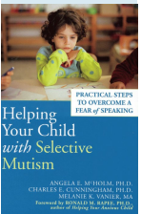

Selective Mutism
Psycho-educational Literature

Slide 23

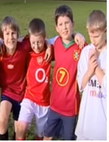
Selective Mutism
Treatment
https://www.youtube.com/watch?v=yPIEgeZiWDo
https://www.youtube.com/watch?v=QgFKuBCKhUw
Notes:
Part 3 and 4 of the documentary, Help Me to Speak, illustrates aspects of psychological and pharmacological treatment

Slide 24
Selective Mutism
Psychotherapy: Integrated Behavioral Therapy by Lindsey Bergman
Conducted at clinic by experienced clinicians with parental participation
20 sessions
Graded exposure tasks to feared stimuli/situation
Therapists in close communication with teachers about exposure tasks
Pilot randomized controlled trial of 21 children
  Significant increase of speech after treatment
  67% no longer qualified for selective mutism
  Clinical gains maintained at 3 months
  Social anxiety symptoms improved per parent not teacher report
Notes:
This treatment is conducted at the clinic by experienced clinicians with
parental participation using graded exposure tasks to the feared stimuli/situation
(verbal communication) (Bergman, 2013). Therapists are in close communication
with teachers to ensure relevance of exposure tasks at school. A pilot randomized
controlled study including 21 children (4 to 8 years of age) found a significant
increase of speech after treatment, with no change in wait-list controls (Bergman
et al, 2002). Importantly, 67% of the children who received treatment no longer fulfilled diagnostic criteria for SM and clinical gains were maintained at 3 months
follow-up (Bergman et al, 2013). Diagnostic comorbidity was not assessed but
significant reductions were found in social anxiety symptoms per parent but not
per teacher report. See Appendix F.5.1 for an overview of the 20 sessions in the
Bergman treatment approach.
Bergman’s manual provides forms and charts helpful in the assessment and
treatment of SM, including suggested exposure exercises. Structured assignments,
planned rewards, outcome description and the rating of child’s feelings are
highlighted. See Appendix F.5.2 and F.5.3 for examples. Click here to access
resources that you can download from the manual.

Slide 25
Selective Mutism
Psychotherapy: Social Communication Anxiety Treatment (S-CAT) by Elisa Shipon-Blum
Nine 3-weekly sessions
Also at the clinic with parental participation using graduated exposure tasks and consultation with teachers
Increasingly demanding verbalization stages using SM-Social Communication Comfort Scale
Pilot study of 40 children
  Significant increase of speech by parent rating
  Low SM symptom severity and high family therapy compliance associated with better outcome
Notes:
This treatment is also conducted at the clinic with parental participation using
graduated exposure tasks and consultation with teachers to ensure understanding of
SM and relevance of exposure tasks at school. The therapy consists of nine 3-weekly
sessions employing extensive transfer of control to parents between the sessions to
promote generalization of therapeutic gains. S-CAT incorporates behavioral and
cognitive strategies to help children communicate socially within a framework of
verbalization stages (see Appendix F.5.3) that become increasingly demanding,
using the SM-Social Communication Comfort Scale (a detailed description can be
found here).
A pilot study without a control group of the S-CAT program, which
included 40 children with SM aged 5 to 12 years, found a significant increase of
speech as rated by parents. Low SM symptom severity and high family therapy
compliance were associated with better outcome (Klein et al, 2016). A detailed
description of Shipon-Blum’s S-CAT program is available here.

Slide 26
Selective Mutism
Psychotherapy: Home & School Based Intervention for SM by Hanne Kristensen
Starts at home and extends to school
Useful in rural areas or where limited access to experts
Teacher etc can carry out intervention under supervision from clinician
Pilot study of 7 children:
  6 spoke freely after 14 weeks
  Continued 1.5 years later
RCT of 24 children
  Significant increase of speech after 3 months
Multiple other studies positive
Notes:
This treatment starts at home, where the child feels safer and is more likely
to start talking and extends to school where the symptoms are more severe. This
treatment approach could be particularly useful in rural areas or where access
to expert clinics is lacking. A teacher or another key person may carry out the
intervention under supervision from a clinician. See Appendix F.5.4 for an
overview of the home and school based intervention.
A favorable outcome was found in a pilot study of seven preschool children
diagnosed with long standing SM (mean 20 months) (Oerbeck et al, 2012). Six of
the seven children spoke freely in all preschool settings after a mean of 14 weeks
treatment, and still did at the 1.5 year follow-up. In a randomized controlled
study including 24 children with SM (age 3 to 9 years), we found a significant
increase of speech after three months of treatment, with no change in wait-list
controls (Oerbeck et al, 2014).
A long-term follow up of 30 of 32 children (aged 3-9 years) who completed this program in Norway showed that, according to parents and teachers, 21of 30 children no longer fulfilled diagnostic criteria for SM. Four children still suffered from SM and five showed partial remission (e.g., they spoke in some but not all school situations). Information from the children themselves was included in this follow-up, and the children rated their overall quality of life as good. (Oerbeck et al, 2018)

Slide 27
Selective Mutism
Medication Treatment: Factors to consider
Not much evidence, so off-label
2 trials: fluoxetine and sertraline
Potential side effects
Use in concert with therapy
Child must have failed therapy alone
Symptoms severe and handicapping
May be more effective in older children
Notes:
The use of medication in children with SM is largely “off label” due to
the paucity of empirical evidence; medication should be considered only in very
special circumstances. Currently there are two small blind trials, one for fluoxetine
and the other for sertraline (Manassis et al, 2016). Medications used are largely
based on extrapolating results from the treatment of other anxiety disorders. It
is important to acknowledge this reality and to explain the rationale for using
medication—e.g., lack of response to psychological treatment, the strong link
between SM and social anxiety disorder (Compton et al, 2014). This often makes
families wonder if it is worth risking the potential adverse effects of medication.
However, the risk of deterioration in social and academic functioning can be high
when SM is not effectively treated, and medication has the potential to improve
these functional outcomes (Manassis & Tannock, 2008). If anxiety decreases
with medication, some children may progress more quickly with psychosocial
treatment. It is also reassuring to families if one indicates that medication response
(positive or negative) and side effects will be monitored closely, and there is a plan
for discontinuing medication once the child is speaking normally in most social
settings.
In the case of Ellen, the child’s symptoms persisted for over two years despite
four months of intensive psychosocial treatment. An attempt at a “fresh start” with a change of school had failed and her social functioning was clearly deteriorating.
These events seemed to justify the use of medication. However, the question of
when to use medication in SM is not easy to answer (see also video clips #3 and
#4. When deciding whether or not to recommend medication, several factors must
be considered:
• The limited evidence of effectiveness and potential side effects,
particularly in pre-pubertal children
• Medication should be used in concert with psychosocial treatment, not
as a monotherapy
• It must be clear that the child is failing to respond to psychosocial
treatment alone and that symptoms are severe and handicapping. There
is some debate as to how long psychosocial treatment should continue
before adding medication but most authors suggest several months
• Because older children appear to have a lower rate of response to
psychosocial treatment than younger ones (Oerbeck et al, 2015),
medication may be considered earlier in older children. Medication
may also be considered earlier in locations where psychosocial treatment
is not readily available.
Fluoxetine is the best studied though there are some reports for other
selective serotonin reuptake inhibitors (SSRI’s) and also for two monoamine
oxidase inhibitors (MAOIs): phenelzine and moclobemide (Manassis et al, 2016).
The use of MAOIs in children is to be avoided given the potential side effects and
foodstuffs interactions. We recommend starting with fluoxetine and switching to
sertraline if there is poor tolerance or lack of response.

Slide 28
Selective Mutism
How should medication be prescribed?
Younger children: 5mg fluoxetine or 12.5mg sertraline
Monitor for weight change, behavioral activation, increased suicidal behavior
Improvement more noticeable at school
Improvement after 2-4 weeks at optimal dose
Taper off medication once good social and academic functioning
If symptoms return, resume lowest effective dose
Long term effects unknown
Notes:
Younger children (under age 7 or so) may start with 5mg of fluoxetine per
day, either in liquid form or (if not available) by taking a 10mg capsule every other
day. Due to its long half-life, the dosage of fluoxetine can be titrated by adjusting
the number of capsules taken per week. If switching to sertraline, 12.5mg per day
could be prescribed initially (i.e., half a 25mg capsule). As in the case example of
Ellen, dosage adjustment may be needed because children vary widely in their
medication needs and tolerance.
It is prudent to monitor the child’s weight, which is sometimes affected by
medication-related nausea, especially early in treatment. Behavioral activation, a
SSRI adverse effect, is not uncommon in children (Strawn et al, 2015); it may
require a reduction of the dose or change of medication. The possibility of an
increase in suicidal behaviour, although uncommon (Bridge et al, 2007), should
be mentioned to the family and appropriate steps put in place to ensure safety.
When evaluating benefit, it is important to obtain information from teachers as
well as parents, and from the child once communicating a little. When medicated,
improvement is often not noted in the home environment, where symptoms are
typically less severe, but is more noticeable at school. Improvement can take time:
typically two to four weeks at an optimal dose, but often several more weeks before
change translates into more appropriate verbal communication. Regular follow up,
e.g., every couple of weeks, is ideal in order to monitor for adverse effects, adjust
dosage, and continue with psychosocial treatment.
Tapering off medication over the summer vacation is usually not advisable,
as the start of school in autumn is often a challenging time for children with SM,
sometimes prompting relapse. Nevertheless, when the child speaks normally in
most social settings and has established good social and academic functioning,
clinicians should taper off medication. Usually, this is done by reducing dosage,
waiting for a few weeks for the re-emergence of symptoms, reducing dosage further
and waiting again, and then stopping medication if the symptoms do not recur. If
symptoms do recur, medication is increased to the lowest previously effective level.
Then, medication dosage can be re-evaluated every six months or so, ensuring that
the child continues on the lowest dosage needed. The risks and benefits of longterm
medication use are unknown.

Slide 29
Selective Mutism
Culturally Specific Issues
International variation
  Importance of children’s ability to present orally at school
  Amount of acceptable pressure on children to increase speaking
  How acceptable it is for health personnel to help children at home or school
  How readily people are willing to use medication
Notes:
The boundaries between normality and pathology vary across cultures.
Hence, whether a behavior is considered problematic will differ. The threshold
of tolerance for situational muteness varies across cultures, social settings, and
families. However, for SM—that is, in terms of the disorder itself—just about
all cultures (even those where shyness/reticence is considered a positive quality)
would consider the behavior aberrant and parents would want help to improve
their child’s functioning.In our opinion, the cultural issues that demand most sensitivity in relation
to SM have to do with treatment:
• Internationally, there is variation about the importance placed on
children’s ability to present orally at school. Also varying is the amount
of pressure considered acceptable when helping a child to increase
speaking behavior
• In the delivery of psychosocial treatment, it varies from country to
country whether health personnel are permitted or willing to help
children at home or at school
• Concerning pharmacotherapy, there is great variation in how readily
people are willing to use medication for SM. In many countries, such
treatment is considered “off label”—meaning that physicians prescribe
it without official approval from health regulators, usually because
there is not enough evidence of effectiveness.

Slide 30
Selective Mutism
Key Points
Relatively rare
Significant social/academic impairment
Cardinal symptom=consistent failure to speak in specific setting despite normal speaking in other setting
Runs in families
Associated with behavioral inhibition
Prevalent comorbidities: anxiety and neurodevelopmental disorders
Input from parents and teachers
First steps: psychoeducation and behavioral management
Gradual exposure and reward contingency=treatment of choice
Notes:
SM is a relatively rare childhood disorder that causes significant
impairment of social and academic functioning
• The cardinal symptom of SM is a consistent failure to speak in specific
settings (e.g., school, social situations) despite speaking normally in
other settings (e.g., at home)
• SM runs in families and is associated with the temperamental trait
behavioral inhibition
• Comorbid conditions are prevalent, especially other anxiety disorders
and neurodevelopmental disorders, and it is important to assess the
child for these
• Assessment requires experience, sensitivity, and detailed information
from parents and teachers as well as evaluating the child
• Psychoeducation and behavioral management are usually the first steps
• A structured treatment approach focusing on gradual exposure to the
feared task (speaking) with reward contingency is the treatment of
choice

Slide 31
Selective Mutism
Key Points (cont’d)
Consider medication:
  If no or partial response to psychosocial treatment
  If psychosocial treatment not available
  Only in conjunction with psychosocial treatment
No medication approved in children and adolescents
Studies suggest cautious optimism for SSRIs
If untreated, high risk for:
  Other psychiatric disorders
  Anxiety disorders
  Continued social/academic impairment
Notes:
• Medication may be useful when there is no, or partial response to
psychosocial treatment. Medication can be considered earlier where
psychosocial treatment is not available
• If at all possible medication should be used in concert with psychosocial
treatment for SM, not as a monotherapy
• Currently, no medication is approved for children and adolescents with
SM. However, a growing number of studies suggest cautious optimism
regarding SSRIs
• If left untreated, SM is associated with a higher risk for other psychiatric
disorders, especially anxiety disorders, as well as continued impairment
in social and academic functioning.

Slide 32

Selective Mutism
Thank You!

