Slide 1
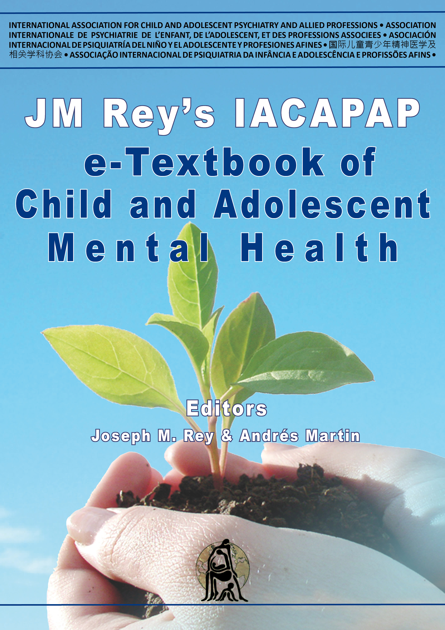
INTRODUCTION
Chapter A.4
THE CLINICAL ASSESSMENT OF INFANTS,
PRESCHOOLERS AND THEIR FAMILIES
TS
Sarah Mares & Sarah
Woodgate
Companion PowerPoint Presentation
Adapted by Grace Sameve & Julie Chilton

Slide 2
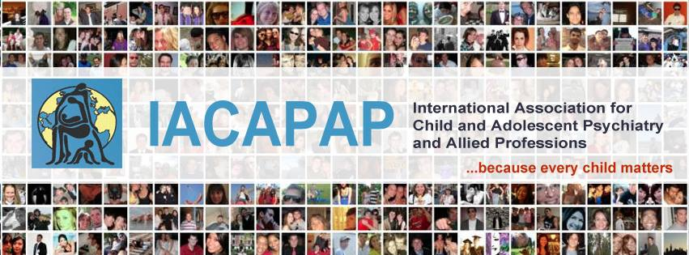
The “IACAPAP Textbook of Child and Adolescent Mental Health” is available at the IACAPAP website http://iacapap.org/iacapap-textbook-of-child-and-adolescent-mental-health Please note that this book and its companion PowerPoint are: · Free and no registration is required to read or download it · This is an open-access publication under the Creative Commons Attribution Non- commercial License. According to this, use, distribution and reproduction in any medium are allowed without prior permission provided the original work is properly cited and the use is non-commercial.

Slide 3
Clinical Assessment of Infants, Pre-Schoolers and Their Families Outline
Early Relationships
Attachment Theory
Clinical Assessment
Parent Interactions
Developmental Assessment
Formulation
Diagnosis
Medical Settings
Assessing Risk
Conclusions
Mother breastfeeding her son by Kitagawa Utamaro (Japan, 1753-1806)
Notes:
By the end of this presentation, you should understand the following about the clinical assessment of infants, pre-schoolers and their families
Health professionals meet families with infants and young children in many different circumstances, from the family home to acute hospital settings. The extent to which mental health and development is the focus of assessment and intervention will be determined by the setting and the family and their presenting concerns. Children’s social and emotional wellbeing and physical health and development cannot be considered in isolation or separately from the quality of family relationships and social and cultural context. Wherever they live and whichever culture they are born into, all babies depend on warm, responsive, language rich, protective environments in which to grow and develop. The quality of care that small children receive is critical to their survival, growth and psychological development (WHO, 2004).
How families and communities meet children’s developmental needs varies greatly across cultures and communities. For example, the small family group typical of many western nations differs greatly from the multiple caretaking arrangements in many other parts of the world.
This chapter outlines a framework for assessing infants, young children and their families. It provides an approach to understanding and formulating their difficulties that can be adapted to a range of settings. No matter what the presenting issue, a comprehensive assessment always includes factors that contribute to resilience and vulnerability in the child, the parents and wider family, and the social and cultural context. This information is used to inform and focus interventions. Assessment of risk (e.g., developmental risk, risk of harm to the infant or the caregiver) is also part of all infant and early childhood health and mental health assessments. The aims of this chapter are: to enhance the interest and ability of health professionals to assess mental health and developmental issues in all their dealings with families who present during this period of rapid developmental change, and to introduce the clinical field of infant mental health, an area of research and practice that has developed substantially over the last 30 years.

Slide 4
Clinical Assessment of Infants, Pre-Schoolers and Their Families Psychologically Healthy Infant
Ability to form close and secure interpersonal relationships
Drive to explore environment and learn
Context of family, community and cultural expectations
Healthy social and emotional development
Notes:
A psychologically healthy infant is characterized by:
• The ability to form close and secure
interpersonal relationships
• Drive to explore the environment and learn
• All within the context of family, community, and cultural expectations for the child
• Synonymous with healthy social and
emotional development

Slide 5

Clinical Assessment of Infants, Pre-Schoolers and Their Families Infants: Importance of Early Relationships
Born ready to relate
Crucial role of family
Genetically and biologically programmed
Parenting quality
Social and physical circumstances
Sensitive and critical periods
https://www.zerotothree.org/
Notes:
There is increasing evidence of the infant’s capacity and motivation for social interaction, exploration of the environment and learning from birth. The infant “self ” or “person” emerges in the context of early caregiving relationships during the transition from almost total dependence on caregivers towards independence and early self-regulation. Infants are born ready to relate, and the family has a crucial part in facilitating and supporting infants’ development throughout the early years. Their capacity to do this affects the strengths and vulnerabilities infants will carry for their lifetime.
Parenting quality also has a developmental impact. The child’s carers are vital in supporting the unfolding of the infant’s social and emotional capacities. The family (infant, caregivers, and siblings) exists within a network of relationships and culture that includes their social and physical circumstances of the family. These can either support or undermine the family’s quality of life and relationships. The infant is genetically and biologically programmed for development but particular environmental experiences are required at specific times - known as sensitive and critical periods for optimal development - and early support and adversity influence how the baby’s genetic endowment is expressed and realised. The lifetime effects of adversity in childhood are now well recognised (Anda et al, 2006).
The first year involves the development of the basics for language and the establishment of attachment relationships. The second year of life involves two major achievements (i) language and symbolic play, and (ii) mobility. Mobility allows children to explore and develop cognitively and to develop independence from the caretaker. The toddler experiments with separation and develops a sense of identity and autonomy. During the third and fourth years of life children consolidate, refine and expand these abilities into a sense of self in relation to others and their place in the world (see Chapter A.2, Table A.2.1).
A series of podcasts, videos and print handouts about early development are available at the Zero to Three website. Click on the picture to view

Slide 6
Clinical Assessment of Infants, Pre-Schoolers and Their Families Importance of Early Relationships
1st Year
Basics for language
Attachment relationships
2nd Year
Language and symbolic play
Mobility → exploration, cognition, independence
3rd & 4th Years
Consolidation, refinement, expansion
Sense of self
Notes:
The first year involves the development of the basics for language and the establishment of attachment relationships. The second year of life involves two major achievements (i) language and symbolic play, and (ii) mobility. Mobility allows children to explore and develop cognitively and to develop independence from the caretaker. The toddler experiments with separation and develops a sense of identity and autonomy. During the third and fourth years of life children consolidate, refine and expand these abilities into a sense of self in relation to others and their place in the world (see Chapter A.2, Table A.2.1).

Slide 7
Clinical Assessment of Infants, Pre-Schoolers and Their Families Early Relationships: Cultural Context
Core questions:
How are needs met?
Who is meeting these needs?
How is sense of self, agency and obligation supported?
How are they socialized?
What is cultural context?
Notes:
Children are raised within a range of family and community constellations and multiple caretaking arrangements are widespread cross-culturally. A focus on understanding children’s relational networks and their adaptive value in particular family and community environments is an essential element of assessment. There is an expanding literature identifying the core elements of adequate care for infants and how this is provided in different cultures. This includes how children’s needs are met and by whom. It also considers how a child’s sense of self, and their developing sense of agency and obligation, is supported and will vary depending on the community where they are raised and how they are socialized (Keller, 2016).
Health workers have an obligation to consider how their own cultural and family experiences may influence their perceptions of and expectations about what appropriate care for children involves. This is particularly true when working in communities where there is cultural and linguistic diversity. Given high rates of voluntary migration and the vast number of displaced people across the world, cultural competence and sensitivity are increasingly necessary.

Slide 8
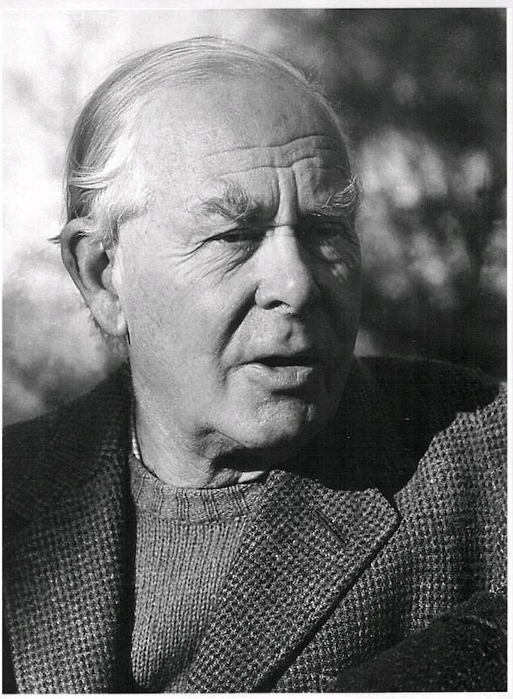
Clinical Assessment of Infants, Pre-Schoolers and Their Families Attachment Theory
“An integrated body of theory and practice that enables links to be made between behaviour and inner representations of relationships, and between the experiences of one generation and the care they will provide to the next—that is, trans-generational aspects of parenting.”
John Bowlby (1907-1990), a British psychiatrist, was the main theorist behind the concept of attachment
Notes:
Attachment theory (see also Chapter A.2) was developed by John Bowlby from a range of previously separate and diverse areas of knowledge (Bowlby, 1969). It is an integrated body of theory and practice that enables links to be made between behaviour and inner representations of relationships, and between the experiences of one generation and the care they will provide to the next—that is, trans-generational aspects of parenting. Attachment can be defined as an enduring emotional bond characterised by a tendency to seek and maintain proximity to a specific figure(s), particularly when under stress. Attachment theory understands the nature of infants’ attachment to their caregivers as a primarily biologically determined phenomenon upon which survival depends. The quality of attachment relationships developed between a young child and their caregivers has a significant impact on social, emotional and cognitive development across the lifespan. The infant develops internal working models of relationships from the quality and nature of early experience with caregivers, and this influences ongoing social and emotional development. Evidence from longitudinal studies indicates that security of attachment during infancy is linked to the young child’s developing capacity for self-regulation, reciprocity and collaborative social interactions (Sroufe et al, 2005). There is also growing evidence about the contribution that attachment security makes to a child’s self-regulation, attention and concentration, and therefore readiness to learn and to make the transition to school.
Attachment theory also provides explanations for the link between observed parenting behaviour, the quality of parent and infant relationships and the later functioning of the child, socially and emotionally. Attachment scholars have developed methods to elicit and evaluate aspects of the inner representational world of the infant, child, and adult. These processes include methods for evaluating the parent’s capacity to “mentalise” or reflect on, and understand mental states. They assess the parent’s capacity to wonder about, and empathise with, the experience of their child, as well as the impact of their own mental state on their children (Fonagy et al, 1991).
Research-based methods for assessing attachment such as the Strange Situation Procedure (Ainsworth et al, 1978), the Adult Attachment Interview (George et al, 1985), the Parent Development Index (Slade, 2005), and the Working Model of the Child (Benoit et al, 1997;Vreeswijk et al, 2012) are time consuming, require extensive training and cannot be easily utilised in the clinical situation. Universally accepted clinical and diagnostic protocols for assessing attachment at different ages and for diagnosing disorders of attachment do not exist although there is a range of approaches to this in clinical settings (Crowell, 2003; Zeanah et al, 2011). Many clinicians when consulted about children’s attachments are handicapped by having little formal training in, and much uncertainty about assessing attachment clinically (Crittenden et al, 2007). For this reason, outside a research context, it is advisable to describe what is observed between child and carer rather than to use language that may imply an attachment classification or diagnosis when formal assessment has not been undertaken. There is an emerging literature considering the application of attachment theory and classifications to families in diverse cultural contexts (Quinn & Mageo, 2013; Keller, 2013).
To date, however, there are few cross-cultural studies that consider issues of attachment disruption and disorder. This is opposed to descriptive studies that identify cultural diversity in approaches to early parenting and discuss how development, safety and exploration are supported and maintained in different cultural and community contexts.
Most infant and early childhood mental health interventions do not require formal assessment of attachment but a good understanding of attachment theory allows clinicians to assess emotional and behavioural problems from a relationship perspective. This includes a focus on the child’s relationship history, and problems and strengths in the relationship between the caregivers and the child, rather than a focus on strengths or difficulties as existing within the individual child alone (Zeanah et al, 2011). The principles of assessment are summarised in Table A.4.1. (Retain from original chapter p5)

Slide 9
Clinical Assessment of Infants, Pre-Schoolers and Their Families What Is Attachment?
“An enduring emotional bond characterised by a tendency to seek and maintain proximity to a specific figure(s), particularly when under stress”
Notes:
Attachment theory (see also Chapter A.2) was developed by John Bowlby from a range of previously separate and diverse areas of knowledge (Bowlby, 1969). It is an integrated body of theory and practice that enables links to be made between behaviour and inner representations of relationships, and between the experiences of one generation and the care they will provide to the next—that is, trans-generational aspects of parenting. Attachment can be defined as an enduring emotional bond characterised by a tendency to seek and maintain proximity to a specific figure(s), particularly when under stress. Attachment theory understands the nature of infants’ attachment to their caregivers as a primarily biologically determined phenomenon upon which survival depends. The quality of attachment relationships developed between a young child and their caregivers has a significant impact on social, emotional and cognitive development across the lifespan. The infant develops internal working models of relationships from the quality and nature of early experience with caregivers, and this influences ongoing social and emotional development. Evidence from longitudinal studies indicates that security of attachment during infancy is linked to the young child’s developing capacity for self-regulation, reciprocity and collaborative social interactions (Sroufe et al, 2005). There is also growing evidence about the contribution that attachment security makes to a child’s self-regulation, attention and concentration, and therefore readiness to learn and to make the transition to school.
Attachment theory also provides explanations for the link between observed parenting behaviour, the quality of parent and infant relationships and the later functioning of the child, socially and emotionally. Attachment scholars have developed methods to elicit and evaluate aspects of the inner representational world of the infant, child, and adult. These processes include methods for evaluating the parent’s capacity to “mentalise” or reflect on, and understand mental states. They assess the parent’s capacity to wonder about, and empathise with, the experience of their child, as well as the impact of their own mental state on their children (Fonagy et al, 1991).
Research-based methods for assessing attachment such as the Strange Situation Procedure (Ainsworth et al, 1978), the Adult Attachment Interview (George et al, 1985), the Parent Development Index (Slade, 2005), and the Working Model of the Child (Benoit et al, 1997;Vreeswijk et al, 2012) are time consuming, require extensive training and cannot be easily utilised in the clinical situation. Universally accepted clinical and diagnostic protocols for assessing attachment at different ages and for diagnosing disorders of attachment do not exist although there is a range of approaches to this in clinical settings (Crowell, 2003; Zeanah et al, 2011). Many clinicians when consulted about children’s attachments are handicapped by having little formal training in, and much uncertainty about assessing attachment clinically (Crittenden et al, 2007). For this reason, outside a research context, it is advisable to describe what is observed between child and carer rather than to use language that may imply an attachment classification or diagnosis when formal assessment has not been undertaken. There is an emerging literature considering the application of attachment theory and classifications to families in diverse cultural contexts (Quinn & Mageo, 2013; Keller, 2013).
To date, however, there are few cross-cultural studies that consider issues of attachment disruption and disorder. This is opposed to descriptive studies that identify cultural diversity in approaches to early parenting and discuss how development, safety and exploration are supported and maintained in different cultural and community contexts.
Most infant and early childhood mental health interventions do not require formal assessment of attachment but a good understanding of attachment theory allows clinicians to assess emotional and behavioural problems from a relationship perspective. This includes a focus on the child’s relationship history, and problems and strengths in the relationship between the caregivers and the child, rather than a focus on strengths or difficulties as existing within the individual child alone (Zeanah et al, 2011). The principles of assessment are summarised in Table A.4.1. (Retain from original chapter p5)

Slide 10
Clinical Assessment of Infants, Pre-Schoolers and Their Families Attachment
Primarily biologically determined
Quality impacts later development
Creates internal working models of relationships
Linked to self-regulation, reciprocity and collaborative social interactions
Relationship-based assessment
-Problems in dyad/triad
-Strengths in dyad/triad
Effects on self-regulation, attention, concentration determine readiness for school
Notes:
Attachment theory (see also Chapter A.2) was developed by John Bowlby from a range of previously separate and diverse areas of knowledge (Bowlby, 1969). It is an integrated body of theory and practice that enables links to be made between behaviour and inner representations of relationships, and between the experiences of one generation and the care they will provide to the next—that is, trans-generational aspects of parenting. Attachment can be defined as an enduring emotional bond characterised by a tendency to seek and maintain proximity to a specific figure(s), particularly when under stress. Attachment theory understands the nature of infants’ attachment to their caregivers as a primarily biologically determined phenomenon upon which survival depends. The quality of attachment relationships developed between a young child and their caregivers has a significant impact on social, emotional and cognitive development across the lifespan. The infant develops internal working models of relationships from the quality and nature of early experience with caregivers, and this influences ongoing social and emotional development. Evidence from longitudinal studies indicates that security of attachment during infancy is linked to the young child’s developing capacity for self-regulation, reciprocity and collaborative social interactions (Sroufe et al, 2005). There is also growing evidence about the contribution that attachment security makes to a child’s self-regulation, attention and concentration, and therefore readiness to learn and to make the transition to school.
Attachment theory also provides explanations for the link between observed parenting behaviour, the quality of parent and infant relationships and the later functioning of the child, socially and emotionally. Attachment scholars have developed methods to elicit and evaluate aspects of the inner representational world of the infant, child, and adult. These processes include methods for evaluating the parent’s capacity to “mentalise” or reflect on, and understand mental states. They assess the parent’s capacity to wonder about, and empathise with, the experience of their child, as well as the impact of their own mental state on their children (Fonagy et al, 1991).
Research-based methods for assessing attachment such as the Strange Situation Procedure (Ainsworth et al, 1978), the Adult Attachment Interview (George et al, 1985), the Parent Development Index (Slade, 2005), and the Working Model of the Child (Benoit et al, 1997;Vreeswijk et al, 2012) are time consuming, require extensive training and cannot be easily utilised in the clinical situation. Universally accepted clinical and diagnostic protocols for assessing attachment at different ages and for diagnosing disorders of attachment do not exist although there is a range of approaches to this in clinical settings (Crowell, 2003; Zeanah et al, 2011). Many clinicians when consulted about children’s attachments are handicapped by having little formal training in, and much uncertainty about assessing attachment clinically (Crittenden et al, 2007). For this reason, outside a research context, it is advisable to describe what is observed between child and carer rather than to use language that may imply an attachment classification or diagnosis when formal assessment has not been undertaken. There is an emerging literature considering the application of attachment theory and classifications to families in diverse cultural contexts (Quinn & Mageo, 2013; Keller, 2013).
To date, however, there are few cross-cultural studies that consider issues of attachment disruption and disorder. This is opposed to descriptive studies that identify cultural diversity in approaches to early parenting and discuss how development, safety and exploration are supported and maintained in different cultural and community contexts.
Most infant and early childhood mental health interventions do not require formal assessment of attachment but a good understanding of attachment theory allows clinicians to assess emotional and behavioural problems from a relationship perspective. This includes a focus on the child’s relationship history, and problems and strengths in the relationship between the caregivers and the child, rather than a focus on strengths or difficulties as existing within the individual child alone (Zeanah et al, 2011). The principles of assessment are summarised in Table A.4.1. (Retain from original chapter p5)

Slide 11
Clinical Assessment of Infants, Pre-Schoolers and Their Families Attachment Theory
Parental capacity to consider child’s mental states:
Mentalize, reflect on, understand
Wonder about
Empathize with
Consider their own state’s effect
Notes:
Attachment theory also provides explanations for the link between observed parenting behaviour, the quality of parent and infant relationships and the later functioning of the child, socially and emotionally. Attachment scholars have developed methods to elicit and evaluate aspects of the inner representational world of the infant, child, and adult. These processes include methods for evaluating the parent’s capacity to “mentalise” or reflect on, and understand mental states. They assess the parent’s capacity to wonder about, and empathise with, the experience of their child, as well as the impact of their own mental state on their children (Fonagy et al, 1991).

Slide 12
Clinical Assessment of Infants, Pre-Schoolers and Their Families Attachment Theory
Attachment Patterns – the ABC+D model
Disorganised: no coherent strategy for managing distress in relation to caregiver
Organised
-Secure
-Insecure/avoidant
-Insecure/ambivalent
Attachment Patterns ≠ Attachment Disorders
Notes:
Attachment theory describes three patterns of what are called organised attachment strategies and one disorganised attachment pattern. This is known as the ABC+D model (Cassidy & Shaver, 2008) (see also Circle of Security website). Children develop these patterns of behaviour and managing feelings in response to repeated interactions with their caregivers. Such strategies are organised to maintain proximity to caregivers and to manage displays of affect particularly at times of distress. Organised attachment patterns are classified as secure, insecure/ avoidant and insecure/ambivalent. Disorganised attachment behaviour is considered to indicate that the child has failed to develop a coherent strategy for managing distress in relation to their caregiver. This most often occurs when the caregiver is simultaneously the source of comfort as well as the cause of distress and anxiety, for example in situations of child maltreatment. (see Howe 2005, Lyons-Ruth et al 2005). Attachment disorders are distinct from attachment patterns, and are currently classified in DSM-5 as “trauma and stressor related disorders”, requiring the child to have “experienced a pattern of extremes of insufficient care…” (p265).

Slide 13

https://www.circleofsecurityinternational.com/
Notes:
The COS website contains useful information for parents and clinicians about the importance of attachment, attachment quality, approaches to parenting and interventions. Information about the core elements of this approach as well as training opportunities can be accessed and downloaded by clicking on the picture.

Slide 14
Clinical Assessment of Infants, Pre-Schoolers and Their Families Clinical Assessment
Clinical assessment interview
Observation of parent-child interaction and relationship
Developmental assessment of child
Notes:
Principles of Assessment
There are a number of core principles and issues that need consideration in any assessment of a family with an infant or young child, independent of the setting in which the assessment occurs or the background of the clinician. The principles are drawn from clinical experience and are informed by research and theoretical understandings of infancy, early childhood and family processes. An assessment informed by these core principles enables the clinician to develop an alliance with the family in order to understand the presenting problem, and decide where intervention and assistance are best targeted.
Principles of assessment:
1.Assessment of risk: Assessment of the immediate and longer term safety or risks to the infant, young child, and other family members is a necessary and inevitable aspect of all assessments. This focus may or may not be clear to the family, but is a key component of clinicians’ responsibilities and obligations.
2.Parents want the best for their children: Almost always, parents want the best for their children and family. The clinician’s role is to assist them in providing this.
3.Biopsychosocial framework: A biopsychosocial approach ensures that physical, psychological, interpersonal, social and cultural factors that contribute to the presentation of the family and infants are examined. The physical and psychosocial wellbeing of the infant cannot be considered separately
4.Developmental context: The perinatal and early childhood period is a time of transition and enormous growth for infant and family. Children develop at differing rates across a range of normal parameters and difficulties need to be understood in a developmental context. Emotional, behavioural and developmental problems presenting in infancy can have lifelong consequences but some are the manifestation of normal developmental transitions: over time, with adequate support, they will resolve
5.A relational approach: Early development can only be understood within the caregiving context. As described above, this includes attachments and the quality of the infants’ primary relationships. Although individual factors in the child or parent may contribute to current difficulties, the interaction or ‘fit’ between the needs and capabilities of each family member and the sources of stress and support in the family context, could determine outcome.
6.Vulnerabilities and strengths: Identifying vulnerabilities and strengths (also called risk and protective factors) helps shape and target interventions.
7.The transactional model of development: The transactional model of development (Sameroff & MacKenzie, 2003) emphasises the interaction between genetic and environmental factors overtime and ‘the development of the child is seen as a product of the continuous dynamic interactions of the child and the experience provided by his or her family and social context’ (Sameroff & Fiese, 2000, p.10)
A comprehensive assessment is based on an understanding of the developmental tasks of the period and observations of the child-carer relationship. It includes: The clinical assessment interview, observation of parent-child interaction and relationship, as well as developmental assessment of the child

Slide 15
Clinical Assessment of Infants, Pre-Schoolers and Their Families Clinical Assessment: Case Study
A two year-old girl
Alloanamnesa
Observation
A 2 year old girl
History of nervousness and agitation Often aggressive Calm with permissive maternal grandfather Shy with strangers Nuclear household: 8 years old, problem-free brother Permissive mother, abusive father
4 week assessment: Interview with parents Observation with child alone and interacting with parents
Plan: Parent Training Program, Limit setting, Daycare
Notes:
The parents of a two year-old girl brought her to a mental health outpatient clinic complaining that she had been “very nervous and agitated since she was one year old”. Her parents said she often became aggressive, hit her head on the wall at home and scratched herself. She would wake up stressed, refusing the bottle and scratching her mother. Her behaviour worsened when in contact with other children, so parents kept her at home. She was aggressive with adults, throwing toys on the floor or at people. They reported that she was calm when near her maternal grandfather, who did everything she wanted including things the parents considered dangerous. With Strangers she was very shy, keeping her head down and not talking. The parents could not identify a precipitant for the symptoms but the onset had coincided with the child learning to walk and therefore becoming more independent. She lived with her parents and her eight year old brother.
It was apparent that parents had very different approaches to managing her. The mother had difficulty setting limits, while the father, when he was at home, punished the girl physically (hitting her with slippers). The mother said she always wanted to have a daughter whom she could ‘dress like a princess’ and this girl had not been what she expected. The brother was very calm and obedient and had never been a problem.
The psychologist assessed the family during four weeks, interviewing the parents , observing the child alone and the interaction between children and parents. She referred the parents to a parent training program. After a few sessions, the parents found better ways to set limits and parent more consistently and the girl’s behavior improved. The next step was to support parents in sending the child to day care for a few days a week, giving her the opportunity to be with other children and adults.

Slide 16
Clinical Assessment of Infants, Pre-Schoolers and Their Families Clinical Assessment: Principles
Risk assessment
Parents want the best for their children
Biopsychosocial framework
Developmental context
Relational approach
Vulnerabilities and strengths
Transactional model of development
Notes:
Principles of Assessment
There are a number of core principles and issues that need consideration in any assessment of a family with an infant or young child, independent of the setting in which the assessment occurs or the background of the clinician. The principles are drawn from clinical experience and are informed by research and theoretical understandings of infancy, early childhood and family processes. An assessment informed by these core principles enables the clinician to develop an alliance with the family in order to understand the presenting problem, and decide where intervention and assistance are best targeted.
Principles of assessment:
1.Assessment of risk: Assessment of the immediate and longer term safety or risks to the infant, young child, and other family members is a necessary and inevitable aspect of all assessments. This focus may or may not be clear to the family, but is a key component of clinicians’ responsibilities and obligations.
2.Parents want the best for their children: Almost always, parents want the best for their children and family. The clinician’s role is to assist them in providing this.
3.Biopsychosocial framework: A biopsychosocial approach ensures that physical, psychological, interpersonal, social and cultural factors that contribute to the presentation of the family and infants are examined. The physical and psychosocial wellbeing of the infant cannot be considered separately
4.Developmental context: The perinatal and early childhood period is a time of transition and enormous growth for infant and family. Children develop at differing rates across a range of normal parameters and difficulties need to be understood in a developmental context. Emotional, behavioural and developmental problems presenting in infancy can have lifelong consequences but some are the manifestation of normal developmental transitions: over time, with adequate support, they will resolve
5.A relational approach: Early development can only be understood within the caregiving context. As described above, this includes attachments and the quality of the infants’ primary relationships. Although individual factors in the child or parent may contribute to current difficulties, the interaction or ‘fit’ between the needs and capabilities of each family member and the sources of stress and support in the family context, could determine outcome.
6.Vulnerabilities and strengths: Identifying vulnerabilities and strengths (also called risk and protective factors) helps shape and target interventions.
7.The transactional model of development: The transactional model of development (Sameroff & MacKenzie, 2003) emphasises the interaction between genetic and environmental factors overtime and ‘the development of the child is seen as a product of the continuous dynamic interactions of the child and the experience provided by his or her family and social context’ (Sameroff & Fiese, 2000, p.10)
A comprehensive assessment is based on an understanding of the developmental tasks of the period and observations of the child-carer relationship. It includes: The clinical assessment interview, observation of parent-child interaction and relationship, as well as developmental assessment of the child

Slide 17
Clinical Assessment of Infants, Pre-Schoolers and Their Families Clinical Assessment
Varied settings
Aim to identify and understand problems of:
Individual
Family
System
Sources
Referring agent
Family
Observations
Medical and Developmental tests
Past reports
Clinician impression
Notes:
The Setting for the Clinical Assessment
Assessment of infants and their families is undertaken in a wide range of settings and circumstances and so the approach will depend upon the clinician’s professional role, practice and the aims of the assessment. Visiting a family at home provides very different information from that obtained in a clinic setting. For example, a family may present only once to their local emergency department late at night when the parents are concerned their baby is unwell and won’t sleep. If seen at home, the practical and financial difficulties (for example, a one-room house and noisy neighbours) that affect their ability to focus on and settle their baby might become more evident. This would alter the focus of the assessment and require a different use of the clinician’s time as well as the potential engagement of other colleagues. Assessment may occur in a mental health setting because there is concern about parental depression and its impact on the infant. Alternatively, a family may be seen regularly in an early childhood clinic, allowing observation over time as their relationships develop and the infant grows. Concerns about abuse or neglect require evaluation and inevitably involve the clinician in the difficult task of establishing rapport and cooperation with parents who feel threatened, afraid or criticised. A developmental assessment or follow-up of a family with a child with medical or developmental problems includes a more direct medical or biological focus, but nonetheless needs to consider the familial and social context. There are no clear right or wrong ways but every clinician needs to think about the advantages and limitations of the approach they take and how this may impact on the information they obtain, and to be sure to include a focus on the relationship between the infant and the parents as well as any individual presenting concerns.
Aims of the Assessment
The essential aim of assessment, whatever the context or setting, is to identify and understand the problems facing the family as individuals and as a family system, their strengths and vulnerabilities, in order to assist them in maximising the developmental potential of their child. Information obtained during the assessment may also be used for other purposes, such as research into clinical or social conditions that affect parenting and child development.
Information is obtained about:
The current problem:
-Why have they come to see you ? (What is the problem?)
-How do family members understand and describe what is concerning them?
-Has this happened before?
-Was there a precipitant?
-Why have they sought help now?
-What have they tried and what has been helpful?
-What made them decide to seek help from you and your service?
-What do they want help with? What are their priorities?
The background and developmental history of child, parents and family
Current supports and stressors. This includes information about:
-The individual parent’s history of their own family and elationships
-Parents as a couple
-Conception, pregnancy and delivery
-Child’s evelopment since birth.

Slide 18
Clinical Assessment of Infants, Pre-Schoolers and Their Families Clinical Assessment
Key considerations:
‘Parents are experts with their child’s best interests at heart’
Non-judgmental listening
Genuine curiosity
Observation of behavior and interactions
Understand first, advise last
Notes:
The Assessment Process
There are a number of key considerations in assessing families with infants or young children. It is important to enable parents and caregivers to explore the complex emotions related to parenting and to support them to identify obstacles that may impede their best efforts. This process is best facilitated by an approach that starts from the assumption that parents are the experts on their child and have their child’s best interests at heart. In addition, non-judgemental listening and genuine curiosity about the problem, the family and the child are essential in communicating the clinician’s interest and concern. As the assessment includes a family member who is not yet verbal and able to tell their own story in words, observation of behaviour and interactions, of more than what is spoken, provides the clinician with rich information about the family system. Finally, the provision of information, advice and intervention should not precede a thorough understanding of the presenting issues.

Slide 19
Clinical Assessment of Infants, Pre-Schoolers and Their Families Clinical Assessment: Information Obtained
Current Problem
What is the problem? How do family members understand and describe what is concerning them? Has this happened before? Was there a precipitant? Why have they sought help now? What have they tried and what has been helpful? What made them decide to seek help from you? What do they want help with?
Background & Developmental History
Child, Parents and Family Current supports and stressors Parents as couple, conception, pregnancy and delivery
Notes:
Information is obtained about:
The current problem:
1.Why have they come to see you ? (What is the problem?)
2.How do family members understand and describe what is concerning them?
3.Has this happened before?
4.Was there a precipitant?
5.Why have they sought help now?
6.What have they tried and what has been helpful?
7.What made them decide to seek help from you and your service?
8.What do they want help with? What are their priorities?
The background and developmental history of:
1.Child
2.Parents and family
3.Current supports and stressors. This includes information about:
o The individual parent’s history of their own family and elationships
o Parents as a couple
o Conception, pregnancy and delivery
o Child’s evelopment since birth.

Slide 20
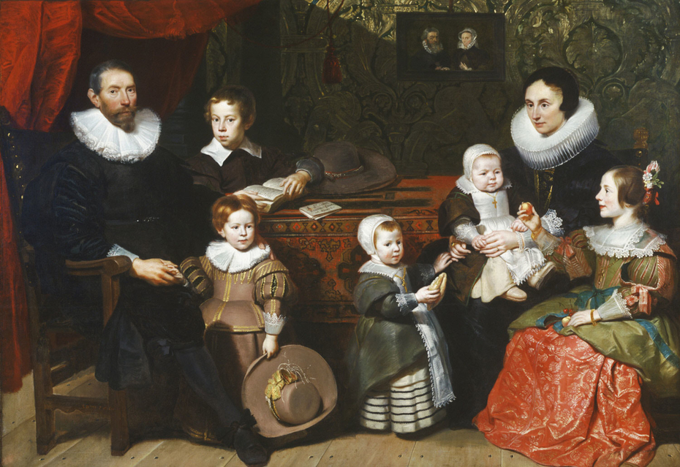
Clinical Assessment of Infants, Pre-Schoolers and Their Families Clinical Assessment: Interview
Goals:
Gather information and objective data
Form therapeutic relationship
Be clear and direct about purpose, professional roles and responsibilities, confidentiality
Listen carefully
Observe interactions
Construct narrative
Cornelis de Vos. Portrait of Anthony Reyniers and his family (1631) Philadephia Art Museum
Notes:
The Interview
The goal of the interview is not only to gather information and objective data, but also to form a therapeutic relationship within which the problem can be understood and hopefully resolved. Whether a family is seen only once or for a series of contacts, the process of developing a therapeutic alliance often determines success in eliciting the facts of the history. Just as parenting is primarily about relationships, so contact with distressed families needs to be understood as a professional relationship within which the family can feel heard and understood, and therefore better able to care for their child.
It is important to be clear and direct about the purpose of the interview, professional roles and responsibilities, and any limits to confidentiality. Even when assessing concerns about child maltreatment or providing a medico-legal report, the importance of the therapeutic alliance cannot be underestimated. Listen carefully to the family: Why have they come? What are their concerns? What do they want help with?
During the interview, there are opportunities to observe the infant or toddler and their interactions with the adults. A unique aspect of assessing families with an infant or young child is that frequently the “patient” has no words to tell their side of the story. In this case, what is observed about the child, their behaviour, their responses and the interaction between family members is crucial in helping the clinician understand the child’s experience.
The clinician and parents can then construct a narrative or “story”—an account of the family’s experience with the child—to make sense of what is happening. This understanding or “version of the story” is often modified through the assessment and intervention, as development and change occur.

Slide 21
Clinical Assessment of Infants, Pre-Schoolers and Their Families Clinical Assessment: Attachment-Informed Assessment
Conception, pregnancy and birth
Losses or significant family difficulties
Attachment figures
Peer and sibling relationships
Current behavior
Help or comfort seeking
Stranger behavior
Ability to use others for comfort
Explore and play in new setting
Response to limit setting
Clinician interaction
Notes:
Attachment-Informed Assessment
As noted above, formal assessment of attachment is not usually conducted in clinical settings, but an attachment-informed approach to assessment includes:
-The history of the conception, pregnancy and birth and any losses or significant difficulties for the family associated with this time.
-A history of the child’s attachments. It is important to focus on a chronological account of the significant attachment figures available to the child since birth, particularly disruptions in care, abandonment or losses, alternate caregivers, neglect of care and abuse. Availability of the current primary carer and contact with other caregivers should be noted, as well as the child’s behaviour with each, and response to changes of carer. In older children, relationships with peers and siblings should be described.
-Details and observations of the infant or child’s current behaviour. Of particular interest in relation to attachment quality and disruptions or disorder are:
-Help or comfort-seeking behaviour, including response to pain or distress (e.g., who do they go to if they fall and hurt themselves; do they show distress; are they discriminating about who can comfort them? are they shy with strangers?)
-Quality of interaction and ability to use caregiver or another adult for comfort, including ability to explore and play in a new setting, response to limit setting and the nature of the interaction with the clinician.
This needs to be understood within a developmental framework. A six-month-old is less likely to show shyness or fear of strangers than a 12-month-old. A three-year-old may be able to use verbal information from the carer (e.g., “I am going out for a minute, I will be back soon”) to tolerate a short separation while a 15-month-old is less able to do this.

Slide 22
Clinical Assessment of Infants, Pre-Schoolers and Their Families Clinical Assessment: Bio-Psycho-Social Framework
Biological:
Temperament
Genetic vulnerability and family history
Environment in utero, past and current health
Psychological:
Current psychiatric illness
Personality, attachment style, interpersonal factors
Social:
Cultural/social isolation or support
Financial security and parental employment
Family openness for support
Notes:
The infant is born with a genetic endowment, including what is often called temperament, and at birth has already been affected by their environment in utero (for example, the adequacy of nutrition, drug or alcohol exposure, prematurity or other medical illness) (see Chapter B.1). These are biological contributions to the presentation. The quality of parenting may alleviate or exacerbate a child’s constitutional difficulties. This is often described as goodness of fit between parental expectations and capabilities and infant aptitudes and needs. It includes psychosocial and interpersonal factors, as well as biological aspects of the parents’ and infants’ health that affect their ability to meet their baby’s needs. The place of the child in the family, including gender and birth order, the meaning of this child to these parents at this time in their lives and their place in the sociocultural context are also important. Information should be obtained about biological, psychological and social factors that have helped or hindered the family now and in the past.
Biological Factors These include genetic vulnerability, past and current health, and any significant family history of illness. In the young child this includes intra-uterine exposure to drugs or other toxins, and other factors affecting development and physical health.
Psychological and Relational Factors Intra-psychic factors, such as current psychiatric illness, personality issues and attachment style and interpersonal factors, such as the history and quality of current relationships.
Social, Cultural and Contextual Factors Factors in the social context, the degree of cultural and social isolation or support, financial security and parental employment. Socioeconomic status is a powerful predictor of infant developmental outcome (Zeanah et al, 1997), but the family’s ability and willingness to access and use support is crucial. Factors to be considered here, identified by Reder et al (2003), are outlined in the above text box.

Slide 23
Clinical Assessment of Infants, Pre-Schoolers and Their Families Clinical Assessment: Transgenerational Issues in Parenting
How caregivers were parented
Stored in procedural memory
History of abuse or neglect
Association with limited current family and social support
1/3 abused children become abusive parents
Notes:
Becoming a parent is a powerful trigger for feelings, thoughts and memories about a person’s own upbringing. Many aspects of parenting are determined by how we were parented ourselves, who held us, how were we comforted, how our needs were met. This information is stored in procedural memory, memory for actions, not in verbal memory. The earliest experiences with our parents occurred long before we were able to put emotions in words. As Winnicott (1987) puts it: “… she was a baby once, and she has in her the memories of being a baby; she also has memories of being cared for, and these memories either help or hinder her in her own experience as a mother” (p 6).
Parents who experienced abuse or neglect as children enter parenthood at a disadvantage. This is because of the abusive models of relationships they have to draw on, the effect of early neglect or abuse on their own capacity for selfregulation and reflection, and this is often associated with limited current family and social support. Only about one third of children who have been abused go on to be abusive parents (Egeland et al, 2002), but this is clearly a risk factor for difficulties in parenting. Assessment of risk is discussed in more detail below.

Slide 24
Clinical Assessment of Infants, Pre-Schoolers and Their Families Rating Scales and Questionnaires
Child Behaviour Checklist (CBCL) for 1.5- years
Strengths and Difficulties Questionnaire (SDQ)
The Ages and Stages Questionnaire (ASQ-3)
The Ages and Stages Questionnaire: Social Emotional (ASQ:SE)
Preschool Age Psychiatric Assessment (PAPA)
The Parenting Stress Index – Short Form (PSI-SF)

Slide 25
Clinical Assessment of Infants, Pre-Schoolers and Their Families Clinical Assessment
Observation Data
Sense of safety Parental sensitivity Child’s responsiveness Child’s help- and comfort-seeking Shared attention and enjoyment Parent-child fit Child and parent safety | Parent’s quality of relationship and collaborative capacity Factors that influence relationship and interaction with child Language used by parents Parent-child communication
Notes:
Observation provides information about:
The child’s sense of safety in an unfamiliar environment
Parental sensitivity to the child
Child responsiveness to parental care and attention
Help and comfort seeking by the child
Shared attention and enjoyment
Fit between parent and child
Child and parent safety
Parents’ capacity to work together to care for the child and the quality of their relationship
The relationship and interaction with the child is affected by:
Immediate contextual factors
Individual aspects and characteristics of the caregiver and child
Events in the past, especially the parents’ experience of being parented
The language used by parents, the way they talk to and about their child also provides information. You may notice for example:
Offhand remarks and nicknames
Stories
Non-verbal communication between parents, and between parent and child, particularly facial expression and touch
What parents say to the child, what they say about the child and how these compare
Ideally, communication between parent and infant or young child is contingent, collaborative and emotionally attuned

Slide 26
Clinical Assessment of Infants, Pre-Schoolers and Their Families Clinical Assessment
Context
Family functioning Stability Utilization of support Extended networks’ contributions Family’s social and cultural factors Relationship quality Family violence Practical issues and circumstances | What do parents bring to parenting? Family’s strengths and resources Phantasies about child Pre-conception history Expectations toward self Personal psychopathology Age and life stage
Notes:
Context -The family and the social environment (Reder et al., 2003)
Family functioning: for example, poverty, unemployment, responses to stress, social or cultural isolation
Stability in relationships and social circumstances
Relationship with others and the ability to use interventions and community support
The extended networks that support or abandon the family at this time of rapid developmental change
Social and cultural factors that impinge on the family
Relationship quality and interactions
Family violence
Practical issues and circumstances:: the practical reality of the family situation
What do parents bring to parenting?
Their psychological and social strengths and resources
Their phantasies of what and who the child will be for them
The history that precedes conception and birth
Their expectations of themselves as parents, influenced by their own experiences of family life
Their psychopathology: the parents’ past and family psychiatric history and current difficulties
Parental age and life stage.

Slide 27
Clinical Assessment of Infants, Pre-Schoolers and Their Families Clinical Assessment: Assessing Interaction
Case I: A mother with postpartum psychosis
Breastfeeding: Picked moaning baby Positioned baby well Did not give access to breast Hold baby against shirt Unaware of baby’s struggle to latch
Notes:
A mother, who was having treatment for a postpartum psychosis, said proudly that she was breastfeeding her baby and it was going well. When the baby started moaning she picked him up and positioned him well to feel but did not open her shirt or give the baby access to her breast, just holding him against her shirt where the baby vainly attempted to latch onto the breast. The mother seemed unaware of his struggle until he grizzled loudly. She still did not open her shirt until the clinician suggested it.

Slide 28
Clinical Assessment of Infants, Pre-Schoolers and Their Families Clinical Assessment: Assessing Interaction
Case II: A two year old boy
‘Independent’ after getting hurt: Did not cry Did not go to mother Walked to the window Looked outside
Notes:
A two year old boy fell off the chair during the assessment and bumped his head quite hard. His mother had described him as ‘independent’. Instead of crying or going to his mother, he walked to the window and looked outside. It was striking to the interviewer that he did not seek parental comfort or show distress.

Slide 29
Clinical Assessment of Infants, Pre-Schoolers and Their Families Clinical Assessment: Assessing Interaction
Case III: A five year old boy
Teacher’s referral: Unable to do activities Quiet Refuse social invitations Display instruction-based play Prohibited from unplanned activities
Notes:
A five year-old boy is brought by his mother to a consultation with a primary care psychologist. The boy was referred by his teacher because he was not able to do the activities proposed in class. He was always quiet and alone, refusing peers’ invitations to play. The mother could not understand his behaviour. In their second consultation, the psychologist invited the boy to play offering him some toys. The boy only could play when the mother came into the room and gave him verbal instructions about what to do. He only moved or changed toys after she gave him permission. After that, the psychologist enquired more about his habits and noticed that he was not allowed to do anything the mother had not planned.

Slide 30

Clinical Assessment of Infants, Pre-Schoolers and Their Families Assessing and Supporting Interactions
Parents ability to:
Nurture
Interpret
Respond sensitively and appropriately
Mentalize
Child’s ability to:
Indicate needs
Accept and respond to parental care
Freely explore
Relate to you
Father and child, Dhaka, Bangladesh. Photo Steve Evans
Notes:
Even in a brief interview with a family, many observations can be made that provide information about the quality of the interaction and relationships. This is also a central component of risk assessment. Interactions reflect the parents’ nurturing capacity, their ability to respond sensitively and appropriately to their child’s cues as well as the child’s ability to indicate what they need and to accept and respond to parental care.
The daily routines of feeding, sleeping and changing are the setting for important social exchanges, and also times of increased risk for the child if the caregiving system is stressed or inadequate. What parents actually do is more important than what they say or think they do. This is what makes observation so important. A parents’ sensitivity to their baby or young child’s communications is central to the developing relationship between them and is predictive of the quality of attachment relationship that may be different with each parent. Observation of the parents’ responses to their child’s emotional signals and communications, and the parents’ capacity to interpret these and respond appropriately, is central to the assessment.
The behaviour of the parents and child while they are with you is as important as what is said. It is recommended that clinicians pay as much attention to what parents and infants are doing as to what they are telling you. With the infant in the room you will see how easily they settle, how responsive they are to parental voice and touch, how they indicate their needs and how these are responded to. With a toddler present, you will learn a great deal about how free he feels to explore the room, how much proximity he seeks from his parent and the behaviours that gain parental attention. In addition, it is interesting how the infant or toddler relates to you. Are they initially shy but then become more sociable? Do they approach you immediately and engage more with you than with their parents? How do you make sense of these behaviours in the context of the whole assessment?
This depends on the capacity of the caregiver to be empathic, and to be attuned to the mind and experience of the child. It requires parents to reflect on their own experiences and inner state and to acknowledge their child as an experiencing being: to be with, rather than do things to, their child. This is known as reflective or mentalizing capacity.
Semi-Structured Play Assessment
A structured or semi-structured process for assessing the parent-child relationship can be useful. An example is the Modified Crowell Procedure (Crowell & Feldman, 1988), which was developed for use with children aged 12- 60 months and takes between 30 and 45 minutes to administer. The parent is asked to undertake a series of activities with the child, some of which include mild frustration or difficulty. This usually includes: to play “as you would at home” (free play); to follow the child’s lead in the play; asking the child to clean up; playing with bubbles; a series of puzzles or problem-solving tasks; and a brief separation/ reunion. At the end, the carer is asked how representative these interactions were of what happens at home. The purpose of this assessment is to observe the carer and child interacting together in a series of slightly different tasks as a way of identifying strengths and weaknesses in their relationship. The focus is on problem solving, play and enjoyment, and on an informal assessment of attachment. It gives an opportunity to observe the child’s persistence, their use of the carer for support, their ability and willingness to ask for help, their fine and gross motors skills, and the degree of enjoyment, ease and pleasure in the interactions. The quality and nature of each participant’s behaviour as well as of their interactions is important, as is the transition between tasks (e.g., do children have difficulty shifting from one activity to another? Is their attention span limited? Do they cooperate with the request to tidy up? How clearly do parents communicate with the child?). How children use the caregiver for support during transitions between activities and the separation and reunion is especially important because these changes represent mild stressors to young children. More discussion about the use of observational measures in assessment can be found in Crowell 2003; Crowell & Feldman, 1988; Mares & Torres, 2014; Miron et al, 2009).
Relationship-Building Tools
The Newborn Behavioural Observation (NBO) system (Nugent et al, 2007) is an example of a relationship-building tool developed for use by clinicians caring for families with newborn babies across multiple settings. It was devised at the Brazelton Institute in the US informed by 25 years of research with the Neonatal Behavioural Assessment Scale (Brazelton 1973; Brazelton & Nugent, 1995).
The NBO is an infant-focussed and family-centred observational tool. It is conducted with the active collaboration of the parents and aims to describe the infant’s competences and individuality. It consists of 18 behavioural and reflex tasks that examine the newborn’s physiological, motor and social capacities over the first 3 months of life (Nugent, 2015). It is performed jointly by the clinician and parents and provides an opportunity for professionals and parents to collaboratively observe and interpret the newborn’s behaviours. The clinician’s reflections and comments are also a key supporting aspect of the process. In general, the NBO aims to help parents to read their newborn’s communication cues, and to promote and foster a positive parent-infant relationship from the beginning. There is emerging evidence that the NBO may improve parent-infant relationship, support the treatment of postnatal depression and anxiety and may increase fathers’ involvement in the early months of parenting (e.g., McManus & Nugent, 2012).
Reflective or Mentalizing Capacity
Mentalizing or reflective capacity refers to the activity of understanding behaviour in relation to mental states, or “holding mind in mind” (Allen et al, 2008, p3). Mental states include thoughts, feelings and intentions; mentalizing involves “the capacity to think about feeling and to feel about thinking” in oneself and in others (Slade, 2005). Fonagy and colleagues (1991) proposed that the parent’s capacity to hold the child’s experience in mind is linked to the intergenerational transmission of attachment security (Slade et al, 2005).
There are formal assessments of reflective capacity available, for example the Parent Development Interview (PDI) (Slade, 2005). In relation to clinical assessment the focus is on the parents’ capacity to take the child’s perspective to appreciate that the child has an experience separate from their own. Children are at higher risk of maltreatment if parents consistently misperceive or misinterpret their behaviour (Howe, 2005).

Slide 31
Clinical Assessment of Infants, Pre-Schoolers and Their Families Reflective or Mentalizing Capacity
“Holding mind in mind”
“The capacity to think about feeling and feel about thinking”
Linked to the intergenerational transmission of attachment security
Parent development Interview
Appreciation that the child has an experience separate from parent’s
Notes:
Reflective or Mentalizing Capacity
Mentalizing or reflective capacity refers to the activity of understanding behaviour in relation to mental states, or “holding mind in mind” (Allen et al, 2008, p3). Mental states include thoughts, feelings and intentions; mentalizing involves “the capacity to think about feeling and to feel about thinking” in oneself and in others (Slade, 2005). Fonagy and colleagues (1991) proposed that the parent’s capacity to hold the child’s experience in mind is linked to the intergenerational transmission of attachment security (Slade et al, 2005).
There are formal assessments of reflective capacity available, for example the Parent Development Interview (PDI) (Slade, 2005). In relation to clinical assessment the focus is on the parents’ capacity to take the child’s perspective to appreciate that the child has an experience separate from their own. Children are at higher risk of maltreatment if parents consistently misperceive or misinterpret their behaviour (Howe, 2005).

Slide 32
Clinical Assessment of Infants, Pre-Schoolers and Their Families Semi-Structured Play Assessment: Modified Crowell Procedure
Children 12-60 months
30-45 minutes
Play with varying degrees of frustration
Identification of strengths and weaknesses
Focus
Problem solving
Play and enjoyment
Informal attachment assessment
Observation of:
Child’s persistence
Use of caregiver for support
Ability and willingness to ask for help
Fine and gross motor skills
Degree of enjoyment, ease and pleasure in interaction
Notes:
A structured or semi-structured process for assessing the parent-child relationship can be useful. An example is the Modified Crowell Procedure (Crowell & Feldman, 1988), which was developed for use with children aged 12- 60 months and takes between 30 and 45 minutes to administer. The parent is asked to undertake a series of activities with the child, some of which include mild frustration or difficulty. This usually includes: to play “as you would at home” (free play); to follow the child’s lead in the play; asking the child to clean up; playing with bubbles; a series of puzzles or problem-solving tasks; and a brief separation/ reunion. At the end, the carer is asked how representative these interactions were of what happens at home. The purpose of this assessment is to observe the carer and child interacting together in a series of slightly different tasks as a way of identifying strengths and weaknesses in their relationship. The focus is on problem solving, play and enjoyment, and on an informal assessment of attachment. It gives an opportunity to observe the child’s persistence, their use of the carer for support, their ability and willingness to ask for help, their fine and gross motors skills, and the degree of enjoyment, ease and pleasure in the interactions. The quality and nature of each participant’s behaviour as well as of their interactions is important, as is the transition between tasks (e.g., do children have difficulty shifting from one activity to another? Is their attention span limited? Do they cooperate with the request to tidy up? How clearly do parents communicate with the child?). How children use the caregiver for support during transitions between activities and the separation and reunion is especially important because these changes represent mild stressors to young children. More discussion about the use of observational measures in assessment can be found in Crowell 2003; Crowell & Feldman, 1988; Mares & Torres, 2014; Miron et al, 2009).

Slide 33
Clinical Assessment of Infants, Pre-Schoolers and Their Families Young Children’s Symptoms of Concern
Very frequent tantrums
No tantrums at all, too quiet and compliant
Role reversal
Controlling and punitive
Compulsive caregiving
Self-soothing, masturbating
Self-harming, head banging
Persistent regression, loss of toileting, more clingy
Persistent precocity and over maturity
Notes:
Symptoms of concern in young children
1.Very frequent tantrums
2.No tantrums at all, too quiet and compliant
3.Role reversal: Controlling and punitive
4.Compulsive caregiving
5.Self-soothing, masturbating
6.Self-harming, head banging
7.Persistent regression, loss of toileting, more clingy
8.Persistent precocity and over-maturity (little adult).
Toddler and preschool presentations are discussed further in Luby (2006) and Banaschewski (2010).

Slide 34
Clinical Assessment of Infants, Pre-Schoolers and Their Families Relationship-Building Tools
The Newborn Behavioural Observation (NBO) system
Infant-focused
Family-centered
Relationship-building
Professionals-parents collaboration
Aim:
Describe infant’s communication cues, competences and individuality
Promote and foster a positive parent-infant relationship
Notes:
Relationship-Building Tools
The Newborn Behavioural Observation (NBO) system (Nugent et al, 2007) is an example of a relationship-building tool developed for use by clinicians caring for families with newborn babies across multiple settings. It was devised at the Brazelton Institute in the US informed by 25 years of research with the Neonatal Behavioural Assessment Scale (Brazelton 1973; Brazelton & Nugent, 1995).
The NBO is an infant-focussed and family-centred observational tool. It is conducted with the active collaboration of the parents and aims to describe the infant’s competences and individuality. It consists of 18 behavioural and reflex tasks that examine the newborn’s physiological, motor and social capacities over the first 3 months of life (Nugent, 2015). It is performed jointly by the clinician and parents and provides an opportunity for professionals and parents to collaboratively observe and interpret the newborn’s behaviours. The clinician’s reflections and comments are also a key supporting aspect of the process. In general, the NBO aims to help parents to read their newborn’s communication cues, and to promote and foster a positive parent-infant relationship from the beginning. There is emerging evidence that the NBO may improve parent-infant relationship, support the treatment of postnatal depression and anxiety and may increase fathers’ involvement in the early months of parenting (e.g., McManus & Nugent, 2012). More information regarding the NBO can be found here.

Slide 35
Clinical Assessment of Infants, Pre-Schoolers and Their Families Parent Interaction: Case Example
Rajni
Violent parents with substance use issues Neglected Physically-abused
At age 11 months: Removed from parents Unexplained leg fracture Delayed developmental milestones Small size Good quality kinship care
Notes:
Rajni parents both used drugs and alcohol regularly after her birth and possibly also during the pregnancy. She was neglected, physically abused and there was considerable violence between the parents. She was removed from her parents aged 11 months after an unexplained leg fracture. At that time her milestones were a little delayed and she was small for her age. She was placed with an older relative who cared well for her and her growth and development improved.

Slide 36
Clinical Assessment of Infants, Pre-Schoolers and Their Families Parent Interaction: Case Example
At age 2½ years: Caregiver developed cancer Parental neglect and abuse
At age 3½ years: Foster family Behavioural issues Emotional-related issues Attachment problems Feeding problems Sleeping problems Sensitivity to noise
Notes:
When she was 2½ years, her carer developed cancer and Rajni was returned to her parents. Another period of neglect and exposure to violence followed. Rajni was again placed with a foster family when she was 3½. They reported frequent tantrums, often scratching and hitting her head. She hoarded and stole food and was indiscriminately socially, attaching herself to relative strangers, climbing on their laps and holding their hands, and she would ‘go blank’ when told off or reprimanded or if there was a loud noise, particularly shouting or arguing.
Rajni’s difficulties could be understood as survival strategies she had developed in response to her early neglect and abuse. Her behaviour began to settle after a period in a safe and loving home environment but she remained sensitive to noise and had difficulties with sleeping, feeding and regulating her emotions.

Slide 37
Clinical Assessment of Infants, Pre-Schoolers and Their Families Developmental Assessment
Varies depending on:
Purpose
Family’s needs & concerns
Clinician’s skills
Instruments:
The Neonatal Behavioral Assessment Scale (NBAS)
The Bayley Scales of Infant Development (BSID)
The Wechsler Preschool and Primary Scale of Intelligence (WPPSI)
The Vineland Adaptive Behaviour Scales
Notes:
A developmental assessment can be included when appropriate as part of the therapeutic intervention. The assessment will vary depending on the purpose of the assessment, the clinician’s skill and the family’s needs and concerns. Involving parents in the assessment process provides them with useful information about their child’s abilities and needs and also allows the clinician to see what use parents make of this information. More information about infant and child development can be found in Chapter A.2. Some of the instruments used for developmental assessments include:
-The Neonatal Behavioural Assessment Scale (NBAS) (Brazelton & Nugent, 1995). The NBAS was designed to capture the early behavioural responses of infants to their environment, before their behaviour is shaped by parental care. Brazelton’s and Nugent’s assumption is that a baby is both competent and complexly organised and an active participant in the interaction with caregivers. The assessment seeks to help understand the infant’s side of the interaction
-The Bayley Scales of Infant Development (BSID) (Bayley, 1993). Applicable to children 1-42 months of age, it provides information about the child’s language development, problem-solving skills, gross and fine motor development, attentional capacity, social engagement, affect and emotion, and the quality of the child’s movement and motor control
-The Wechsler Preschool and Primary Scale of Intelligence (WPPSI) (Wechsler, 2002). A neuropsychological assessment that can be useful for children from 30 months of age onwards. It evaluates children’s verbal comprehension, perception, organization and processing speed abilities, giving clinicians a developmental perspective of the child’s intelligence.
-The Vineland Adaptive Behavior Scales (Sparrow et al, 1984). This is a parent interview that obtains information on children’s adaptive functioning in real-life situations covering the domains of daily skills, communication, socialization, motor functioning, and maladaptive behaviour.

Slide 38

Clinical Assessment of Infants, Pre-Schoolers and Their Families Formulation
Basis of Formulation:
Why presenting now?
Why do they need a clinician?
The 4 Ps:
Summary of contributing factors
Predisposing
Precipitating
Perpetuating
Protective
Notes:
The aim of assessment is to understand why this family is presenting with this problem at this time, and what are the impediments or obstacles that have prevented them from resolving their difficulties without professional help. This information forms the basis for what is called a formulation. Formulation is an integrative statement that provides an aetiological understanding of the problem and of the factors contributing to the presentation. It can take different forms, but ideally includes consideration of bio-psycho-social and cultural factors. This summary informs the development of a comprehensive intervention plan. Another way of thinking about formulation is to identify or organise the information obtained in the assessment into what can be called the 4 Ps.
Ideally, during the process of assessment, the family and clinician come to a new, shared understanding—a story—about the meaning and nature of the presenting difficulties and also the way forward. Developing an intervention and anticipating prognosis requires the clinician to think about and identify protective factors and resources that can be built on. As discussed above the assessment process in families with infants and young children have the added complexity of identifying and addressing the needs of family members who are not yet verbal.
The 4 Ps
This is a way of summarising the factors contributing to the family’s presentation:
-Predisposing: what made this family vulnerable?
-Precipitating: why have they come now?
-Perpetuating: what makes it hard for things to get better?
-Protective: what strengths can we identify and build on in our intervention in the child, the family and the social and cultural context?

Slide 39
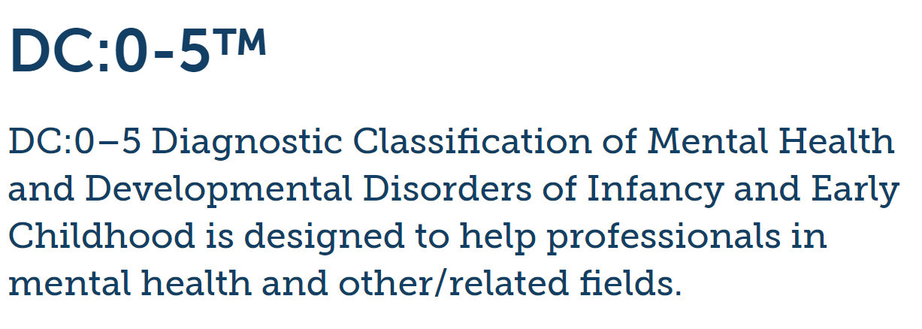
https://www.zerotothree.org/
Notes:
A variety of resources can be found and downloaded at the website (click on the picture). The DC:0-5 (Diagnostic Classification of Mental Health and Developmental Disorders of Infancy and Early Childhood) is not free but can be purchased.

Slide 40
Clinical Assessment of Infants, Pre-Schoolers and Their Families Diagnosis
Challenges:
Period of rapid development and change
Relationship & interaction-focused
Context dependent behavior
Limited first-person information
Identification of parental issues
Societal stigma
Aids in:
Explaining difficulties
More complete formulation
Treatment recommendations
Inter-professional communication
Notes:
There are many challenges to developing and using diagnostic and classificatory systems of disorder for infants and young children. This is a period of very rapid development and change. Therefore, distinguishing between a transient delay or disruption and an ongoing disorder can be difficult and requires time and skill. In addition, the focus of assessment, as outlined above, is on relationships and interactions, while classificatory systems such as DSM or ICD focus primarily on the individual rather than on relationships and context. Young children are very responsive to and dependent on the support they receive and therefore may behave and function quite differently in different settings, for example with familiar adults at home and at child care. Babies and toddlers have little or no language for their subjective experience and therefore assessment relies on the history provided by caregivers and the clinician’s skill in observation and in integrating information from a range of sources and contexts. In addition, the assessment of relational quality is a core element of assessing immediate, ongoing or cumulative risk to the baby or young child and this may include identifying any mental or physical health difficulties and diagnosis in the parents that may impact on their capacity to adequately care for the child. Last, but not least, psychiatric diagnoses are associated with considerable stigma in most societies so, at what age should young children be given a diagnosis?
That said, establishing a diagnosis that helps explain, at least in part, an infant or young child’s difficulties can be helpful for the family and contributes to a more complete formulation. Diagnosis can indicate which treatment is appropriate and, ideally, which treatments are supported by evidence. It can facilitate communication between the various professionals taking care of the child. A diagnostic classification for mental health problems in infants, toddlers and preschool children has recently been updated. It includes an approach to defining relational difficulties in early childhood (Zeanah & Lieberman, 2016).

Slide 41
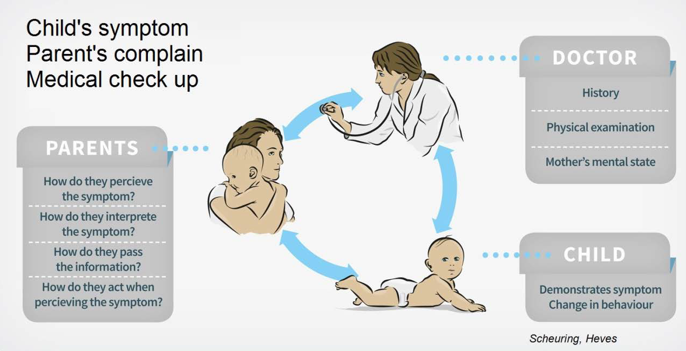
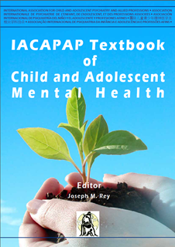
The Clinical Assessment of Infants, Pre-Schoolers and Their Families Infants and Parents in Medical Settings
Notes:
In medical settings, the child’s symptoms are the focus of investigation but paediatricians need to be mindful of the parents as well. In other words, in paediatricians’ clinical work the infant is treated but parents are also a focus of attention and support. The meeting between parents, baby and paediatrician is unique. The child displays symptoms with changes in behaviour and parents interpret them to paediatricians. The transfer of this information can be difficult and confusing. A lot depends on parents’ interpretation of the infant’s symptoms and on the infant’s physical and mental state, along with other factors.
In paediatric practice, diagnostic methods and therapy generally focus on organic conditions but, in many cases, especially in regulation disorders (e.g., problems of feeding or sleeping, extreme crying, etc.) a bio-psycho-social approach is required to adequately understand the presenting difficulties. It can be frightening for parents when the baby’s behaviour changes, so they consult the paediatrician. It is helpful if the paediatrician has basic mental health skills to recognise how the interaction between parent and infant can contribute to abnormal symptoms in the baby and, in turn, how this may alter how a parent perceives and communicates about their infant (Hinshaw et al, 2000). Paediatricians need to listen carefully about the specific problem parents and baby are presenting and provide relevant information to parents in a sensitive and supportive way (Committee on Psychosocial Aspects of Child and Family Health et al, 2009; 2012).
Parents consult a paediatrician because the child’s behaviour is of concern to them and expect treatment, explanation and reassurance. Ascertaining the factors producing the symptoms often requires a multidisciplinary approach. Furthermore, a special awareness is needed to define the symptoms and to communicate effectively with the parents. This is particularly true in disorders of regulation (Mares et al, 2011). The paediatrician may find problems difficult to manage when the symptoms observed in the child are inconsistent with those described by the parent. Feeding problems, for example, rank highly in this group—no clear medical explanation can be found in more than 80% of cases (Cole et al, 2011)—and yet the infant is symptomatic and the parents anxious and concerned. Parents’ complaints must be taken seriously because if they think that there is a problem, then there is a problem (Kerzner et al, 2015). Parental anxiety and infant distress can become self-perpetuating. We call this a “misjudged symptom” in the infant and suggest conceptualizing the infant’s symptom in the context of parents’ complaints and concerns. The symptom is real enough but often not fully explained by a medical cause, thus it may not need actual therapy, only changes in the infant’s lifestyle, and reassurance and support for the parents. A functional rather than an organic explanation is assumed and the persistence of the symptoms is understood to result from maladaptive coping in the parent or infant or some difficulty in their relationship (Mares et al, 2011).

Slide 42
Clinical Assessment of Infants, Pre-Schoolers and Their Families Examples of Risk & Protective Factors
Tammy
Risk Factors | Protective Factors
Premature Narcotic-dependent mother | Organised attachment with aunt
Quality of kinship care | Quality of kinship care
Tornado-destroyed house Sheltered housing Depressed, jobless uncle | Resourceful Establish close interpersonal relationship
Move to socially-isolated district
Notes:
Examples of risk and protective factors
Tammy was born slightly premature and narcotic dependent as her mother had used heroin during pregnancy (biological risk). Her mother was thought to be unable to care for her because of ongoing substance use and Tammy was placed with her aunt and uncle when she was one month old (the quality of care she receives in this kinship placement will determine whether it is a developmental risk or a protective factor for Tammy). She was initially a very irritable and unsettled baby but then developed well and established an organised attachment to her aunt (psychologically protective).
When she was aged three, a severe tornado lashed the town where the family lived destroying the house (contextual risk). Although no one was hurt, the family had to live in a shelter for several months, the uncle lost his job and there were a lot of stressors, resulting in him becoming depressed (psychological/relational risk). In order to find work they had to mover from the area they had always lived in to another district where they were socially isolated (socio-cultural risk). They were a resourceful family and developed close relationships with other families who were also new to the town and who helped them settle in the new community (contextually protective).

Slide 43
Clinical Assessment of Infants, Pre-Schoolers and Their Families Indicators of Risk
In the Infant/Child
Failure to thrive Delayed milestones Hypervigilant Quiet and withdrawn Marked aggression | Unmet basic needs Caregiving role reversal Regulation problems Unexplained bruising or medical injury
Notes:
Approaching the child’s pathological symptoms and/or the parents’ complaints from a bio-psycho-social model is effective in recognising, evaluating and treating presentations where parental responses to their symptomatic infant contribute to an infant with persisting distress. Paediatricians benefit from acquiring basic competencies in infant mental health (Briggs et al, 2007), and from working in collaboration with a multidisciplinary team when organic and functional disorders co-occur (Sharp et al, 2017). Early recognition of such disorders when there are particular concerns that parental factors contribute to the infant’s symptoms can be improved by using screening tests such as the Edinburgh Postnatal Depression Scale (Töreki et al, 2014) which rates parental anxiety and depression, or the Coping Health Inventory for Parents, which rates parents’ efforts in coping with health issues in the family (McCubbin et al, 1983).

Slide 44
Clinical Assessment of Infants, Pre-Schoolers and Their Families Indicators of Risk
In the Parents
Poor recognition of needs Psychiatric illness or substance use Limited insight and engagement with treatment services Child incorporated in parental delusional system | Insensitivity to signals and needs Thoughts of self harm Fear of harming child Frightening behaviour toward child Hostile or negative attributions Unrealistic expectations Poor parenting skills
Notes:
Approaching the child’s pathological symptoms and/or the parents’ complaints from a bio-psycho-social model is effective in recognising, evaluating and treating presentations where parental responses to their symptomatic infant contribute to an infant with persisting distress. Paediatricians benefit from acquiring basic competencies in infant mental health (Briggs et al, 2007), and from working in collaboration with a multidisciplinary team when organic and functional disorders co-occur (Sharp et al, 2017). Early recognition of such disorders when there are particular concerns that parental factors contribute to the infant’s symptoms can be improved by using screening tests such as the Edinburgh Postnatal Depression Scale (Töreki et al, 2014) which rates parental anxiety and depression, or the Coping Health Inventory for Parents, which rates parents’ efforts in coping with health issues in the family (McCubbin et al, 1983).

Slide 45
Clinical Assessment of Infants, Pre-Schoolers and Their Families Indicators of Risk
In the Context
Absence of protective adult Cultural or social solation Minimal social supports Domestic, family or community violence Multiple social risks Chronic stress
Notes:
Approaching the child’s pathological symptoms and/or the parents’ complaints from a bio-psycho-social model is effective in recognising, evaluating and treating presentations where parental responses to their symptomatic infant contribute to an infant with persisting distress. Paediatricians benefit from acquiring basic competencies in infant mental health (Briggs et al, 2007), and from working in collaboration with a multidisciplinary team when organic and functional disorders co-occur (Sharp et al, 2017). Early recognition of such disorders when there are particular concerns that parental factors contribute to the infant’s symptoms can be improved by using screening tests such as the Edinburgh Postnatal Depression Scale (Töreki et al, 2014) which rates parental anxiety and depression, or the Coping Health Inventory for Parents, which rates parents’ efforts in coping with health issues in the family (McCubbin et al, 1983).

Slide 46
Clinical Assessment of Infants, Pre-Schoolers and Their Families Case Study
Lola
At 4 months old: Feeding refusal Growth deficiency Deceased grandfather Parent’s good relationship quality | Poor mother and maternal grandmother relationship Problematic paternal grandparents Initial postnatal issues
Hospitalization
Escalated feeding problems Mother’s frustration | GERD diagnosis Multidisciplinary treatment
Notes:
Lola was 4 months old when she was admitted to hospital. She refused to drink breastfeeding milk by nursing bottle and formula was tried. Her weight had stagnated leading to a growth deficiency. The relationship between her mother and grandmother was difficult and her grandfather had passed away. Her father’s parents were alcoholic and not supportive. Lola’s parent’s got on well, understanding and supporting each other. Lola’s birth was uneventful and breastfeeding was not problematic initially.
After two months Lola’s appetite lessened and her food intake decreased. The mother tried to force breast-feeding even when the baby resisted. Finally Lola accepted only 20-80 ml on each feeding and she was fed 5-6 times per day. Her behaviour changed and she became lethargic and unresponsive.
In hospital Lola showed escalating distress when feeding. Nursing assistance was needed during mother’s attempts to force the baby to take the breast and feed; each feed took a long time. The mother became increasingly anxious and fraught. She lost self-confidence, thought she was not a good mother and was concerned that her baby might die.
During the medical assessment it was suspected that gastro-oesophageal reflux disease (GORD) contributed to the baby’s symptoms. Treatment for GORD began but unfortunately Lola needed supplementary tube feeding because her intake of breast milk was inadequate. The therapy included parallel parent-infant consultation alongside breast feeding support and medical treatment of GORD
Topics for discussion with parents included:
Their fears about Lola’s sickness
Understanding the cues and feelings about their baby
Reducing expectations about breast feeding intake
A focus on the enjoyment instead of on the amount taken during each feed
Helping parents believe in their child’s health and their own care for her
Lola was released from hospital continuing to breast feed and with nasogastric tube feeding and close follow up. The baby pulled out the tube, which was replaced, and vomited many times. Every time this happened a parent-infant consultation also occurred. These events became gradually less frequent. Lola gained weight, breast feeding intake improved and tube feeding decreased. Lola’s behaviour also changed: smiling more often, crying, moving and sleeping less. Her parent’s fears decreased. After two months the nasogastric tube could be removed.
This example illustrates the need to identify and treat the organic or biological (GORD) problem, the functional aspect (distress and breast refusal) and relational issues (high parental anxiety, force feeding) to solve Lola’s growth faltering and breastfeeding problems

Slide 47
Clinical Assessment of Infants, Pre-Schoolers and Their Families Types of Risk
Immediate physical or emotional safety
Optimal development: genetic, in-utero, physical
Indirect Risk: repeated separation, parental mental health
Cumulative risk: exposure to multiple risk factors
Greatest developmental risk: Long-term parenting issues
Chronic neglect
Chronic instability
Ongoing hostility
Maltreatment
Notes:
In general, risk can be defined as the probability of an event occurring, including consideration of the losses and gains associated with it. In the context of infant development and child protection, risk assessment is not free from cultural and moral judgements. There is a high degree of uncertainty when predicting risk in child-protection matters and inevitably this contributes to the anxiety felt when assessing risk by even very experienced clinicians working in this area.
Children who have been abused or neglected may have physical, emotional and behavioural sequelae, which will make caring for them more difficult. For example, traumatised children may continue to show avoidant or disruptive behaviour for some time after being placed in safe fostering environments. Abuse and neglect may have long-term effects on the child’s understanding of feelings and relationships. A child with brain damage after head trauma may have long-term physical and emotional symptoms, meaning that caring for them is particularly difficult and challenging. This presents parents (including foster and adoptive parents) with challenges that they may not have anticipated, requiring more patience or perseverance than with a less traumatised child.
Infants in high-risk situations are more likely to develop insecure or disorganised attachment relationships with their caregivers. There is evidence that disorganised attachment during infancy is linked to emotional and behavioural difficulties in childhood, adolescence, and adult life. Therefore, although an infant may not be at an immediate physical risk, an erratic, neglectful or unstable caregiving environment is a threat to their social and emotional development. In child neglect, chronic unresponsiveness to the child’s physical or emotional needs can have profound developmental consequences but may be harder to detect than physical abuse. Unfortunately, many infants at risk suffer both neglect and abuse.

Slide 48
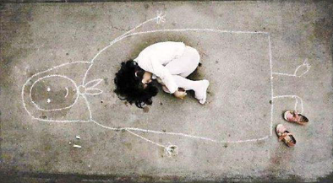
Clinical Assessment of Infants, Pre-Schoolers and Their Families Factors that Promote Resilience
A well-functioning involved significant adult
Social supports
Professional intervention (when necessary)
Consistency in other relationships and activities
Skill acquisition
An Iraqi girl in an orphanage – missing her mother, so she drew her and fell asleep then
Notes:
Factors that promote resilience in the child (Ferguson & Horwood, 2003)
1.A well-functioning parent or other involved adult
2.Social supports
3.Professional intervention when it is indicated
4.Consistency in other relationships and activities
5.Having a skill or talent.

Slide 49

Clinical Assessment of Infants, Pre-Schoolers and Their Families Conclusion
Various contexts and reasons for assessment
Comprehensive assessment:
Relational- & developmental-
focused
Bio-psycho-social factors
Strengths & vulnerabilities
Consideration of risk
Family-clinician alliance for intervention
Portrait of Madesta and Inesita (1939) Diego Rivera
Notes:
Assessment of families with infants and young children occurs in a variety of contexts and for many different reasons. Nonetheless, a comprehensive assessment should always include a relational and developmental focus, with consideration of both strengths and vulnerabilities that parents’ and child bring to their current circumstances, and attention to biopsychosocial factors that help or hinder the family at this time of rapid developmental change.
A working alliance between the family and the clinician supports any proposed interventions. Concerns about the immediate or long-term safety of the child or caregivers need to be addressed openly and directly with the caregivers and referring agency. Appropriate intervention must follow, and processes put in place for monitoring the ongoing safety and wellbeing of all family members.
All assessments of young children involve consideration of risk. The notion of risk in infancy and early childhood is complex and multifactorial. It includes consideration of immediate risks to child and parent safety, the impact of single and cumulative risk factors, and the notion of developmental risk and psychopathology following early adversity. The vulnerability and dependence of young children on the availability of their caregivers means that risk is always considered within the caregiving context and threats to the safety of either or both parents inevitably impacts on the child’s wellbeing.
Risk increases whenever the child’s needs outweigh the capacity of the carers and their supports to meet these needs. As described, this can occur because of factors in the child, the caregiving system (parents), or the social context, and many at risk children and families have vulnerabilities in all three areas.
Situations of high risk are distressing for all concerned, particularly when the clinician recommends the removal of an infant or young child from their home. A comprehensive assessment that includes a careful history, consideration of the coherence of the history provided, observation of interactions between child and caregiver(s), and corroborative history are central to an adequate assessment of risk. This ensures that decisions are based on sound information obtained from a variety of sources and are made in the best interests of the child and the family.

Slide 50
Clinical Assessment of Infants, Pre-Schoolers and Their Families Additional Resources
Center on the Developing Child
Center on the Developing Child’s inBrief Series
Zero to Three
Adverse Childhood Experiences Study
Care for Child Development
https://www.futurelearn.com/courses/babies-in-mind
Mares, S., Newman, L., and Warren, B. (2011). Clinical skills in infant mental health: The first three years (2nd ed.). Melbourne, AUS: ACER Press
World Association for Infant Mental Health

Slide 51

Clinical Assessment of Infants, Pre-Schoolers and Their Families Thank You!

