Slide 1
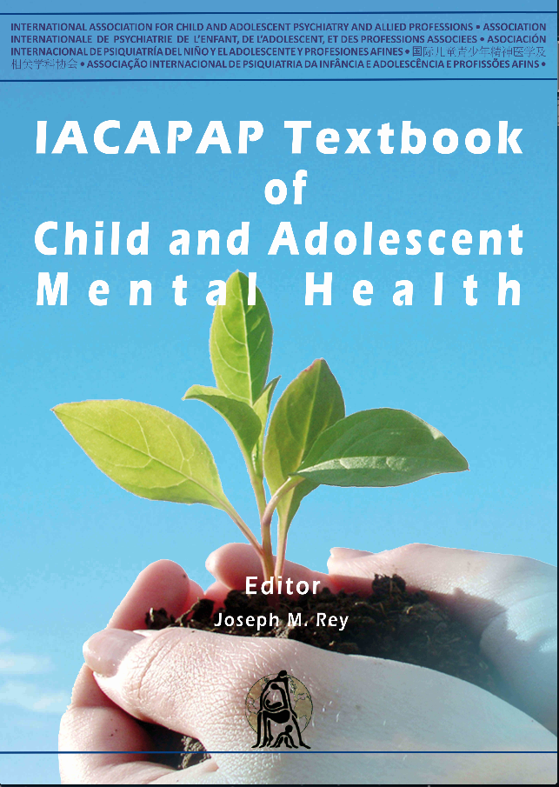
INTRODUCTION
Chapter A.13
What Child Mental Health Professionals Should Know About Genetics
Robert R. Althoff
DEPRESSION IN CHILDREN AND
ADOLESCENTS
Companion Powerpoint Presentation
Adapted by Julie Chilton

Slide 2
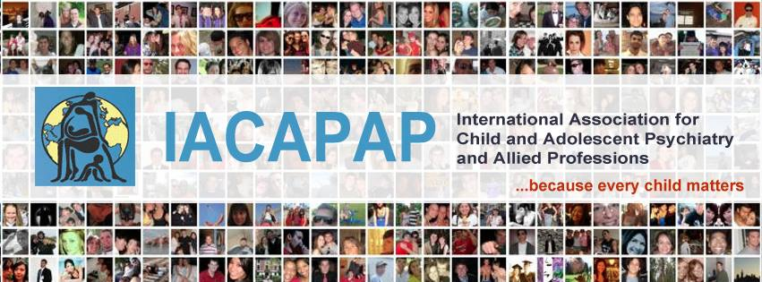
The “IACAPAP Textbook of Child and Adolescent Mental Health” is available at the IACAPAP website http://iacapap.org/iacapap-textbook-of-child-and-adolescent-mental-health Please note that this book and its companion powerpoint are: · Free and no registration is required to read or download it · This is an open-access publication under the Creative Commons Attribution Non- commercial License. According to this, use, distribution and reproduction in any medium are allowed without prior permission provided the original work is properly cited and the use is non-commercial.

Slide 3
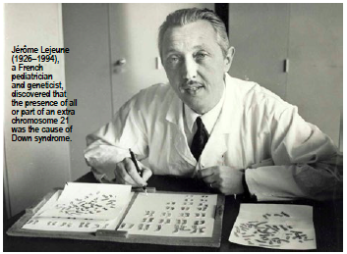
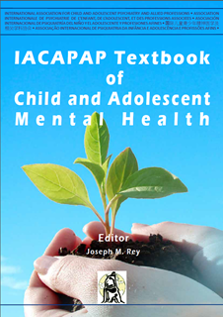
Genetics Outline
The Basics
Genetics of Child
Psychiatric Disorders
Genetic Studies
Child and Adolescent Psychiatric Disorders Known to be Inherited
Genetic Testing
Genetic Counseling
Notes:
Jerome Lejeune
(1926-1994)
A French pediatrician and geneticist, discovered that the presence of all or a part of an extra chromosome 21 was the cause of Down Syndrome
To help make sense of child psychiatric genetics, we will first introduce the basic concepts of genetics. This will serve as a brief primer in the way that mental health problems are passed from parent to child. We will then discuss the importance of examining families in an empirical way such that information about both the genetics and the environment of the family can be ascertained. Then, we will describe the different types of research studies in genetics and how to interpret them. This leads naturally into a discussion of the differences between single gene (Mendelian) and polygene (complex) disorders. We will then discuss what genetic tests may be appropriate for these conditions in clinical practice and when genetic counseling is appropriate.

Slide 4
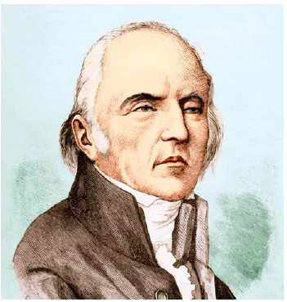
Genetics Genetics of Child Psychiatric Disorders
Prime examples of complex traits
Not Mendelian inheritance
Associated with multiple genes
Associated with multiple environments
Jean Baptiste Lamarck
(1774-1829)
Notes:
Over the past 20 years, the field of child and adolescent psychiatry has benefitted from advances in behavioral and molecular genetics. While child psychiatric conditions were once assumed to be caused by mechanisms such as “fixation” in a particular phase of development or “refrigerator mothers”, the discovery of the familiality and heritability of these disorders has made it less fashionable to argue against the biological underpinnings of developmental psychopathology. On the other hand, most clinicians are primarily taught genetics based on single gene, Mendelian inheritance. Because this kind of one-gene-one-disorder inheritance is relatively rare in child psychopathology, there has been a perception that psychiatric genetics is not moving fast enough to find the causes of child psychiatric conditions. Indeed, if ADHD, autism, or bipolar disorder in children were caused by a single gene, it would have been found by now. Instead, child psychiatric disorders are prime examples of complex traits. A complex trait is one that does not follow simple Mendelian inheritance, but rather is associated with multiple genes (and, likely, multiple environments) operating together.
Jean-Baptiste Lamarck (1774-1829 ), a French biologist, developed a theory of evolution which included the idea that traits can be acquired and then passed along to offspring. During his life Lamarck’s ideas did not receive much support and scientific attention but have raised more interest recently. Forms of “soft” or epigenetic inheritance within organisms have been suggested as neo- Lamarckian in nature.
“Lamarck is far from dead ... The inheritance of acquired characteristics is one of those ideas that holds out eternal fascination. It seems so right. If only inheritance were Lamarckian, evolution would be orderly, and efficient.”
(Hull DL (1984). Lamarck among the Anglos. Introduction to Lamark’s Zoological Philosophy. University of Chicago Press).

Slide 5
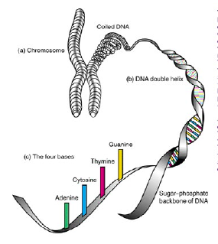

Genetics Basic Concepts of Genetics
http://www.ted.com/talks/james_watson_on_how_he_discovered_dna
Notes:
Each cell in the human body (except red blood cells) contains 23 pairs of chromosomes. Chromosomes are inherited: each parent contributes one chromosome per pair to their children. (a) Each chromosome is made up of a tightly coiled strand of DNA. When uncoiled it reveals (b) the familiar double-helix shape. If we picture DNA as a twisted ladder, the sides, made of sugar and phosphate molecules, are connected by (c) rungs made of chemicals called bases—adenine (A), thymine (T), guanine (G), and cytosine (C)—that form interlocking pairs. The order of these bases along the length of the ladder is called the DNA sequence.
E Branscomb.
One other key concept is necessary here to make it clear why we examine DNA in child psychiatry. DNA is passed on from parent to child. DNA is a double stranded molecule that contains one strand from one parent and a second strand from the other parent. On each of these strands, or chromatids, are strings of nucleotides, some of which cluster into functional units, or genes, that code for protein. Other parts of the chromatid are intragenic or in-between genes. These regions themselves may also be important to the function of proteins, possibly indirectly. Both genes and intragenic regions are passed from parent to child. Genes often come in two forms, called alleles. A child, therefore, receives one allele from his or her father and another allele from his or her mother. Thus, if one were to determine that specific alleles of a gene follow along with a particular disorder within a family, one could derive associations between specific genes and specific disorders.
James Watson and Francis Crick, together with Maurice Wilkins, were awarded the 1962 Nobel Prize in Medicine for their discovery of the structure of DNA. Click on the image to view James Watson relate the frank and funny story of how he and Francis Crick, discovered the structure of DNA (20:54).

Slide 6

Genetics Basic Concepts of Genetics
DNA transcribed into mRNA
mRNA translated by tRNA into protein
Proteins do work of cell
http://www.genome.gov/Glossary/
Notes:
Central to psychiatric genetics is the fundamental notion that in the nucleus of the cell, deoxyribonucleic acid (DNA) is transcribed into messenger ribonucleic acid (mRNA), which is then translated in the ribosome via transfer RNA (tRNA) into protein. Proteins do the work of the cell – being transported in and out of the cell membrane to serve as receptors for neurotransmitters, changing the way that the cell fires, serving as messengers for other biological systems, etc. This central dogma of biology that DNA ->RNA -> protein provides the basis for all other associations that we will discuss. Because the proteins in neurons start first as a basic code in DNA, the way that neurons function can be affected by the variation in the DNA code. Further, because DNA in each cell is, at least in structure, essentially the same pattern of nucleotide base pairings, one need not look at neurons directly to make these associations. DNA taken from any cell in the body (although most frequently from blood lymphocytes or cheek/salivary epidermal tissue) can provide insight into the DNA sequence throughout the rest of the body. If a change in the DNA code is associated differentially with a psychiatric condition, one would be a step closer to understanding the biological system that undergirds that condition.
Is there a term that you don’t know? Click on the image to find a description and images of common genetic terms

Slide 7
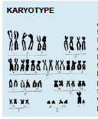
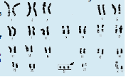
Genetics Basic Concepts of Genetics
Notes:
One other key concept is necessary here to make it clear why we examine DNA in child psychiatry. DNA is passed on from parent to child. DNA is a double stranded molecule that contains one strand from one parent and a second strand from the other parent. On each of these strands, or chromatids, are strings of nucleotides, some of which cluster into functional units, or genes, that code for protein. Other parts of the chromatid are intragenic or in-between genes. These regions themselves may also be important to the function of proteins, possibly indirectly. Both genes and intragenic regions are passed from parent to child. Genes often come in two forms, called alleles. A child, therefore, receives one allele from his or her father and another allele from his or her mother. Thus, if one were to determine that specific alleles of a gene follow along with a particular disorder within a family, one could derive associations between specific genes and specific disorders.
Because half of the DNA in an individual is transmitted from the mother and half from the father, this has enabled clinicians and researchers to be able to determine specific inheritance patterns for particular single gene disorders. For example, Huntington Chorea is inherited due to an expansion in the number
of specific tri-nucleotide repeats at a particular area of the genome (4p16.3). This region of the chromosome is inherited from parent to child with worsening symptoms in each subsequent generation due to the accumulation of more repeats. Because of this inheritance pattern, the familiality was first established by examining and plotting out the histories of families with Huntington (see Figure A.13.1). This was followed by discovery of the pertinent chromosome, after which a particular gene in that region was identified. True to the central dogma above, this gene — huntingtin — codes for the huntingtin protein which plays a role in the pathogenesis of Huntington chorea.
A karyotype is the number and appearance of chromosomes in the nucleus of a cell. The term is also used to denote the complete set of chromosomes in an individual organism. Karyotypes describe the chromosome count of an organism, and what these chromosomes look like under a light microscope: length, the position of the centromeres, differences between the sex chromosomes, and any other physical characteristics. The figure on the left shows the karyotype of a normal human male, while the one on the right is the karyotype of a person with Down syndrome.

Slide 8
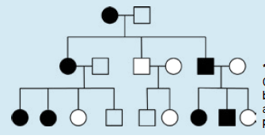
Genetics Basic Concepts of Genetics
Notes:
ALLELE
An allele is an alternative form of a gene (one member of a pair) that is located at a specific position on a specific chromosome. These DNA codings determine distinct traits that can be passed on from parents to offspring. Individuals inherit two alleles for each gene, one from each parent. If the two alleles are the same, the individual is homozygous for that gene. If the alleles are different, the individual is heterozygous. In traditional Mendelian genetics, alleles can be dominant or recessive. Under this model, if a trait is influenced only by a single gene, an organism that is heterozygous at a specific locus—and, therefore, carries one dominant and one recessive allele—will express the dominant phenotype. Alleles contribute to the organism’s phenotype, which is the outward appearance of the organism. Allelesare divided into the “major” and the “minor” allele based on the allele of a gene that most frequently occurs in the population. Alleles are considered “common” ifthey occur more often than 1% in a population. Otherwise, they are considered “rare.”
In pedigrees, circles represent females and squares represent males. Circles and squares are filled if that individual is affecd by the trait being diagrammed. Horizontal lines connecting individuals represent a mating pair. Vertical lines represent the offspring of that mating pair.

Slide 9

Genetics Genetics of Child Psychiatric Disorders
Common disease-common variant hypothesis
Rare variant-common disease hypothesis
Gene-environment interaction hypothesis
https://www.coursera.org/course/behavioralgenetics?authMode=login
Notes:
For most child psychiatric disorders, however, the Mendelian pattern does not hold. Instead, child and adolescent psychiatric disorders are related to genetics in one of three scenarios, which are not mutually exclusive:
The common disease-common variant hypothesis
The rare-variant-common disease hypothesis; and
The gene-environment interaction hypothesis.
Because each of these hypotheses has stemmed from, and has led to, slightly different approaches in the literature, we review them each briefly.
The Common Disease-Common Variant Hypothesis
In this hypothesis, child psychiatric disorders are due to the accumulation of multiple common genes, each of which has a minor additive effect on the presentation of the illness. In this hypothesis, genes which may otherwise have been selected against through natural selection are kept in the population because in other environments and in combination with certain other genes they are advantageous. When enough of the risk alleles are put together, however, the combined effect pushes the child towards a particular disorder. Support for this hypothesis comes from findings like those of Constantino et al (2010) who showed using quantitative measurement that subsyndromal autistic traits are found in siblings of individuals with autism. Similar arguments have been made for ADHD. This suggests that there is a familial aggregation of genes that affect the individual, but one individual has an overall higher dose of them. Further support for this hypothesis comes from findings in the literature of combined additive genetics of disorders (as we will see below under “twin studies” and “genome-wide complex trait analysis”). Consistent with this has also been the relatively minimal findings of genes of major effect for child psychiatric disorders when genome-wide association studies (GWAS) are performed.
The Rare-Variant-Common Disease Hypothesis
This hypothesis holds that common psychiatric disorders are associated with an accumulation of rare mutations in a population. Proponents of this hypothesis would postulate that one or several of these rare (less than 1% allele frequency) mutations placed along the same critical developmental pathway may push the organism towards having a child psychiatric condition (Hoffman & State, 2010). This model has been used to help explain disorders in which there is the appearance of a new condition in an otherwise healthy family. This might occur because, at times, the process of DNA replication and subsequent inheritance is not perfect, leading to changes in the gene sequence that are passed from mother or father to child. This process of de novo mutation allows for new mutations to be passed onto the child. In the rare-variant-common disease hypothesis, these de novo mutations become problematic when they accumulate. For example, these rare variants are overrepresented in autistic families where there is a single autistic individual (so-called, “simplex” families) (Sebat et al, 2007). Because these are new mutations that can then be passed along, they can have profound effects on each subsequent generation, making their concentration in the gene pool stronger. At their extreme, rare variant mutations can act more like Mendelian traits which can then be inherited if the individual reproduces.
The Gene-Environment Interaction Hypothesis
In this hypothesis, it is assumed that either common variants or rare variants (most often the former) only have an effect on the expression of a child psychiatric condition if placed into an environment in which those particular genes were expressed and could therefore be deleterious. As noted below, this hypothesis has been quite central to plant genetics for some time, but really came into the human behavioral genetic literature with findings of Caspi and Moffitt in the early 2000’s with a series of influential papers (Caspi et al, 2002; Caspi et al, 2003) proposing that the type of environment in which a child was raised placed them at higher risk for later illness, depending on their genotype. While these findings have had variable success in replication, they have provided the foundation for the burgeoning field of epigenetics and gene expression in child and adolescent psychiatry.
In the following section, we will describe the types of genetics studies that one is likely to encounter in the child and adolescent psychiatric literature and will key them back to these three hypotheses.
If you wish to increase your knowledge of behavioural genetics you may want to enrol in the MOOC “Introduction to Human Behavioral Genetics” by Matt McGue of the University of Minnesota. This course entails committing 3-5 hours/week during 8 weeks. Click on the image to access the course (it requires registration but it is free).

Slide 10
Genetics Different Types of Genetic Studies
Family studies
Twin and
adoption studies
Candidate gene
studies
Linkage studies
Genome-wide
association studies
Genome –wide
complex trait analysis
Epigenetics
Gene x environment interplay
Notes:
Here, we describe the types of genetic studies likely to appear in the literature and provide some detail as to the questions that they are able to address. Under the section “when is genetic testing appropriate” we provide information about specific clinical genetic tests.
Family Studies
The most fundamental type of genetic study is the study of families. As noted above, DNA is passed on from parent to child. Therefore, disorders in which genes are involved should run in families. Family studies have been useful for establishing the heritability of almost all child psychiatric conditions. Family studies require information from at least two, but most often three or more members of the family, and analyses to determine whether a trait is more likely to occur in certain families than in others. Of course, there is familial transmission of more than DNA from parent to child. Wealth, for example, although it runs in families, is not transmitted genetically. Both the environmental influences of the parents and their genes are responsible for familiality. In fact, in behavioral genetics, it is assumed that a trait is influenced by at least three factors, the effects of:
Genes (A),
The particular environment that affects an individual (E), and
The shared environment (C) – which is a measure of how two children in the family are alike, regardless of their genetic similarity.
In family studies, one cannot separate out additive genetics (A) from shared environment (C), because they both contribute to disorders running in families. A limitation, therefore, of family studies is that, although they can establish familiality, they cannot establish heritability, unless specific genetic markers are measured or environments are held constant (see Figure A.13.2). To separate shared environmental from genetic associations within families, we need twin and adoption studies.
Twin and Adoption Studies
Twin and adoption studies can hold constant either environmental or genetic factors, or both (in the case of twin-adoption studies). Adoption studies are still relatively rare, but have provided marked insight into the environmental factors that influence traits. In adoption studies, children are assessed to see whether they are more similar to their birth parents or to their adoptive parents. If the children resemble their adoptive parents more than expected by chance, this indicates shared environmental influence. Adoption studies, while less common than either twin or family studies, have demonstrated shared environmental associations for antisocial behavior and personality, among others. The dearth of adoption studies, however, likely reflects the difficulty of controlling for birth parent variables when researchers are unable to obtain information about one or more birth parents (Alsobrook et al, 2002).
In contrast to adoption studies where the environment is varied, twin studies allow systematic separation of the shared environment from additive genetics based on the biological variance of twin type. Twins share either all of their genes (identical or monozygotic twins) or half of their genes (fraternal or dizygotic twins) allowing one to compare the concordance rate of a disorder between monozygotic (MZ) twins and dizygotic (DZ) twins as a first test for genetic contributions. If a disorder is almost entirely related to genes, the concordance rate between MZ twins will be twice that of DZ twins, because MZ twins share 100% of their DNA sequence while DZ twins share, on average, only 50%—this assumes that the genetics are additive, without evidence of genetic dominance, rater bias, or other interaction. On the other hand, if genes are not involved at all, the MZ and DZ twin concordance rates will be equal.
The role of estimating additive genetic effects using twin designs is most consistent with the common variant-common disease model listed above whereby all of the genetic effects across the population of twins are modeled together. Twin studies have the additional advantage of being able to control for genetic effects while testing specific environmental effects by comparing MZ twins who are concordant and discordant on a particular trait. In this situation, de novo mutations may play a larger role, as it is possible for one MZ twin to carry a mutation while the other does not (Ehli et al, 2012); supporting the rare variant-common disorder hypothesis. However, this is rare for highly heritable disorders. Twin studies can also be used to evaluate more complicated questions such as issues of gender effects (using opposite sex twins) and questions of informant bias. For other advantages of twin designs, see Boomsma et al (2002).
Candidate Gene Studies
Once family studies have determined familiality and twin or adoption studies have determined heritability, researchers can then investigate which genes, exactly, are involved. Uncovering the genes that are involved should enable us to design and test treatments that are specific to particular physiological pathways involved in particular phenotypes. Studies are often conducted on candidate genes – that is to say, genes hypothesized to be involved in a phenotype for some reason. A classic example is the dopamine receptor D4 (DRD4) gene which, as the name implies, encodes the D4 subtype of the dopamine receptor. The DRD4 gene has multiple single nucleotide polymorphisms (SNPs) associated with it and also has a site containing a variable number of tandem repeats (VNTR). This VNTR, the 7-repeat sequence of the DRD4 gene, has been used frequently as a marker for attention-deficit/hyperactivity disorder (ADHD). Investigators first started examining the dopamine genes, however, because of the dopamine hypothesis of ADHD which, essentially, arose from the clinical finding that medications used for the treatment of ADHD (i.e., the psychostimulants) have dopamine re-uptake inhibition as one of their mechanisms of action. Dopamine receptor genes were, therefore, explored as candidates and were found to be associated with ADHD. Another way of developing candidates is to use pedigrees with known genetic changes to identify gene regions which may be involved. A final pathway to a candidate gene is to examine the results of either linkage or genome-wide association studies (GWAS, described below) and to choose likely “hits”. Unfortunately, candidate gene studies fall prey to a number of difficulties. Foremost has been the lack of replication across studies. Many highly significant findings in one population have not been replicated in others. Some of this may be due to the relative distribution of risk alleles within particular populations – that is, allele frequencies vary by race and by geographical region. This feature of SNPs can lead to population stratification – association of an allele with a disorder only because both the allele and the disorder are more common in a subpopulation. Moreover, because only one SNP is typically tested at a time, there is a higher prior probability of it being detected than if the whole genome was being tested. Many candidate gene tests do not survive correction for comparisons across the entire genome. Consequently, many researchers prefer to test only candidate SNPs that have been derived from a whole-genome approach such as linkage or GWAS studies.
Linkage Studies
Linkage studies were the first type of molecular genetics study that was able to search across the entire genome and determine where on the chromosome a disease locus might lie. In linkage studies, at least 2 members of a pedigree, preferably three or more, are examined to see whether portions of the genome co-segregate with a disorder. Critical to linkage is the idea of identity by descent – that is, the matching of specific chunks of DNA that are inherited together along with a disorder. By examining the distance between these chunks of DNA, the likelihood of recombination given a particular distance of markers from one another, and the proposed genetic relations among members of a family, whole genome scans can be conducted on relatively small sample sizes with smaller numbers of markers than needed for genome-wide association studies. A disadvantage to linkage studies is that the spatial resolution on the chromosome is not very high, so that a linkage peak, which would denote an important association with a phenotype, may contain many genes underneath it. Still, linkage has been a critical tool for detecting candidate genes for further study.
Genome-Wide Association Studies (GWAS)
Linkage studies have fallen a bit out of vogue with the advent of relatively inexpensive chip-based technologies that sample across thousands or millions of common SNPs at once. GWAS can tag these common SNPs across the genome and can simultaneously perform millions of association tests with the disorder being studied. Because statistical controls take account of multiple comparisons across the genome, large samples are needed to obtain enough power to detect associations. Even with large samples and stringent statistical controls, GWAS hits have been difficult to replicate. For example, childhood ADHD has been shown to have additive genetic factors accounting for up to 70% of the variance in twin studies, but a recent meta-analysis using over 1.2 million SNPs and nearly 10,000 individuals found no genetic hits (Neale et al, 2010). That said, other highly heritable traits such as height, weight, and diabetes, despite having more easily defined phenotypes, have required even bigger samples to find associated genes in GWAS. Failure to find genes of major effect using GWAS is consistent with the common disorder-common variant hypothesis, but because rare variants are excluded from GWAS, such findings do not necessarily contradict the rare variant hypothesis. When copy number variations (which are a collection of catalogued rare variants that can be included on microarray chips) are included in whole genome studies, for example, rate [IS THIS CORRECT?] variant findings have emerged for ADHD, autism, and other disorders.
Genome-Wide Complex Trait Analysis (GCTA)
An alternative way to use whole genome data has been to examine the additive effects of genes directly. Genome-wide complex trait analysis, a relatively new method, essentially takes large samples and creates a genetic similarity matrix of correlations among the alleles from all measured SNPs among all individuals. By using the degree of measured genetic similarity between individuals and comparing it to the likelihood of trait expression, researchers can examine directly the heritability of a particular child psychiatric condition. GCTA requires larger sample sizes than traditional twin methods (~3000), and a recent comparison of the GCTA heritability estimates to twin heritability estimates for childhood disorders showed lower estimates in GCTA than in the traditional twin models (Trzaskowski et al, 2013). Still, the ability to examine heritability directly through GCTA (or other methods being developed) without the need for sampling of twins is an exciting development. GCTA studies are built upon and strongly support the common disorder-common variant hypothesis.
Epigenetics
Epigenetics provides an additional approach to psychiatric genetics. Literally meaning “outside of genetics”, epigenetics was first used to describe heritable changes in the genome that are not related to changes in the DNA sequence. These changes could include changes in DNA methylation (wherein a methyl group [CH3] is placed on a cytosine-guanine base pairing changing the function of the gene) or histone deacetylation (wherein an acetyl group [COCH3] is removed from histone complexes), changing DNA expression. However, epigenetics has come to mean any change in the genome that does not alter DNA structure but can alter gene expression. As noted above, examination of DNA sequences allows the uncovering of variance in the alleles that may affect proteins. Proteins, as noted above, do the work of the cell. Thus, changes in gene expression are likely to be associated with altered neuronal function, regardless of the allele sitting on the chromosome. However, a challenge for epigenetics is that, unlike gene structure, which is the same regardless of the cell being examined, gene expression changes by cell type. Thus, the expression of a particular gene in the buccal mucosa or a peripheral lymphocyte might not represent the expression of that gene in the brain area of interest for a child psychiatric phenotype. There is some evidence, however, that there may be enough of a signal in peripheral tissue to allow epigenetics outside of the brain to be useful for child psychiatric conditions. This is an area of active research and, despite this limitation, epigenetics is a burgeoning field because the idea of altering gene expression rather than DNA structure offers a tantalizing explanation for how genes and environments might interact. To learn more about this, please watch the excellent and entertaining talk about What Is Epigenetics? By Nessa Carey.
Gene x Environment (GxE) Interplay
I use the term gene x environment interplay because genetic effects are not just moderated by environments but can also correlate with them directly. For example, there can be GxE correlations whereby the expression of a particular genetic trait makes it more likely that one will enter a particular environment which, in turn, makes the expression of the phenotype even more likely. These GxE correlations are probably more common in families than we appreciate.
It has long been known that genes and the environment interact with one another. In some ways, GxE interactions are the foundation of natural selection. Organisms whose genotypic expression allows them to survive in the environment in which they were placed will be able to reproduce, passing on their genes to the next generation. Elmer Heyne, the great plant geneticist, knew this well as he attempted to develop strains of wheat. He recognized that what is inherited is the manner of reaction to a given environment – with certain strains of wheat able to adap to wet environments and others to arid environments. It is this concept – that a particular allele is not good or bad or advantageous or high risk, but rather that an allele can be any of these depending on the environment – that lays the foundation for GxE studies.
The field of psychiatric genetics became enamored with the idea of finding specific causal alleles. When these were not easily uncovered, some researchers turned to the study of the environment as a moderator of the effects of particular risk alleles. As an example, research by Caspi, Moffitt, and their colleagues showed that an allele of the neurotransmitter-metabolizing enzyme monoamine oxidase A (MAOA) gene increased the risk for adult antisocial behavior among individuals who had experienced childhood adversity (Caspi et al, 2002). Similarly, they showed that an allele of the serotonin transporter gene (5HTTLPR) increased the risk for adult depression among individuals who had been maltreated in childhood (Caspi et al, 2003). Although meta-analyses have cast doubt on the effect sizes, the concept of GxE interaction has remained at the forefront of psychiatric genetics over the past 10 years. In fact, at this stage the old question of nature versus nurture has really been answered. It is, almost always, nature and nurture working towards the expression of child mental health phenotypes.

Slide 11
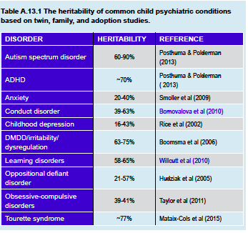
Genetics Heritability of Child and Adolescent Psychiatric Conditions
Notes:
Nearly all of the common child and adolescent psychiatric conditions or their related constructs have been found to have genetic components. While it may seem strange to make such an absolute statement, there is not a single DSM-5 condition listed in the childhood disorders section where heritability has been tested that has not had a demonstrable genetic component. The relevance of related constructs is illustrated by the new DSM-5 category of disruptive mood dysregulation disorder —which has not been tested in a twin or GCTA design— but the constructs of irritability and of dysregulation, both related to the disruptive mood dysregulation construct, have both been demonstrated to be heritable. Table A.13.1 lists the estimated heritability for many of the common childhood psychopathologies.
The estimates in Table A.13.1 come from studies of twins and families. But, because of the advances in genome-wide complex trait analysis and other direct measurement approaches to heritability, these may need to be revised soon. In general, when genome-wide complex trait analysis is applied to twin samples, heritabilities tend to be lower in GCTA than when using the twin methodology. Whether genome-wide complex trait analysis underestimates or twin models overestimate heritability is an area of active research.

Slide 12
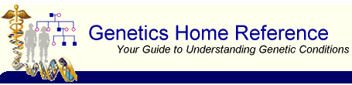
Genetics Known Genetic Conditions of Importance
Down syndrome
Fragile X syndrome
Williams syndrome
Prader-Willi syndrome
Angelman syndrome
Rett syndrome
22q11.2 deletion syndrome
Turner syndrome
Smith-Magenis syndrome
Deletion or duplication of 16p11
SEE CHAPTER C.1
http://ghr.nlm.nih.gov/
Notes:
Keeping in mind that many of the common child and adolescent psychiatric disorders involve complex traits with polygenic inheritance, some genetic conditions are known to have psychiatric symptoms as part of their presentation (Siegel & Smith, 2011). These conditions may present to child and adolescent mental health professionals for behavioral management or for evaluation of associated developmental delays. In these cases, an understanding of the general presentation of children with these conditions is also important. A few examples are provided below. More details can be found on the Genetics Home Reference page of the US National Institute of Health.

Slide 13
Genetics Down Syndrome
Trisomy 21
Advance parental age
1/1000 live births
De novo change
Partial trisomy possible
Facial features
Cardiac/GI problems
Language delay
Intellectual Disability
10% autism
Increased risk for
ADHD
Anxiety
Depression
Seizures
Dementia
Diagnosis: karyotype
Notes:
Down syndrome
This describes a constellation of symptoms associated with three copies (trisomy) of chromosome 21. Trisomy 21 is often detected during prenatal screening and has been associated with both advanced maternal and paternal age. Trisomy 21 occurs in about 1 in 1000 live births. Parents most often have unremarkable karyotypes and the trisomy is considered a de novo change. It can also occur as a partial trisomy wherein just a portion of chromosome 21 is transmitted – most frequently due to Robertsonian translocation. The additional genetic material from the extra chromosome results in overexpression of a number of genes, likely leading to the cognitive phenotype (see also Chapter C.1).
Non-psychiatric clinical characteristics: Down syndrome has distinguishing facial features (up-slanting palpebral fissures, epicanthal folds, a broad nasal bridge, small mouth, relatively large tongue), posteriorly rotated ears, short stature, and single palmar crease. There can be associated cardiac problems (e.g., ventricular septal defect), gastrointestinal problems (such as Hirschsprung’s disease, duodenal atresia, or celiac disease), and other nonpsychiatric medical problems.
Psychiatric clinical characteristics: Most individuals with trisomy 21 have some form of intellectual disability. Language delay is common. While social responsiveness is not necessarily impaired, up to 10% of individuals with trisomy 21 meet the criteria for an autism spectrum disorder. Patients are at increased risk for many child psychiatric disorders and neurological problems including ADHD, anxiety, depression, seizures, and, later in life, dementia.
Diagnosis: Karyotype.

Slide 14
Genetics Fragile X Syndrome
Inherited
1/4000 males
1/8000 females
Increased trinucleotide repeats
FMR1 gene on X chromosome
Repeats accumulate
>200=clinical syndrome
F<M because x-linked
Macrocephaly, big ears, long narrow face, macro-orchidism
Developmental delay
Intellectual disability
Attention, communication, social pragmatic problems
1/3 autism
Diagnosis: FISH
Notes:
Fragile X syndrome
In contrast to Trisomy 21, which typically occurs as a de novo mutation in the germ line cells of a parent, fragile X syndrome is inherited from parent to child. This makes it the most common inherited condition leading to intellectual disability, occurring at a rate of about 1 in 4000 live male births and 1 in 8000 live female births. As noted above, the pathogenesis of fragile X syndrome involves increasing numbers of trinucleotide repeats – specifically cytosine-guanine-guanine (or CGG) repeats in the FMR1 gene on the X chromosome. Across generations, more repeats accumulate. When they accumulate higher than about 200 repeats, the clinical syndrome emerges. Because one X chromosome is inactivated in the cells of females, they tend to be less affected than males. This process of X-inactivation allows for the dosing of genes on the X-chromosome between males and females to be essentially the same. Through an epigenetic process, cells in females express only one of their two X-chromosomes. In the case of X-linked disorders, the affected chromosome is usually inactivated. It can still, however, be transmitted to offspring through the maternal line. Males who receive the affected X chromosome, however, have the affected FMR1 gene unopposed by another X chromosome (see also Chapter C.1).
Non-psychiatric clinical characteristics: Classical features may take until puberty to be manifest but consist of macrocephaly, prominent ears, a long, narrow face and macro-orchidism (in males). There is frequent hyperextendability of joints such as in the fingers.
Psychiatric clinical characteristics: Males most often demonstrate some developmental delay – often with intellectual disability that correlates roughly with the number of CGG repeats present. Attention, communication, and social pragmatics are often impaired – even in mildly affected females. Autistic features are common with around 1/3 meeting criteria for an autism spectrum disorder. Other emotional and behavioral problems also occur.
Diagnosis: Fluorescence in situ hybridization (FISH) testing for fragile X.
FLUORESCENCE IN SITU HYBRIDIZATION (FISH)
A technique whereby particular parts of the genome are tagged with a fluorescent marker and changes to DNA structure can be identified.

Slide 15
Genetics Williams Syndrome
1/1000 births
Deletion chromosome 7
Broad forehead, wide mouth, full lips, full cheeks, narrow temples
Skin, joint, heart problems possible
Intellectual disability
Visual-spatial difficulties
Superficial hypersocial personality
Miss social cues
ADHD
Anxiety
Sleep problems
Diagnosis: FISH or microarray
Notes:
Williams syndrome
Occurring in about 1 in 10,000 live births, Williams syndrome is related to a deletion in a region on chromosome 7 affecting around 30 genes involved in development, cardiovascular disease, and connective tissue development.
Non-psychiatric clinical characteristics: Children with Williams syndrome have characteristic facial features: a broad forehead, a wide mouth with full lips, full cheeks, and a narrowing of the distance between the temples. There may be joint problems and increased elasticity of the skin and joints. Depending on the extent of the deletion, there can be supravalvular aortic stenosis of the heart.
Psychiatric clinical characteristics: There is typically mild to moderate intellectual disability, especially visual-spatial difficulties. Auditory rote memorization and language may be spared. They may have a superficial hypersocial personality but may miss subtle social cues. ADHD symptoms are common, as are anxiety disorders and sleep disturbance.
Diagnosis: FISH testing or microarray.

Slide 16
Genetics Prader-Willi Syndrome
Multiple etiology
Chromosome 15q11-q13 deletion/inactivation
1/15000 births
Infancy: poor feeding, slow growth, developmental delay, hypotonia
Childhood: hyperphagia, obesity, diabetes
Narrow forehead, triangular mouth, almond eyes
Small, narrow hands and feet
Delayed puberty
Underdeveloped genitalia
Intellectual disability
Compulsive behavior
Diagnosis:
methylation PCR
Notes:
Prader-Willi syndrome
Prader-Willi syndrome is one of two conditions that are associated with deletion of chromosome 15q11-q13. Prader-Willi syndrome most frequently occurs when the child’s paternal copy of this gene is deleted and the maternal copy is inactivated. Alternatively, the child could have received two copies of the maternal chromosome 15 (so-called uniparental disomy) or there could have been some other de novo mutation that inactivates the genes. In all, Prader-Willi syndrome occurs in about 1 in 15,000 live births.
Non-psychiatric clinical characteristics: The earliest manifestations appear in infancy with poor feeding, slow growth, developmental delay, and hypotonia. In childhood, hyperphagia becomes common with resultant obesity and later diabetes. There are characteristic facial features with a narrow forehead, triangular mouth, and almond-shaped eyes. Growth delay, particularly with small, narrow hands and feet, are common. Pubertal development is often delayed and individuals have underdeveloped genitalia.
Psychiatric clinical characteristics: Mild to moderate intellectual disability is common but not universal. Most of the manifestations of Prader-Willi are related to compulsive behavior. Most prominent is hyperphagia or compulsive eating, but skin picking, nose picking, and hair pulling are not uncommon. Obsessions do not often occur with the compulsions. Hoarding and gorging of food frequently occurs, as does poor frustration tolerance when limits are placed on eating. Emotion regulation difficulties may continue into adolescence and adulthood.
Diagnosis: Methylation PCR.

Slide 17
Genetics Angelman Syndrome
Loss of maternal copy UBE3A gene chromosome 15
1/15,000
Seizures in first 2 years
Hypopigmentation
Coarse facial features
Delayed development
Intellectual disability
Happy appearance
Frequent laughing
Hand flapping
Social disinhibition
Poor sleep
Diagnosis: Methylation PCR /UBE3A analysis
Notes:
The mirror of Prader-Willi syndrome is Angelman syndrome, which affects around 1 in 15,000 live births as well. In this case, there is loss of the maternal copy of the UBE3A gene on chromosome 15 due to a deletion with the maternal copy of the gene, two copies of the paternal allele or other mutations being inherited.
Non-psychiatric clinical characteristics: Seizures emerging in the first 2 years of life are not uncommon. There may be some hypopigmentation of the skin and hair and coarse facial features as individuals age.
Psychiatric clinical characteristics: The earliest manifestations are delayed development and intellectual disability. Children with Angelman syndrome appear happy and tend to laugh readily and frequently, at times associated with hand flapping. There is social disinhibition. Sleep is frequently poor.
Diagnosis: Methylation PCR and/or UBE3A specific mutation analysis.

Slide 18
Genetics Rett Syndrome
MECP2 mutation
Boys die in utero or infancy
Mostly girls
1/8500 females
Mostly normal development in first 6-18 months
Then profound developmental delay, autistic traits, hand movements
Eventual motor function loss
Seizures common
Little to no language
Sleep problems
Irritability
~Autism
Diagnosis: MECP2 gene sequencing
Notes:
Rett syndrome
Resulting from a mutation in the MECP2 gene, Rett syndrome occurs almost exclusively in girls at a rate of about 1 in 8,500 live female births. The MECP2 gene sits on the Xq28 locus and is X-linked dominant. Most males with the mutation die in pregnancy or infancy.
Non-psychiatric clinical characteristics: Classically, this syndrome is characterized by mildly delayed or typical early development for the first 6-18 months followed by profound developmental delay, autistic traits, and the characteristic loss of purposeful hand movements. These hand movements are replaced with hand wringing, washing, or clapping movements. Unfortunately, there is eventual loss of most motor function. Seizures are very common.
Psychiatric clinical characteristics: The earliest manifestations are developmental delay beginning around 6-18 months which frequently results in little or no language. Along with hand movements, sleep difficulties can be present, as can irritability and autistic-like behaviors.
Diagnosis: MECP2 gene sequencing.

Slide 19
Genetics 22q11 Deletion Syndrome
Deletion of 22q11 gene
TBX1 gene
COMT gene
1/4000
Variable medical
Cleft lip and palate
Ventricular septal defect
Thymus gland
Low Ca++
Conotruncal anomaly face syndrome
Variable clinical
Intellectual disability
Attention
Anxiety
Social withdrawal
Autism
Psychosis
Diagnosis: FISH testing for 22q11
deletion
Notes:
22q11.2 deletion syndrome
The 22q11.2 deletion occurs relatively frequently—rates estimated as 1 in 4,000 people—which may be an underestimate because of the variability in the
presentation of the syndrome. The loss of the TBX1 gene in this region may be responsible for many of the nonpsychiatric characteristics, while loss of the COMT gene, which codes for a protein involved in catecholamine metabolism, may be responsible for the psychiatric symptoms.
Non-psychiatric clinical characteristics: These are highly variable, including cleft lip and palate, other midline structural defects, ventricular septal defect, small or absent thymus gland, low calcium levels, and the conotruncal anomaly face syndrome consisting of hypertelorism, small, upward slanting palpebral fissures, prominent eyelids, a low nasal bridge and a small mouth.
Psychiatric clinical characteristics: They are highly variable. There may be borderline or mild intellectual disability. Attention problems, anxiety, or social withdrawal can be present at a young age. Many children meet the criteria for an autism spectrum disorder. Psychotic disorders are over-represented in these children.
Diagnosis: FISH testing for 22q11 deletion.

Slide 20
Genetics Others
Turner syndrome
Single X
No paired X or Y
Short stature
Intellectual disability
Deletion/Duplication
16 p11
Autism, epilepsy, schizophrenia, intellectual disability
Smith-Magenis Syndrome
Loss of RAI gene on chromosome 17
Sleep problems
Short stature
Temper tantrums
Self-hugging
Finger-licking
Self-injury
Notes:
Others
There are other syndromes of which one needs to be aware also. Among others these include Turner syndrome – a single X chromosome with no paired X or Y, responsible for short stature and possibly intellectual disability; Smith- Magenis syndrome – associated with loss of the RAI1 gene on chromosome 17 and is associated with sleep disturbance, short stature, temper tantrums, self-hugging, finger-licking, and self-injury; deletion or duplication of 16p11 which may predispose to autism, epilepsy, schizophrenia, and intellectual disability;

Slide 21
Genetics When is Genetic Testing Appropriate?
No current role for common child psychiatric conditions
Indicated only when 2 of the following exist:
Multiple congenital system involvement
Intellectual disability
Unusual or abnormal face
Multiple affected individuals in a family
Autism diagnosis warrants chromosomal microarray
Notes:
A frequently asked question is: “Knowing what we know now about psychiatric genetics, is there a role for genetic testing for the common disorders?” In general, for most of the common child psychiatric conditions, there is no current role for genetic testing. Despite a proliferation of for-profit companies that test cheek swabs or salivary samples and provide genotyping results, the science of prediction for common genetic markers is not yet helpful to mental health professionals. In fact, it seems absurd to pay high fees for information about nonspecific genetic markers that may increase or decrease risk by 1%. It is especially silly to pay such fees when much better information can be gleaned from empirically-based clinical assessment of patients and documentation of their family history. Genetic testing is nevertheless indicated when two or more of the following conditions exist:
Multiple congenital system involvement (e.g., cardiac, pulmonary, gastrointestinal)
Presence of intellectual disability
Presence of unusual or abnormal facies
Multiple affected individuals in a family.
In general there is no current role for genetic testing for most of the common child psychiatric conditions.
It was previously recommended that patient karyotyping and perhaps FISH testing be done in these situations (Tsuang et al, 2000). However, after these recommendations were made and many other guidelines came out, there have been significant advances in genetic technologies. At this point, for intellectual disability, autism spectrum disorders, or multiple congenital involvement the recommendation is to start with a chromosomal microarray assay rather than a standard or high resolution karyotype (Miller et al, 2010). If an abnormality is detected, it should be followed up by confirmation and the parents should be tested. If there are no chromosomal microarray abnormalities, but clinical findings suggest a genetic disorder, then more specific tests (e.g., single gene tests, FISH for fragile X, or methylation studies) can be performed. However, even the microarray technologies may soon be superseded by next-generation DNA sequencing technologies, which literally map every base-pairing in the genome (or the exome) of an individual.

Slide 22
Genetics Genetic Counseling in Mental Health Services
Basic education by mental health or primary care clinician
Coordinate tests and counseling with primary care clinician
Begin with accurate diagnosis
Obtain family history
Evaluate emotional and intellectual capacity of family members
Evaluate burdens and benefits of testing
Form tiered plan
Discuss recurrence risks
Facilitate non-directive decision-making
***More research needed in this area***
Notes:
GENETIC COUNSELING IN MENTAL HEALTH SERVICES
An awareness of genetic contributions to psychiatric symptoms can have important implications for diagnosis and patient care (Finn & Smoller, 2006). When genetic counseling becomes relevant, the following points should be considered: Firstly, counseling begins with an accurate diagnosis. A careful history and physically examining the clinical characteristics of known conditions may point towards a particular diagnosis, which can then be used to educate families prior to genetic counseling. The education of individuals and families, be it broadly about genetic concepts or specifically about a suspected genetic syndrome, starts with the mental health professional or the primary care clinician. The primary care clinician should be consulted so that all testing and counseling is coordinated. Next, a genetics consultation can be offered prior to ordering testing. The referring clinician should inform the family that the yield of this kind of evaluation, especially in cases of autism and developmental delay, is likely to be low. After that, the evaluation should be tiered, in that the highest yield tests should be considered first.
Genetic counseling should be provided as a part of the clinical genetics consultation and would include confirming the diagnosis, obtaining a family history, evaluating the intellectual and emotional capacity of family members, evaluating the burdens and benefits of testing, and forming a tiered plan (Schaefer & Mendelsohn, 2013; Finn & Smoller, 2006). Recurrence [WHAT DO YOU MEAN BY RECURRENCE?] risks should be discussed. Nondirective counseling should be made available to facilitate decision making about options for dealing with recurrence. Genetic counseling may be helpful to those who request it, but there is very little empirical evidence regarding who should receive such counseling, when they should receive it, and who should provide it. There is a clear need for systematic research in this area with suggestive findings that support the requirement for an increased knowledge base in genetic testing (Finn & Smoller, 2006).

Slide 23

Genetics Thank You!

