Slide 1
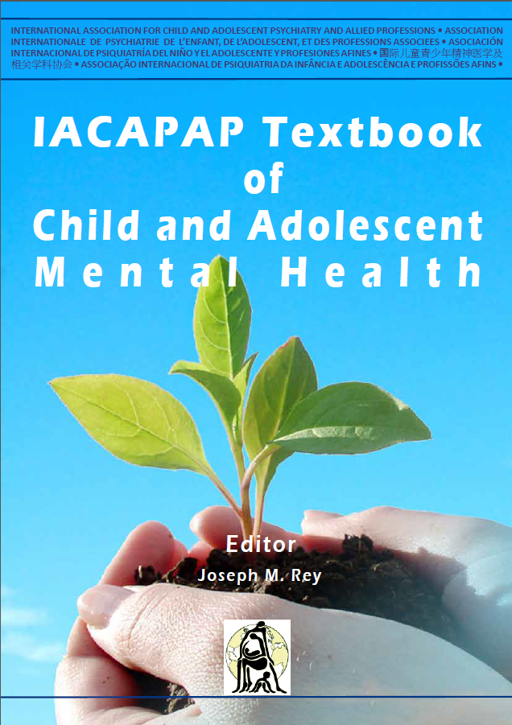
DEVELOPMENTAL DISORDERS
Intellectual
Disability
Chapter C.1
Xiaoyan Ke &
Jing Liu
Companion Powerpoint Presentation
Adapted by Henrikje Klasen & Julie Chilton

Slide 2
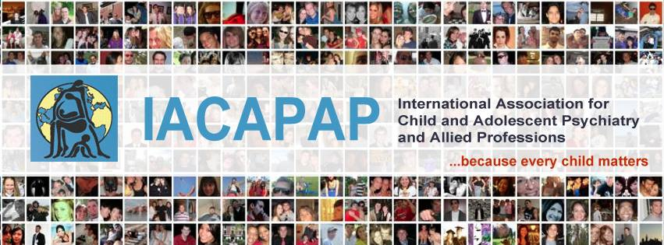
The “IACAPAP Textbook of Child and Adolescent Mental Health” is available at the IACAPAP website http://iacapap.org/iacapap-textbook-of-child-and-adolescent-mental-health Please note that this book and its companion powerpoint are: · Free and no registration is required to read or download it · This is an open-access publication under the Creative Commons Attribution Non- commercial License. According to this, use, distribution and reproduction in any medium are allowed without prior permission provided the original work is properly cited and the use is non-commercial.

Slide 3

Intellectual Disability Learning Objectives
Differentiate and diagnose
Mild or marked ID
Other related mental/physical health problems
Treat or manage through
Psycho-education
Basic psycho-social interventions
Pharmacotherapy
Know when to refer patient to a specialist
Notes:
At the end of this session you should be able to:
define, recognize, diagnose and manage ID
Differentiate and diagnose
Mild or marked ID
Other related mental/physical health problems
Treat or manage through:
Psycho-education
Basic psycho-social interventions
Pharmacotherapy
Know when to refer patient to a specialist

Slide 4
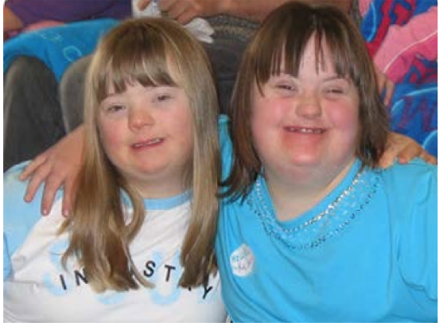
Intellectual Disability Why Do You Need to Know?
Intellectual disabilities (IDs):
very common
preventable
pose a huge burden
lead to stigmatization
Risks to children with IDs:
harmful forms of traditional healing
neglect or harsh treatment
High caregiver stress
Effective treatment and education available
Notes:
Intellectual disabilities (IDs) are very common especially in low and middle income countries (LAMIC)
In many cases IDs can be prevented
IDs pose a huge burden to affected families and society
Children with ID are often stigmatized and excluded. They may:
not be brought for vaccination/essential health care
be subject to harmful forms of traditional healing
be neglected or harshly treated by frustrated parents
Carers of children with ID may develop mental health problems
The lives of children with disabilities and of their families can be substantially improved through treatment and education

Slide 5
Intellectual Disability The Basics
WHO Definition
“a condition of arrested or incomplete development of the mind, which is especially characterized by impairment of skills manifested during the developmental period, which contribute to the overall level of intelligence, i.e., cognitive, language, motor, and social abilities”
Core symptoms
Low intellectual functioning IQ <70 (i.e., 2 SD below mean)
AND
Impaired adaptive behavior
Types: Mild ID (IQ 50-69), Moderate (IQ 35-49)
Severe (IQ 20-34), Profound (IQ 0-20)
Borderline Intellectual Functioning
Notes:
The term intellectual disability (ID) is increasingly being used instead of mental retardation. ID or mental retardation is defined as a condition of arrested or incomplete development of the mind, which is especially characterized by impairment of skills manifested during the developmental period, which contribute to the overall level of intelligence, i.e., cognitive, language, motor, and social abilities (World Health Organization, WHO, 1992). The American Association on Intellectual and Developmental Disabilities (AAIDD) describes ID as characterized by significant limitations both in intellectual functioning and in adaptive behavior as expressed in conceptual, social, and practical adaptive skills. This disability originates before age 18. In general, ID applies to the same individuals who were previously diagnosed with mental retardation in kind, level, type, duration and the need for services and supports. Every individual who is or was eligible for a diagnosis of mental retardation is eligible for a diagnosis of ID (Schalock et al, 2007).
ALSO:
Borderline intellectual functioning
The boundary between “normal” and “below average” IQ is not rigid, as highlighted by the fact that psychosocial impairment is also required for a diagnosis of ID. Individuals with an IQ in the range of 71-85 − borderline intellectual functioning, about 7% of the population − are not impaired enough to warrant a diagnosis of ID, nevertheless they face considerable difficulties due to their limited cognitive ability. They may be able to perform day to day activities and a simple job without assistance but are more vulnerable to stressful life events and more likely to develop a psychiatric disorder as a result.

Slide 6
Intellectual Disability The Basics: What is IQ?
A score derived from one of several tests: WISC, Stanford-Binet, Kaufman, Raven’s, etc
Many types: general and specific
Mean = 100
1 SD=15 points; 2SD of mean=95% of population
Heritability increases with age
Different from achievement tests
Notes:
IQ is a score derived from one of several tests. There are many types of IQ tests that seek to measure general or specific abilities: reading, arithmetic, vocabulary, memory, general knowledge, visual, verbal, abstract-reasoning etc. Well-known IQ tests include the Wechsler Intelligence Scale for Children, Stanford-Binet, Kaufman Assessment Battery for Children, and Raven’s Progressive Matrices. Traditionally, an IQ score was obtained by dividing the mental age of the person taking the test (the age group which on average scored such a result in a random sample of the population) by the chronological age multiplied by 100. However, this method has shortcomings (e.g., it cannot be used in adults). Currently the test results are standardised against a representative sample of the population; IQ scores for children are relative to children of the same age. The median result is defined to be 100 and one standard deviation is 15 points, therefore, 95% of the population have scores within two standard deviations of the mean (i.e., within an IQ range of 70 to 130). For IQ to be accurate needs to be standardised against a population culturally similar to that of the person being tested. For example, using norms obtained in a Brazilian population would produce biased results if the person taking the test is Burmese.
Although IQ can change to some extend with increasing age, it is a surprisingly robust construct that is strongly predictive of achievement. IQ has a large inherited component but environmental factors have a strong effect as well. Heritability increases with increasing age: it can be as low as 0.2 in infancy, 0.4 in middle childhood, and up to 0.8 in adulthood. What appears to be a straightforward concept has been marred by controversy over the years. For example, some scholars believe that intelligence is a learned combination of many different skills and abilities while others assume that intelligence is a single trait that is heavily determined by genetics, even others believe that there are large ethnic or racial differences.
IQ tests are different from achievement tests, the latter seek to measure the skills and knowledge learned (e.g., language, arithmetic), usually through schooling; IQ tests measure aptitude rather than actual achievement (see Chapter C.3). While in the past there was an emphasis on the so-called “general intelligence” current theories view intelligence as a more complex ensemble of aptitudes in a variety of areas (musical, mechanical, physical, social) which can differ substantially in the same individual.
Table C.1.2 illustrates the attainment in adulthood of people with different degrees of ID (WHO). It is clear that even those with severe ID can become at least partly independent in looking after themselves through proper supervision, care and training.

Slide 7
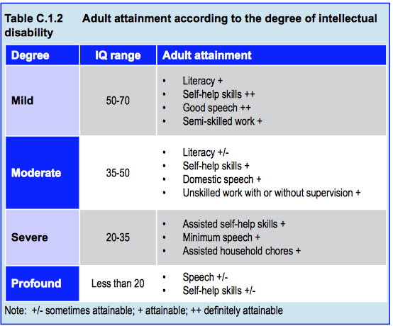
Intellectual Disability Course: Adult Attainment by Subtype
Notes:
Table C.1.2 illustrates the attainment in adulthood of people with different degrees of ID (WHO). It is clear that even those with severe ID can become at least partly independent in looking after themselves through proper supervision, care and training.
The manifestations of ID are mainly developmental delay in intellectual functioning and deficits in social adaptive functioning. According to the severity of the delay in intellectual functioning, deficits in social adaptive function and IQ, the psychiatric classifications describe four levels of severity:
Profound
IQ is usually below 20; profound intellectual disability accounts for 1% to 2% of all cases. These individuals cannot take care of themselves and have no language. Their capacity to express emotions is limited and poorly understood (Adams & Oliver, 2011). Seizures, physical disabilities, and reduced life expectancy are common.
Severe
IQ is usually between 20 and 34; severe intellectual disability accounts for 3% to 4% of all cases. Every aspect of their development in the early years is distinctively delayed; they have difficulty pronouncing words and have a very limited vocabulary. Through considerable practice and time, they may gain basic self-help skills but still need support at school, home and in the community.
Moderate
IQ is usually between 35 and 49, accounting for about 12% of all cases. They are slow in meeting intellectual developmental milestones; their ability to learn and think logically is impaired but are able to communicate and look after themselves with some support. With supervision, they can perform unskilled or semiskilled work.
Mild
IQ is usually between 50 and 69 and account for about 80% of all cases. Development during their early life is slower than in normal children and developmental milestones are delayed. However, they are able to communicate and learn basic skills. Their ability to use abstract concepts, analyze and synthesize are impaired but can achieve reading and computing skills to grade three to six level. They can perform house-work, look after themselves and do unskilled or semi- skilled work. They usually require some support.

Slide 8
Intellectual Disability Clinical Symptoms
Speech
Perception
Cognition
Concentration
Memory
Emotion
Movement
Behavior
Notes:
Speech
Children with ID usually have delayed language development and difficulties speaking and expressing themselves. The degree of severity varies with the level of impairment of intellectual ability. Mild cases can achieve language skills that are only a little poorer than children in the normal range of development. Severe or profound cases can’t communicate at all or speak only a few words.
Perception
Children with ID are slow in reacting and perceiving environmental stimuli. They have difficulties distinguishing small differences in the shape, size and color.
Cognition
Capacity to analyze, reason, comprehend and calculate, and for abstract thinking is often impaired to a greater or lesser extent according to severity. Children with mild ID are capable of achieving reading and mathematics skills to approximately the level of a typical child aged 9 to 12 (Daily et al, 2000). Individuals with severe or profound ID lack the capacity to read, calculate or even understand what others say.
Concentration and memory
Ability to concentrate is low and narrow. By and large, memory is poor and they are slow at remembering although there are exceptions (e.g., savants). They have difficulties recalling and their memories are often inaccurate.
Emotion
Emotions are often naive and immature but may improve with age. Capacity for self-control is poor and impulsive and aggressive behavior is not uncommon. Some are timid, withdrawn and shy.
Movement and behavior
Children with ID often lack coordination, may be clumsy or show excessive movement. Meaningless or stereotyped movements (e.g., rocking, head-banging, teeth-biting, shouting, tearing clothes, pulling hair, playing with the genitals) are frequent in severe ID. Destructive, aggressive or violent behavior can also be observed. Self-injurious behavior (e.g. self-slapping or biting) may occur in moderate and severe ID.
Behavior problems:
Symptoms like restlessness (continuously moving around, unable to sit in one place), poor concentration, impulsiveness, temper tantrums, irritability and crying are common. Other disturbing behavior, like aggression, self-injurious behavior (such as head banging) and repetitive rocking may also be seen (see section on challenging behaviors below). When such behavior is severe and persistent, it can become a major source of stress for families. Therefore, attention should be paid to reduce such behavior while providing treatment and care.

Slide 9
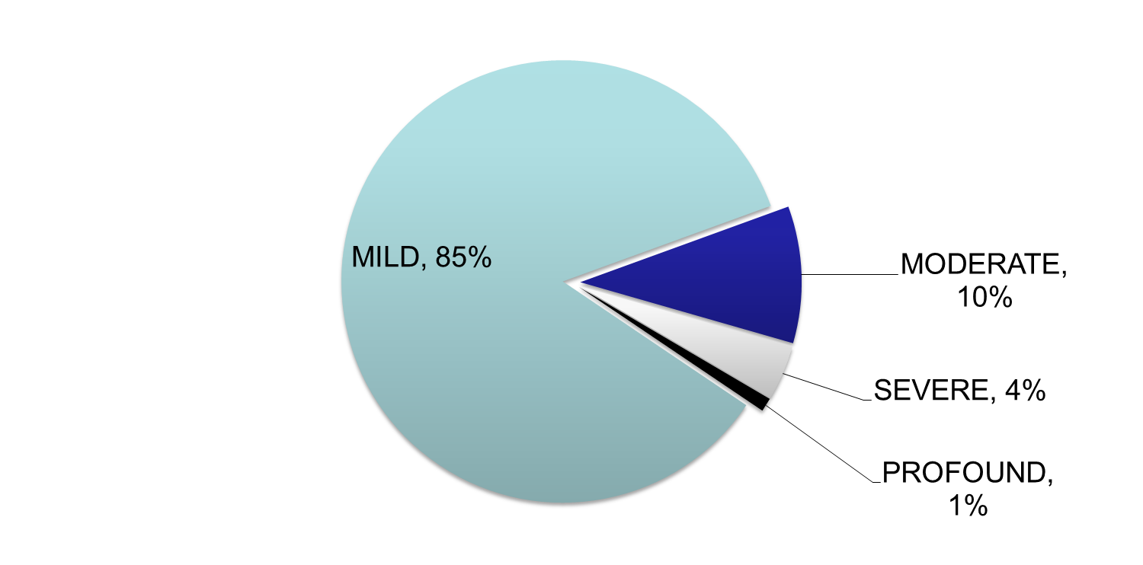
Intellectual Disability Epidemiology
Prevalence between 1% and 3 %
Males > females
LAMIC > HIC 2:1
Notes:
There have been many surveys to ascertain the prevalence of ID across the world with estimates ranging from 1% to 3% (Harris, 2006). A recent meta- analysis concluded that the average prevalence of intellectual disability across all the studies is 1%. Prevalence is higher in males in both adult and child and adolescent populations. Among adults, the female-to-male ratio varies between 0.7:1 and 0.9:1, while in children and adolescents it ranges between 0.4:1 and 1:1. Rates vary according to income; the highest prevalence occurs in low and middle income countries where rates are almost twice those in high income countries (Maulik et al, 2011). Another meta-analysis, which considered studies published between 1980 and 2009 in European countries, found overall estimates ranging from 0.4% and 1.4% (Wittchen et al, 2011). The prevalence of ID across Asia is broadly consistent with estimates in western countries: 0.06%-1.3% (Jeevanandam, 2009). The most recent Chinese national survey on disability, conducted in 2006, estimated a prevalence of ID of 0.75%. Prevalence in urban areas was lower (0.4%) than in rural areas (1.02%) (Kwok et al, 2011)

Slide 10
Intellectual Disability Etiology
Heterogeneous
Mild ID: no specific cause in 40% of cases
Genetic causes, injury, infections, poor nutrition
Marked ID: specific cause found more often
Genetic: Trisomy 21, Fragile X, single gene disorders
Prenatal: fetal alcohol syndrome, maternal infection like HIV
Perinatal: placental dysfunction, birth trauma, septicemia, jaundice
Postnatal: brain infection, head injury
Notes:
Etiology of ID is heterogeneous. Injury, infections and toxins have become less prevalent causes because of improved antenatal care, while genetic factors have become more prominent. No specific etiology can be found in up to 40% of cases, particularly in mild ID. Environmental influences (e.g., malnutrition, emotional and social deprivation experienced, for example, in poorly run orphanages) can also cause or aggravate ID. Understanding the etiology of ID raises the possibility of treatment or prevention in some cases, while it may allow predicting specific difficulties in others.
Many factors have been confirmed to cause or be associated with ID. These factors, which influence the development and function of the child’s brain prenatally, perinatally or postnatally, can be divided into three groups: organic, genetic and socio-cultural. Trisomy 21 and fragile X are the commonest diagnosable genetic causes of intellectual disability. It is unlikely that all intellectual disability will fit neatly into these three groups − overlapping genetic, environmental and socio-cultural factors are likely to be relevant in many cases. Conversely, in up to two-thirds of mild cases and one-third of severe cases, no causes are found, highlighting the need for further research. A more detailed list of causes is available at the WHO website (see Table C.1.1). A few are described below in more detail.

Slide 11
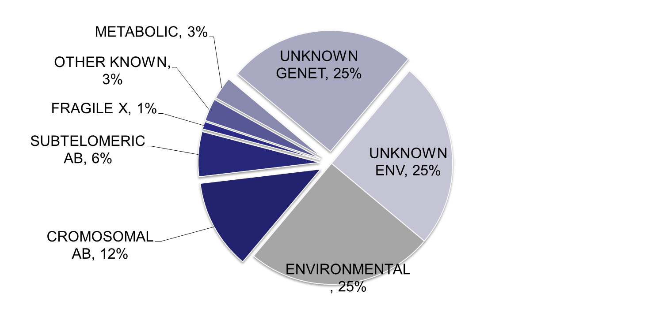
Intellectual Disability Etiology
Trisomy 21
(Down syndrome) is the single most frequent cause of ID (about 1/1500)
Fragile X syndrome is the most frequent X-linked syndrome (1/2,000-5,000)

Slide 12
Intellectual Disability Psychiatric and Medical Comorbidity
Psychiatric co-morbidity common (~50%)
anxiety, ODD, autism
ADHD, depression, conduct problems
diagnosis of psychiatric disorder difficult
Specific syndromes often associated with symptom clusters (e.g., fragile X and ADHD)
Medical co-morbidity also common
epilepsy, cerebral palsy, sensory issues most common
often undetected and undertreated!
Notes:
Compared with normal children, children with ID are at a higher risk of having other health problems. The most prevalent health conditions are: epilepsy (22%), cerebral palsy (20%), anxiety disorders (17%), oppositional defiant disorder (12%), and autistic disorder (10%) (Oeseburg et al, 2011).
Dual diagnosis. As already highlighted, intellectually disabled young people have higher rates of psychiatric disorder. A comorbid psychiatric illness (often referred to as “dual diagnosis”) occurs in about half of individuals with ID, the more frequent being ADHD, depression, autism and conduct problems, but schizophrenia and bipolar disorder also occur at least as often as in the non-ID population. Psychiatric illnesses like schizophrenia, depression and obsessive compulsive disorder present with roughly the same features in those with mild ID as in other people. However, recognition can be difficult in youth with moderate and severe ID, who tend to display more disorganized, unpredictable and difficult to understand symptoms, compounded by inability to describe their experiences:
− Depression may present as withdrawn behavior, irritability and aggression
− Manic episodes may present as distinct periods in which the youth with ID absconds, becomes boisterous, irritable or disinhibited
− Aggression without clear precipitants and associated with bizarre behaviors suggestive of hallucinations or suspiciousness could suggest schizophrenia.
The existence of a family history of psychiatric illness such as schizophrenia or mood disorders may raise the suspicion. Timely identification and treatment of these comorbid conditions reduce disability, family burden and improve quality of life. There are questionnaires available that can help clinicians in the assessment of comorbid psychiatric problems such as the Developmental Behaviour Checklist (DBC; Einfeld & Tonge, 2002) a 96-item inventory, and the Aberrant Behavior Checklist (ABC; Aman et al, 1985), a 58-item questionnaire.
Epilepsy
Between 1% and 13% of children with Down syndrome have epilepsy (Arya et al, 2011)
Epilepsy, often severe and hard to control, is present in 85% of Angelman syndrome patients within the first three years of life (Fiumara et al, 2010)
• Patients with fragile X syndrome are highly prone to develop epilepsy (Qiu et al, 2008)
Visual and hearing problems are present in about 5%-10% of persons with ID. Sometimes these problems can be resolved by using hearing aids or glasses, or undergoing surgery for cataracts
As noted earlier, other developmental disabilities, such as cerebral palsy, speech problems and autism can occur along with ID. Persons with multiple disabilities pose a big challenge in terms of providing care.

Slide 13
Intellectual Disability Common Conditions Associated with ID
Down Syndrome (trisomy 21) 1:1000
Fragile X (1:2000-5000)
Phenylketonuria (PKU); variable prevalence: 1:4000 Turkey; 1:100 000 China
Congenital hypothyroidism (1:2000-4000)
Fetal alcohol syndrome (0.2-1.5:1000 USA)
What causes of ID are common in your country?
Notes:
Down Syndrome (trisomy 21) 1:1000. Risk increases according to maternal age:
1:1250 at age 25, 1:10 at age 49
Fragile X (1:2000-5000) X-linked dominant; M>F
Phenylketonuria (PKU); variable prevalence: 1:4000 Turkey; 1:100 000 China
Congenital hypothyroidism (1:2000-4000)
Fetal alcohol syndrome (0.2-1.5:1000 USA)
What causes of ID are common in your country?

Slide 14
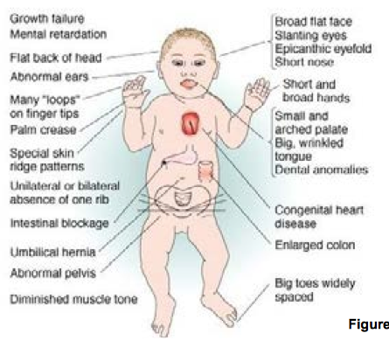
Intellectual Disability
Conditions Associated with ID: Down Syndrome
Notes:
Down syndrome, also known as trisomy 21, is a chromosomal disorder caused by an additional copy of genetic material on chromosome 21, which affects the development of the body and brain. This syndrome was first described by the British physician John Langdon Down and identified in 1959 as caused by a 21 trisomy by Jérôme Lejeune.
Maternal age and Down syndrome A woman's risk of having a baby with Down syndrome is:
At age 25, 1 in 1,250
At 30, 1 in 1,000
At 35, 1 in 400
At 40, 1 in 100
At 45, 1 in 30
At 49, 1 in 10
The incidence of Down syndrome is approximately one per 1000 newborns (Roizen & Patterson, 2003) and is influenced by maternal age. Women aged 35 and older have significantly higher risk.
Down syndrome can be diagnosed by chromosome analysis either prenatally or postnatally, according to which it can be grouped into four types: trisomy 21, mosaicism, translocation and duplication of a portion of chromosome 21.
Clinical features of Down syndrome include (Figure C.1.1):
Intellectual disability, usually mild; they possess good social skills
A characteristic appearance including brachycephaly, epicanthal folds, upslanting palpebral fissures, strabismus, Brushfield spots on iris, flattened nose, low-set and rounded ear, macroglossia, open mouth, short neck, brachydactyly, fifth finger clinodactyly, atypical fingerprints, wide 1-2 toe gap known as sandal foot
Impaired physical growth such as short stature, short limbs and lax ligaments
Often accompanied by different medical problems including congenital heart disease, duodenal atresia, hearing loss, ophthalmological problems, hypothyroidism, early-onset dementia, and leukemia.
Down syndrome can be detected through prenatal screening. Common screening procedures include: (a) measurement of maternal serum alphafetoprotein (AFP), human chorionic gonadotropin (hCG), unconjugated oestriol, and inhibin-Alpha (INHA) at 15-20 gestational weeks; (b) fetal ultrasound testing for a thickened nuchal fold with measurement of maternal serum free Beta hCG and pregnancy-associated plasma protein A (PAPPA) at 10-13.5 gestational weeks; both (a) and (b). For families with a high risk of having a child with Down syndrome, an invasive diagnostic test, such as amniocentesis, chorionic-villus sampling, or percutaneous umbilical cord blood sampling, performed in the late first trimester or early second trimester, is most accurate.

Slide 15
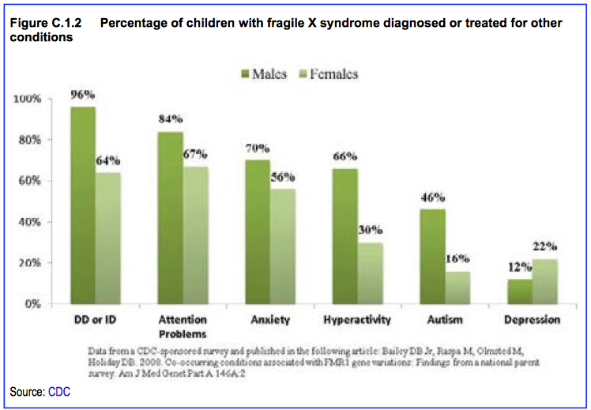
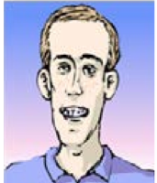
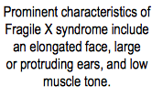
Intellectual Disability Conditions Associated with ID: Fragile X
Notes:
Fragile X syndrome (also known as Martin-Bell syndrome and Escalante's syndrome) is an X-linked disease that is one of the most common inherited forms of ID. It is also associated with autism. Martin and Bell first described this disorder in 1943, and Herbert Lubs identified an associated fragile site on the X chromosome in 1969.
The fragile X syndrome is characterized by an expansion of a single trinucleotide gene sequence to over 200 copies of a CGG repeat in the 5’-untranslated region of the fragile X ID 1 (FMR1) gene located at band q27.3 on the long arm of the X chromosome (Xq27.3), which silences the transcription of the gene.
Incidence is about 1 per 2000-5000 persons and is 30% more frequent in males than in females (Hessl et al, 2002; Ridaura-Ruiz et al, 2009). Fragile X syndrome is an X-linked dominant condition with variable expressivity and possibly reduced penetrance that is largely transmitted by females but affecting males more often because males normally have only one copy of the X-chromosome.
Clinical manifestations of the fragile X syndrome vary from mild to severe in physical, cognitive, emotional and behavioral features. Generally, females have a less severe form of the disease than males. Physical phenotype includes a long, narrow face with a prominent forehead and protuberant ears, joint hypermobility associated with connective tissue dysplasia, double-jointed thumbs, flat feet, and macro-orchidism after puberty in males. Individuals with fragile X syndrome usually have cognitive deficits − IQ ranging from normal or borderline to severely low − such as problems with working memory, executive function, and mathematic and visuospatial abilities. Language delay is also evident in early childhood. Emotional and behavioral disturbances are common, including anxiety and mood disorders, features of attention deficit hyperactivity disorder, obsessive compulsive- like symptoms (e.g., repetitive actions or phrases), aggressive and self-injurious behavior, and a difficult temperament. Fragile X syndrome is a common cause of autism. Neurological problems such as seizures may also be found. In addition, persons carrying a premutation (CGG repeat number ranges from 55 to 200) are believed to have a clinical disorder characterized by mild learning disability, emotional problems, premature ovarian failure, and a neurodegenerative disorder called fragile X-associated tremor/ataxia syndrome in older people.
Genetic tests for CGG repeat expansions in FMR1 gene using PCR and southern blot analysis is diagnostic for fragile X syndrome and should be provided to all persons with developmental delay, borderline intellectual abilities, ID and autism. Sequencing of FMR1 gene should be considered as well to exclude deletions of this gene if normal CGG-repeat length is found (Garber et al, 2008).
Genetic counseling is recommended for the whole family if a positive fragile X syndrome premutation or full mutation is detected, and cascade testing should be planned for family members. Although genetic counseling cannot prevent fragile X syndrome, it is still important to give at-risk families accurate reproductive counseling and allow for appropriate intervention beginning in infancy.

Slide 16

Intellectual Disability Conditions Associated with ID: PKU
https://www.youtube.com/watch?v=KUJVujhHxPQ&feature=related
Notes:
A 6 minute film about PKU
Phenylketonuria (PKU) is an autosomal recessive single gene disorder
discovered by the Norwegian physician Ivar Asbjørn Følling in 1934. It is caused by mutations of the phenylalanine hydroxylase (PAH) gene or genes coding for enzymes involved in the cofactor tetrahydrobiopterin (BH4) biosynthesis or recycling, which result in dysfunction of phenylalanine metabolism leading to excessive phenylalanine and related substances in the blood, the brain and the urine. Increased phenylalanine concentrations in the brain are toxic and cause disruption of neuropsychological function. The prevalence of phenylketonuria varies widely around the world due to ethnic and social reasons (e.g., frequency of consanguinity). In Europe the prevalence is about one case per 10000 live births, but it is one in 4000 in Turkey, one in 25000 to one in 50000 in Latin America and one in 100000 live births in some regions of China (Blau et al, 2010).
PKU is diagnosed if blood amino acid analysis reveal a raised concentration of phenylalanine (>120 umol/L). To clarify whether the patient with hyperphenlalaninaemia is deficient in BH4 synthesis or regeneration, measurement of urinary pterins or red blood cell dihydropteridine reductase through a filter paper-dried blood specimen, or BH4-load test should be done (Blau et al, 2005). Urinary pterins patterns can differentiate several types of PKU:
Classical PKU with PAH deficiency: total pterins are high but the ratio between neopterin and biopterin is normal
GTP cyclohydrolase (GTP-CH) I deficiency: total biopterins are very low or not detectable
6-pyruvoyl-tetrahydropterin synthase (6-PTS) deficiency: neopterin is increased but biopterin is decreased
Pterin-4a-carbinolamine dehydratase deficiency: neopterin is high while biopterin is low or borderline, and primapterin is high
Dihydropteridine reductase (DHPR) deficiency: neopterin is normal and biopterin is raised.
Babies with PKU seem normal at birth but progressively show developmental disabilities frequently accompanied by lighter skin, hair, eyes, eczematous rash, “mousy” odor, motor deficits, seizures, behavior problems and autism. Early screening, diagnosis and prompt intervention can prevent individuals with PKU from further damage to the brain. Newborn blood screening test for PKU is usually performed three to seven days after birth and a repeat test at approximately two weeks of age to verify the initial test, followed by further diagnostic tests if positive.
Intervention should be started as soon as PKU is confirmed. Restriction of dietary phenylalanine is still the most important and effective management: phenylalanine-free formula with low protein; avoiding foods rich in protein (such as meat, fish, milk, eggs, standard bread, most cheeses, nuts and seeds) and containing aspartame (flour, soya). For patients with the BH4-responsive type, identified by BH4-load test, preparations containing BH4 may be prescribed. Other approaches, such as large neutral amino acids treatment, use of phenylalanine ammonia lyase and gene therapy are under investigation (Blau et al, 2010). For best outcomes, serum phenylalanine should be monitored regularly throughout life in case changes are needed to maintain target therapeutic blood levels.

Slide 17


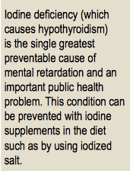


Intellectual Disability
Conditions Associated with ID: Congenital Hypothyroidism
Notes:
Congenital hypothyroidism is an endocrine disease caused by thyroid hormone deficiency after birth. It can be classified into permanent and transient. Permanent congenital hypothyroidism is usually associated with thyroid dysgenesis, dysfunction of thyroid hormone biosynthesis or metabolism, or deficiency of thyroid stimulating hormone (TSH), while transient congenital hypothyroidism is due to iodine deficiency, maternal intake of antithyroid drugs, or transplacental maternal thyrotropin receptor blocking antibodies (TRB-Ab). Congenital hypothyroidism occurs in approximately one per 2000 to 4000 live births (Rastog et al, 2010).
Congenital hypothyroidism is diagnosed by measuring serum TSH and either free T4 or total T4 combined with T3 resin uptake. According to age- normative reference ranges, primary congenital hypothyroidism is confirmed with increased TSH and decreased or normal free T4 or total T4, while secondary (central) congenital hypothyroidism is likely if T4 is low but TSH is not elevated. There are other diagnostic tests to further determine the underlying etiology including measurement of urinary iodine, radionuclide uptake and scan, thyroid ultrasonography, serum thyroglobulin measurement, antithyroid antibody determinations, evaluation for other pituitary hormone deficiencies, brain MRI, and genetic testing.
Clinical features of congenital hypothyroidism in infants include: persistent jaundice, poor feeding, quiet, excessive sleeping, constipation, low body temperature, abnormal cry, umbilical hernia, bradycardia, hypotonia with delayed reflexes. Some may have a palpable goiter. The typical appearance includes a wide posterior fontanel, puffy face, flattened nose, eyes exhibiting pseudohypertelorism, and open mouth with macroglossia. If untreated, congenital hypothyroidism can result in growth failure, permanent mental impairment and cardiac problems.
Newborn thyroid screening tests and early management are very important to prevent the development of ID in congenital hypothyroidism. Blood sampled from a heel-prick between two and five days of age is screened by special filter paper cards to detect TSH levels. A second test is performed, especially for preterm and acutely ill term infants with “delayed TSH rise”, between two and six weeks of age. If initial TSH >30mU/L serum or >15mU/L whole blood, confirmatory serum thyroid testing should be performed (Rastog & LaFranchi, 2010).
Once congenital hypothyroidism is diagnosed, oral thyroxine treatment should be initiated immediately with close follow up, particularly in the first two to three years of life, crucial for positive neurologic outcome. High dose levothyroxine is recommended to normalize serum T4 and TSH as rapidly as possible, monitoring closely in order to adjust levothyroxine dose promptly if results are abnormal. For infants with central congenital hypothyroidism, however, low dose levothyroxine should be started and increased slowly, with addition of physiological doses of cortical hormone meanwhile to prevent sudden hypocorticism from happening. Treatment of transient congenital hypothyroidism takes several years, whereas it is lifelong in permanent congenital hypothyroidism. Genetic counseling and antenatal diagnosis should be considered for families at risk of having a baby with congenital hypothyroidism.

Slide 18


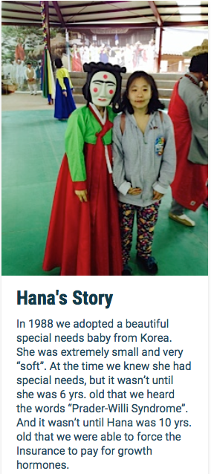
Intellectual Disability
Conditions Associated with ID: Prader-Willi
http://www.pwsausa.org/about-pws/personal-stories
Notes:
Prader-Willi syndrome is an uncommon genetic disorder of chromosome 15q11-13. It was first described by Andrea Prader and Heinrich Willi in 1956. Symptoms include weak muscle tone, feeding difficulties, short stature, incomplete sexual development, cognitive disabilities, and a chronic feeling of hunger that can lead to excessive eating and obesity. Incidence is approximately one in 25,000 to one in 1,000 newborns (Killeen, 2004). Individuals with Prader-Willi syndrome are at risk of learning and attention difficulties. Research suggests that most (50%- 65%) fall within the mild/borderline/low average intelligence range (Curfs & Fryns,1992; Cassidy,1997).
Traditionally, Prader-Willi syndrome was diagnosed by clinical characteristics but it can now be diagnosed by genetic testing. Prader-Willi syndrome has no cure. Early diagnosis allows for early intervention. Children should receive treatment to improve muscle tone. Speech and occupational therapy are also indicated. School aged children will benefit from a highly structured learning environment as well as special education. Daily recombinant growth hormone injections are helpful (Carrel et al, 2002).

Slide 19
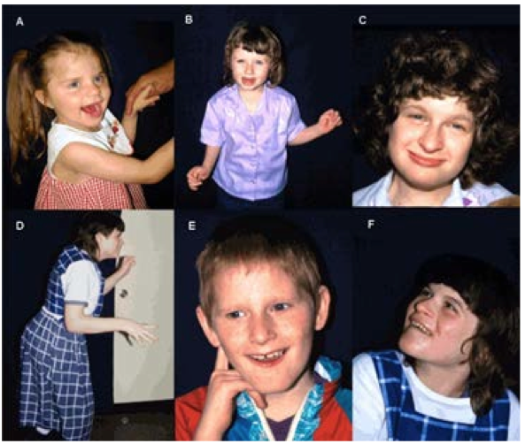
Intellectual Disability
Conditions Associated with ID: Angelman Syndrome
Notes:
Angelman syndrome is a complex genetic disorder characterized by intellectual and developmental delay, severe speech impairment, seizures, ataxia, hand-flapping, and a happy, excitable demeanor with frequent smiling and laughter. It was first described by Harry Angelman in 1965. Prevalence is approximately one in 10,000 to one in 20,000 live births (Petersen et al,1995; Steffenburg et al,1996).
Angelman syndrome is caused by the loss of the normal maternal contribution to a region of chromosome 15, most commonly by deletion of a segment of that chromosome. Diagnosis relies on a combination of clinical features, molecular genetic testing or cytogenetic analysis. Consensus diagnostic criteria for Angelman syndrome are available (Williams, 2006). Analysis of parent- specific DNA methylation imprints in the 15q11.2-q13 chromosome region detects approximately 78% of individuals with Angelman syndrome; fewer than 1% have a cytogenetically visible chromosome rearrangement. UBE3A sequence analysis detects mutations in an additional 11%. Accordingly, molecular genetic testing identifies alterations in approximately 90% of individuals with Angelman syndrome (Dagli & Williams, 2011). Currently, Angelman syndrome has no cure; treatment is symptomatic (e.g., epilepsy can be controlled with anticonvulsant medication).

Slide 20
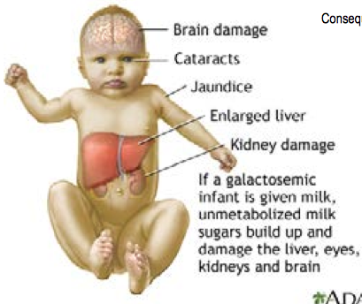
Intellectual Disability
Conditions Associated with ID: Galactosemia
Notes:
Galactosemia is an autosomal recessive single gene disorder associated with a dysfunction of the enzymes that convent galactose into glucose, leading to the accumulation of toxic amounts of galactose in the blood and body tissues, resulting in ID and multiple organ damage. It was first reported by Goppert in 1917, and identified as a defect of galactose metabolism by Herman Kalckar in 1956. Its prevalence is about one per 60,000 live births.
According to the enzymes affected, galactosemia can be classified into three typeType I, classic galactosemia, is due to galactose-1-phosphate uridyltransferase (GALT) deficiency
Type II, galactokinase (GLK) deficiency
Type III, UDP-galactose epimerase (GALE) deficiency.
Diagnosis of galactosemia is established by a test using blood or urine to detect activity of the three enzymes mentioned above and to quantify galactose levels. In addition, molecular genetic testing is now available (Elsas, 2010).
Infants with galactosemia present nonspecific symptoms including vomiting, diarrhea, poor feeding, prolonged jaundice, hepatomegaly, failure to thrive, lethargy, and bleeding diathesis. If not treated promptly, sepsis, liver failure, cataracts, intellectual disabilities, growth delay and death may occur. However, chronic or secondary complications are probable in older children and adults even with early and adequate therapy, including delayed growth, poor intellectual functioning, speech defects, motor problems, learning disabilities and ovarian failure.
To prevent the primary manifestations of galactosemia, it is very important to perform newborn screening tests for all infants and immediate restrictions on all lactose-containing foods and medicines in those affected. Symptoms resolve quickly and prognosis is good if dietary therapy is started in the first three to ten days of life. Routine monitoring of galactose accumulation is necessary to make adjustments to treatment. Other interventions include calcium supplements, ophthalmologic examination, developmental evaluation, and speech assessment. For families at risk of having an affected child, genetic counseling and prenatal diagnosis are recommended.

Slide 21

Intellectual Disability
Conditions Associated with ID: Fetal Alcohol Syndrome
https://www.youtube.com/watch?v=tyjc3gfEnTA
Notes:
Fetal alcohol syndrome, the most severe form of fetal alcohol spectrum disorders, is a preventable cause of intellectual disability. Fetal alcohol syndrome is the result of high alcohol consumption during pregnancy, especially in the first three months of gestation, which can inflict considerable harm to the developing fetus, particularly to the brain. Rates vary according to alcohol consumption in a population; in the USA, it is estimated at 0.2 to 1.5 per 1000 live births have fetal alcohol syndrome (Centers for Disease Control and Prevention, 2009).
Medical practitioners’ knowledge about this condition is low and detection is very poor, with many sufferers going undiagnosed. Together with a history of maternal alcohol intake, currently physicians still rely heavily on three clinical characteristics for diagnosis (Centers for Disease Control and Prevention, 2009):
Facial abnormalities
Central nervous system abnormalities
Growth deficits.
More effective diagnostic tools for early detection using biomarkers, such as fatty acid ethyl esters in the meconium (Bearer et al, 2005), are under investigation.
Clinical symptoms vary depending on the amount, frequency and timing of alcohol exposure, maternal and genetic influences. Infants with fetal alcohol syndrome usually show growth retardation and a mixture of characteristic craniofacial anomalies, which are the hallmarks, including a flat philtrum, thin upper lip, short palpebral fissures, epicanthal folds, low nasal bridge, short upturned nose, ear malformations, and flattened maxilla. Central nervous system abnormalities are also commonly seen in fetal alcohol syndrome, which may include microcephaly, seizures, poor motor coordination, neurosensory hearing loss, cognitive and functional impairments. Furthermore, fetal alcohol syndrome may predispose to the development of mental health problems and substance use.
The only way to prevent fetal alcohol syndrome is to keep away from alcohol during pregnancy. Education for pregnant women or who are planning pregnancy is essential. In addition, screening questionnaires and biochemical markers for detection of maternal alcohol use are useful to detect risk behaviors and intervention to prevent further damage to the fetus. More research on this area is sorely needed (Ismail et al, 2010).

Slide 22
Intellectual Disability Diagnosis
IQ below 70
Impairment of adaptive functioning
Onset before age 18
Interview: family medical history, pregnancy, development, environment of home
Physical exam
IQ measurement
Adaptive behavior: clinical judgment and scales
Labs and genetic testing
Notes:
According to both the DSM and ICD, three basic criteria should be met for a diagnosis of intellectual disability (or mental retardation):
Significantly sub average intellectual functioning (IQ of 70 or below)
Concurrent deficits or impairments in adaptive functioning in at least two of the following areas: communication, self-care, home living, social/interpersonal skills, use of community resources, self-direction, functional academic skills, work, leisure, health, and safety
Onset is before age 18 years.
The subtypes and their characteristics have already been described earlier in the chapter. Diagnosis requires a full professional assessment of intelligence and adaptive behavior. Children with ID are usually brought to professional attention because of their behavior rather than their low intelligence. Moderate and severe forms are identified early because developmental milestones are markedly delayed. Milder forms often become apparent during primary school as a result of academic difficulties, or even later, during adolescence.
A comprehensive assessment should include detailed questioning about:
The medical history of parents and family: genetic conditions, infections during pregnancy, prenatal exposure to toxins, perinatal injury, prematurity, and metabolic disorders
Development: language and motor skills, socialization, understanding and calculation
Environment in which the child is raised: education, resources and the family environment
Physical examination, by the mental health clinician or pediatrician, focusing on symptoms associated with ID. For example, appearance of the face (e.g., the flat, broad face of Down syndrome) (Conor, 1999) or Brushfield spots (small white or grayish/brown spots on the periphery of the iris also common in Down syndrome) that may alert the clinician to the possibility of ID.
IQ measurement is mandatory in all cases in which ID is suspected. IQ should be measured using, if at all possible, widely accepted tests that have been standardized for the specific − or culturally similar − population (e.g., normative data obtained in a German population should not be used for Chinese children). Widely used tests include the Wechsler Intelligence Scale for Children and the Stanford-Binet Intelligence Scales.
It is also useful to evaluate adaptive behavior. To do that professionals compare the functional abilities of a child to other children of similar age and education. There are many adaptive behavior scales available, such as Vineland Adaptive Behavior Scales and Adaptive Behavior Assessment System-II, but an accurate assessment of children’s adaptive behavior requires clinical judgment as well.
Laboratory investigations (e.g., genetic testing) are indicated in all patients with ID, seeking to ascertain its etiology, which may have significant implications for treatment, prognosis and prevention. The extent of these investigations will largely depend on parents’ resources and availability of these tests in the specific country.

Slide 23
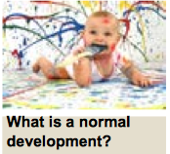
Intellectual Disability Cross-Cultural Differences
How would you diagnose ID in a country without validated IQ tests?
http://www.parentcenterhub.org/repository/disability-landing/
Notes:
Discuss the older definition of IQ and mental age:
Traditionally, an IQ score was obtained by dividing the mental age of the person taking the test (the age group which on average scored such a result in a random sample of the population) by the chronological age multiplied by 100. However, this method has shortcomings (e.g., it cannot be used in adults).
Make clear that it is important for participants to know the developmental milestones in order to estimate approximate “mental age”. Even though this might be an obsolete procedure in many HIC it might aid approximation of IQ in LAMIC if no testing is available.
What is a normal development?
There is a wide range of what can be considered “normal” but growth follows a certain sequence. Particular kills are expected to emerge at more or less a specific age. For a detailed description of normal developmental milestones go to Chapter A.2 or click on the picture to go to the National Dissemination Center for Children with Disabilities .

Slide 24
Intellectual Disability Cross-Cultural Differences
A rough estimate of IQ:
(Developmental age/chronological age) x 100
Example: a child is 6 years old. She is toilet trained and can eat by herself. She still needs help dressing, but can put on a T-shirt. She can walk and jump but only balance for 1-2 seconds on each foot. Her speech is understandable and she can name some colors but cannot count. She can scribble and copy a straight line but not a circle. Her teacher says she is not yet ready for 1st grade.
How do you estimate her developmental age?
How do you estimate her IQ?
Notes:
Discuss the older definition of IQ and mental age
Make clear that it is important for participants to know the developmental milestones in order to estimate approximate “mental age”. Even though this might be an obsolete procedure in many HIC it might aid approximation of IQ in LAMIC if no testing is available.
In this case the developmental age is about 3-4 (according to Denver II), the chronological age 6: Thus 3.5/6 = 0.58 x 100 = estimated IQ around 60, mild ID. Please note this is a rough estimate, but it will enable therapists to make some prognosis: the child can go to school, but might find it difficult and she might need some extra help and stimulation and/ or might need to repeat some years. She should be able to learn to read and write and learn skills. It is no use punishing her if she struggles and is behind other children in school. In contrast she should be praised for any academic effort, so that she enjoys learning and can ultimately achieve more!

Slide 25
Intellectual Disability Assessing IQ
International standard is the WISC – not normed in some countries
Use Denver II (a developmental screening test) or similar scale to assess general development of pre-school children in four domains
Ask about academic functioning in older children
Mild ID may be able to reach grade 2-6 status, can be taught simple reading and math skills, can gain relative independence
Moderate ID may be able to speak, understand, learn self-help skills, follow commands, do unskilled work
Severe ID can have some speech, assisted self-help/household chores
Profound: minimal self-help, speech, dependent on adults for self care
Ask parents about their estimate of developmental age
Notes:
International standard is the WISC – not normed in some countries
Use Denver II (a developmental screening test) or similar scale to assess general development of pre-school children in four domains
Ask about academic functioning in older children
Mild ID may be able to reach grade 2-6 status, can be taught simple reading and math skills, can gain relative independence
Moderate ID may be able to speak, understand, learn self-help skills, follow commands, do unskilled work
Severe ID can have some speech, assisted self-help/household chores
Profound: minimal self-help, speech, dependent on adults for self care
Ask parents about their estimate of developmental age

Slide 26
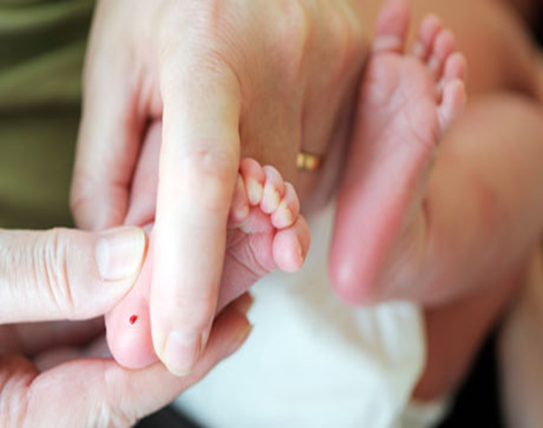
Intellectual Disability Screening: The heel prick test
Routinely done (but voluntary) in HIC/MIC to detect rare genetic disorders in infants 48-72 hours old
It usually screens newborns for:
Phenylketonuria (PKU)
Primary congenital hypothyroidism
Cystic fibrosis.

Slide 27
Intellectual Disability Medical Differential Diagnosis
Exclude sensory (deafness, poor eyesight) problem
Take good care to identify underlying causes of ID, especially those reversible:
Infections (e.g. cerebral malaria)
Neurological disorders (e.g. epilepsy)
Endocrine (e.g. hypothyroidism)
Carefully check family history (e.g., consanguinity) etc.
Any sudden regression (loss of skills that were
once mastered) should be treated
as a medical emergency

Slide 28
Intellectual Disability Psychiatric Differential Diagnosis
Severe under stimulation/abuse/neglect
Specific developmental disorders (e.g. specific reading disabilities etc.)
Autism (with or without ID)
Notes:
Among the most common conditions that can be misdiagnosed as ID are specific developmental disorders and school underachievement. In the former, children may appear developmentally disabled because they perform poorly in one or several academic skills (e.g., reading, arithmetic) when in fact they have an average IQ. In the latter, poor school performance mimicking ID may be due to other factors such as depression or school non-attendance (see Chapter C.3). Although rare, the possibility of severe environmental deprivation, which may present with similar symptoms to ID (e.g., in severely deprived and under- stimulated children in orphanages), should also be excluded. Many children with autism spectrum disorders also have ID, however, they show the specific symptoms of the autism spectrum disorder. In these cases both diagnoses should be made.

Slide 29
Intellectual Disability Further Considerations
Parental mental health issues
Always check how parents are coping
Depression in mothers is common
Severe marital discord/ domestic violence/recent divorce
Raising a child with ID is hard, are parents working together?
Often one parent blames the other and/or withdraws
Child abuse or neglect
Severe bullying or exclusion by peers
Severe deprivation or poverty

Slide 30
Intellectual Disability Carer Depression/Poorly Stimulating Environment
Maternal Depression
Caring for a child with developmental delay is very demanding. Assess for depression:
Are you ok?
How are you coping?
Do you feel that this is too difficult for you?
Do you have time to rest or visit relatives and friends?
Poorly Simulating Environment
How do you play with your child?
How do you communicate with your child?
Recommend suitable play and stimulation to parents
Notes:
Emphasize the importance of asking the carers questions about their well-being.

Slide 31
Intellectual Disability Aims of Treatment
Identify and treat reversible causes of ID
Alleviate suffering for child and family
Promote healthy development towards greatest possible independence.

Slide 32
Intellectual Disability What Works?
Evidence-Based Treatments:
Etiological treatment if cause is known and treatable (e.g., PKU, hypothyroidism)
Parent skills training
Behaviour intervention for challenging behaviour
Psychoeducation
Physio/speech/occupational therapy (when available)
Education plan
Community based rehabilitation
Notes:
Challenging behaviors is a term used to describe comportment that interferes with the daily life of individuals with ID and their carers, reduce their quality of life and survival. These represent a wide range of problems that includes, among others, aggression, self-injury (such as head banging or ingestion or inhalation of foreign bodies), destroying objects, non-compliance, idiosyncratic habits (e.g., restricted range of foods), and socially inappropriate behavior. These problems frequently result in carers seeking medical help and can easily overwhelm families’ ability to cope with and care for these young people, often resulting in rejection or, in more severe cases, institutionalization.
As in non-ID individuals, challenging behaviors serve a function and they are maintained or reinforced if the person with ID is successful in altering their internal or external environment through their behavior – such as by gaining attention, avoiding duties or demands, achieving access to preferred activities or objects or control over their own life, sensory feedback (e.g. hand flapping, eye poking), and reduction of arousal and anxiety. The causes of challenging behavior are complex and include:
• Medical
− Unrecognized pain or discomfort
− Side effects of medications
− Substance abuse
− Physical illnesses such as epilepsy
− Behavioral phenotypes specific for a syndrome
Dual diagnosis. As already highlighted, intellectually disabled young people have higher rates of psychiatric disorder. A comorbid psychiatric illness (often referred to as “dual diagnosis”) occurs in about half of individuals with ID, the more frequent being ADHD, depression, autism and conduct problems, but schizophrenia and bipolar disorder also occur at least as often as in the non-ID population. Psychiatric illnesses like schizophrenia, depression and obsessive compulsive disorder present with roughly the same features in those with mild ID as in other people. However, recognition can be difficult in youth with moderate and severe ID, who tend to display more disorganized, unpredictable and difficult to understand symptoms, compounded by inability to describe their experiences:
Depression may present as withdrawn behavior, irritability and aggression
− Manic episodes may present as distinct periods in which the youth with ID absconds, becomes boisterous, irritable or disinhibited
− Aggression without clear precipitants and associated with bizarre behaviors suggestive of hallucinations or suspiciousness could suggest schizophrenia.
The existence of a family history of psychiatric illness such as schizophrenia or mood disorders may raise the suspicion. Timely identification and treatment of these comorbid conditions reduce disability, family burden and improve quality of life. There are questionnaires available that can help clinicians in the assessment of comorbid psychiatric problems such as the Developmental Behaviour Checklist (DBC; Einfeld & Tonge, 2002) a 96-item inventory, and the Aberrant Behavior Checklist (ABC; Aman et al, 1985), a 58-item questionnaire.
Environmental
− Problems in the living and working environment (e.g., lack of stimulation, family conflict, bullying)
− Life events (e.g., change of school, death or separation)
− Communication issues (e.g., inability to communicate, carers not attuned to the young person’s needs, inappropriate management that reinforces challenging behavior)
− Life stages (e.g., puberty)
Behavior serves a function or purpose for the person. Challenging behaviors are maintained if the person is successful in altering their internal or external environment through their behavior.
Management of challenging behaviors
People with ID and challenging behaviors or dual diagnosis are one of the most disadvantaged groups in most countries, very often receiving substandard care. One of the key roles of mental health professionals dealing with people with ID is the management of challenging behaviors. This requires considerable time, experience and skill. The starting point is to ascertain whether there are treatable causes (as listed above) and to conduct a behavior analysis. The settings in which problems occur can be the home, school or vocational training place, respite care facility or institution. Behavior analysis includes:
A detailed description of the challenging behavior
When and where does it take place (time, place, activity, context)
The sequence of events and interactions with others: possible triggers, how others respond, do these responses reinforce the behavior?
Skill factors (or lack of) involved
Potential needs met by the challenging behaviors.
Once this is understood, a behavior intervention plan can be designed to address the problem. The first goal will be to ensure the safety of the child with ID and of the family or carers. The second would be to extinguish the undesirable behavior. In most cases this will involve families, teachers or workers in institutions, taking into consideration the family’s needs, strengths and weaknesses, and often supporting and empowering them. Educating, helping and engaging the support network is essential for success.

Slide 33
Intellectual Disability Overview of Management
Family psychoeducation
explain problem to carers
give parents skills to support child development
promote participation in family, school and community life
address psychosocial needs of carers
Advice for teachers
Manage risk/contributing factors
hearing and vision problems
nutrition
maternal depression
lack of stimulation
Manage co-occurring epilepsy, depression and behaviour problems
Notes:
Developmental disorders are lifelong conditions and there are no effective drugs to address the problem.
What can primary health care providers do in these cases?
Here is a summary of the main objectives for the management of developmental disorders at the primary health care level.
Emphasize the importance of providing explanations for the problem and guidance to parents.

Slide 34
Intellectual Disability Psychosocial Treatments
Many effective parent training programs available to reduce behavior problems and increasing adaptive functioning
For LAMIC WHO “parent skills training” is being trialed
In the absence of formal training teach parents about promoting learning and managing challenging behavior etc.)

Slide 35
Intellectual Disability Care for Child Development (WHO, UNICEF)
Notes:
Source: Care for Child Development: improving the care of young children. Counseling Cards. WHO and UNICEF, 2012

Slide 36
Intellectual Disability Medication
Not much evidence for effectiveness
Only use after comprehensive assessment and in combination with psycho-social treatment
Antipsychotics sometimes useful in crisis situations, short-term use safer
Doses: start low – go slow!
Sensitivity to medication common in ID
Co-morbidity (e.g. depression, ADHD) can be treated in the same way as in non-ID children
Notes:
Medication is often used (probably overused; Branford, 1994) in the treatment of people with ID. Because mental health professionals are often consulted in crisis situations, medication may be prescribed in an ad hoc basis to deal with the crisis, when medication should optimally be used after a comprehensive assessment and as part of an overall treatment plan in which behavioral management and involvement of the family are essential (see above). The particular issues of informed consent in this population should also be taken into account.
Smaller doses than those typical in non-ID patients should be used – people with ID generally have more medical problems and are more sensitive to the side effects of drugs. Therefore it is wise to start with a very low dose and gradually increase it according to response and side effects.
Use of medications in this group is largely based on clinical experience rather than trial data. In the absence of controlled trial data, antipsychotics, antidepressants, mood stabilizers and other psychotropic medications should be used for the same indications as for children without ID, with the precautions listed above. The growth in the use of second generation antipsychotics, particularly for the management of challenging behaviors, is of concern. While some trial data in children (Snyder et al, 2002) – not replicated in adults (Tyrer et al, 2008) – suggest
that they may be useful in the short term, there are growing concerns about their long-term use because of side effects (e.g., metabolic syndrome).
Agents that reduce sexual desire are of special relevance to adolescents with ID because they occasionally display inappropriate, difficult to control sexual behavior. This can cause alarm and may result in restrictions to their freedom. Although the use such medications (e.g., cypropterone, testosterone antagonists) pose significant ethical challenges, they are increasingly prescribed for this purpose (Reilly et al, 2000).

Slide 37
Intellectual Disability
Discussion: When to refer?
Which children with ID should be seen in pediatrics?
Who should be seen in psychiatry?
Who should receive community care?
What training do workers in the community need to care for children with ID?
Who should deliver the training?

Slide 38
Intellectual Disability Prevention
Primary (preventing occurrence of ID):
Prenatal: (toxins, infections incl. HIV)
Peri-natal: (delivery, neo-natal screening)
Post-natal: (immunization, treatment for infections, safe and enriching environment)
Secondary (halting disease progression):
Discover ID early, provide stimulation for optimal development
Tertiary (maximizing functioning)
Support for families
Stimulation, training, vocational opportunities
Notes:
Prenatal
avoid exposure to harmful substances,
Avoid/treat infection incl. HIV
Peri-natal
Safe delivery
neo-natal screening(PKU
Post-natal:
Universal immunization,
prompt treatment for infections,
safe, caring, enriching environment

Slide 39
Intellectual Disability Further Resources
American Association on Intellectual and Developmental Disabilities
Australian Institute of Health and Welfare
Australasian Society for Intellectual Disability
Center for Effective Collaboration and Practice
Council for Exceptional Children (CEC)
Down’s Syndrome Association (UK)
European Association of Intellectual Disability Medicine
Independent Living Canada
National Center on Birth Defects and Developmental Disabilities (US)
National Dissemination Center for Children with Disabilities (US)

Slide 40

Medication: ADHD
Intellectual Disability
Thank You!
Notes:
--American Academy of Child and Adolescent Psychiatry has an excellent ADHD Resource center

