Slide 1

PSYCHIATRY & PEDIATRICS
Chapter I.5
Pediatric Delirium:
A Practical Approach
Jan N M Schieveld, Erwin Ista, Hennie Knoester & Marja L Molag
DEPRESSION IN CHILDREN AND
ADOLESCENTS
Companion PowerPoint Presentation
Adapted by Julie Chilton

Slide 2
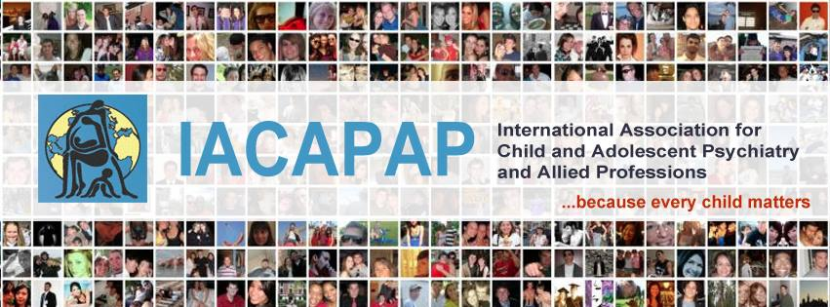
The “IACAPAP Textbook of Child and Adolescent Mental Health” is available at the IACAPAP website http://iacapap.org/iacapap-textbook-of-child-and-adolescent-mental-health
Please note that this book and its companion PowerPoint are:
· Free and no registration is required to read or download it
· This is an open-access publication under the Creative Commons Attribution Non- commercial License. According to this, use, distribution and reproduction in any medium are allowed without prior permission provided the original work is properly cited and the use is non-commercial.

Slide 3
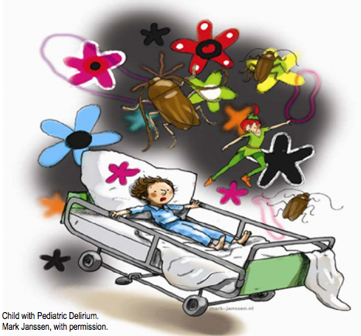

Pediatric Delirium
Outline
The Basics
Epidemiology
Clinical Characteristics
Etiology
Diagnosis
Treatment
Sequelae
Notes:
.

Slide 4
Pediatric Delirium
The Basics: “also known as”
acute confusional state
toxic psychosis
ICU psychosis
organic psychosyndrome
encephalopathy
Notes:
Many names have been used by different disciplines to describe the clinical
entity of delirium, such as “acute confusional state”, “toxic psychosis”,
”ICU psychosis”, “organic psychosyndrome”, “encephalopathy” etc.
Pediatric delirium was described for the first time in Leo Kanner’s 1935 textbook
Child Psychiatry in the chapter “Transient cerebral infections”.

Slide 5
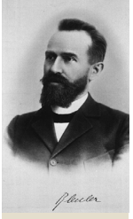
Pediatric Delirium
The Basics: Historical Context
First described in 1935
Underrecognized and underdescribed until 1991
Awareness increasing in last few years
More publications lately
More research needed
Paul Eugen Bleuler
Notes:
Pediatric delirium was described for the first time in Leo Kanner’s 1935 textbook
Child Psychiatry in the chapter “Transient cerebral infections”. “Children become
delirious so often and quickly that this is of no interest to us” wrote Bleuler (1955)
in his Lehrbuch der Psychiatrie. After a long period in which pediatric delirium was
ignored in textbooks, the topic was dealt with in the 1991 edition of Lewis’ Textbook
of Child and Adolescent Psychiatry. In DSM-IV, the section devoted to children
and adolescents does not have a single mention of pediatric delirium but there is
some mention in the section devoted to delirium in adults. Pediatric delirium is
not described in DSM-5. However, in the last few years there has been a growing
awareness of the clinical importance of pediatric delirium, consistent with an
increasing number of publications on the topic (Kudchadkar et al, 2014; Schieveld
& Janssen, 2014; Schieveld et al, 2014) and concerns have been expressed about
its clinical implications, the lack of systematic evidence and the lack of treatment
guidelines (Schieveld & Janssen, 2014; Schieveld et al, 2014).
Paul Eugen Bleuler
(1857-1939) was a Swiss
psychiatrist known for
his contribution to the
understanding of mental
illness. He coined the term
“schizophrenia”. Bleuler
considered pediatric delirium
to be unimportant because
children became delirious
easily and often. Opinion
has changed since then.

Slide 6
Pediatric Delirium
The Basics: Definition
Latin de-lira (out of the track)
Neurocognitive disorder due to a somatic illness or its treatment
One of several brain reactions to illness:
  Sickness behavior
  Fever
  Epilepsy
  Catatonia
  Delirium
  Refractory agitation
  Coma
Notes:
Delirium, from the Latin de-lira (out of the track), is a neuro-cognitive
disorder due to a somatic illness or its treatment. The brain can react to illness,
particularly critical illness, with several responses of which the more important
are sickness behavior, fever, epilepsy, catatonia, delirium, refractory agitation, and
coma.
By critical illness it is meant a life-threatening failure of the brain, heart or
major organs. Sickness behavior is the behavioral repertoire displayed by humans—
and other mammal species—in response to infection, trauma, oncological
problems, and their treatment. This behavior is characterized by loss of interests
and appetite, emotional irritability, tiredness, and an increased need for sleep.

Slide 7
Pediatric Delirium
The Basics: DSM-5 Criteria
  Disturbance of attention*/awareness
  Changes in cognition
  Develops quickly and fluctuates
  Typically worse in evening
  Likely result of medical condition or treatment
  Excludes coma
  *attention is the first to be lost and the last back
Notes:
According to DSM-5 (American Psychiatric Association, 2013) the essential
features of delirium are:
• A disturbance of attention or awareness
• This disturbance is accompanied by changes in cognition that cannot be
better accounted for by another pre-existing neurocognitive disorder (e.g.,
mental retardation, dementia)
• The condition develops in a short period of time, hours or days, and
often fluctuates during the day, typically worsening in the evening
(“sundowning”); and
• There are indications from the patients’ history, examination or laboratory
results that the disturbance is probably the result of a medical condition or
its treatment.
The DSM-5 definition of delirium has been criticized because of the
requirement to exclude coma without specifying how this is to be done.
Consciousness has two simultaneous aspects:
• Arousal, which goes from clarity of mind to somnolence, stupor, and to
coma; and Content of thought, from logical reasoning according to age and education
to thought disorder.
Without an appropriate level of arousal thinking is not possible; that is,
arousal is necessary for thinking. Arousal allows mental processes and the ability to
focus, sustain and shift attention to take place. With somatic disorders, attention is
the first to be lost and the last back.

Slide 8
Pediatric Delirium
The Basics: ICD-10 Criteria
Etiologically nonspecific organic cerebral syndrome with disturbances of:
  Consciousness and attention
  Perception
  Thinking
  Memory
  Psychomotor behavior
  Emotion
  Sleep-wake schedule
Variable duration and severity
Notes:
ICD-10 (World Health Organization, 2015) defines delirium as an
etiologically nonspecific organic cerebral syndrome characterized by concurrent
disturbances of consciousness and attention, perception, thinking, memory,
psychomotor behavior, emotion, and the sleep-wake schedule. The duration is
variable and the degree of severity ranges from mild to very severe.

Slide 9
Pediatric Delirium
Epidemiology: Delirium
High prevalence
10-30% of general hospital patients
Up to 80% in intensive care
In adults, associated with increased:
  Length of stay
  Morbidity
  Mortality
In elderly, associated with:
  Faster cognitive decline
  Loss of independence
  Increased mortality x 1 year
Most important predictor of proximity of death in elderly and oncology patients of any age
Notes:
Delirium has a high prevalence; it affects 10% to 30% of general hospital
patients and up to 80% in tertiary intensive care units (ICUs). Delirium in adults
and the elderly is strongly associated with increased length of hospital stay, morbidity
and mortality. In the elderly it is associated with a faster cognitive decline, loss of
independence, and increased mortality in the year following hospital discharge.
Delirium is the most important predictor of the proximity of death in the elderly
and in oncological patients, young or old (terminal delirium).
Overall, there are more similarities than differences between children, adults
and the elderly:
• In general, critically ill children with delirium have a higher resilience
(and better prognosis) than adults. This is probably owing to a better
vascularization of their brains, hearts, lungs etc. and they mostly have no
other comorbidities or polypharmacy
• The negative neuro-cognitive effects of delirium in adults and the elderly are
well known, but we do not know yet whether this is also true for children.

Slide 10
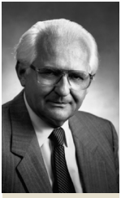
Pediatric Delirium
Epidemiology: Pediatric Delirium
20-30% of critically ill children
A worldwide problem in PICU’s*
Risk factors include:
  Younger age
  Severity of underlying illness
  Number of medications
  Diagnostic tools used
  General ward vs intensive
  care unit
  Developmental delay
  Previous episode
Zbigniew J Lipowski
PICU: Pediatric intensive care unit
Notes:
The reported prevalence of delirium in critically ill children varies from 20%
to 30%. Rates depend on age (more common in younger children), severity of the
illness, number of medications, diagnostic tools used, and group under study (e.g.,
pediatric ICU patients, general ward). Mental retardation and a previous episode
of delirium are also known risk factors.
Zbigniew J Lipowski
(1924-1997) was a PolishCanadian
neuro-psychiatrist
who wrote several books
on consultation-liaison
psychiatry, delirium and
psychosomatic illness
as well as numerous
articles. Lipowski had an
abiding interest in and
knowledge about the
interface of consultation
liaison psychiatry and
neurology, in particular
the problem of delirium.
His work culminated
with the publication in
1980 of his influential
monograph Delirium: Acute
Confusional States.

Slide 11
Pediatric Delirium
Clinical Characteristics
Can be benign or non-benign
2 types of benign delirium:
  Emergence delirium/agitation
    Immediate postoperative period
    After anesthesia withdrawal
    Short-lived~ 30-45 minutes
    Resolves completely
  Common/general practice delirium
    With infections, fevers
    Confusion
    Waxing/waning course
    Worse at night
    Resolves within 2-3 days
    If persistent, or already present in the morning, it requires emergency medical evaluation
Notes:
According to seriousness, pediatric delirium can be benign and non-benign.
There are two types of benign pediatric delirium: emergence delirium and the
common delirium seen in general practice.
Emergence delirium, also known as emergence agitation, is a welldocumented
phenomenon occurring in children—and adults—in the immediate
postoperative period, after the withdrawal of anesthetic drugs. It frequently occurs
in an otherwise healthy child even after minor surgery or a diagnostic procedure.
Clinically, it fulfills all the criteria for pediatric delirium but has a benign course
and usually resolves completely—mostly without any intervention—in 30 to 45
minutes.
In general practice pediatric delirium frequently occurs in the context of
an infection (febrile delirium). It is characterized by confusion, which can be
intense, in a sick child with a waxing and waning course, increasing in the evening
and night, usually coinciding with an increase in the fever. Although it can be
dramatic, more often than not the underlying infection resolves within two or
three days and so does the delirium. In cases of persistent delirium of this kind an
emergency medical assessment is indicated.

Slide 12
Pediatric Delirium
Clinical Characteristics: Non-Benign
Hyperactive
  Agitation
  Irritability
  Increased motor activity
Hypoactive:
  Apathetic
  Uninterested
Mixed
Notes:
Delirium can also be hyperactive (children are agitated, irritable and thrash
about), hypoactive (they appear apathetic, uninterested) and mixed (see case
vignettes for clinical examples).

Slide 13
Pediatric Delirium
Case Vignette: Hyperactive Delirium
6 year old boy with asthma attack
Intubated and sedated in ICU
After extubation on day 3:
  Confused and anxious
  Hallucinations of flying objects and monsters
  Verbally aggressive
  Diagnosed with delirium and treated with lorazepam and IV haloperidol
  Improved after 24 hours
Notes:
A 6-year-old boy was admitted to the pediatric ICU with respiratory insufficiency due
to an asthma attack. Despite asthma treatment he deteriorated and needed intubation and
mechanical ventilation with high doses of sedatives and even muscle relaxation for a few
hours because of high ventilation parameters. Before intubation he said he was afraid to die
because of his breathing difficulty.
After two days his asthma improved and he was weaned from the ventilator. After
extubation, on the third day after admission, he became confused, extremely anxious and had
hallucinations about flying objects and monsters; he became verbally aggressive (swearing
using words his parents believed he did not know). Besides, his parents did not recognize his
behavior as that of their child anymore. He was diagnosed as being delirious and treated with
lorazepam (because of his extreme anxiety) and haloperidol intravenously.
Twenty-four hours after starting treatment his delirium improved, his behavior
normalized and he told his parents that he was feeling well again. This is a typical presentation
of hyperactive pediatric delirium.

Slide 14
Pediatric Delirium
Case Vignette: Hypoactive Delirium
3 year old girl mechanically ventilated for 6 days after tracheal surgery
Sedated with midazolam, ketamine, dexmedetomidine, levomepromazine, dexamethasone, and morphine
Everything tapered for extubation and morphine switched to methadone
Day after extubation became:
  Agitated and disoriented
  Unable to focus attention
  Then apathetic and unresponsive
  21 points on the CAP-D
Notes:
A 3-year-old girl was admitted for tracheal surgery. After surgery she was
mechanically ventilated for six days during which she was sedated with midazolam, ketamine,
dexmedetomidine, levomepromazine, and morphine in various combinations. She was also
treated with dexamethasone. To prepare her for extubation this sedation was tapered off
except for the morphine which was changed to methadone. The day after extubation she
suddenly became slightly agitated, disoriented and was unable to focus her attention. That
same evening she became apathetic and unresponsive. She seemed to look through us with
an empty gaze and without making eye contact. She scored 21 points on the CAP-D (a score
above 10 is consistent with pediatric delirium) with high scores particularly on the hypoactive
delirium criteria. Her parent’s remarked: “We do not recognize our daughter anymore”. This is
a typical case of hypoactive pediatric delirium.

Slide 15
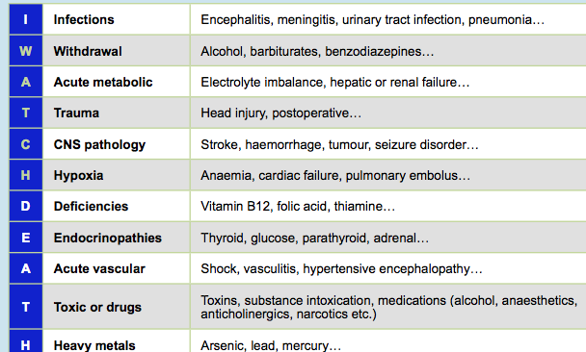
Pediatric Delirium
Etiology: I WATCH DEATH*
*MG Wise in Textbook of Neuropsychiatry (1987)
Notes:
Increasing evidence suggests there is a positive association between illness
severity and pediatric delirium, that is, severity of disease is a major risk factor for
delirium—the most common cause of severe delirium is a critical illness. Depending
on the local facilities, the most frequent places to encounter pediatric delirium are
hospitals or pediatric ICUs. The differential diagnosis of conditions potentially
leading to delirium is summarized by the acronym “I WATCH DEATH” (Wise et
al, 1987; see Table I.5.1).
The differential diagnosis of hypoactive delirium—given its high prevalence
and frequently disappointing response to treatment deserves particular attention:
• In the context of withdrawal of medication (too fast)
• When there is an underlying intoxication with psychotropics or a
neuroleptic-induced syndrome due to sensitivity to antipsychotics
• The possibility of non- convulsive status epilepticus, major depressive
disorder and catatonic inhibition should be excluded.
An EEG may be helpful in these cases, although frequently there is a mix of
conflicting or co-occurring signs and potential explanations.

Slide 16
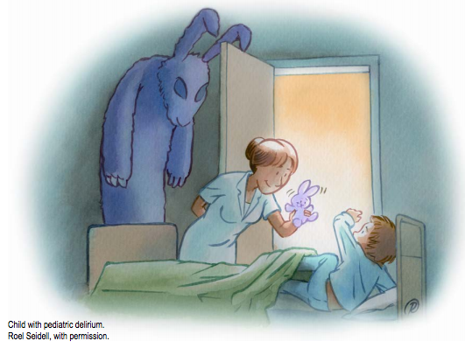
Pediatric Delirium
Diagnosis: Important Questions
Eye contact with parents?
Purposeful actions?
Aware of surroundings?
Restless?
Inconsolable?
Underactive?
Increased response latency?
“This is NOW not my child anymore!” (comment by parents, family)
Notes:
The most frequently described early symptoms are subtle: cognitive (e.g.,
they do not remember what they have just been told, are unable to concentrate,
do not know where they are), perceptual (e.g., visual hallucinations), thought
(e.g., delusions), language, emotional (e.g., may be frightened, irritable) and
psychomotor disturbances (e.g., restless, agitated, unable to be still). Answering
the following questions (based on the CAP-D; Silver et al, 2012) can be helpful in
raising the possibility of delirium:
• Does the child make eye contact with the parents?
• Are the child’s actions purposeful?
• Is the child aware of their surroundings?
• Does the child communicate needs and wants?
• Is the child restless?
• Is the child inconsolable?
• Is the child underactive (moves very little while awake)?
• Does the child take a long time to respond to interactions?

Slide 17
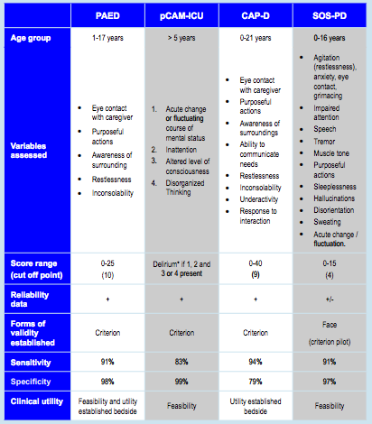
Notes:
PAED: Pediatric Anesthesia Emergence Delirium scale (Janssen et al, 2011).
pCAM-ICU: Pediatric Confusion Assessment Method-Intensive Care Unit (Smith et al, 2011).
CAP-D: Cornell Assessment of Pediatric Delirium (Silver et al, 2012; Traube et al, 2013);
SOS-PD: Sophia Observation withdrawal Symptoms-Pediatric Delirium scale (van Dijk et al, 2012; Ista et al, 2014).
*There is no score range.
The diagnosis of delirium in children older than 5 years with normal
development is based on DSM-5 or ICD-10 criteria. Accurately diagnosing
pediatric delirium requires using a reliable, valid and clinically suitable bedside
tool that may also serve for screening and to guide treatment such as the Pediatric
Anesthesia Emergence Delirium Scale (PAED; Sikich & Lerman, 2004); the
pediatric Confusion Assessment Method for ICU (pCAM-ICU; Smith et al, 2011); the Cornell Assessment Pediatric Delirium tool (CAP-D; Silver et al,
2012; Traube et al, 2013); and the Sophia Observation Withdrawal SymptomsPediatric
Delirium scale (SOS-PD; van Dijk et al., 2012, Ista et al, 2014). No tool
stands out; therefore the choice is a matter of context and personal preference. The
characteristics of the better studied rating scales are summarized in Table I.5.2.

Slide 18

Pediatric Delirium
Diagnosis: 3 Questions to Ask after a Positive Score
Developing somatic complications?
Medication change?
Physical discomfort?
Notes:
It must be emphasized however that the right diagnosis and treatment for
pediatric delirium cannot be made merely on the basis of scores on an observational
screening tool. It is also necessary to evaluate all other possible diagnostic
explanations of a sudden emotional or behavioral disturbance in a critically ill
child (as listed in Table I.5.1). After a positive score on a pediatric delirium rating
scale and before starting treatment one should answer three questions to exclude
other explanations for a positive delirium score (e.g., as described by Esseveld et
al, 2013). Only after a negative response to these questions a diagnosis of delirium
would be made and treated accordingly. These questions are:
• Are symptoms the manifestation of a somatic complication developing
(e.g., pneumonia)?
• Has there been a change of medication?
• Is there physical discomfort (a full bladder, full bowel, stomach distension,
hunger, thirst, itching, pain due to lines, IV lines, catheters, etc.?

Slide 19
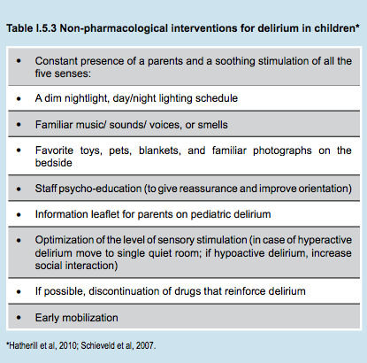
Pediatric Delirium
Treatment: Non-pharmacological Interventions
Minimize risk factors:
  Repeated orientation
  Early mobilization
  Noise reduction
  Non-pharmacologic sleep management
  Day-night rhythm
  Single room
Notes:
Many risk factors for delirium have been identified. These can be classified
as relating to the patient, iatrogenic, and environmental (e.g., hospital, ward,
pediatric ICU). The conditions for which children are admitted to the ICU
often predispose them to delirium, for example infections, metabolic disorders,
hypertension, pain, and withdrawal from medications. Iatrogenic factors that
precipitate delirium in ICU patients include mechanical ventilation, restraints,
sleep disturbance, catheters, and IV lines.
Minimizing these factors is a logical and important approach in preventing
the onset of pediatric delirium. Non-pharmacological interventions appear to
have been successful in several studies (Tabet & Howard, 2009). For example, a
40% decrease in the incidence of delirium was achieved in adults using a multicomponent
approach, which included repeated reorientation, early mobilization,
noise reduction, and a non-pharmacological sleep management (Marcantonio
et al, 2001). In adults, the effectiveness of preventive interventions such as early
mobilization, ear plugs, and staying in a single room is well established (Colombo
et al, 2012; van Rompaey et al, 2012; Zaal et al, 2013).
Can these findings from adults be extrapolated to children? There is
limited evidence that this is the case. However, common sense suggests that these
interventions (for example promoting orientation and day-night rhythm, and
avoiding overstimulation by light and sounds) may be effective for children as well.

Slide 20
Pediatric Delirium
Pharmacologic Treatment: Hyperactive Delirium
Preventive administration not recommended
Consider for:
  Anxiety, agitation, hallucinations, sleep
Monitor drug-drug interactions
Weigh risks and benefits
Same medications used in adults and children
  Benzodiazepine withdrawal→ benzodiazepines and clonidine
  Opiate withdrawal→ clonidine and methadone
Recommendations based on consensus not evidence
  IV and PO haloperidol (EKG if risk factors)
  PO risperidone
  adverse effects: dystonia, oculogyric crisis, akathisia, hyperpyrexia
Start low and go slow
Scales 3 times a day
Wean gradually
Notes:
Prevention of pediatric delirium by pharmacological means is not advised
in children, although it is sometimes recommended in adults, especially in patients
that have experienced delirium previously. There are no studies on pharmacological
prevention of delirium in children although there are studies on prevention of
emergence delirium in children. These studies are very variable in quality and no
firm conclusions for the prevention of pediatric delirium can be drawn from them.
Hyperactive delirium
Medication may be considered to reduce symptoms such as anxiety,
agitation, hallucinations and disturbed sleep. Pharmacokinetics in children is
different from adults. Before starting pharmacological treatment the risk of side
effects and interactions with other medications and the route of administration
have to be considered and weighed against the potential benefits of treatment.
The same antipsychotics (typical antipsychotics, such as haloperidol, and
atypical antipsychotics, such as risperidone) are used in children as in adults.
Benzodiazepines and clonidine are used in the treatment of delirium due to
benzodiazepine withdrawal; clonidine and methadone are used in the treatment of
delirium due to opiate withdrawal.
Studies on the pharmacological treatment of pediatric delirium are scarce
and have serious methodological flaws: small numbers of patients with large
age differences and very different physical illnesses, interventions or outcomes
are poorly described, and the studies often have no control group. Therefore
recommendations are based on consensus rather than on evidence. However, there
are suggestions that haloperidol and risperidone are effective in reducing symptoms
of pediatric delirium in seriously ill children.
Haloperidol is mostly given intravenously; risperidone is only available
orally. In a sophisticated pediatric ICU setting the IV route is preferable because it
is faster and easier to control. The oral administration of haloperidol or risperidone
is also acceptable. Dosage varies in the different studies. The recommended
dosages are summarized in Tables I.5.4 and I.5.5. Benzodiazepines are not usually
recommended due to their potential deliriogenic effects in adults and the elderly.
Most experts recommend to start pharmacological treatment of pediatric
delirium when, in spite of non-pharmacological interventions, the child shows
extreme agitation or anxiety, hallucinations or delusions, especially when this leads
to discomfort, stress or danger to the child (e.g. loss of IV catheters or endotracheal
tubes), when delirium leads to extreme stress in parents or when it interferes
seriously with the care of other patients in the ICU or ward. When the child is
comfortable, it is easier for the parents to take care of their child. Some studies
indicate that patients who are treated pharmacologically may be more comfortable
and weaned earlier from the ventilator than patients that are not treated.
Adverse effects are extrapyramidal symptoms, such as dystonia, oculogyric crisis, akathisia, and hyperpyrexia. Extrapyramidal symptoms are seen frequently,
particularly if antipsychotics are increased rapidly. Start low and go slow is an
important principle. It can take 24 to 48 hours before an adequate response is
achieved. To cover this time-window of ongoing agitation the short term addition
of levomepromazine (also known as methotrimeprazine) has been described (with
a total starting dosage of 1 to 3 mg/IV slowly in 30 minutes and then titrating
according to the clinical response, up to a maximum dosage of 1mg/kg/IV in 24
hours).
Recognizing and treating adverse effects is important. Treatment consists
in reducing the dose of antipsychotic and administration of an anticholinergic
drug such as biperiden (50 micrograms/kg/IV in 15 minutes). In adult patients
lengthening of the QTc interval has been reported with the possibility of Torsades
de Pointes. This has not been reported in children. Experts, however, recommend
performing an ECG before starting treatment with haloperidol when the child has
other risk factors for increased QTc interval (e.g., electrolyte abnormalities, other
medications that can lengthen the QTc interval, or medications that influence
CYP2D6 or CYP3A4 metabolism).
More adverse effects have been reported for haloperidol than for risperidone.
Therefore risperidone is the treatment of choice when symptoms are not extreme
and oral administration is possible. When no benefit is obtained with one of them,
a switch to the other should be considered.
The consensus is that a pediatric delirium rating scale should be used at least
three times daily, to score delirium when medication is started and for as long as
the patient receives medication. It is not known for how long treatment should
continue. Experts advice to continue treatment at least until symptoms have
disappeared and until risk factors that possibly led to the delirium have lessened.
Medication should be weaned gradually, over a few days

Slide 21
Pediatric Delirium
Pharmacologic Treatment: Hyperactive Delirium
EXAMPLE
Using repeated loading doses (starting low & going slow) try to find a therapeutic response after 1 or 2 hours, or in the first 24 hours, and the duration of it.
Then calculate, based on these data, a maintenance dosage for the next 24 hours (divided in 3 doses).
The maintenance dosages suggested are only indicative.
Notes:
Prevention of pediatric delirium by pharmacological means is not advised
in children, although it is sometimes recommended in adults, especially in patients
that have experienced delirium previously. There are no studies on pharmacological
prevention of delirium in children although there are studies on prevention of
emergence delirium in children. These studies are very variable in quality and no
firm conclusions for the prevention of pediatric delirium can be drawn from them.
Hyperactive delirium
Medication may be considered to reduce symptoms such as anxiety,
agitation, hallucinations and disturbed sleep. Pharmacokinetics in children is
different from adults. Before starting pharmacological treatment the risk of side
effects and interactions with other medications and the route of administration
have to be considered and weighed against the potential benefits of treatment.
The same antipsychotics (typical antipsychotics, such as haloperidol, and
atypical antipsychotics, such as risperidone) are used in children as in adults.
Benzodiazepines and clonidine are used in the treatment of delirium due to
benzodiazepine withdrawal; clonidine and methadone are used in the treatment of
delirium due to opiate withdrawal.
Studies on the pharmacological treatment of pediatric delirium are scarce
and have serious methodological flaws: small numbers of patients with large
age differences and very different physical illnesses, interventions or outcomes
are poorly described, and the studies often have no control group. Therefore
recommendations are based on consensus rather than on evidence. However, there
are suggestions that haloperidol and risperidone are effective in reducing symptoms
of pediatric delirium in seriously ill children.
Haloperidol is mostly given intravenously; risperidone is only available
orally. In a sophisticated pediatric ICU setting the IV route is preferable because it
is faster and easier to control. The oral administration of haloperidol or risperidone
is also acceptable. Dosage varies in the different studies. The recommended
dosages are summarized in Tables I.5.4 and I.5.5. Benzodiazepines are not usually
recommended due to their potential deliriogenic effects in adults and the elderly.
Most experts recommend to start pharmacological treatment of pediatric
delirium when, in spite of non-pharmacological interventions, the child shows
extreme agitation or anxiety, hallucinations or delusions, especially when this leads
to discomfort, stress or danger to the child (e.g. loss of IV catheters or endotracheal
tubes), when delirium leads to extreme stress in parents or when it interferes
seriously with the care of other patients in the ICU or ward. When the child is
comfortable, it is easier for the parents to take care of their child. Some studies
indicate that patients who are treated pharmacologically may be more comfortable
and weaned earlier from the ventilator than patients that are not treated.
Adverse effects are extrapyramidal symptoms, such as dystonia, oculogyric crisis, akathisia, and hyperpyrexia. Extrapyramidal symptoms are seen frequently,
particularly if antipsychotics are increased rapidly. Start low and go slow is an
important principle. It can take 24 to 48 hours before an adequate response is
achieved. To cover this time-window of ongoing agitation the short term addition
of levomepromazine (also known as methotrimeprazine) has been described (with
a total starting dosage of 1 to 3 mg/IV slowly in 30 minutes and then titrating
according to the clinical response, up to a maximum dosage of 1mg/kg/IV in 24
hours).
Recognizing and treating adverse effects is important. Treatment consists
in reducing the dose of antipsychotic and administration of an anticholinergic
drug such as biperiden (50 micrograms/kg/IV in 15 minutes). In adult patients
lengthening of the QTc interval has been reported with the possibility of Torsades
de Pointes. This has not been reported in children. Experts, however, recommend
performing an ECG before starting treatment with haloperidol when the child has
other risk factors for increased QTc interval (e.g., electrolyte abnormalities, other
medications that can lengthen the QTc interval, or medications that influence
CYP2D6 or CYP3A4 metabolism).
More adverse effects have been reported for haloperidol than for risperidone.
Therefore risperidone is the treatment of choice when symptoms are not extreme
and oral administration is possible. When no benefit is obtained with one of them,
a switch to the other should be considered.
The consensus is that a pediatric delirium rating scale should be used at least
three times daily, to score delirium when medication is started and for as long as
the patient receives medication. It is not known for how long treatment should
continue. Experts advice to continue treatment at least until symptoms have
disappeared and until risk factors that possibly led to the delirium have lessened.
Medication should be weaned gradually, over a few days

Slide 22
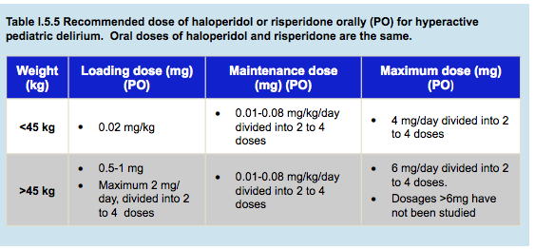

Slide 23
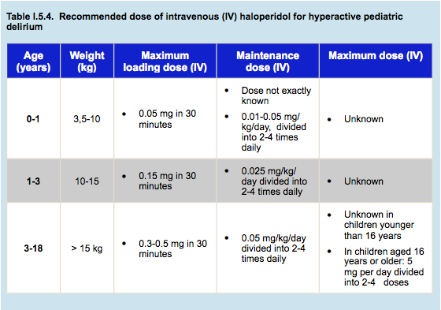
Pediatric Delirium
Pharmacologic Treatment
Preventive administration not recommended
Notes:
Prevention of pediatric delirium by pharmacological means is not advised
in children, although it is sometimes recommended in adults, especially in patients
that have experienced delirium previously. There are no studies on pharmacological
prevention of delirium in children although there are studies on prevention of
emergence delirium in children. These studies are very variable in quality and no
firm conclusions for the prevention of pediatric delirium can be drawn from them.
Hyperactive delirium
Medication may be considered to reduce symptoms such as anxiety,
agitation, hallucinations and disturbed sleep. Pharmacokinetics in children is
different from adults. Before starting pharmacological treatment the risk of side
effects and interactions with other medications and the route of administration
have to be considered and weighed against the potential benefits of treatment.
The same antipsychotics (typical antipsychotics, such as haloperidol, and
atypical antipsychotics, such as risperidone) are used in children as in adults.
Benzodiazepines and clonidine are used in the treatment of delirium due to
benzodiazepine withdrawal; clonidine and methadone are used in the treatment of
delirium due to opiate withdrawal.

Slide 24

Pediatric Delirium
Pharmacological Treatment: Hypoactive Delirium
No studies
No consensus
Notes:
Hypoactive delirium
There are no studies and no consensus on the pharmacological treatment of
hypoactive pediatric delirium.

Slide 25
Pediatric Delirium
Sequelae of Delirium in Children and Parents
No studies on delirium
Increased length of hospital stay
Large increase in hospital costs
Increased mortality
PTSD symptoms
Delusional memories
Cognitive problems after intensive care unit stays
  Hypoxia
  Hypoperfusion
  Infection
  Trauma
Neurotoxicity in animal studies
  Benzodiazepines
  Opioids
  Anesthetics
Notes:
There are no studies on the long term sequelae of pediatric delirium.
The published studies—on long term sequelae in children that had a hospital
admission—have been performed in premature-born children admitted to neonatal
intensive care units, children with cancer, or children admitted to a pediatric ICU.
PTSD symptoms are often reported in these children and their parents. Some
studies describe an association between psychological and psychiatric problems
after discharge and the occurrence of “delusional memories” (possibly a symptom of
delirium) about their ICU stay and invasive procedures during the ICU admission
(Colville et al, 2008; Colville & Pierce, 2012)
In adults, there is evidence that some cognitive problems after ICU discharge
are related to benzodiazepine use and delirium. Possible causes of cognitive
problems in children after pediatric ICU admission are hypoxia, hypoperfusion,
infection, and trauma. Long term effects of medications such as benzodiazepines,
opioids and anesthetics have not been studied in children. Animal studies, show
that these drugs can be neurotoxic, especially to the developing brain.

Slide 26

Pediatric Delirium
Thank You!

