Slide 1

DEVELOPMENTAL DISORDERS
Chapter C.5
ENCOPRESIS
Alexander von Gotard
DEPRESSION IN CHILDREN AND
ADOLESCENTS
Companion PowerPoint Presentation
Adapted by Julie Chilton

Slide 2

The “IACAPAP Textbook of Child and Adolescent Mental Health” is available at the IACAPAP website http://iacapap.org/iacapap-textbook-of-child-and-adolescent-mental-health
Please note that this book and its companion powerpoint are:
· Free and no registration is required to read or download it
· This is an open-access publication under the Creative Commons Attribution Non- commercial License. According to this, use, distribution and reproduction in any medium are allowed without prior permission provided the original work is properly cited and the use is non-commercial.

Slide 3


Encopresis
Outline
Definition and Classification
Epidemiology
Clinical Signs and Symptoms
Etiology
Comorbidity
Diagnosis
Treatment
Course and Outcome
Notes:
By the end of this presentation, you should understand the following about Encopresis in children and adolescents

Slide 4
Encopresis
The Basics
Affects children worldwide
Distressing for children and parents
30-50% have comorbidity
2 major forms of encopresis:
  With constipation
  Without constipation
Notes:
Encopresis (or fecal incontinence) is a disorder which affects children worldwide.
It is even more stigmatized than enuresis and urinary incontinence
and is associated with high levels of distress for both children and parents.
Also, the rate of comorbid emotional disorders is higher, affecting 30%-50% of all
children with encopresis (von Gontard et al, 2011).
Two major forms of encopresis can be differentiated: encopresis with and
without constipation. The specific differentiation into these two subtypes is of
utmost importance as they differ according to pathophysiology, clinical features
and, especially, treatment (i.e., the former does not respond to laxatives, while
in the latter they are essential in treatment). The aim of this chapter is to give
an overview and practical approaches to assessment and treatment of these two
subtypes of encopresis.

Slide 5
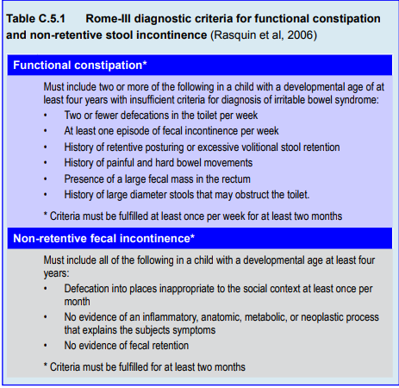
Notes:
According to ICD-10 (World Health Organization, WHO, 2008) and
DSM-IV-TR (American Psychiatric Association, APA, 2000), encopresis is defined
as both voluntary and involuntary passage of feces in inappropriate places in a
child aged four years or older, after organic causes have been ruled out. Despite
major similarities between the two systems, they differ regarding essential points,
especially the definition of subtypes. In ICD-10, one episode per month for at
least three months is needed. ICD-10 does not define subtypes nor differentiate
clearly between encopresis with and without constipation. The duration required
for diagnosis in DSM-IV-TR (2000) is the same but it distinguishes between
encopresis with and without constipation.
Based on current research and validation studies, the most precise taxonomy
was proposed by pediatric gastroenterologists in their Rome-III classification for
functional disorders of the gastrointestinal tract (Table C.5.1) (Rasquin et al, 2006).
The first difference is that the neutral term of fecal incontinence was chosen instead
of encopresis. This means, that fecal incontinence and encopresis can be used as
synonyms (as in this chapter). The second change is that constipation was defined
as the main disorder that can − but does not necessarily have to − be associated
with soiling. Constipation is, in fact, more common than encopresis: many
constipated children do not soil. The main symptoms of functional constipation
can be seen in Table C.5.1. The definition of constipation cannot be based on
a low defecation frequency on the toilet alone: some children pass stools every
day but still retain fecal masses in the rectum and colon. Therefore, additional
clinical signs and symptoms are needed and these are listed explicitly in the RomeIII
criteria. The authors chose a shorter duration − two months − to encourage
early treatment and to avoid chronification. Two symptoms must be present: a
low defecation frequency; soiling; holding maneuvers; painful, hardened stool; and
large fecal masses.
For encopresis without constipation, the neutral term of non-retentive fecal
incontinence was suggested. The etiology of this subtype is not known and much
less research has been generated for this disorder than for constipation (Bongers et
al, 2007). Except for a shorter duration of two months, the criteria are similar to
those of DSM-IV.

Slide 6
Encopresis
Epidemiology
Affects 1-3% children >4 years old
3 different trajectories:
  Chronic
  Relapsing
  Spontaneous remission
Constipation: prognosis less favorable
Boys > Girls
Nocturnal encopresis more often organic
Norm=1 bowel movement/day
Chronic constipation > encopresis
Notes:
Encopresis is a common disorder affecting 1% to 3% of children older than
four years (the definitional age). Three different trajectories can be defined (Heron
et al, 2008):
• Children with chronic encopresis over many years
• Those with relapses, and
• A group with a tendency to remit spontaneously.
In a Dutch study, 4.1 % of 5-6 year olds and 1.6 % of 11-12 year olds were
affected (van der Wal et al., 2005). Prevalence depends on the definition used; for
example, 5.4 % of 7-year old children soiled, but only 1.4 % once or more per
week (Joinson et al, 2006). Encopresis can persist into adolescence and even young
adulthood. Without constipation (i.e., non-retentive fecal incontinence), 49% of
children soiled at the age of 12 years, and 15% at 18 years in a long-term follow
up (Bongers et al, 2007). The prognosis of constipation is less favorable: only
80 % had a good outcome by the age of 16 years, and 75% to 80% at 16-27 years
(Bongers et al, 2010).
Three to four times more boys are affected by encopresis than girls (Bellman,
1966). Encopresis occurs almost always during the day (Bellman, 1966). Nocturnal
encopresis is more often associated with organic causes and requires a more detailed
somatic assessment.
Most children from the age of four years onwards have one bowel movement
a day – with great individual variability (Bloom et al, 1993). Chronic constipation
is a more common disorder than encopresis. According to a large meta-analysis,
the median prevalence was 9% world-wide with different definitions used (van den Berg et al, 2006). This meta-analysis included studies from countries such as
Italy, US, Hong Kong, Japan, Finland, Turkey, Brazil, Saudi Arabia, among others.

Slide 7
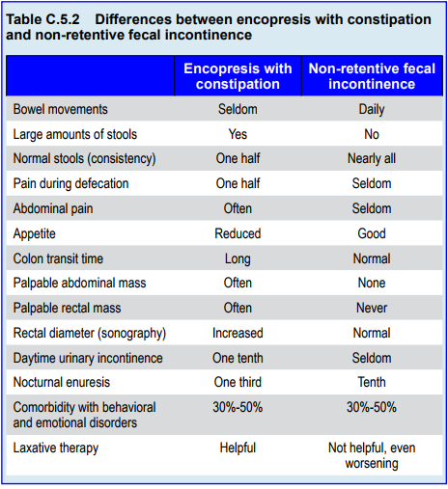
Notes:
As the differentiation of the two subtypes – constipation and non-retentive
fecal incontinence − is decisive for treatment, it is important to know the basic
signs and symptoms of each. Based on the research of Benninga et al (1994; 2004),
as well as others, the main differences between the subtypes are shown in Table
C.5.2.
Children with encopresis with constipation (or functional constipation) have
a reduced number of bowel movements with large stools of altered consistency (too
soft or too hard). They often experience pain during defecation. Abdominal pain
and reduced appetite are typical. The colon transit time is increased, abdominal
and rectal masses are palpable. In sonography, the rectal diameter is increased (> 25
mm). Often, daytime urinary incontinence and even enuresis co-exists. Additional
emotional and behavioral disorders are found in 30%-50% of them and, finally,
laxative therapy is helpful.
Children with encopresis without constipation (non-retentive fecal
incontinence) do not have many of these symptoms. They have daily bowel
movements of normal size and consistency. Pain is not frequent and appetite is good. Colon transit time is normal and no stool masses can be palpated. Enuresis
and urinary incontinence are less common, while comorbidity with psychological
disturbances is similar (30%-50%). Finally, laxatives have no effect – can even
worsen the soiling.

Slide 8
Encopresis
Etiology: Genetics of Functional Constipation
Constipation concordance rate
  Monozygotic twins 70%
  Dizygotic twins 18%
Risk of occurrence:
  1 affected parent: 26%
  Both parents: 46%
  40% if father
  19% if mother
  (Bakwin & Davidson, 1971)
Notes:
Fecal continence is achieved following night-time and daytime urinary
continence (Largo et al, 1978; 1996). Early toilet training can lead to early fecal
continence in infancy and toddlerhood but has no influence on the development of
encopresis at the age of 4 years. Encopresis can be preceded by delayed development
and difficult temperament in the child, as well as maternal depression and anxiety
(Joinson et al, 2008)
.
Functional constipation
Genetic factors do play a role in constipation but less so in encopresis. The
concordance rate for constipation for monozygotic twins is 70%, for dizygotic
twins 18%. The risk of occurrence is 26% if one parent is affected, 46% if both
parents, 40% if father, and 19% if mother is affected (Bakwin & Davidson, 1971).

Slide 9
Encopresis
Etiology: Functional Constipation
Often starts after acute constipation
Possible psychological triggers:
  Stressful life events
  Losses
  Family conflict
Possible somatic triggers:
  Anal fissures
  Diet change
  Intensive toilet training
  Medication
  (Cox et al, 1998)
Notes:
Functional constipation often develops after an acute constipation, which
affects 16%-22% of young children. This can be triggered by a wide variety of
psychological factors such as stressful life events, losses, family conflict, as well as
somatic factors such as anal fissures, changes of diet, intensive toilet training and
medication (Cox et al, 1998).

Slide 10
Encopresis
Etiology: Functional Constipation
Development of chronic stool retention:
Pain and avoidance of defecation
Habitual contraction of anal sphincter
Accumulation of fecal material
Increased transit times
Decreased peristalsis and sensation
Fluid withdrawal and hardening of stool
Megacolon
Fresh stools bypassing hard fecal mass
*etiology of non-retentive fecal incontinence unknown
Notes:
Irrespective of the initial triggers, a sequence of
chronic stool retention can follow. Acute constipation causes painful defecation
and avoidance of defecation, inducing a paradoxical contraction of the external
anal sphincter, which becomes habitual. Avoidance of bowel movements leads to
accumulation of fecal material in the rectum and colon. Transit times are increased,
peristalsis and sensation are decreased. Fluid withdrawal leads to large, hard fecal
masses and a megacolon. Encopresis occurs because of interference of these masses
with rectal function and by fresh stools bypassing the hard fecal masses.
Non-retentive fecal incontinence
In contrast to the clear model of functional constipation, the etiology of
non-retentive fecal incontinence is not known (Bongers et al, 2007). It cannot
be caused by psychological factors alone, as the comorbidity rate of both types
of encopresis is the similar: 30%-50% of cases (Benninga et al, 1994; 2004; von
Gontard et al, 2011).

Slide 11
Encopresis
Comorbidity
30-50% have emotional or behavioral comorbidity
Increased rates of:
  Separation anxiety
  Specific phobias
  Generalized anxiety
  ADHD
  Oppositional defiant disorder
No difference in rates between encopresis with vs without constipation
Notes:
Overall, 30-50% of all children with encopresis have a comorbid emotional
or behavioral disorder. This means, that three to five times more children with
encopresis have additional disturbances in comparison to non-soiling children.
In a large population-based study of children aged 7½ years, children with
encopresis had significantly increased rates of separation anxiety (4.3%), specific
phobias (4.3%), generalized anxiety (3.4%), ADHD (9.2%) and oppositional
defiant disorder (11.9%) (Joinson et al, 2006). In other words, children with fecal
incontinence show a heterogeneous pattern of both internalizing and externalizing
disorder comorbidity. Regarding subtype, encopretic children with constipation have similar rates of behavioral scores in the clinical range as children without
constipation (Benninga et al, 1994; 2004). In other words, they cannot be
differentiated according to the behavioral comorbidity.

Slide 12
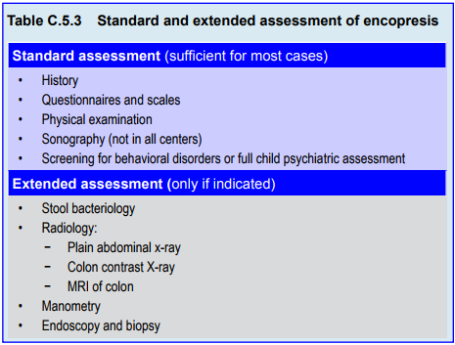
Notes:
The assessment of children with encopresis should be as non-invasive as
possible, and should always include parents or other caregivers. For most children,
a basic evaluation that can be conducted in many primary care settings is sufficient
(Table C.5.3).
Each child should have a physical examination. Both a general pediatric and
a neurological examination are recommended. The perianal and perigenital areas
should be inspected. Spine, reflex differences and asymmetries of buttocks should
be noted. A rectal examination should be performed at least once. If sonography is
available, this can replace the rectal exam if no organic form or fecal incontinence
is suspected.
If available, sonography of abdomen, kidneys, bladder and retrovesical
region is helpful. The most important finding is an enlarged rectal diameter of
>25-30 mm in children with constipation (Joensson et al, 2008). In these cases, a
rectal examination can be avoided. If sonography is not possible, a standard rectal
exam should be performed and rectal masses can be palpated.
Due to the high comorbidity rate, a child psychiatric assessment is
recommended in child psychiatric settings. In other settings, screening with
validated questionnaires (such as the Child Behavior Checklist; Achenbach, 1991)
is recommended. If scores are in the clinical range, further assessment or child
psychiatric referral is recommended (von Gontard et al, 2011).
All other examinations are not routinely indicated – only if an organic type
of fecal incontinence is suspected. It is important to avoid unnecessary and invasive
investigations. Further details regarding assessment can be found in von Gontard
and Neveus (2006).

Slide 13
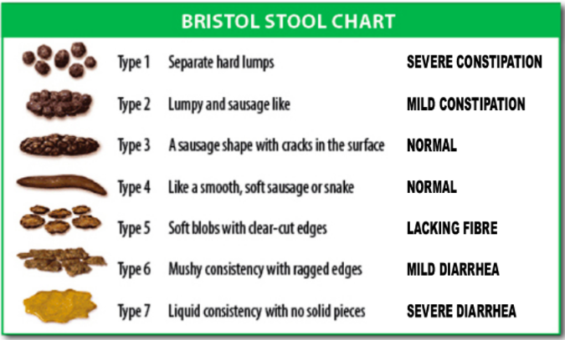
Notes:
A very useful chart is the Bristol Stool Chart. Seven types of stool forms
are depicted ranging from “separate hard lumps, like nuts (hard to pass)” (type
1) to “watery, no solid pieces, entirely liquid” (type 7). The scale enables parents
and children to identify the predominant type of stool easily and without lengthy
descriptions. The course of treatment can also be monitored using this scale.

Slide 14
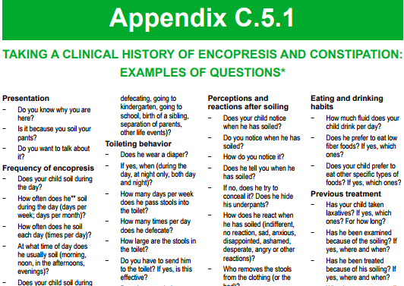
Notes:
The history is the most important aspect of assessment. If conducted
correctly and empathically, the most relevant information will be gathered through
the history. It is worthwhile to take enough time during the initial consultation.
Useful questions for a detailed history can be found in Appendix C.5.1.

Slide 15
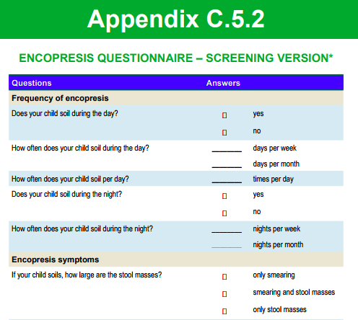
Notes:
Questionnaires can be a useful and time-saving procedure to gain
information and to check if the information obtained through history is complete.
A short questionnaire is shown in Appendix C.5.2.

Slide 16
Encopresis
Somatic Causes of Chronic Constipation
Anatomic: anal fissures, abscesses, skin tags, dermatitis, stenosis
Metabolic/endocrine: cystic fibrosis, celiac disease, milk allergy, diabetes, hypothyroid
Neurologic: cerebral palsy, spina bifida, myelomeningocoele
Drugs
*Hirschsprung’s disease
Notes:
Somatic causes are present in 5% of children with chronic constipation and
must be ruled out. These include anatomic causes such as anal fissures, abscesses,
skin tags, dermatitis, anal stenosis and other ano-rectal malformations. Metabolic
and endocrine causes include cystic fibrosis, celiac disease, cow milk intolerance/
allergy, diabetes mellitus and hypothyroidism. Neurological causes include cerebral
palsy, spina bifida and myelomeningocele. Constipation can also be caused by
various drugs (von Gontard and Neveus, 2006).
The most important differential diagnosis is Hirschsprung’s disease, which
affects 1:5000 infants and is an intrinsic neuromuscular disease of the gastrointestinal
tract characterized by aganglionosis. Symptoms begin in the neonatal period with
vomiting, abdominal distension, and food refusal. Older children can have small
caliber stools, while soiling is a rare symptom. Most cases (80%) are diagnosed by
the age of 4 years (Felt et al, 1999).
Organic causes in non-retentive fecal incontinence are much less frequent
affecting a maximum of 1% of children. The most important are infectious
diarrhea, neurological conditions such as spina bifida occulta and postoperative
residual symptoms.

Slide 17
Encopresis
Treatment
Psychoeducation:
Subtype information
Enhance motivation
Shift ineffective parental interventions
Change diet
Increase fluids
Toilet Training:
3 x a day
After mealtimes
5-10 minutes
Feet on the floor
Positively experienced
No expectation for output
Token rewards
Notes:
Following assessment, children and parents are given detailed information
on the subtype of encopresis (psychoeducation). As in the treatment of enuresis,
unspecific factors such as enhancing motivation and building a good therapeutic
relationship are helpful. Feelings of guilt, dysfunctional parental attributions (“my
child is doing this on purpose”) and frustration can be verbalized. Ineffective
parental interventions such as punishment or non-indicated medication can be
discussed with parents. If the child’s food intake is restricted to low fiber foods,
a change in the child’s diet can be useful. Also, the amount of fluids should be
increased, as many children do not drink enough during the day.
Toilet training
A baseline period with observation and recording is not necessary. Instead,
toilet training is initiated right from the start. This training is indicated for both types of encopresis. Children are asked to sit on the toilet three times a day, after
mealtimes. This time is especially useful as the postprandial defecation reflexes are
then most active. Children are asked to sit on the toilet five to ten minutes in a
relaxed way, for this, it is important that their feet touch the floor. Otherwise a
little foot-stool should be provided. These toilet sessions should be experienced in
a positive way: children are allowed to read comics, books, play with computers
or cell phones, draw pictures, etc. They do are not expected to pass urine or stools
every time. These toilet sessions are documented in a chart as depicted in Appendix
C.5.3. If necessary, the co-operation of the child can be enhanced positively by a
simple token system with small rewards. All criticism or punishment should be
avoided.

Slide 18
Encopresis
Treatment: Laxatives for Constipation
First for dis-impaction, then maintenance
Rectal: enemas with phosphates
  --(30 mL/10 kg bodyweight)
  --80% successful
Oral: polyethyleneglykol
(1.5g/kg body weight max)
--68% successful
Lower doses for maintenance: 6 months to 2 years
Treat comorbid disorders
Notes:
Laxatives
In non-retentive fecal incontinence, this toilet training is the main aspect of
treatment. Laxatives are not indicated. In children with constipation, toilet training
is combined with laxatives: first disimpaction, then maintenance treatment.
Disimpaction is necessary to evacuate fecal masses at the beginning of
treatment. This can be performed rectally or orally. In rectal disimpaction, enemas
are applied. The most widely used and recommended are enemas containing
phosphates such as sodium hydrogen phosphate and sodium monohydrogen
phosphate. Recommended doses are 30ml/10kg of bodyweight or half an enema
for pre-school children, ¾ to one enema in school children. Often, these have to be
repeated several times. An alternative is oral disimpaction with polyethylenglykol
(PEG; macrogol). Large doses of up to 1.5g/kg body weight per day are given.
Sufficient oral fluids are required for this osmotic laxative to be effective.
Once large stool masses have been passed, a lower maintenance dose should
be given. Through these procedures success is achieved in 80% of children with
rectal and 68% with oral disimpaction, both leading to a normalization of colon
transit times (Bekkali et al, 2009).
Maintenance treatment
After successful disimpaction, a long-term maintenance treatment over a
minimum of six months to two years should follow to avoid re-accumulation of
stool masses (Felt et al, 1999). In addition to toilet training three times a day
after mealtimes, oral laxatives are given. The standard and most effective laxative is
polyethylglykol (PEG; macrogol), a long, linear polymer that binds water (Candy
& Belsey, 2009; Pijpers et al, 2009). Side effects such as abdominal pain are rare.
The initial dose is 0.4g/kg bodyweight per day in two doses. If stools are too hard,
the dose is increased, if too soft, reduced. The therapeutic range varies from 0.2g/
kg to 1.4g/kg bodyweight per day (Nurko et al, 2008). Lactulose, a disaccharide, is
less effective and has more side effects. The dosage of liquid lactulose ranges from
1ml/kg to 3ml/kg bodyweight per day in one to three doses.
If comorbid emotional and behavioral disorders are present, these need to
be treated separately. Untreated comorbid disorders will reduce adherence and
compliance and outcome of encopresis treatment will not be optimal.

Slide 19
Encopresis
Course and Outcome
If untreated, both outcomes unfavorable
Both can persist into adolescence and adulthood
Treat actively
See patients at regular intervals
Give laxatives through maintenance
Notes:
The untreated long-term course of both types of encopresis is not favorable.
Constipation and non-retentive fecal incontinence can persist into adolescence
and even young adulthood (see epidemiology). Therefore, encopresis needs to
be treated actively and patients should be seen at regular intervals. In case of
constipation, laxatives should be given for long enough; two years or longer in
some children.

Slide 20

Encopresis
Thank You!

