Slide 1

OTHER DISORDERS
Chapter H.2
TIC DISORDERS
Hannah Metzger,
Sina Wanderer
& Veit Roessner
DEPRESSION IN CHILDREN AND
ADOLESCENTS
Companion Powerpoint Presentation
Adapted by Julie Chilton

Slide 2
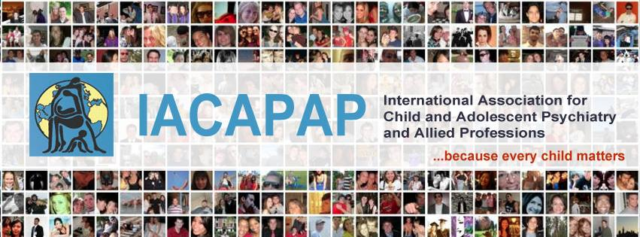
The “IACAPAP Textbook of Child and Adolescent Mental Health” is available at the IACAPAP website http://iacapap.org/iacapap-textbook-of-child-and-adolescent-mental-health
Please note that this book and its companion powerpoint are:
· Free and no registration is required to read or download it
· This is an open-access publication under the Creative Commons Attribution Non- commercial License. According to this, use, distribution and reproduction in any medium are allowed without prior permission provided the original work is properly cited and the use is non-commercial.

Slide 3


Tic Disorders
Outline
The Basics
Epidemiology
Etiology
Risk Factors
Diagnosis
Comorbidity
Treatment
Notes:
By the end of this presentation, you should understand the following about Tic Disorders in children and adolescents
Samuel Johnson, one of the most influential English literary figures, particularly because of his “Dictionary of the English Language” published in 1755, appears to have suffered from Tourette’s Disorder

Slide 4
Tic Disorders
The Basics: Definition of a Tic
Motor movement or vocalization that is:
  Involuntary
  Sudden
  Rapid
  Recurrent/Repetitive
  Non-rhythmic
  Short bursts or series
  Various muscle groups
  Simple or complex
  Transient or chronic
  Premonitory urge
Notes:
Tics may range from a discrete, hardly noticeable flinching of the eye to a painful, socially incapacitating und subjectively shameful phenomena involving several muscle groups. Those afflicted by tics, as well as their family, may experience substantial suffering due to the symptoms, be it through bullying or to inappropriate response by caregivers resulting in a dysfunctional parent-child relationship. People in the extended environment may also react with irritation, for instance where vocal tics occur in inappropriate settings, such as the cinema or the classroom. On the other hand, some of the people afflicted successfully develop strategies to control their tics and learn to live and cope with them.
Tics are sudden, abrupt, fast movements comprising various muscle groups, with or without vocal utterances, which occur involuntarily. Tics are brief but repetitive – though not rhythmic – and usually appear in short bursts or even series. They may be classified according to the degree of complexity (simple, complex) as well as their quality (motor, vocal) (Rothenberger et al, 2007).
By the age of 10 or 11 years, children begin to report a premonitory urge. This can be any kind of sensation, typically a tickling, itching or prickling feeling, in the area of the muscle groups involved, announcing the imminent occurrence of a tic (Steinberg et al, 2010).

Slide 5
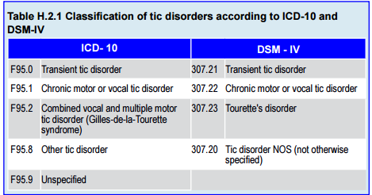
Tic Disorders
Tic Disorders: Multiple Types
Notes:
Classification usually follows the criteria of the International Classification of Diseases (ICD-10; World Health Organisation, 1996) or the Diagnostic and Statistical Manual of Mental Disorders (DSM-IV; American Psychiatric Association,1994). This classification has not changed substantially in DSM-5. Tic disorders are best classified among the neuropsychiatric disorders. Table H.2.1 shows the classification of tic disorders.
Whether a transient or a chronic tic disorder is present depends on the duration of symptoms: in the case of a transient tic disorder, symptoms last less than 12 months. Transient tic disorders mostly occur in school age children and usually do not require specific treatment.
Diagnosis of Gilles-de-la-Tourette syndrome (or simply Tourette syndrome or disorder) is warranted in cases where several motor tics and at least one vocal tic are present at the same time or have been present in the past. Motor and vocal tics do not have to be present at the same time but should have occurred almost every day over one year at least to warrant the diagnosis. The onset of Tourette syndrome is generally before the age of 18; it rarely occurs for the first time in adulthood.

Slide 6
Tic Disorders
The Basics: Motor Tics
Range
Simple & sudden
  Eye blink
  Grimace
Complex behavioral patterns
  Crouching or hopping
  Copropraxia
  Echopraxia
  Self harm
Notes:
Motor tics range from simple, sudden movements such as eye blinking or grimacing, to complex behavioral patterns, for example crouching down or hopping. In extreme cases, complex motor tics may present themselves as obscene gestures (referred to as copropraxia; e.g., pulling trousers down) or even have an element of self-harm (e.g., hitting oneself in the head). In some cases the afflicted person is compelled to repeat or imitate a movement observed in another person (echopraxia).

Slide 7
Tic Disorders
The Basics: Vocal/Phonic Tics
Involuntary utterances
Sounds, noises, sentences, or words
  Simple
  Complex
    Coprolalia
    Echolalia
    Palilalia
Notes:
Vocal or phonic tics are involuntary utterances of sounds, noises, sentences or words. A simple vocal tic may be a slight coughing, clearing of throat, wheezing, squeaking or loud shouting. More complex vocal tics involve syllables, words or sentences. Coprolalia is the utterance of obscene or aggressive words or sentences. Coprolalia occurs seldom, in less than 20% of persons affected by Tourette disorder (Rothenberger et al, 2007). In other cases sufferers feel compelled to repeat their own previously spoken words (palilalia – it is called echolalia if they repeat words previously spoken by someone else).

Slide 8
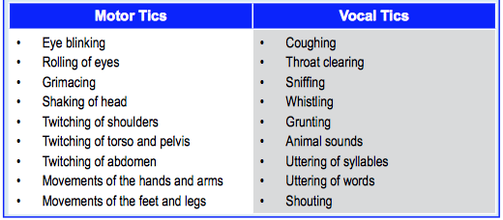
Tic Disorders
Common Motor and Vocal Tics

Slide 9

Tic Disorders
Examples of a Variety of Tics
https://www.youtube.com/watch?v=1SEKZLivG54

Slide 10
Tic Disorders
The Basics: Transient* Tic Disorder
Symptoms less than 12 months
Mostly school age
Usually no specific treatment
*“Provisional” in DSM-5
Notes:
Whether a transient or a chronic tic disorder is present depends on the
duration of symptoms: in the case of a transient tic disorder, symptoms last less
than 12 months. Transient tic disorders mostly occur in school age children and
usually do not require specific treatment.

Slide 11

Tic Disorders
The Basics: Tourette Syndrome
Several motor tics
At least 1 vocal tic
Not at the same time
Almost every day > 1 year
Onset usually < 18 years
Notes:
Diagnosis of Gilles-de-la-Tourette syndrome (or simply Tourette syndrome
or disorder) is warranted in cases where several motor tics and at least one vocal tic
are present at the same time or have been present in the past. Motor and vocal tics
do not have to be present at the same time but should have occurred almost every
day over one year at least to warrant the diagnosis. The onset of Tourette syndrome
is generally before the age of 18; it rarely occurs for the first time in adulthood.
Georges Albert Édouard
Brutus Gilles de la Tourette
(1857-1904), French
neurologist, described the
symptoms of the syndrome
that bears his name in nine
patients in 1884, which he
termed “maladie des tics".
Gilles de la Tourette had a
colourful and eventful life.
He was shot in the head in
his consulting rooms by a
paranoid young woman who
had been a patient at the
Salpêtrière Hospital claiming
she had been hypnotised by
him against her will causing
her to lose her sanity.
The trial sparked intense
public debate over whether
hypnosis could be used to
induce criminal behavior
in otherwise law-abiding
citizens.
He died in a psychiatric
hospital in Lausanne,
Switzerland, where he had
been interned probably
because of a bipolar illness
and syphilis.

Slide 12
Tic Disorders
Epidemiology
4-12% of all children
3-4% chronic tic disorder
1% Tourette’s
Children & adolescents 10 x > adults
Boys 3-4 x > girls
Familial predisposition
Notes:
It is estimated that 4% to12 % of all children suffer from tics at some time
during their development. Approximately 3%-4% are afflicted by a chronic
tic disorder and 1% with Tourette’s syndrome (Rothenberger et al, 2007).
Children and adolescents are 10 times more likely to suffer from tics than adults
(Kerbeshian & Burd 1992). This may be due to the high spontaneous remission
rate in younger patients. Boys are afflicted three to four times more often than
girls (Freeman, 2007). A familial predisposition has been established (O’Rourke
et al, 2011).

Slide 13
Tic Disorders
Cultural Differences
Worldwide Prevalence 1%
Different from country to country
  Classification systems
  Medical priorities
  Ethnicities and epigenetics
  Racial genetics
Similarities: demography, family history, clinical features, associated conditions, comorbidity, treatment outcome
Notes:
The prevalence of Tourette syndrome is about 1% worldwide (Robertson et
al, 2009). However, Tourette syndrome is less likely to occur in some countries.
Differences in prevalence across various countries seem partly to reflect the fact
that not all follow the same classification system. China, for example, has reported
slightly lower prevalence rates; rates appear to be lower among African Americans
in the US and occurrence is extremely rare in Sub-Saharan black Africans. Possible
reasons for these findings include the implementation of different diagnostic
systems, other medical priorities with less likelihood to seek treatment, ethnic
and epigenetic differences, genetic and allelic differences in different races and
the presence of a mixture of races (Robertson, 2008). By contrast, a cross-cultural
review by Staley et al (1997) concluded that demography, family history, clinical
features, associated conditions, comorbidity and treatment outcome were basically
the same across cultures.

Slide 14
Tic Disorders
Age at Onset and Usual Course
Onset: 2-15 years
Peak: 6-8 years
Motor tic of face first
Shoulders, torso, extremities after
Vocal tics 2-4 years later
Fluctuations every 6-12 weeks in location, complexity, type, intensity, frequency
Notes:
Tics generally occur for the first time between the ages of two and 15 years.
However, the peak age of onset is between six and eight years. Typically, the first
symptom is a simple motor tic in the face, such as eye blinking or grimacing. With
time, they spread to shoulders, extremities and torso. Often vocal tics appear two
to four years after the start of the motor tics (Leckman et al, 1998).
In most cases tics fluctuate in their location, complexity, type, intensity and
frequency. This can be confusing and frustrating for parents of children afflicted by
tics. Fluctuations often occur at irregular intervals, approximately every six to 12
weeks, without any apparent reason (Roessner et al, 2004). This changing course
is one of the main distinguishing features when differentiating between Tourette
syndrome and the abnormal movements found in conjunction with other illnesses,
such as dystonia or chorea, which typically do not change or show less accentuated
fluctuations.

Slide 15
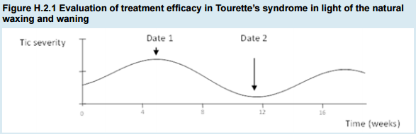
Tic Disorders
Fluctuations in Course
Notes:
At date 1 (in which a reduction in tics naturally occurs) a therapeutic intervention is followed by a reduction in tics
irrespective of the intervention’s potential to increase or not to have an effect on tics. The reduction could be falsely
attributed to the intervention when in fact was the result of the tics natural waxing and waning. A therapeutic intervention
at date 2 could be followed by an increase in tics despite its potential to reduce tics. The effect of the therapeutic
intervention might attenuate the natural waxing of the tics but is biased by the spontaneous increase. This means that
a meaningful appraisal of treatment efficacy in Tourette’s disorder can only be ascertained in most cases after a long
observation period. Source: Roessner et al (2011). Reproduced with permission.

Slide 16
Tic Disorders
Fluctuations in Course: Natural Evolution
Older children
  Better control of tics
  Suppression for minutes to hours
  Increased intensity after school day
Worsening of symptoms during adolescence
Remission during young adulthood
Children and adolescents 10 x > chance of having tics than adults
Notes:
Usually there is a worsening of symptoms during adolescence. As children
progresses into young adulthood, tics often go into remission (Sandor et al, 1990).
As a result, children and adolescents are 10 times more likely to be affected than
adults.
With increasing age, tic-afflicted patients also gain better control over
their tics and are often able to suppress them for minutes or up to several hours.
However, after a period of suppression, patients often feel compelled to exhibit
their tics with heightened intensity (Banaschewski et al, 2003). For this reason
some children may be able to suppress their tics over the course of the school day
but, as soon as the child arrives at home, tics reappear with more intensity and the
feelings of heightened tension generated by the suppression of tics will temporarily
fade.

Slide 17
Tic Disorders
Fluctuations in Course
Poor Prognosis:
Familial history
Existence of vocal or complex tics
Comorbid hyperkinetic disorder
Obsessive Compulsive Symptoms
Aggressive behavior vs self or others
Spontaneous Remission:
50-70% chronic simple or multiple tics
3-40% Tourette’s Syndrome
Notes:
The severity of the tic disorder during childhood only has a limited predictive
value concerning the illness in adulthood. A poor prognosis is usually associated
with:
• Familial history
• Existence of vocal or complex tics
• Comorbid hyperkinetic disorder
• Obsessive-compulsive symptoms
• Aggressive behavior against self or others.
Spontaneous remission of chronic simple or multiple tics occurs in 50% to
70 % of cases and 3% to 40% for Tourette syndrome (Erenberg et al,1987).

Slide 18
Tic Disorders
Fluctuations in Course: Environmental and Psychosocial Effects
Can decrease during:
Distraction
High concentration job
Cannabis use
Alcohol use
Intentional movements
Can increase during:
Stress
Fear
Emotional trauma
Social pressure
Joy
Tension
Notes:
Specific circumstances may cause variation of tic symptoms. Emotional
states such as fear, joy or tension frequently lead to an increase. Distractions, an
occupation requiring high concentration and consumption of cannabis or alcohol may lead to a decrease. Tics hardly ever interfere with intentional movements such
as cycling. It is possible for tics to appear during any of the sleep stages, albeit
with reduced frequency, intensity and complexity. Due to the aforementioned
characteristics, it is possible to differentiate tic symptoms from most other
movement disorders (see table H.2.3).
However, environmental influences, first and foremost
psychosocial stress, undoubtedly modulate tic severity. Experiences that cause fear,
emotional trauma and social pressure generally result in an exacerbation of tics.

Slide 19
Tic Disorders
Etiology
Multifactorial: genetic, neurobiological, psychological, environmental
Dysregulation in cortico-striato-thalamo-cortical circuits
Deviations in dopaminergic and serotonergic systems
Increased dopamine activity in basal ganglia→ deficient subcortical inhibition→
impaired autonomic control of movement
Notes:
Although the cause of primary tic disorders has not been conclusively
determined, it is widely assumed to be the result of an interaction of genetic,
neurobiological and psychological factors as well as environmental influences.
A dysregulation within cortico-striato-thalamo-cortical circuits with deviations
within the dopaminergic and serotonergic systems is believed to be responsible
for the occurrence of tics. It seems that overactivity of the dopaminergic system in
the basal ganglia leads to deficient subcortical inhibition and impaired automatic
control of movement, which then clinically presents itself as motor or vocal tics
(Leckman et al 1997; Singer, 2011).

Slide 20
Tic Disorders
Risk Factors
50% heritability
Possible pre, peri, and post-natal risk factors:
  Premature birth
  Hypoxia
  Low birth weight
  Nicotine and caffeine use
Rare secondary causes:
  Tumors, poisonings, infection, head trauma
Notes:
A familial predisposition is as a risk factor. Heritability has been estimated
to be around 50 % (Singer & Walkup, 1991). Various prenatal, perinatal and
postnatal factors are considered possible factors that increase the risk. They include
premature birth, perinatal hypoxia, low birth weight as well as excessive nicotine
and caffeine consumption by mother during pregnancy. On rare occasions tics
may develop as secondary symptom of tumors, poisoning, infection, head trauma
or vascular disease (Burd et al, 1999; Mathews et al, 2006) .

Slide 21
Tic Disorders
Medical Imaging
Possible decreased volume
  basal ganglia
  corpus callosum
Deviation of glucose metabolism
  basal ganglia
  prefrontal cortex
  somatic sensorimotor cortex
  insula
  temporal lobe
Notes:
Medical imaging techniques have determined that, on a neuroanatomical
level, patients with tics show a reduced volume of the basal ganglia as well as the
corpus callosum, but heterogeneity of study samples in terms of several confounders
(e.g., long-term use of medication, tic performance and suppression over years)
prevents firm conclusions. Furthermore, deviation of glucose metabolism in
the basal ganglia, prefrontal and the somatic sensorimotor cortex, insula andtemporal lobe has become apparent. Apart from dopaminergic overactivity, other
neurotransmitters implicated include dysfunctions within the serotonergic and
noradrenergic systems.

Slide 22
Tic Disorders
Diagnosis
Detailed medical history
Standardized questionnaires:
  Child Behavior Checklist
  Strengths & Difficulties Questionnaire
Interviews:
  Yale Global Tic Severity Scale
  Tourette’s Syndrome Severity Scale
Parental/Self Rating Scales
  Yale Tourette Syndrome Symptom List-Revised
Physical & neurological exam
EEG
Notes:
A detailed medical history should be obtained from birth onwards.
Additionally, standardized questionnaires may be used. The Child Behavior
Checklist (Achenbach, 1991) can be employed to obtain information concerning
possible comorbid disorders (see Chapter A.5). The Strengths and Difficulties
Questionnaire (Goodman, 1997) can also be recommended for this purpose (see
Chapter A.5). Tic-specific or semi-structured interviews include the Yale Global Tic
Severity Scale (YGTSS) (Leckman et al, 1989) and the Tourette’s Syndrome Severity
Scale (TSSS) (Walkup et al, 1992). Parental or self-rating can be done using the
Yale Tourette Syndrome Symptom List-Revised (TSSL-R) (Leckman et al, 1989).
A thorough physical and neurological examination should be conducted,
including an EEG. The main purpose for this is to exclude other possible illnesses
that could cause the symptoms. Usually no further tests, such as an MRI, are
necessary unless there are pathological findings. ECG, thyroid function tests or
other procedures (e.g., metabolic tests) are not necessary in the absence of abnormal
findings.
Tests of cognitive ability are not necessary either unless there is indication
of learning problems. Completing questionnaires provides a good opportunity to
observe the patient in a challenging situation, even though patients are often able
to suppress tics for a certain period so that the true extent of the symptoms may
not be observed.

Slide 23
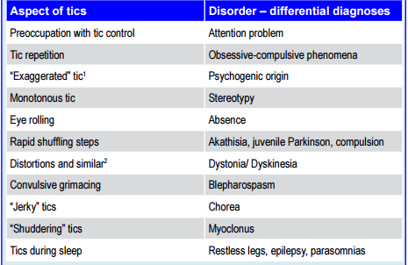
Tic Disorders
Differential Diagnosis

Slide 24
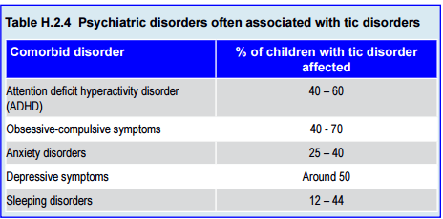
Tic Disorders
High Comorbidity
Notes:
Approximately 65 % of children and adolescents with chronic motor or vocal
tic disorder have a comorbid condition (Conelea et al, in press). Around 90% of
those with TS develop one or more psychiatric disorders (Freeman, 2007). The
probability of having a comorbid disorder increases with the severity of tics, early
onset and familial loading.
When there are comorbid psychiatric disorders and Tourette syndrome, it
should always be ascertained which of the presenting conditions is causing the
greater impairment. Treating one disorder frequently has a positive effect on the
other and may render further specific treatment unnecessary.

Slide 25
Tic Disorders
Treatment: Psychoeducation
Patient, caregivers, teachers
Individual causal factors
Options for treatment
Self help groups
Notes:
Psychoeducation, involving the patient as well as relevant caregivers, should
be provided at the beginning of treatment. Further, individual causal factors and
options for treatment should be discussed. Referral to self-help groups is also
useful. Treatment is usually delivered as an out-patient; inpatient treatment can
be necessary in severe cases requiring more extensive investigations, when severe
comorbid disorders are present or to monitor and achieve optimal drug treatment.
Figure H.2.2 shows a decision tree (Roessner et al, 2011).
Psychoeducation involves providing detailed information to the relevant
persons, in the case of young people this usually will involve parents and teachers.
Information should be provided regarding the disorder, its course, investigations
and options for treatment. Information which often is of use to teachers involves
recommending allowing the child to sit exams on their own or to be permitted to
leave the classroom for short periods – to lessen the urge to release the tics.
In cases of mild severity – taking into account the high rate of spontaneous
remission – psychoeducation is all that is required. For this reason it makes sense to
adopt a “wait-and-see” approach, keeping a watchful eye on recurrences or possible
comorbid disorders (Wanderer et al, 2012).

Slide 26
Tic Disorders
Treatment: Psychotherapy
Cognitive Behavioral Methods
Habit Reversal Training
Exposure Response Prevention
Massed (Negative) Practice
Relaxation Training
Contingency Management
Family Therapy
Notes:
Cognitive behavioral methods are the most effective psychotherapeutic
intervention. This treatment should be administered by trained professionals well versed in the complexities of the disorder. It may involve the following (Verdellen
et al, 2011):
• For well-motivated and insightful patients, habit reversal training has
been shown to be effective. Training comprises a set of techniques
intended to help patients become aware of impending tics and
practicing a competing response to inhibit or interrupt the tic. These
techniques include relaxation training, contingency management and
generalization training. To heighten tic awareness, methods such as:
− Response description (patients learn to describe the topography
of their tics and develop a detailed, usually written, description
of each tic)
− Response detection (patients receive feedback concerning the
occurrence of a tic, until they can detect the target behavior
unassisted)
− Early warning procedures (patients practice identifying the early
signs of a tic, such as specific urges, sensations or thoughts) and
− Situation awareness (patients describe people, places or
situations in which the tics occur most commonly) are included
in the training.
− Competing response training involves the patient learning to
purposefully initiate a tic for one to three minutes or until the
urge to perform the tic has disappeared.
• Exposure and response prevention is based on the association of a
premonitory urge followed by the vocal or motor tic, which results
in the relief of the urge sensation. The aim is to break the association
between the urge and the resultant tic, which – according to learning
theory – has been strengthened over time. By confronting the patient
with the premonitory urge over a longer period (exposure) and having
them resist giving in to it (response prevention), the patients would
learn to endure the urge without having to act out the tic (habituation).
Patients are also encouraged to self-monitor symptoms by recording
times and situations in which tics occur over certain periods to ascertain
when and where tics are most frequent.
• Massed (negative) practice involves intentionally and repeatedly acting
out the tic in an effortful and rapid way over a certain period with short
rests in between. The long-term effectiveness of this seems limited but can help patients if they are about to enter situations which require ticfree
appearance (i.e., going to the cinema).
• Relaxation training is assumed to help reduce tics because tic intensity
often increases in times of stress and anxiety. Relaxation training
includes progressive muscle relaxation, imagery, autogenic training or
deep breathing and is mostly applied as one part of a multi-modal
treatment plan. In terms of effectiveness, Peterson and Azrin (1992)
found that tics were reduced by 32% with relaxation training, by
55% with habit reversal training and by 44% with self-monitoring
techniques.
• Contingency management, again as a part of a multi-modal program,
seeks to positively reinforce tic-free intervals (e.g., through tokens,
praise or demonstration of affection) and to ignore tics. According to
learning theory this should result in a lessening of the behavior (in this
case, the occurrence of tics). Because this method is usually incorporated
in multi-component treatment packages, it has been difficult to assess
the value of this specific technique.
• Sometimes the presence of a tic disorder in a child may result in
significant problems among family members. In such cases family
therapy should be recommended.

Slide 27
Tic Disorders
Treatment: Medication
Most treatment “off label”
Only when interfering with function or subjective discomfort
Start slowly
Only discontinue after a year
Reduce in late adolescense
Pre-medication work-up: CBC, LFTs, prolactin, EEG, ECG, physical/neurological exams
Notes:
There is good empirical evidence supporting the use of a variety of
medications for Tourette syndrome (see below). However, medication for Tourette
syndrome is often prescribed “off-label”. For instance, the only drug approved
for tics in Germany is haloperidol, which on current evidence is considered only
a medication of third choice. Pharmacological treatment is recommended when
tics result in significant subjective discomfort, such as muscular pain or physical
injury, ongoing social problems (e.g., isolation or bullying), emotional problems,
or significant functional impediment, typically in academic performance (Roessner
et al, 2011). The aim is to achieve the best balance between maximum benefit and
minimum side effects. It is not to be expected that tics will disappear completely
with medication; at best, symptoms will be alleviated.
Before initiating pharmacological treatment, the following investigations
should be carried out: blood and liver function tests, prolactin levels, ECG,
EEG, as well as physical and neurological examinations (to establish a baseline,
exclude cardiac contraindications, including long QT syndromes, other physical
illnesses or potential contraindications for the use of medication ). Additionally,
it is important to assess whether the tic disorder or another comorbid disorder
is causing the greatest impairment, in order to determine which of the disorders
should be primarily treated. For instance, treating comorbid ADHD can result in
improved ability to suppress the tics without having to specifically treat them –
conversely, psychostimulant drugs may rarely worsen the tics.
Generally speaking, medication should start slowly, with effectiveness and
tolerability being assessed at regular intervals. Once optimal dosage has been
ascertained, medication should be taken regularly for at least one year before
considering a discontinuation. At the very latest, medication should be reduced in
late adolescence to ascertain whether continuation is necessary, taking into account
the high rates of spontaneous remission. Table H.2.5 summarizes the European
recommendations about medication for tic disorders

Slide 28
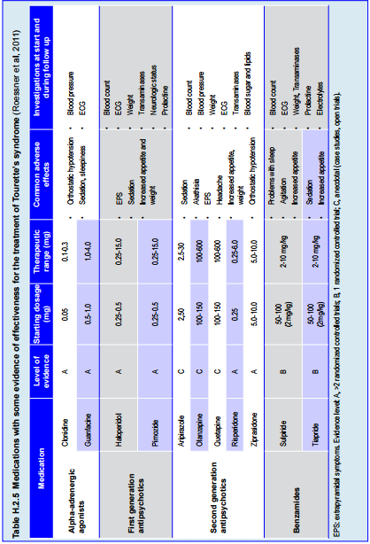
Tic Disorders
Treatment: Medication
Notes:
Haloperidol is the only medication officially approved for the treatment
of tic disorders in Europe (from the age of three years). Haloperidol
has strong antidopaminergic action and results in a reduction of tics
in approximately 80 % of cases. However, adverse reactions such
as extrapyramidal symptoms occur quite frequently, which makes
haloperidol not the treatment of first choice. • Tiapride is a selective D2 receptor antagonist that shows virtually no
antipsychotic action. It has a good side effect profile and is well tolerated
with few extrapyramidal symptoms. The most frequent adverse
reactions are drowsiness, moderate transient hyperprolactinemia and
weight gain. There is no evidence of negative effects on children’s
cognitive performance. Tiapride is currently the first-choice medication
for treatment of Tourette syndrome in Germany.
• Risperidone is a second generation antipsychotic agent with a high
affinity for D2 and 5-HT2 receptors. Efficacy is similar to that of
haloperidol but with a more favorable side effect profile (see Table
H.2.5).
• Aripiprazole has shown promising effects specifically in patients who
had not responded to, or had not tolerated well other medications.
Aripiprazole has a high affinity for D2 receptors but, in contrast to
other second generation antipsychotics, it is also a partial agonist of
5HT1A receptors and a potent antagonist at 5HT2A receptors. This
profile has raised hopes that it may be better than the other drugs
(Roessner, 2011). It also has the advantage that weight gain is low.
Nausea and sedation are the most frequently reported adverse effects.
Although the best evidence from clinical trials is still that for the typical
antipsychotics haloperidol and pimozide, European clinical practice has gradually
substituted these substances with atypical antipsychotics, foremost risperidone.
Availability of and experience with specific medications, however, also plays a role
in the choice. In the German-speaking world, tiapride is regarded as the first choice
drug in the treatment of tic disorders in children and adolescents (Rothenberger
et al, 2007). Although evidence is comparatively limited, Roberston and Stern
(2000) also recommend tiapride as well as sulpiride in their review of treatment
for tic disorders, due to their balance of efficacy and tolerability. Aripiprazole has
shown potential regarding efficacy in refractory cases. There is, however, a lack of
placebo-controlled studies for this medication.

Slide 29
Tic Disorders
Treatment for Tics & Comorbid Disorders
ADHD:
  Psychostimulants, e.g., methylphenidate
  Atomoxetine or clonidine for mild to moderate tics
  Addition of risperidone
Emotional disorders
  Sulpiride for mild to moderate mood or anxiety symptoms
  Selective serotonin reuptake inhibitor (SSRI)
  SSRI & antipsychotic for moderate to
  severe tics
Notes:
When there are comorbid psychiatric disorders and Tourette syndrome, it
should always be ascertained which of the presenting conditions is causing the
greater impairment. Treating one disorder frequently has a positive effect on the
other and may render further specific treatment unnecessary.
Attention deficit hyperactivity disorder (ADHD)
If ADHD is comorbid with a tic disorder, the former may be treated
with psychostimulants, such as methylphenidate. There has been a longstanding
argument about whether psychostimulants may cause, trigger or worsen tics
in these cases and, therefore, whether they should be contraindicated in these
circumstances. Recent studies have shown that in most cases psychostimulants
do not lead to an exacerbation of tics (Pringsheim & Steeves, 2011). Treating
patients with atomoxetine or clonidine has proven effective as long as the Tourette
syndrome is only of mild to moderate severity (Roessner et al, 2011). These two
medications mainly reduce ADHD symptoms only having a marginal effect on tics. Should the aforementioned medication have little effect on tics, the addition
of risperidone can be considered. Alternatively, ADHD symptoms may be treated
with methylphenidate, which can be combined with risperidone if necessary.
Emotional disorders
In cases presenting with mild to moderate depressive or anxious symptoms
comorbid with Tourette syndrome, pharmacological treatment solely with sulpiride
can be considered. Sulpiride has positive effects on tics as well as the comorbid
emotional problems with few extrapyramidal symptoms and vegetative adverse
reactions (Roessner et al, 2011), with the exception of galactorrhea.
Another option for treating Tourette syndrome with comorbid depression
or obsessive-compulsive disorder is using a selective serotonin reuptake-inhibitor
(SSRI). Antipsychotic drugs can be prescribed in combination with SSRIs in cases
of moderate to severe tic symptoms.

Slide 30
Tic Disorders
Alternative Medicine Treatments
Substantial anecdotal evidence for:
  Physical exercise
  Recreational activities in general
No evidence for:
  Diet
  Vitamin or mineral supplementation
  Hypnosis
Notes:
Substantial anecdotal evidence exists concerning the benefits of physical
activity (rhythmic sports, such as swimming) and recreational activities in general.
Patients should be informed and encouraged accordingly. There is no evidence that
diet, vitamins or mineral supplements as well as hypnosis are of benefit and should
not be recommended.

Slide 31

Tic Disorders
Thank You!

