Slide 1
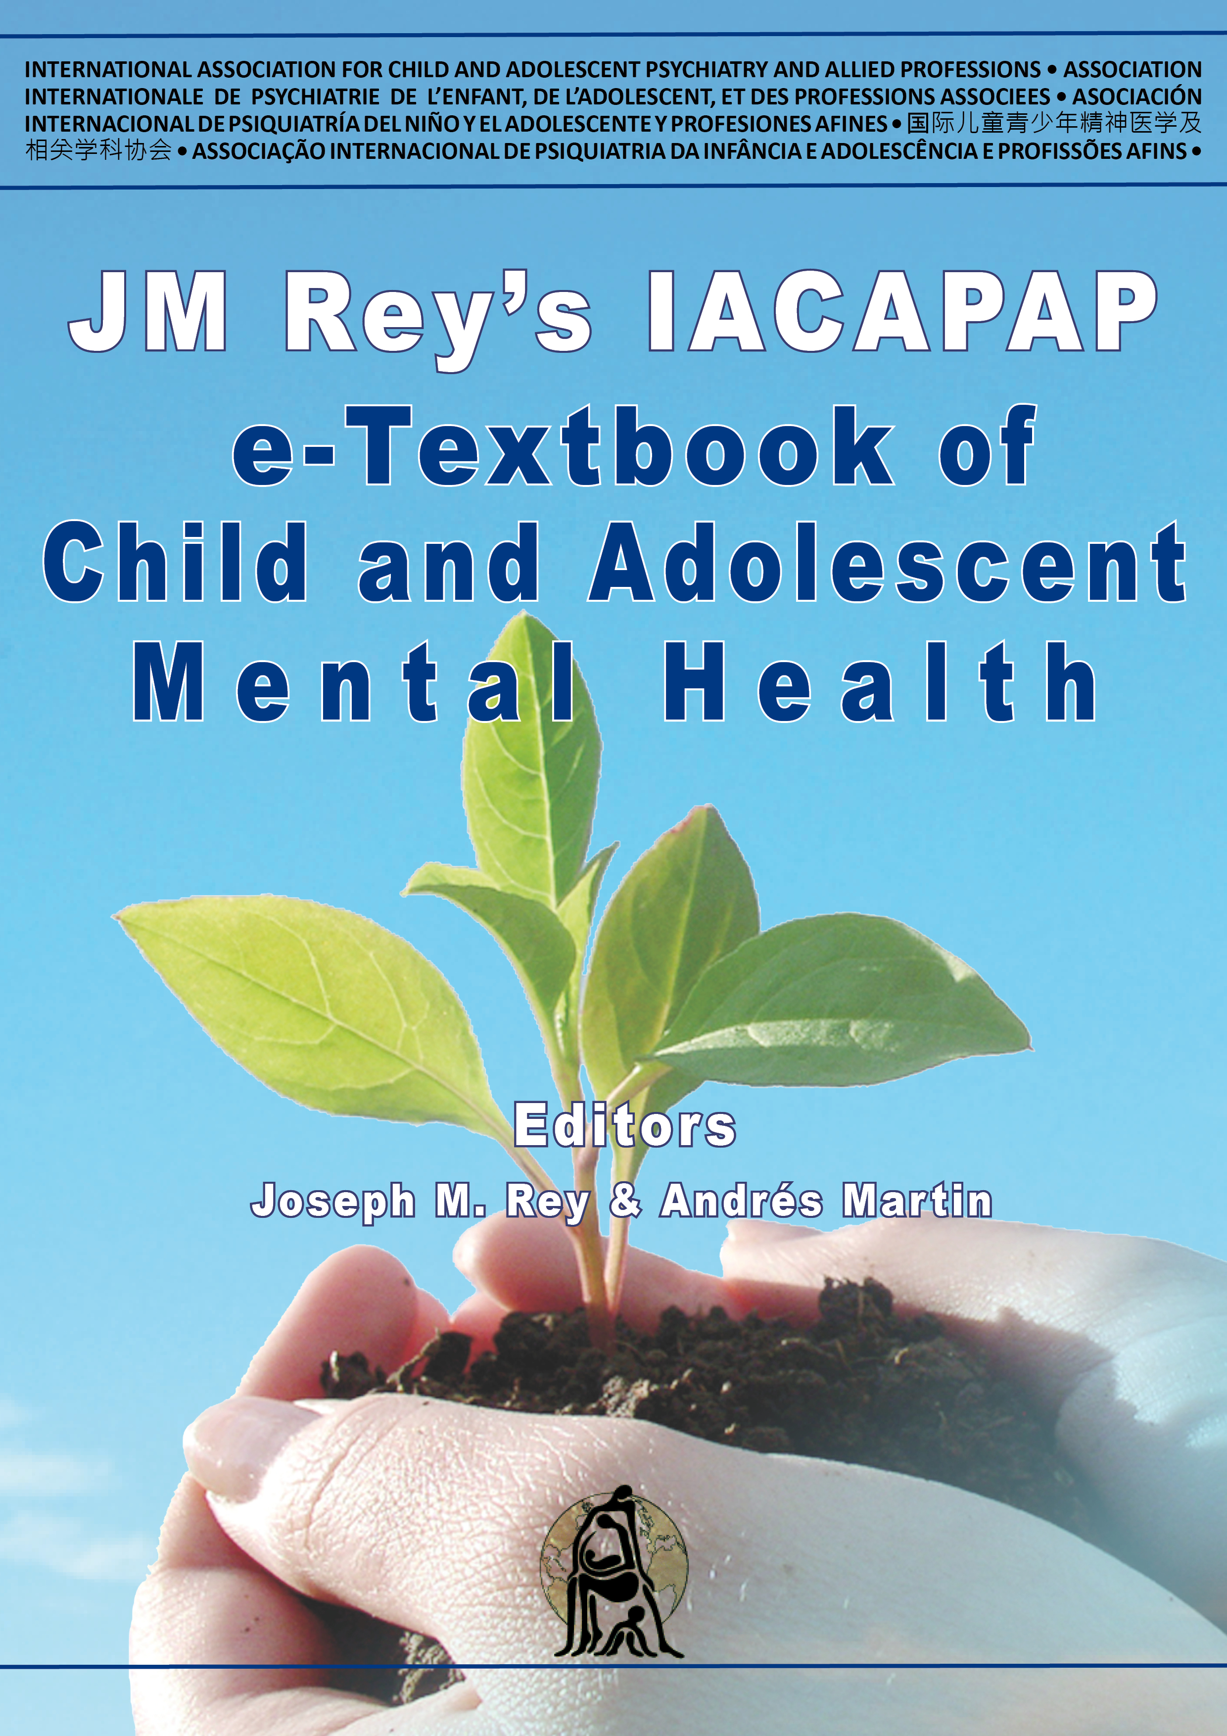
Substance Use Disorders
Chapter G.2
Cannabis Use and Misuse
Alan J Budney & Catherine Stanger
DEPRESSION IN CHILDREN AND
ADOLESCENTS
Companion PowerPoint Presentation
Adapted by Thomas Campbell & Julie Chilton

Slide 2
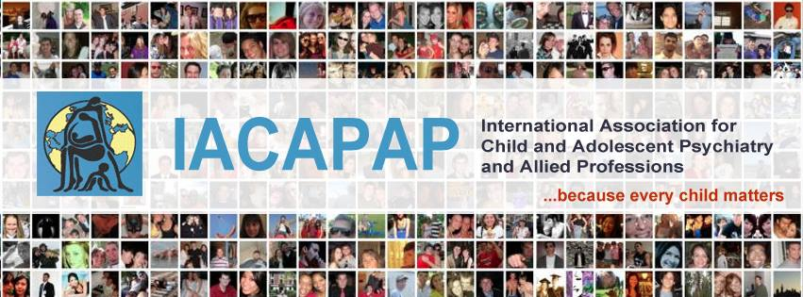
The “IACAPAP Textbook of Child and Adolescent Mental Health” is available at the IACAPAP website http://iacapap.org/iacapap-textbook-of-child-and-adolescent-mental-health
Please note that this book and its companion powerpoint are:
· Free and no registration is required to read or download it
· This is an open-access publication under the Creative Commons Attribution Non- commercial License. According to this, use, distribution and reproduction in any medium are allowed without prior permission provided the original work is properly cited and the use is non-commercial.

Slide 3
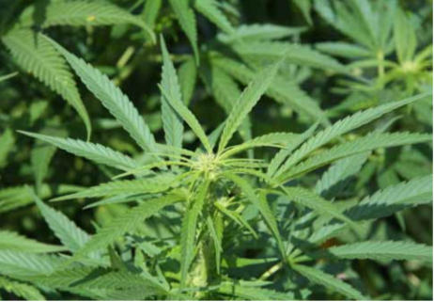
Cannabis Use and Misuse
Outline
What is cannabis and how does it work?
Adverse effects
Epidemiology
Gateway effect
Screening, assessment, and diagnosis
Treatment and outcome
Prevention
Medical marijuana and legalization
References
Notes:
By the end of this presentation, you should understand the following about cannabis use and misuse in children and adolescents
**No citation for this Picture*

Slide 4
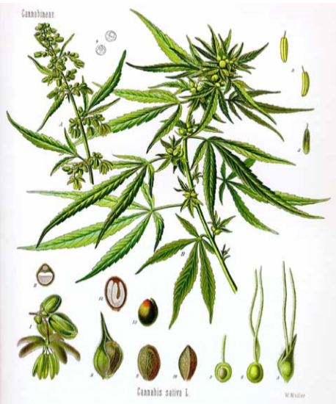
Cannabis Use and Misuse
Background
Cannabis Sativa
Weed, ganja, marijuana, hashish, dagga, pot, and reefer
Use > 166 million people
Controversy
  Legal status
  Medical use
  Addictive potential
  Medical and psychosocial consequences
  “Gateway drug”
Notes:
Cannabis is the generic term for the psychoactive substance derived from Cannabis sativa, a plant grown in many areas of the world and widely used to alter consciousness. Many know cannabis by other names: marijuana, hashish, bhang, ganja, dagga, weed, pot or reefer, to name just a few. Throughout this chapter, we will use “cannabis” to refer to all the various forms of the substance. Cannabis, more so than any other substance of potential abuse, has generated tremendous controversy worldwide. Estimates of global use exceed 166 million people (UNODC, 2008), and policies related to its legal status and potential for medical use vary across and within countries. Many have questioned its addictive potential. That is, they have been skeptical about whether or not someone can really become dependent or addicted to cannabis. The seriousness of the medical and psychosocial consequences of cannabis has also been challenged. Some believe that its status as a “gateway” substance leading to use of even more harmful drugs makes cannabis dangerous. These questions also lead one to wonder whether there is a need for potent treatments to help people quit. Recent advances in our knowledge about cannabis and addiction provide clarity to some of these questions. This chapter makes available science-based information on cannabis and its potential for harm, with the goal of providing an informed and thoughtful understanding and appreciation of cannabis and its potential impact on adolescents.

Slide 5
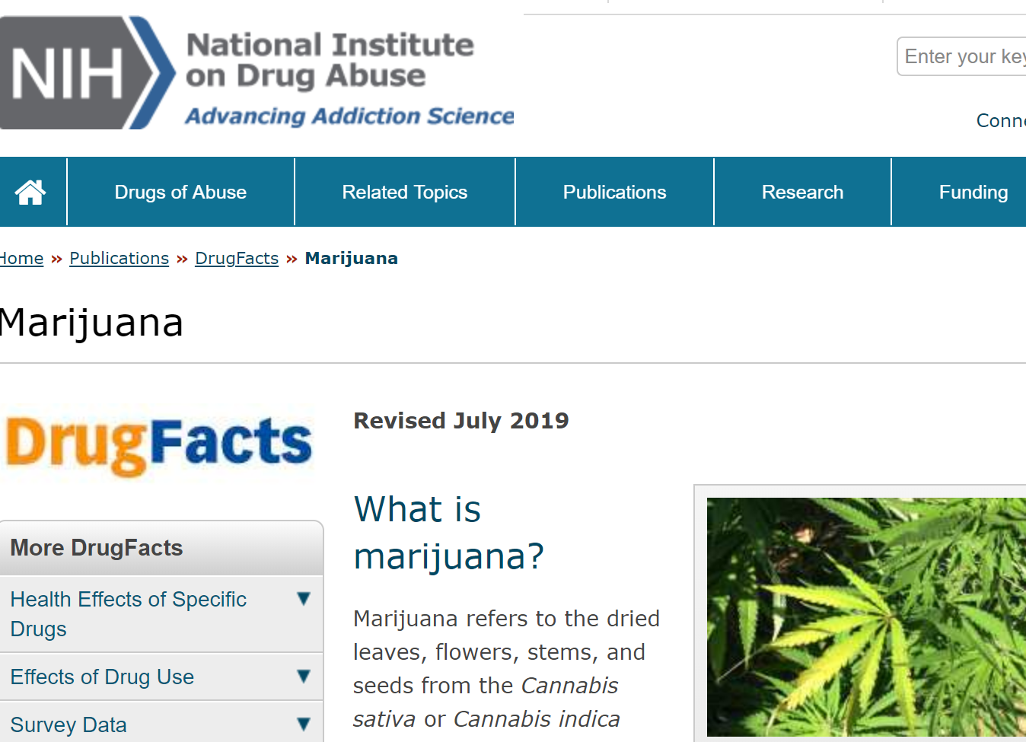
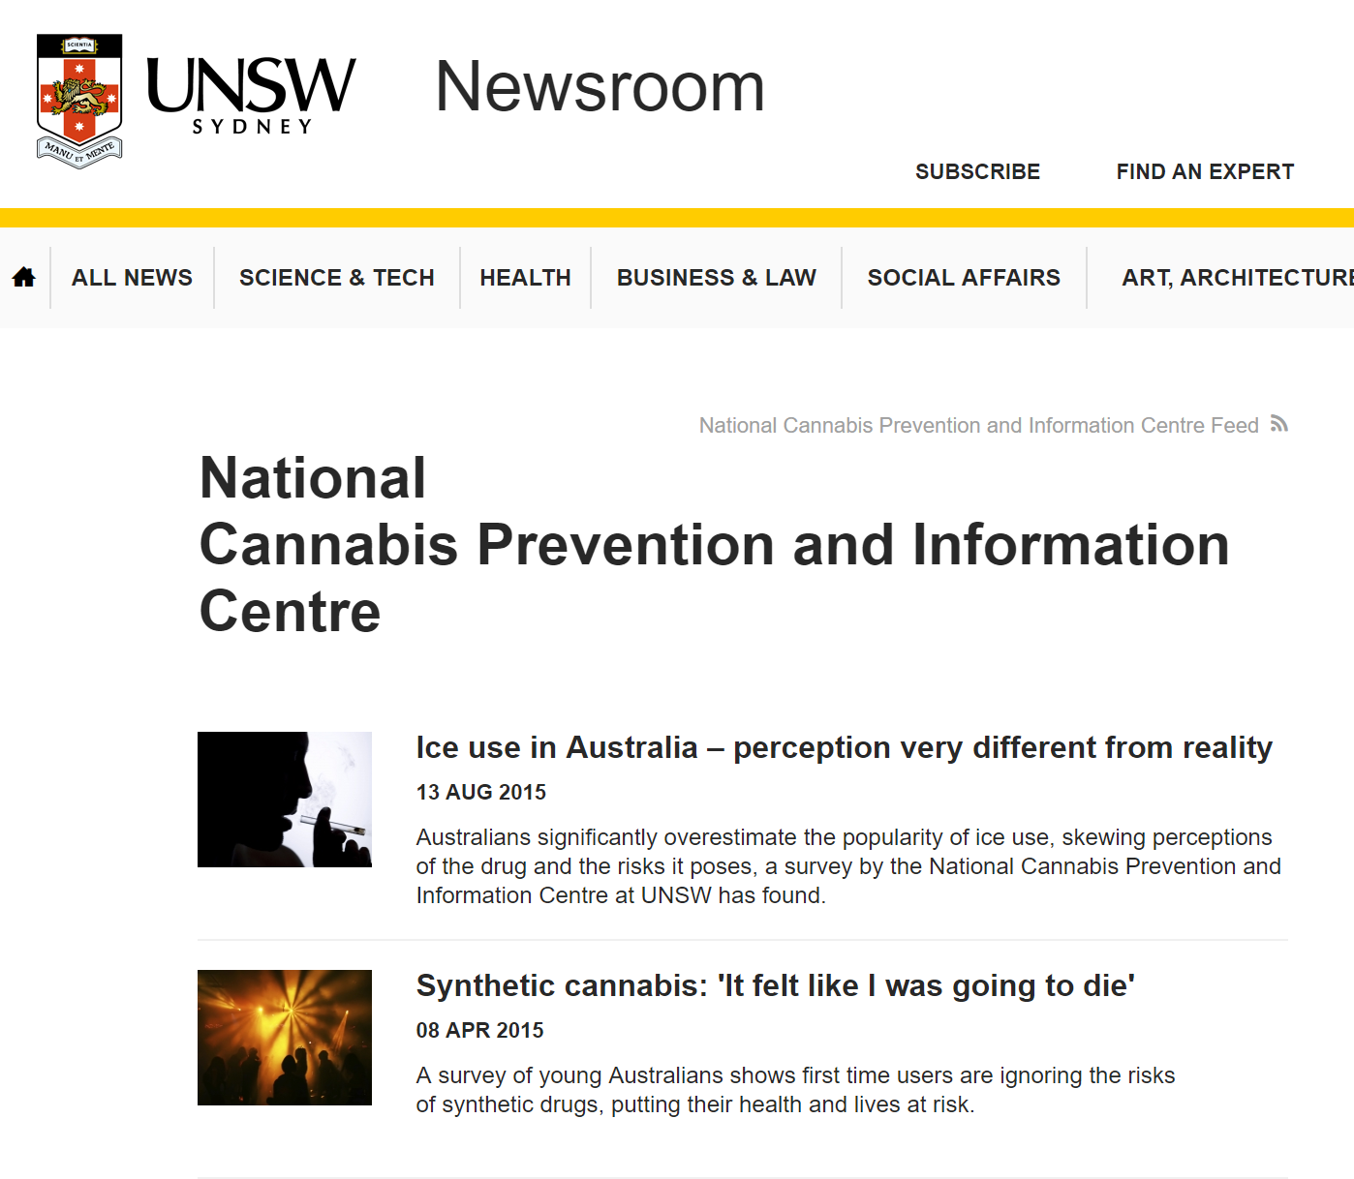
Cannabis Use and Misuse
Resources
Notes:
Click on the picture above to access the National Institute on Drug Abuse (US) website and the one below to access the National Cannabis Intervention and Prevention Center (Australia)

Slide 6

Cannabis Use and Misuse
Cannabis Throughout History
Appeared 4000 years ago
  China
  Clothing, rope, and paper
Medicinal and spiritual use
1870 U.S. pharmacopeia
Government research: not addictive and potential health benefits
Early-mid 1900’s: Increasing public controversy over racist fears
Advertisement in the
Jan 1895 issue of the "Medical Advance Journal"
Notes:
By some accounts, cannabis first appeared approximately four thousand years ago in the Chinese culture as a plant grown for use of its fiber to make clothing, paper, and rope (Abel, 1980). Over time, people from many cultures have used cannabis as a medicine for various maladies and for spiritual ceremonies related to its mind-altering effects. Cannabis’ value as useful fiber, its potential for medicinal use, and its psychoactive effects and abuse potential have combined to generate debate and controversy across cultures for many centuries. In the 19th century cannabis became part of the US Pharmacopeia (ca.1870) based on medical writings describing its potential medicinal applications. Societal concern related to cannabis misuse and its consequences, however, lead to government-sponsored studies, which concluded that cannabis was not “addictive” and had potential health benefits (e.g., Ohio State Medical Society, 1860 and the Indian Hemp Drug Commission, 1895). Increasing cannabis use was a source of public controversy in the US in the early-mid 1900’s as some expressed an irrational fear that marijuana use by African Americans and Mexican Americans would prompt children of the white middle and upper class to use marijuana. International concerns also grew, as reports from the International Opium Conference and the League of Nations indicated that multiple countries felt the need to place controls on cannabis, while other countries resisted such efforts.

Slide 7
Wet and dry pattern
Cannabis Use and Misuse
Cannabis Throughout History
1924: International Opium Conference
  labeled a narcotic, strict controls
1941
  Declared illegal in Britain
  Taxed in US and removed from pharmacopeia
1944: New York Academy of Sciences
  Public concerns exaggerated, but negative side effects
1972: US National Commission
  Recommendation to decriminalize
1999: Institute of Medicine
  Negative aspects but potential medical benefits
Notes:
In 1924, the International Opium Conference labeled cannabis a “narcotic” and called for strict controls. In 1941, Britain declared cannabis illegal, and the United States legislated a Marijuana Transfer Tax and removed cannabis from the US Pharmacopeia. In 1944, the New York Academy of Sciences indicated that the public concerns about cannabis were exaggerated and that cannabis does not lead to addiction, yet its report described multiple negative aspects of cannabis use. In 1972, the US National Commission on Marihuana and Drug Abuse recommended that cannabis possession be decriminalized. In that decade a number of US states replaced prison terms with civil penalties or misdemeanor fines. Concurrently, the US banned medical research on cannabis, while the state of New Mexico passed a law allowing cannabis for medical use. In 1999, the Institute of Medicine released a comprehensive report acknowledging the potential negative effects of cannabis including addiction, but also provided a clear statement regarding its potential for medical benefits. Legalization and decriminalization discussions continue to evolve internationally with still no consensus and a resultant wide range of national and regional policies.
In 1941, Britain declared cannabis illegal, and the United States legislated a Marijuana Transfer Tax and removed cannabis from the US Pharmacopeia. In 1944, the New York Academy of Sciences indicated that the public concerns about cannabis were exaggerated and that cannabis does not lead to addiction, yet its report described multiple negative aspects of cannabis use. In 1972, the US National Commission on Marihuana and Drug Abuse recommended that cannabis possession be decriminalized. In that decade a number of US states replaced prison terms with civil penalties or misdemeanor fines. Concurrently, the US banned medical research on cannabis, while the state of New Mexico passed a law allowing cannabis for medical use.

Slide 8
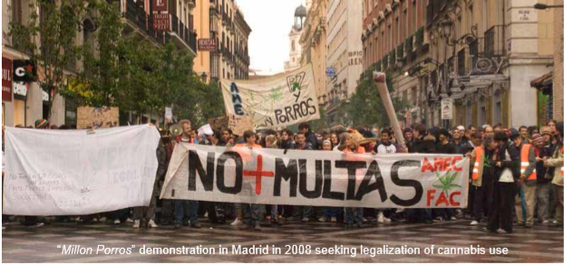
Notes:
“Millon Porros” demonstration in Madrid in 2008 seeking legalization of cannabis use

Slide 9
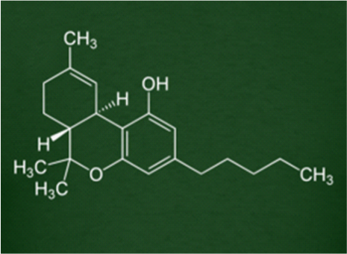
Cannabis Use and Misuse
What Is Cannabis and How Does It Work?
Delta-9tetrahydrocannabinol (THC)
produces high
Research mixed on cannabidiol
Three pressing issues:
  Cannabis vs. pure THC used medically
  Synthetic THC (K2) vs Cannabis
  Health effects of inhaled cannabis
Chemical structure of THC
Notes:
Although cannabis contains many chemical substances, it is delta-9tetrahydrocannabinol (THC) that has been identified as the primary compound that produces the “high” that occurs when smoking or ingesting the plant materials. It is likely that other compounds in cannabis also contribute and interact with THC to produce its myriad of physical and psychological effects. In particular, research has focused on better understanding the role of cannabidiol. Some evidence suggests that cannabidiol may moderate the effects of cannabis, reducing the potential anxiolytic and psychomimetic effects of THC, yet other studies have not observed such effects (Bhattacharyya et al, 2010; Karschner et al, 2011). Awareness and understanding of the compounds other than THC in cannabis has relevance to evaluating three pressing issues related to cannabis use: • How the effects of cannabis use compare with the use of the pure THC that is sometimes administered in medical settings • How the effects of synthetic THC-like compounds being consumed recreationally (e.g., K2, Spice, Kronic) compare with natural cannabis use, and • How the other substances contribute to the impact on health when the smoke from cannabis is inhaled (e.g., carcinogens, tar).

Slide 10
Cannabis Use and Misuse
How is cannabis prepared and consumed?
Dried
  Whole plant (2%-5% THC)
  Hashish (10-15%)
  Unfertilized flowers (up to 20% THC)
  Hash oil resin (up to 60%)
Increased potency over past 20 years
Smoking most common
  Joints, blunts, pipes, bongs
  Combining with tobacco
  “Vaporizing”= inhalation without combustion
Edible cannabis -> becoming more popular
Notes:
The cannabis plant is cultivated cannabis and then marketed in various forms. Most often, it is dried and divided either into mixtures that include the whole plant or only the unfertilized flowers of the female plant. The parts of the plant have differing THC potency with whole plant mixtures being least potent (2%-5% THC content), and flower-only mixtures having much higher potency (up to 20%). The other common cannabis preparation is hashish, which comprises the cannabis plant resin, with a typically high potency of THC (10-15%). Hash oil preparations are even more potent; these consist of concentrated resin extract and may reach potencies up to 60%. Of note, the average cannabis available on the street for purchase has become increasingly potent over the past 20 years most likely due to increased expertise in hybridization and growing techniques. The most common method of administration of cannabis is smoking; the plant material is burned and the smoke is inhaled. Devices for smoking range from cigarettes (joints), pipes, water pipes (bongs or hookahs), and most recently hollowed out cigars that are usually called blunts. Smoking cannabis and tobacco simultaneously either via blunts, spliffs (joints that mix the substances together), or by chasing cannabis with tobacco has become more common recently, particularly among teens and young adults (Agrawal et al, 2011; 2012; Peters et al 2012) Cannabis can also be “vaporized”, which involves heating it to a temperature high enough to release psychoactive compounds for inhalation, but low enough that combustion does not occur. This route of administration is thought to be somewhat “safer” than traditional smoking methods. Oral consumption of cannabis is also fairly common and usually involves dissolving it into food substances, frequently baked goods, although recently some places that dispense “medical marijuana” have begun to market other edible products that include doses of cannabis.

Slide 11
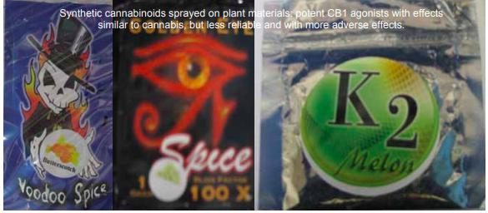
Cannabis Use and Misuse
Synthetic Cannabinoids
Notes:
Synthetic cannabinoids sprayed on plant materials: potent CB1 agonists with effects similar to cannabis, but less reliable and with more adverse effects.

Slide 12
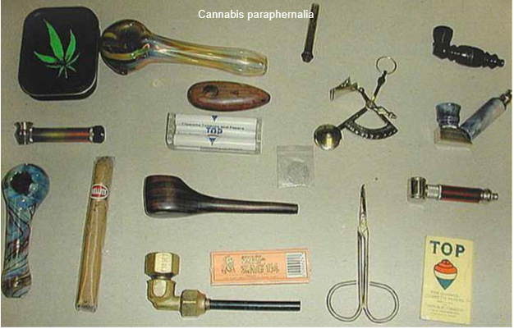

Slide 13
Cannabis Use and Misuse
What Are the General Effects of Cannabis Use?
Administration
  Smoked (start 1-2 minutes -> ends 4 hours)
  PO (start 30 minutes -> ends 6 hours)
General effects of Cannabis use:
  Potential Positives:
    Euphoria, relaxation, laughing, >appreciation for music
  Potential Negatives:
    Anxiety, fear, paranoia, or panic
    Hallucinations (rare)
    Dissipate with time
Notes:
Do different administration methods have different effects?
Smoked and vaporized cannabis have similar bioavailability to THC, which results in a similar time course of intoxication effects. Onset of intoxication typically occurs within 1-2 minutes, reaches peak usually within 30 minutes, and can last for up to four hours. When consumed orally, bioavailability is lower, and thus intoxication is delayed with onset usually occurring after at least 30 minutes, peak effects resulting in approximately two hours, and effects lasting for more than six hours.
What are the general effects of cannabis use?
Cannabis ingestion has numerous, well-documented direct effects, most of which are dose dependent. The effects associated with the feeling of being “high” or “stoned” include euphoria, a sense of relaxation, increased giddiness or propensity for laughing, the sense that time seems to slow down, an increased appreciation for music and other art forms, and tendency to prefer nonverbal social activities or introspection. The less often discussed feelings of anxiety, paranoia, fear, or panic may also be experienced. These effects occur most often in less experienced users or following use of higher than usual doses. In rare cases, usually involving particularly high doses, users may experience hallucinations. These effects are not life threatening, dissipate with time, and may be reduced with comfort and reassurance. Use of cannabis also produces several reliable physiological effects.

Slide 14
Cannabis Use and Misuse
Acute Effects
Dry mouth
Stimulated appetite (munchies)
Antiemetic (low doses)
Nausea and vomiting (high doses)
Dilate blood vessels (red eyes)
Increased heart rate
Orthostatic hypotension
Impaired:
  Attention
  Short term memory
  Some complex cognitive processes,
  Motor abilities
Most effects are dose dependent and moderated by tolerance, comparable to those of moderate doses of alcohol (BAC approximately 0.05%)
Notes:
The mouth becomes dry and appetite is stimulated (i.e., the onset of munchies) which typically results in an increase in the consumption of food and drink, particularly high calorie products. At low to moderate doses, cannabis typically has antiemetic effects (reduces nausea), but can induce nausea or vomiting at higher doses or among less experienced users. Cannabis use has a broad range of effects on cardiovascular function. Use is associated with increase in resting heart rate, slight increase in supine blood pressure, and increased orthostatic hypotension (dizziness or lightheadedness that results from a sudden drop in blood pressure after standing) (Jones, 2002). Also dilation of small blood vessels occurs, which results in redness of the eyes. Cannabis can impair focused and divided attention, short term and episodic memory, some types of complex cognitive processing, and some aspects of motor ability (Vandrey & Mintzer, 2009). Many of these effects are not large, but are dose-related and moderated by cannabis use history (tolerance). Generally, moderate doses of cannabis appear to have comparable effects to moderate doses of alcohol (BAC approximately 0.05%) on measures of motor ability, attention and episodic memory.

Slide 15
Cannabis Use and Misuse
Effects with Long Term Use
Impaired cognition
  Attention
  Memory
  Problem solving
  Mental flexibility
Altered brain function on neuroimaging:
  Prefrontal cortex
  Cerebellum
  Hippocampus
*Likely reversed following extended abstinence*
Notes:
Sustained use of cannabis can impair attention, memory and complex cognitive abilities such as problem solving and mental flexibility (Kalant, 2004; Solowij et al., 2002). Neuroimaging studies indicate that long-term cannabis users have altered brain function in the prefrontal cortex, cerebellum, and hippocampus. Again, the functional significance of such impairments is difficult to assess and quantify. Most research suggests that much of the impairment associated with chronic cannabis use is likely reversed following extended periods of abstinence.

Slide 16
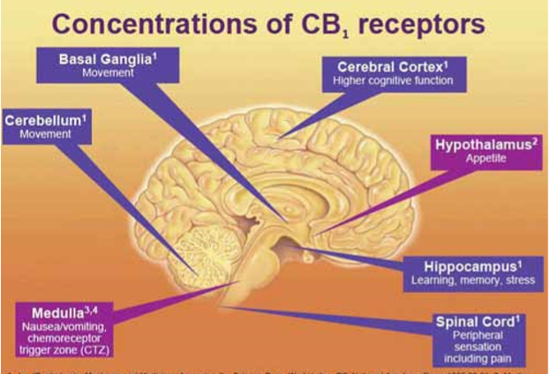

Slide 17
Cannabis Use and Misuse
How Does Cannabis Interact with the Brain?
Endogenous cannabinoid receptors (CB1, CB2) and 5 endogenous ligands
CB1
  Psychoactive and reinforcing effects
  Highest concentrations
    Basal ganglia (reward, learning, motor control)
    Cerebellum (sensorimotor coordination)
    Hippocampus (memory)
    Cortex (planning, inhibition, higher-order cognition)
  Dose and time dependent
  Euphoria: increased dopamine in reward center
Notes:
Cannabis exerts its effects primarily through an endogenous cannabinoid receptor system. Two receptor subtypes (CB1 and CB2) and five endogenous ligands have been identified. The psychoactive and reinforcing effects of cannabis are primarily mediated by activation of the CB1 receptor by the THC compound. This receptor is abundant throughout the central nervous system, but is expressed in the brain at the highest concentrations in the basal ganglia (reward, learning, motor control), cerebellum (sensorimotor coordination), hippocampus (memory), and cortex (planning, inhibition, higher-order cognition). Changes in brain activity following administration of THC are localized mostly in these areas, and neuroimaging studies indicate that these brain activity changes are THC dose- and time-dependent effects. The euphoric effects of cannabis are primarily related to THC enhancing dopamine neuronal firing and synaptic dopamine levels in the reward pathway of the brain (Gardner, 2005), which not surprisingly is a hallmark neurobiological feature of most abused drugs.

Slide 18
Cannabis Use and Misuse
How Does Cannabis Interact with the Teen Brain?
Chronic or frequent use
  Impaired executive function
  Impaired higher-level control of attention
  Impaired working memory
  Decreased cortical thickness
  Possible decreased myelination
Notes:
Adolescent neuroimaging studies have indicated that chronic use of cannabis in adolescence leads to less efficient neural processing on tasks requiring executive function, and in particular, on tasks requiring higher level control of attention (Abdullaev et al, 2010). Similarly, frequent or recent cannabis use among teens, and onset of cannabis use prior to the age of 16 have been found to be associated with less efficient (overactive) cognitive processing on working memory tasks (Becker et al, 2010; Jager et al, 2010; Schweinsburg et al, 2010). Working memory is a cognitive system that holds information, permitting verbal and nonverbal activities such as reasoning and comprehension processing, which are important components involved in goal-oriented monitoring or manipulation of information that contributes to decision making (Becker & Morris, 1999). Adolescent cannabis users also have structural abnormalities including decreased cortical thickness (Lopez-Larson et al, 2011) and reduced cortical fractional anisotropy, suggestive of decreased myelination (Ashtari et al, 2009). These findings suggest that cannabis use alone or in combination with other substance use (e.g., alcohol) in adolescence may negatively influence normal neuro-developmental processes.

Slide 19
Cannabis Use and Misuse
Behavioral, Medical, and Psychiatric Adverse Effects
Adolescents with regular use:
  Try other substances
  Develop substance use disorders
  Poor academic performance
  Drop out of school
  More delinquent behavior
  Psychiatric problems
  Emergency department visits
  Risky behavior
    Drugged driving
    Sexually transmitted diseases
Notes:
Adolescents who report regular use compared to those who do not use cannabis are much more likely to (Tims et al, 2002): • Use other substances and to develop substance use disorders • Have poor academic performance and drop out of school • Engage in delinquent behavior and get arrested • Have other psychiatric problems and have more emergency room visits • Engage in more risky behavior such as drugged driving, which increases risk of accidents, and sexual behavior that increases risk of unplanned pregnancy and of STDs. In adults, regular cannabis use has also been linked to poor work history and less satisfactory relationships. Some research has raised concern that cannabis exposure to the fetus during pregnancy may impact learning and cognitive function during the school years (Fried et al, 2003). Cannabis has also been linked to increased respiratory problems (e.g., bronchitis), but has not clearly been associated with cancer risk, although smoking cannabis produces a high level of carcinogens (Tetrault et al, 2007). .

Slide 20
Cannabis Use and Misuse
Cannabis and Schizophrenia
Using Cannabis →psychotic disorders
  Association repeatedly demonstrated
Higher risk
  Frequent use
  Early onset
Prior schizophrenia diagnosis
  Negative effect on course and treatment
  Possible positive effect on cognition
Notes:
Although it is difficult to demonstrate that cannabis use is a causal factor in these adverse consequences, certainly it plays some contributing role. Of particular concern is whether cannabis use contributes to the development of severe mental illnesses such as schizophrenia (Sewell et al, 2009). A clear association between cannabis use and the development of psychotic disorders has been repeatedly demonstrated. Particular risk is associated with frequent use and early onset of use. Thus, this concern is of great importance during adolescence and young adulthood. Evidence is not conclusive on whether or not these relationships are causal (e.g., whether cannabis use actually causes new cases of schizophrenia) or whether psychosis would have developed eventually without cannabis use (e.g., cannabis only bringing forward the onset of the illness). Cannabis is likely to trigger early onset of psychosis and perhaps the expression of psychosis among those with predisposing risk factors for psychosis. Moreover, among those with psychotic disorders, cannabis use clearly has a negative impact on its course and response to treatment, despite some evidence that it may enhance acute cognitive functioning in some persons with schizophrenia.

Slide 21
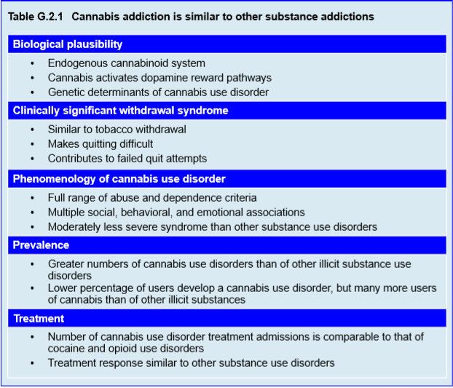
Notes:
Although agreement on how to best define “addiction” is sorely lacking, by most indicators, cannabis use can develop into cannabis addiction or diagnostically speaking, a cannabis use disorder. Laboratory, epidemiological, genetic, and clinical studies have demonstrated the biological plausibility, existence, prevalence and clinical importance of cannabis use disorders.

Slide 22
Cannabis Use and Misuse
Neurobiology and Genetics
Effects + endogenous cannabinoids
  Addiction biologically plausible
  Parallel other drug pathways
Genetics
  30-80% Risk
  Substance specific
  Substance non-specific
  Environmentally modifiable
Notes:
As reviewed above, the neurobiology of how cannabis produces its effects and the concomitant endogenous cannabinoid system provide biological plausibility for cannabis addiction. That is, these neural systems and actions closely parallel those of most other drugs for which people can develop addictive problems. In addition, multiple studies have established that genetic influences contribute to the development of cannabis use disorders. Heritable factors – contributing between 30-80% of the total variance in risk of cannabis use disorder – have been reported and genetic linkage studies of cannabis use disorder and earlier stages of cannabis use (including frequency of use) further establish a genetic link to cannabis use problems (Agrawal & Lynskey, 2009). Three sources of genotypic risk (substance specific, substance non-specific and environmentally modifiable) have been identified. First, substance specific genes may impact vulnerability to the general addictive potential of cannabis. Second, specific genes may increase or decrease genetic vulnerability to externalizing behavior problems in general, including adolescent experimentation and misuse of psychoactive substances. Third, certain genes may impact an individual’s reactivity to environmental variables such as stress, which may influence risk for substance misuse.

Slide 23
Cannabis Use and Misuse
Cannabis Withdrawal
Experienced by most heavy users
Cannabinoid antagonist → withdrawal
Resume THC and symptoms abate
Cannabis withdrawal syndrome
  Begins 1-2 days after stopping
  Peaks in 2-4 days
  Lasts for 1-3 weeks
  No major medical/psychiatric consequences
  More severe withdrawal=worse prognosis
Notes:
Drug withdrawal is a considered by many as a hallmark of addiction. Thus, one important part of the larger question of whether you can become addicted to cannabis is: does regular cannabis use result in the experience of withdrawal when one stops using? The past 10-15 years of research provide a clear answer to this question; a true, clinically significant cannabis withdrawal syndrome is experienced by many heavy users of cannabis (Budney & Hughes, 2006; Budney et al, 2004).
The neurobiological basis for cannabis withdrawal was established with the discovery of the aforementioned endogenous cannabinoid system. Studies with nonhuman animals have shown that administration of a cannabinoid antagonist can precipitate withdrawal. Studies with humans have demonstrated that deprivation of THC in some users causes withdrawal symptoms, and that symptoms abate with re-administration of THC, clearly establishing the pharmacological specificity of cannabis withdrawal (e.g., Budney et al, 2007; Haney et al., 2004). Moreover, laboratory and clinical studies with adults and adolescents have provided support for the reliability, validity, and time course of a cannabis withdrawal syndrome (Budney et al, 2004; Chung et al, 2008; Levin et al, 2010; Milin et al, 2008; Vandrey et al, 2005). Most withdrawal effects appear within 24-48 hours of cessation, peak in 2-4 days, and return to baseline within 1-3 weeks. A substantial proportion (25%-95% across studies) of heavy marijuana users reports multiple withdrawal symptoms, with individuals seeking treatment for cannabis use disorders showing the highest rates of withdrawal.
Concern about the clinical significance or importance of this withdrawal syndrome was a primary reason for the omission of this condition from the DSM-IV. However, data now show that cannabis withdrawal is comparable in magnitude and severity to the well-established tobacco withdrawal syndrome (Budney et al, 2008; Vandrey et al, 2008); many adolescent and adult users report that withdrawal symptoms adversely impact their attempts to quit, and lead to the use of cannabis or other drugs to relieve withdrawal symptoms (Copersino et al, 2006); a substantial proportion of adults and adolescents in treatment for cannabis use disorder complain that these symptoms make cessation more difficult; and the severity of withdrawal appears to have predictive validity – adolescents with more severe withdrawal have a higher probability of poor treatment outcome (Chung et al, 2008; Cornelius et al, 2008). In summary, the cannabis withdrawal syndrome does not typically include major medical or psychiatric consequences and might be considered “mild” compared with heroin and alcohol withdrawal. However, the emotional and behavioral symptoms that are a hallmark of cannabis withdrawal impede cessation attempts, and as such should be assessed and addressed in clinical settings or when self-quitting.

Slide 24
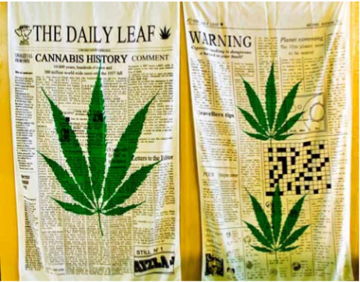
Cannabis Use and Misuse
Cannabis Withdrawal Symptoms
Irritability/anger
Nervousness/anxiety
Sleep difficulty
Decreased appetite
Depressed mood
Physical symptoms
  Stomach pain
  Tremor, headache
  Fever, chills, sweating
Photo: Tony Fischer

Slide 25
Cannabis Use and Misuse
Epidemiology of Cannabis Use Disorder (CUD)
Most users do not develop a use disorder
  9% of cannabis users = CUD
    15% of cocaine users
    25% heroin users
  # of patients with CUD > other drug use disorders
  increasing # of patients with CUD
    Stable rates of cannabis use
    Increased potency
    Earlier onset of use
Notes:
As with other drugs, the majority of people who have tried cannabis do not develop a problem with addiction. However, the number of persons who at some time in their lives meet criteria for a cannabis use disorder as defined in the Diagnostic and Statistical Manual of Mental Disorders (DSM-IV) (American Psychiatric Association, 2000) is more than double the number that meet such criteria for any other illicit drug (Anthony & Helzer, 1991; Anthony et al, 1994). This reflects the fact that many more people have ever used cannabis compared with having ever used other illicit drugs of abuse. In contrast, the percentage of persons who have ever used cannabis and who then develop dependence is lower (approximately 9% in the US) than with other illicit substances; for example, 15% of those who try cocaine and 24% of those who try heroin develop dependence. The 9% dependence rate among cannabis users may seem low but, given the large number of people who have used cannabis, this results in a substantial number of persons with cannabis use disorders. It is of some concern that the prevalence of cannabis use disorders has been increasing despite stable rates of use (Compton et al, 2004). Increased potency of cannabis available in the streets and earlier age of initiation of cannabis use may contribute to this trend. Early onset of cannabis use (or any substance of abuse) is particularly worrying as it is a strong predictor of both substance use and mental health problems in young adulthood (Degenhardt et al, 2003; Fergusson et al, 2002; Gfroerer et al, 2002)

Slide 26
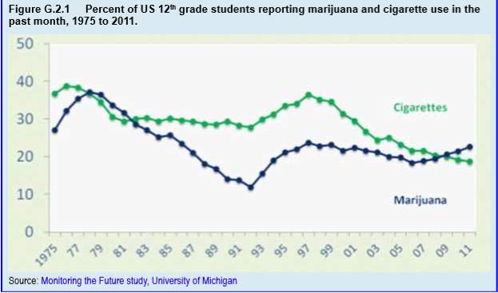

Slide 27
Cannabis Use and Misuse
Severity of Cannabis Use Disorder
Adults in treatment
  Average = 10 years using
  Multiple failed quit attempts
  Use despite consequences
  Withdrawal
Differences in severity (compared with other drugs)
  < DSM criteria met
  < Health effects
  < Psychosocial consequences
***NOT EASIER TO QUIT***
Notes:
In most respects, the phenomenology of cannabis use disorders appears quite similar to that of other substance use disorders (Budney, 2006). Adults in treatment for a cannabis use disorder, on average, have been using cannabis daily for 10 years and made multiple unsuccessful attempts to quit (Budney, 2006; Copeland et al, 2001; Stephens et al, 2002). They experience the full range of symptoms of abuse or dependence. For example, they report continuing to use cannabis despite experiencing social, psychological and physical problems related to their use; they perceive themselves as unable to stop and most experience withdrawal symptoms when they stop abruptly. Moreover, they acknowledge relationship and family problems and guilt associated with using, financial difficulties, low energy and self esteem, dissatisfaction with their productivity levels, sleep and memory problems, and low life satisfaction (Gruber et al, 2003; Stephens et al, 2002). Though the phenomenology of cannabis use disorder is similar, there appear to be differences in severity (Budney, 2006; Budney et al, 1998). On average, individuals with cannabis dependence do not meet as many DSM dependence criteria as with alcohol, cocaine or opioid dependence. The withdrawal experience causes discomfort but is not associated with major health risks, and the associated health and psychosocial consequences, although substantial, are on average not as severe. Despite this milder dependence syndrome, quitting cannabis once problematic use has developed does not appear to be any easier than trying to quit other substances (see section on treatment below).

Slide 28
Cannabis Use and Misuse
Epidemiology of Cannabis Use Disorder:
Recent trends in the US
  Daily marijuana use in teens is mostly steady
  Use is higher among high school students in states with medical marijuana laws
  The number of teens who think marijuana use is harmful is declining
Notes:
Paralleling the rise in cannabis use disorders, admissions to treatment services for primary cannabis use disorder have been dramatically increasing in some countries (e.g., US, Australia) such that the percentages of those in treatment for cannabis use disorder is comparable to those in treatment for cocaine and heroin use disorders. This may be due to increased number of people developing cannabis use disorders, the growing recognition and acceptability of a need for treatment, and the availability of specific treatments. Moreover, the existence of such treatment programs may raise awareness of cannabis’ addictive potential, which may result in more cannabis users contemplating the possibility that it might be a significant problem for them. Among adolescents, cannabis is by far the most commonly acknowledged substance used among those entering treatment (Substance Abuse and Mental Health Services Administration, 2008). In the US, over 40% of treatment admissions for cannabis use disorder are persons under 20 years of age. Adolescents appear to be more vulnerable to the development of cannabis use disorders than adults, as indicated by more rapid development of cannabis use disorder from time of onset of use. There is a clear need for effective, easily accessible treatments specifically for cannabis use disorders and especially for adolescents. Summary Findings from a growing body of multidisciplinary research indicate that debate over whether or not cannabis use can lead to dependence or addiction should be considered obsolete. Cannabis misuse and addiction are relatively common and are associated with significant negative consequences. Moreover, cannabis-related problems reflect a significant public health issue that requires continued attention and action towards developing more effective treatment and prevention interventions.

Slide 29
Cannabis Use and Misuse
Epidemiology of Cannabis Use Disorder:
Treatment Admissions
Primary CUD admissions
  More CUD
  Recognition and acceptability
  Availability of treatment
Adolescent’s #1 substance
  40% CUD admissions < 20 years old
  Adolescents develop CUD faster than adults
Notes:
Paralleling the rise in cannabis use disorders, admissions to treatment services for primary cannabis use disorder have been dramatically increasing in some countries (e.g., US, Australia) such that the percentages of those in treatment for cannabis use disorder is comparable to those in treatment for cocaine and heroin use disorders. This may be due to increased number of people developing cannabis use disorders, the growing recognition and acceptability of a need for treatment, and the availability of specific treatments. Moreover, the existence of such treatment programs may raise awareness of cannabis’ addictive potential, which may result in more cannabis users contemplating the possibility that it might be a significant problem for them. Among adolescents, cannabis is by far the most commonly acknowledged substance used among those entering treatment (Substance Abuse and Mental Health Services Administration, 2008). In the US, over 40% of treatment admissions for cannabis use disorder are persons under 20 years of age. Adolescents appear to be more vulnerable to the development of cannabis use disorders than adults, as indicated by more rapid development of cannabis use disorder from time of onset of use. There is a clear need for effective, easily accessible treatments specifically for cannabis use disorders and especially for adolescents. Summary Findings from a growing body of multidisciplinary research indicate that debate over whether or not cannabis use can lead to dependence or addiction should be considered obsolete. Cannabis misuse and addiction are relatively common and are associated with significant negative consequences. Moreover, cannabis-related problems reflect a significant public health issue that requires continued attention and action towards developing more effective treatment and prevention interventions.

Slide 30
Cannabis Use and Misuse
Gateway Effect
Cannabis → “harder” drugs
  Alcohol/tobacco→ same
Causally related?
Possible hypothesis:
  Neurobiology
  Contact with drug dealers
  Altered decision making
  Interpersonal/environment characteristics
    Conduct problems
    Neighborhood
    Parental factors
Notes:
Cannabis has been described as a “gateway” drug because its use usually precedes use of “harder” drugs such as cocaine and heroin, and frequent cannabis users have a much greater probability than nonusers of using heroin or cocaine in their lifetime. Such data, in addition to the high co-morbidity rates of cannabis use disorder and other substance use disorders, raise the question of whether cannabis use is causally related to use and misuse of other substances. Although cannabis use typically precedes other drug use, so do tobacco and alcohol. Recently, it has become more apparent that the timing of initiation of use of different substances varies geographically and by culture, indicating that drug availability and societal factors likely contribute to specific drug-onset trajectories. Hypotheses for cannabis as a gateway substance include:
• Neurobiological effects of cannabis use may increase sensitivity to the desirable effects of other substances
• Cannabis use increases opportunity for other substance use by placing the user in contact with those who use or sell other drugs
• Use of cannabis may impact cognitive functioning and decision making affecting choice of whether or not to use other drugs
• Common intrapersonal and environmental characteristics determine risk of substance use in general (e.g., conduct problems, neighborhood, neurobiology, parental factors).
Research demonstrates that genes, environmental factors and common preexisting risk factors account for much – but not all – of the association between early initiation of cannabis use and future other substance use, suggesting that all these hypotheses have merit (Agrawal et al, 2007; Lynskey et al, 2006). However, each of these factors would also explain alternative sequences of the onset of drug use.

Slide 31
Cannabis Use and Misuse
Screening, Assessment, and Diagnosis
Similar to other SUDs
  Diagnostic interview
Cannabis Use Disorder Identification Test
Cannabis Problems Questionnaire
  Adult and adolescent versions
Marijuana Screening Inventory
CRAFFT Questionnaire
  Alcohol + other drug use
  If + → further drug specific assessment
Two Instruments assessing change
  Marijuana Problem Inventory
  Marijuana Withdrawal checklist
Notes:
Assessment of cannabis use and cannabis use disorders is similar to that for other substance use disorders, with formal criteria for clinical diagnoses found in the DSM or the International Classification of Diseases (ICD). Structured or semistructured diagnostic interviews (e.g., Structured Clinical Interview for DSM-IV [SCID]) are most appropriate for determining cannabis use disorder diagnoses. In addition, the Substance Dependence Severity Scale, a five-item scale designed to measure dependence severity, has been validated for assessing dependence in cannabis users (Miele et al, 2000). A few cannabis specific instruments for screening for problematic cannabis use have been developed (Piontek et al, 2008). For example, The Cannabis Use Disorder Identification Test is a short screen for DSM-IV diagnosis of abuse or dependence (Annaheim et al, 2008). The Cannabis Problems Questionnaire has adult and adolescent versions that yield a severity score for cannabis-related problems (Copeland et al, 2005; Martin et al, 2006). The Marijuana Screening Inventory (Alexander & Leung, 2006) assesses patterns of use and identifies clinical cases. Standard instruments that assess all types of substance use problems have a longer history and more data supporting their psychometric properties than cannabis-specific instruments. For adolescents, the CRAFFT is a 6-item questionnaire designed to screen for high-risk alcohol and other drug use (see Table G.2.2). It has excellent psychometric properties with adolescents, is selfadministered, and can be used in a variety of health and educational settings (Knight et al, 2002). A positive CRAFFT screen suggests that further assessment of substance use disorders is warranted. Two instruments that have been used primarily to measure change during treatment rather than as diagnostic or screening tools are the Marijuana Problem Inventory and the Marijuana Withdrawal Checklist. The Marijuana Problem Inventory yields a severity score of specific cannabis-related consequences (Marijuana Treatment Project Research Group, 2004), and is a useful index of response to treatment. The Marijuana Withdrawal Checklist can be used to assess withdrawal symptom history but has more commonly been used in research studies to examine changes in withdrawal during the early stages of abstinence (Budney et al, 2003). Such information can be used to assess and manage treatment strategies related to concerns about withdrawal. Another withdrawal assessment tool, Cannabis Withdrawal Scale is under development and holds promise for use in clinical settings (Allsop et al, 2011).

Slide 32
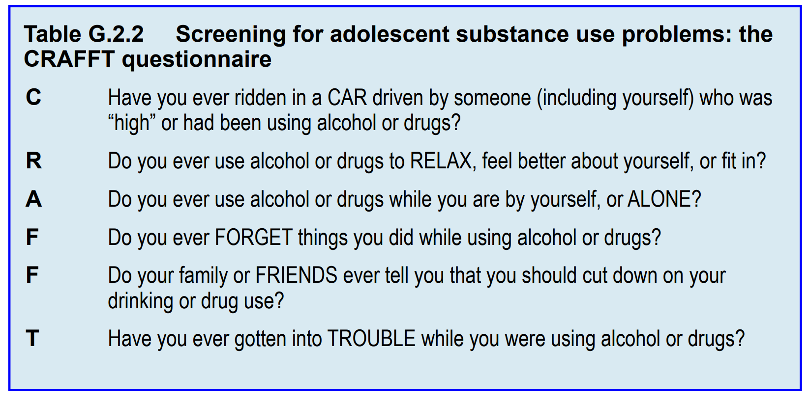

Slide 33
Cannabis Use and Misuse
Screening, Assessment, and Diagnosis:
Testing for cannabis use
Screening + treatment outcome
Dipstick methods
  Cheap + Qualitative
Gas Chromatography/Mass Spec
  Expensive
Ensure integrity of sample
  Observation of specimen provision
  Urine temp
  Trained Personnel
Saliva/hair samples
Notes:
Testing for evidence of recent cannabis use is a vitally important screening and treatment outcome tool for adolescents and adults, as many persons in such contexts may have good reason for not being truthful about their substance use. Multiple methods for reliable and valid urine testing for THC metabolites are available. Easy to use and inexpensive dipstick methods provide qualitative results (yes vs. no) in approximately 2-5 minutes. Other more sophisticated techniques (e.g., gas chromatography-mass spectrometry) are also available but require relatively expensive equipment or transport to a laboratory. Most importantly, for any of these tests, reliability and validity will be high only if specimen collection procedures ensure the integrity of the sample by: • Observation of specimen provision • Temperature check and testing for urine concentration level and contaminants • Personnel with adequate training to accurately interpret the results (Cary, 2006). Misconception and cynicism are common related to urine testing for cannabis. Clinical staff must develop expertise for collection and testing protocols, and interpretation of results. Saliva and hair specimens can also be used. However, these technologies have limitations related to their window for detection of cannabis use. For example, current methods for saliva testing can detect only very recent use, while hair testing may detect fairly distant cannabis use and also has the potential for false positives caused by passive cannabis smoke. In summary, use of any biological screening methods requires comprehensive knowledge to facilitate reliable and valid testing and interpretation of results.

Slide 34
Cannabis Use and Misuse
Treatment and Outcome
Abstinence and relapse = other SUDs
Behavioral interventions showing promise:
  Group/Individual Cognitive Behavioral Therapy (CBT)
  CBT + Motivational Interviewing (MI)
  MI or CBT + contingency management, community reinforcement
  Multisystemic therapy
  Multidimensional, functional, or brief strategic family therapy
  Family support network
  Family behavior therapy
Notes:
People dependent on cannabis typically use the drug multiple times per day, may be ambivalent about its negative effects, acknowledge multiple perceived positive effects, and cost is relatively low; all these factors make quitting difficult. Treatment studies with adults and adolescents indicate that abstinence and relapse rates observed following treatment are highly similar to those observed with other substance use disorders (Budney, 2007; Waldron & Turner, 2008). Below we discuss treatment approaches for adolescents. Most information on the efficacy of treatment for teens with cannabis use disorders comes from studies that have included youth who use various substances with the understanding that the majority have a primary cannabis use disorder. Multiple types of behavioral interventions have shown promise in randomized clinical trials including (Stanger & Budney, 2010; Waldron & Turner, 2008): • Group and individual cognitive-behavioral therapy (CBT) • CBT combined with motivational enhancement therapy • Motivational enhancement therapy or CBT combined with contingency management, community reinforcement approach counseling, functional family therapy, multidimensional family therapy • Multisystemic therapy • Brief strategic family therapy • Family support network, and • Family behavior therapy. The motivational enhancement therapy and CBT interventions that have been tested are similar in scope and duration to those used with adults. The familyfocused interventions take advantage of social networks (parents, schools and other social agencies) that are somewhat unique to adolescents. These generally include efforts to address maladaptive family patterns that contribute to substance use (e.g., parent drug use, parent-child relationship problems, parent supervision), make use of resources in the school and criminal justice system, and address problems that might be associated with the teen’s peer network. Although not clearly supported by the empirical literature (Dennis et al, 2004; Hendriks et al, 2011) some assert that these behaviorally-based, family approaches produce a more potent effect than those that do not include a family component. That said, even with the most effective interventions tested to date, observed reductions in substance use have been modest and robust effects on abstinence rates have been difficult to demonstrate. In the largest clinical trial reported to date, 600 adolescents with cannabis use disorders received one of five treatments Motivational enhancement therapy and CBT5 (2 individual and 3 group sessions) • Motivational enhancement therapy and CBT12 (2 individual and 10 group sessions) • Motivational enhancement therapy and CBT12 plus family support network • Adolescent community reinforcement approach counseling, and • Multidimensional family therapy. Comparably significant decreases in drug use and symptoms of cannabis use disorder were observed with each treatment. Yet approximately two-thirds of the youth continued to experience significant substance-related symptoms. That is, many never achieved abstinence or substantial reductions in cannabis use, and many of those who were initially successful relapsed. Such modest outcomes are similar to those observed with earlier studies evaluating the aforementioned familyfocused and individual/group therapies, indicating a strong need for continued development of more potent adolescent treatment models and interventions (Compton & Pringle, 2004).

Slide 35
Cannabis Use and Misuse
Treatment and Outcome
Treatment = modest effects
Largest clinical trial (600 adolescent w/ CUD)
  (MI + CBT5) vs (MI + CBT12) vs (MI + CBT12 + family support) vs (adolescent community reinforcement counseling) vs multidimensional family therapy
  Comparable significant with each
  2/3 significant CUD persisted
Better treatment needed
Notes:
That said, even with the most effective interventions tested to date, observed reductions in substance use have been modest and robust effects on abstinence rates have been difficult to demonstrate. In the largest clinical trial reported to date, 600 adolescents with cannabis use disorders received one of five treatments Motivational enhancement therapy and CBT5 (2 individual and 3 group sessions) • Motivational enhancement therapy and CBT12 (2 individual and 10 group sessions) • Motivational enhancement therapy and CBT12 plus family support network • Adolescent community reinforcement approach counseling, and • Multidimensional family therapy.
Comparably significant decreases in drug use and symptoms of cannabis use disorder were observed with each treatment. Yet approximately two-thirds of the youth continued to experience significant substance-related symptoms. That is, many never achieved abstinence or substantial reductions in cannabis use, and many of those who were initially successful relapsed. Such modest outcomes are similar to those observed with earlier studies evaluating the aforementioned family focused and individual/group therapies, indicating a strong need for continued development of more potent adolescent treatment models and interventions (Compton & Pringle, 2004).

Slide 36
Cannabis Use and Misuse
Treatment and Outcome:
Contingency and Management Interventions
Systemic environmental consequences
  Reinforcement and punishment
Teens rarely seek treatment
  Often do not see problem
  Parents initiate treatment
Contingency management:
  Incentive program rewarding abstinence
  Behavioral parenting
    Abstinence-based contract
  Incentives for parents
  Weekly CBT/MI
Notes:
A recent evaluation of a novel contingency-management based intervention has shown some promise for enhancing treatment outcomes for teens with cannabis use disorders (also described in Chapter G.1). Contingency management interventions are based on extensive basic science and clinical research evidence showing that drug use and abuse are sensitive to systematically applied environmental consequences, i.e., reinforcement and punishment contingencies (Higgins et al, 2004). Contingency management approaches have become one of the most thoroughly researched and effective behavioral procedures to increase drug abstinence and other treatment targets across adult substance-dependence disorders (Higgins et al, 2008; Petry & Simic, 2002; Stitzer, 2006); however, such interventions have received only minimal attention in the adolescent substance use disorder treatment literature.
Contingency management may help address a number of important situational factors that affect treatment effectiveness. First, teens rarely seek treatment on their own accord, but rather are brought to treatment by their parents after being caught either using or getting in trouble because of use at home, school, or by the police. Accordingly, teens frequently do not perceive their cannabis use as a problem and motivation to quit using and remain abstinent is typically low. In contrast, parents usually consider their teens’ cannabis use a problem and are motivated to take action. Contingency management for teen cannabis use, as described by Stanger and colleagues (Kamon, 2005; Stanger, 2009) addresses these issues via:
• An incentive program to motivate and reward teens to not use substances, which involves providing tangible incentives for documented abstinence from all substances
• A behavioral parenting intervention that focuses on the development and implementation of an abstinence-based contract directing parents to provide tangible incentives for drug abstinence and to deliver negative consequences for evidence of continued use, and
• Incentives that motivate and reward parents for adhering to a parent training program and the abstinence contract.
These contingency management components are integrated with weekly individual motivational enhancement therapy/CBT counseling and twice weekly urine drug testing and alcohol breath testing (see Table G.2.3 and Appendix G.2.1).

Slide 37
Intervention Components | Description
Motivational enhancement therapy/ cognitive behavior therapy (CBT) | Positive/negative aspects of use Coping skills related to use Goals for future + treatment
Clinic based contingency management | Teens earn incentives at visit Incentive increase with abstinence Relapse resets incentives
Twice weekly urine drug testing | Objective evidence for contingency plan Evaluate treatment progress
Substance monitoring contract Appendix G.2.1 | Home incentives for abstinence Specific consequence for relapse
Family management curriculum | “adolescent transitions program” Teaches parents skills and principles
Parent Incentives | Attending sessions and drug testing Enforcing substance use contract
Notes:
Stanger et al (2009)
Adolescent Substance Abuse: Contingency Management Intervention
Motivational enhancement therapy/ cognitive behavior therapy (CBT)
Teens receive individual counseling including two sessions of motivational enhancement therapy followed by 10 sessions of CBT. Sessions address: • The positive and negative consequences of substance use • The teen’s goals for the future and for treatment • Coping skills related to substance use (refusal skills, relapse prevention, coping with cravings) and • General life skills (problem solving, mood management, anger management)
Clinic based contingency management
Teens earn incentives at each visit • Incentives for documented abstinence escalate with continuous abstinence • Substance use or failure to submit a specimen resets voucher values to the starting value, but are reset back to the maximum after three consecutive negative tests. Teens who remain abstinent throughout weeks 1–14 can earn vouchers worth $590
Twice weekly urine drug testing
Objective testing for substance use is necessary to conduct the abstinence-based contingency management program, and is also necessary for valid evaluation of treatment progress. During treatment, teens submit twice weekly urine samples that are tested immediately in the clinic, with results shared with the teen, parents and clinical staff
Substance monitoring contract
Parents create a contract specifying rewards the teen earns after each ½ week period of abstinence (documented by teen and parent report, urine drug testing, and parent administered breathalyzers—see Appendix G.2.1 for a model). Parents also specify consequences for substance use that last until the next period of documented abstinence.
Family management curriculum
This curriculum from the “adolescent transitions program” teaches parents basic principles and skills to decrease problem behaviors and increase prosocial behaviors (Dishion & Kavanagh, 2003).
Parent Incentives
Parents receive incentives for: • Attending sessions • Attending urine drug testing appointments with the teen • Completing assignments to track teen behavior at home • Document parenting changes, and • Enforcing the substance monitoring contract Parents typically earn about $100 over the 14-week program.

Slide 38
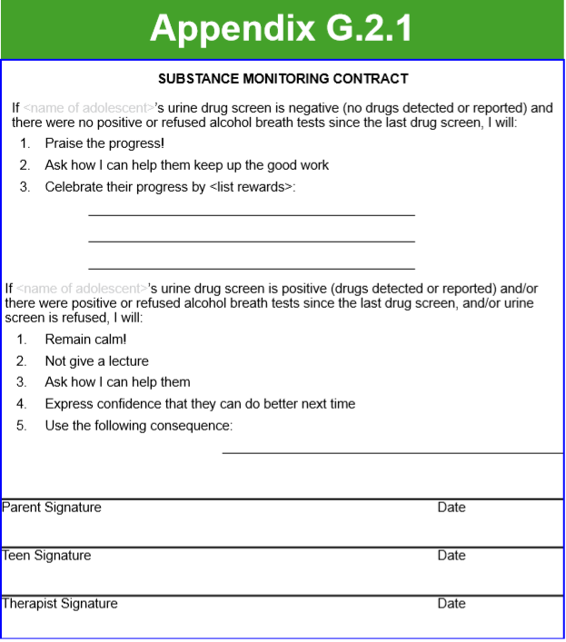

Slide 39
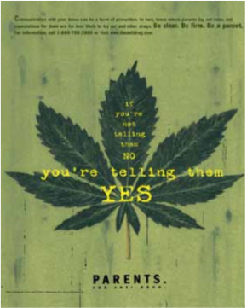
Cannabis Use Disorder
Treatment
Clinic Delivered Incentive Program
  Negative Urine test = Incentive
  Parents utilize breathalyzers
  Monitor alcohol use
  No alcohol = incentive
Parent-Delivered Contingency Management Program
  Model appropriate substance use
  Clear + consistent consequences
  Monitor youth’s behavior
  Motivate drug abstinence
Notes:
Clinic-delivered incentive program
Teens receive incentives each time they provide urine specimens that test negative for cannabis and other drugs. In addition, to receive the incentive, parents must report that the teen has not used alcohol since the last scheduled urine test. Parents are provided with disposable breathalyzers and instructed on how to use them. Incentives have a monetary value that increases with each consecutive negative urine test and parent report. Cash is not provided, instead, gift cards/ certificates from various retailers are used.
Parent-delivered contingency management program.
Parents are expected to: • Model appropriate behavior related to substance use • Increase monitoring of their youth's behavior • Learn to develop clear, consistent, and effective consequences for substance use, and • Develop effective methods to motivate drug abstinence. Therapists assist parents to develop a contract (see Appendix G.2.1), which includes specific positive and negative consequences that the parent will implement in response to urine and breath test results.

Slide 40
Cannabis Use Disorder
Treatment
Objective Testing
  Motivation for teens to lie
  Observed urine collection twice weekly
  2 weeks no cannabis ~ negative test
Results
  Contingency management w/ ME + CBT vs. ME + CBT + parent education + attendance incentive
    Twice weekly urine test in both
    Contingency management group = abstinence
    Effect stopped post treatment
    Abstinence in both groups
Notes:
Objective testing
Objective testing for substance use is necessary to conduct the abstinence based contingency management program and for valid evaluation of progress. Teens rarely show high motivation for abstinence and also typically face aversive consequences from parents, schools, or juvenile justice if they continue to use substances. Thus, they are motivated to give inaccurate self-reports and avoid or manipulate the objective testing procedures. Teens provide urine specimens prior to their counseling session under direct staff observation according to a twice weekly schedule throughout treatment. Specimens are immediately screened for cannabis, cocaine, opioids, benzodiazepines, amphetamines, and methamphetamine, and results are provided to teens, parents, and therapists within 10-15 minutes of providing the specimen if possible. Adulterant testing is conducted to assess for dilution and attempts to directly alter test results. With cannabis, up to two weeks of abstinence (and sometimes longer) are needed to allow sufficient time for a valid negative test result (e.g., for THCCOOH: 50ng/ml cutoff). This time is highly variable and influenced by individual difference in physiology, amount and duration of cannabis use, and recent activity level. The contingency management program used in Stanger et al (2009) and in adult contingency management studies targeting cannabis use was delayed two weeks before implementing the incentives program. Teens are clearly informed and repeatedly reminded about the need to be abstinent for 1-2 weeks before urinalysis testing will result in a cannabis-negative finding. The other drugs tests performed typically take 3-7 days post use to test negative at their respective standard cutoff levels.
Results
This contingency management program combined with motivational enhancement therapy and CBT was compared with an intervention that included motivational enhancement therapy, CBT, weekly educational parent sessions, and an attendance-based incentive program. Both treatments included twice weekly urine testing with results provided immediately to the parents and the teen. The contingency management group demonstrated greater rates of continuous abstinence during treatment than the comparison intervention, but this effect did not clearly extend to post-treatment assessments. Overall, rates of cannabis abstinence in both treatment conditions were relatively high compared with those reported in previous studies, suggesting that the comparison condition might also warrant further evaluation to determine its efficacy. The twice-weekly urine testing program provided in both treatment conditions, which systematically reported results to parents, was unique to this study and may be an active component in its own right.

Slide 41
Cannabis Use and Misuse
Treatment: Pharmacotherapy
  No strong evidence for any medication
  No approved medications for CUD
  N-acetylcysteine (glutamate)
    One study for CUD in adolescents and young adults
    Small open label trial
    Controlled follow-up study
  New research
    CB1 agonists
    CB1 antagonists (rimonabant)
  Lofexidine & zolpidem withdrawal symptoms
Notes:
Pharmacotherapy
Research exploring medications for cannabis use disorder has been stimulated by the increased recognition of the need for cannabis use disorder treatments, combined with new findings about cannabis withdrawal and better understanding of the endogenous cannabinoid system (Benyamina et al, 2008; Hart et al, 2005; Nordstrom & Levin, 2007; Vandrey & Haney, 2009). Unfortunately there is currently no strong evidence supporting any specific medication – thus there are no medications for cannabis use disorder approved by regulatory bodies. Among the many laboratory studies and a few clinical trials that have been published, only one study has assessed a medication for cannabis use disorder in adolescents or young adults. A small open label trial of N-acetylcysteine – a medication targeting glutamate – showed promise for reducing cannabis use in 18-21 year olds with cannabis use disorder (Gray et al, 2010). Preliminary reports from a controlled follow-up study appear to provide further support for the potential efficacy of this medication.
Medications research is targeting a number of different mechanisms. For example, agonist medications that have a similar mechanism of action as THC and can either substitute for cannabis or blunt the euphoric effects of cannabis if used (in the case of relapse), or be used short-term to suppress withdrawal symptoms; CB1 receptor antagonists can reduce binding to the receptor and thereby reduce euphoric effects if cannabis were used or, possibly, prompt withdrawal symptoms in the case of inverse agonists. Although some promising data have emerged for one such antagonist, rimonabant, concerns regarding its safety (i.e., putatively causes depressive symptoms and suicidality) have stopped investigation and halted its use.
Another approach has been to test medications that might provide symptomatic relief of withdrawal or reduce desire or craving. To date, most studies have been unsuccessful in finding promising candidate medications using this approach. Two medications that improve sleep, lofexidine and zolpidem, have shown some promise for reducing withdrawal symptoms and in particular sleep difficulties that occur with abrupt cessation of cannabis.

Slide 42
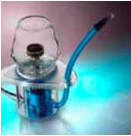
Cannabis Use and Misuse
Maintaining Treatment Effects
“Assertive Continuing Care”
Case management after inpatient
  90 days of weekly home visits
  Engagement in outpatient services
  Pro-social activities
  New social support system
  Reinforcement strategies
  Higher long-term abstinence
Notes:
Maintaining treatment effects
An intervention for teens focused on maintaining treatment gains (reducing relapse), “assertive continuing care”, warrants mention (Godley et al, 2007). With assertive continuing care, adolescents are assigned a case manager for 90 days after discharge from an inpatient treatment facility. The case manager makes weekly home visits with the goals of engaging the youth in other identified services, development of a new social support system involving pro-social activities, and generally reinforcing strategies to maintain abstinence. In a randomized trial comparing assertive continuing care to usual care, the assertive continuing care intervention was more effective in increasing adolescents’ engagement and retention in care, and resulted in higher longer-term abstinence from cannabis.
**Vaporizer used to consume cannabis**

Slide 43
Cannabis Use and Misuse
Secondary Prevention
“Check-up” intervention
  Ambivalent adult users
  Computerized assessment + 2 ME sessions
    Randomized for check up vs delayed treatment
    Similar reduction in use
Another study with similar sample
  ME vs “education feedback control” vs delayed feedback control group
    2 active treatments cannabis use
      ME >> reduction in use
      3 more studies support ME cannabis use
Reduction NOT abstinence
Development of effective treatments needed
Notes:
Secondary prevention
“Check-up” interventions, originally developed to reach adult cannabis users who were ambivalent about stopping their use or who did not perceive their use to be a problem (Stephens et al, 2007), have recently been adapted for adolescents. An initial US study tested a check-up intervention with teens in grades 9-12 who had used cannabis at least 9 times in the past month (Walker et al, 2006). The check-up consisted of a computerized assessment and two 30-minute motivational enhancement sessions. Teens were recruited with posters and health education lectures and then were randomized to either the check-up intervention or a 3-month delayed treatment condition. Teens in both conditions significantly reduced their cannabis use, yet between-group differences were not observed. A second study with a similar sample of teens compared the same brief motivational enhancement intervention with an “educational feedback control” intervention and a delayed feedback control group (Walker et al, 2011). The two active treatments reduced cannabis use over 3 months with a greater reduction observed in the motivational enhancement condition. Both conditions showed reductions over 12 months with no between-group differences. Three additional studies further demonstrated that brief motivational enhancement-based interventions show promise for reducing cannabis use in adolescents outside a treatment setting (Martin & Copeland, 2008; McCambridge & Strang, 2004; Winters & Leitten, 2007). This body of research clearly shows that cannabis-using teens will engage in brief interventions that address cannabis use, and that these interventions can reduce use. Note that reduction and not abstinence is the most common outcome among teens exposed to these interventions.
In summary, a number of behavior- and family-based psychosocial interventions have been developed that are efficacious for treating cannabis use disorders in adolescents. Unfortunately, as with treatment in adults and for substance use disorders in general, the rates of abstinence are modest. Integrating contingency management-based programs is one way of enhancing response rates, but still many teens do not respond. Clearly, further development of effective treatments will be required to better prevent and meet the needs of those who experience problems related to cannabis use.

Slide 44

Cannabis Use and Misuse
Risk Factors
Genetic
Environmental
  *Availability*
  Delinquent Behavior
  Chaotic Home
  Low socio-economic status
  Other psychopathology
  Low perceived risk of harm
  Peer/Family Use
  Use of other substances
Earlier initiation risk of CUD
Cannabis coffee shop in Amsterdam
Notes:
Risk Factors
In addition to the aforementioned genetic risk for the development of cannabis use disorder – or substance use disorders in general – environmental factors contribute to the use and abuse of cannabis. Perhaps availability is of most importance. Because of high demand and ease of growing, cannabis is the most widely available illicit drug in the world. Legal policies regarding cannabis possession likely impact access and use rates. Although some argue that “legal use” – such as that in the Netherlands where use of cannabis by adults and regulated sale of small quantities is tolerated – does not increase rates of use and cannabis use disorder, this may be because cannabis is widely available and accessible even in countries where it is not tolerated. In the US, where it is illegal, cannabis is almost as easy for teens to obtain as alcohol or tobacco (Johnston et al, 2009). Other factors that strongly predict cannabis use and cannabis use disorders include (Brook et al, 2001; von Sydow et al, 2002): • Delinquent behavior • Chaotic home environment • Low socio-economic status • Other psychopathology • Low perceived risk of harm • Use of other substances • Use by peers, and • Use by family members. Moreover, early initiation of use increases the probability of developing a cannabis use disorder, any substance use disorder, and other psychiatric disorders.

Slide 45
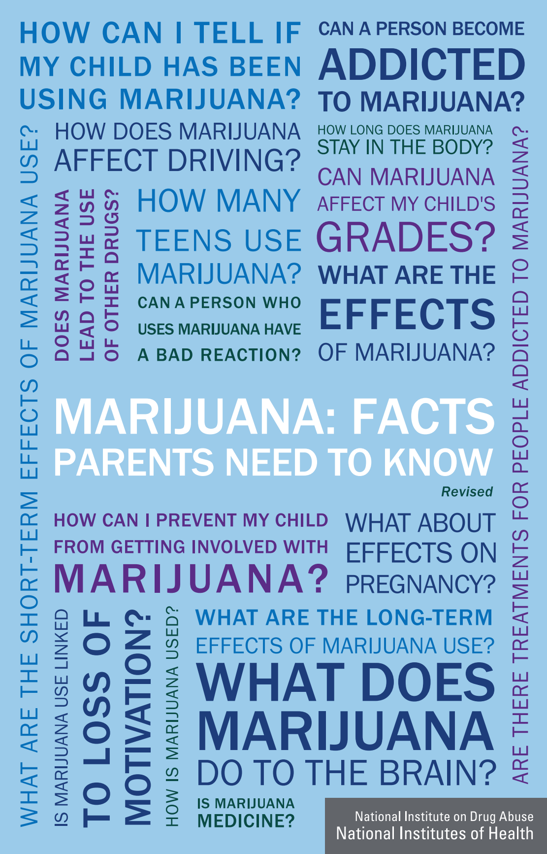
Cannabis Use and Misuse
Resources
Notes:
Click on the picture on the left to access NIDA’s publication “Marijuana: Facts Parents Need to Know” and the picture on the right “Marijuana: Facts for Teens”. Both provide reliable information

Slide 46
Cannabis Use and Misuse
Prevention
Minimal treatment available → Prevention
Strategies = other SUDs
  Perception cannabis harmful
  Parent education/training
  Balanced, science based, and rational education
    No “scare-tactics”
  School based prevention programs
  Targeted educational programs for high risk youth
Notes:
Prevention
Given the difficulty in successfully treating cannabis use disorders, prevention efforts become paramount for reducing the consequences associated with cannabis use and cannabis use disorders. Targets and strategies for prevention are similar to those for other types of substance use disorders and are focused on the risk factors mentioned. Educational campaigns, social policies, and media portrayals of cannabis that increase the perception that cannabis is potentially harmful and may lead to problems are likely to reduce the probability of use and delay initiation. Parenting education and training on effective family approaches to discuss and handle substance use in general and cannabis use in particular, are important targets (Stormshak et al, 2011). A number of websites (mentioned elsewhere in this chapter) offer excellent science-based information to guide this process. Similarly teen educational approaches that are balanced, science-based and rational, rather than based on “scare-tactics” are also available and likely to have positive impact. More broadly, particular school-based prevention programs can be helpful (Porath-Waller et al, 2010; Rohrbach et al, 2010). And last, enhanced general education programming and approaches for low socio-economic, high risk youth can be an effective method for reducing or delaying the onset of cannabis use (Tobler et al, 2011).

Slide 47
Cannabis Use and Misuse
Medical Marijuana and Legalization
Controversial
Legality affects teens’ perception of risk
Suggestion of evidence for targeted compounds
  Data: potential benefits for many conditions
    Nabilone for AIDS wasting syndrome + cancer patients
    Oral spray for muscle spasticity (Canada/New Zealand)
  Smoked vs oral
      Delta-8-THC + cannabidiol
      Adverse effects of smoking
      Increase intoxication +risk for CUD
Notes:
Controversy related to the potential for medicinal use of cannabis and its legalization has caused confusion and mistrust of the data about cannabis and its potential adverse consequences and benefits. These issues warrant discussion because laws and regulations can strongly affect a teen’s perception of the risk of harm associated with cannabis – and thereby the likelihood that they may try it or decide to use it regularly.
Medicinal use
In 1999, the Institute of Medicine acknowledged the importance of studying the risks and benefits of the use of cannabis and cannabinoids for specific medical conditions. Available data clearly suggest that the compounds in cannabis have potential beneficial effects for a number of medical conditions. This is not surprising as oral preparations of pure THC have been approved by regulatory bodies in multiple countries for AIDS wasting syndrome and for cancer patients receiving chemotherapy. The synthetic cannabinoid nabilone has been approved for use in cancer patients undergoing chemotherapy. An oro-mucosal spray extract, which contains THC and cannabidiol is approved for use in Canada and New Zealand to manage muscle spasticity in patients with multiple sclerosis and for neuropathic pain in cancer patients. The important question, however, is whether smoked cannabis should be considered a “medicine” and be prescribed for specific ailments. Arguments for added benefit from smoked cannabis compared with oral or oral-mucosal modes of administration are related to the more rapid onset and absorption of THC that occurs from inhalation of the smoke, and the possible therapeutic contribution of constituents of cannabis other than THC (e.g., delta-8-THC and cannabidiol). Disadvantages include the adverse effects of smoke on the respiratory system and its potential carcinogenic impact, difficulty in determining therapeutic doses and reliably delivering such doses through smoke inhalation, increased probability for intoxication, and the potential to develop a cannabis use disorder with its associated social, cognitive, and behavioral consequences. Currently, the evidence for determining the efficacy and safety of specific doses of smoked cannabis for targeted medical indications does not approach that required by regulatory bodies to even consider approval.

Slide 48
Cannabis Use and Misuse
Legalization
Pros
Alcohol use -> more harmful
Regulation/tax -> fiscal benefits + quality control
Addictive potential relatively low
Reduced crime and consequences
Medical benefits: pain, eating disorders or appetite problems neuromuscular/neurodegenerative/autoimmune disorders
Cons
Psychosocial, health, psychiatric consequences
Possible increase use
Many illegal drugs have medical benefit potential
Reduced perceived harm
Driving under influence -> accidents
Notes:
Our rapidly increasing knowledge about the endocannabinoid system has increased optimism for the eventual use of cannabinoids (cannabis-like compounds) as medicines in areas such as treatment of pain, neuromuscular and neurodegenerative disorders, eating or appetite disorders, autoimmune diseases, and other psychiatric disorders (Budney & Lile, 2009). The target of such work is to produce alternative synthetic cannabinoid-based medications that reproduce the putative positive effects of smoked cannabis while reducing the aforementioned concerns. This path might approximate that of opioid medications, which have been developed and marketed for pain despite their abuse potential and substantial side effects, but have not included a smoked formulation for administration.
Discussion of legalization of cannabis can obviously influence how a teen may perceive the potential harm associated with cannabis use. Controversy regarding its legal status has grown since the early part of the 20th century. Pro-cannabis groups have been calling for decriminalization or legalization for many years, with most recent efforts directed at legalization for medical use.
Arguments for legalization include:
• Alcohol use and abuse are more harmful and costly
• Regulated and taxed cannabis would provide fiscal benefits to society and quality control for cannabis
• Addictive potential is relatively low
• Reduce crime related to dealing and prevent criminal status labels and future consequences for those who get arrested, and reduce the costs associated with prosecution
• Cannabis has medical benefits
• Criminalization impinges on personal freedom.
Counter arguments include:
• The psychosocial, health, and psychiatric consequences associated with cannabis misuse and related disorders are substantial
• Reduced cost combined with marketing/advertising would increase use and cannabis use disorders, particularly in vulnerable groups such as teens and those of low socioeconomic status
• Medical potential can be claimed for most substances that are abused and illegal
• Legalization would reduce the perceived harm and increase use, increased use will result in more driving under the influence of drugs and accidents.
Many of these points made by both pro- and anti-cannabis supporters have merit. Policymakers, who must decide how to manage cannabis in their respective cultures, are faced with a most difficult task of balancing multiple factors; most countries to date have sided with arguments related to the government protection of the public, including teens, from a potentially harmful substance.

Slide 49
Cannabis Use and Misuse
Conclusion
Misuse, abuse, dependence & withdrawal
  Real & common
  Problem especially for adolescents/teens
Similar to other SUDs
Some level of cannabis = harmful effects
Most users significant consequences
Valuable new research
Notes:
CONCLUSION
Cannabis misuse, abuse, dependence and withdrawal are real and relatively common problems with significant associated consequences that reflect a clear public health problem, particularly for adolescents and young adults. In most respects, cannabis use and the development of cannabis use disorders approximate what is observed with most other substances of abuse. A reasonable perspective is to acknowledge that some level of cannabis use can and does result in harmful effects. Like all other substances, including alcohol, that have addictive potential, most individuals who initiate cannabis use do not experience significant consequences, but others misuse, abuse, or become dependent and experience adverse outcomes. Fortunately, recent research has provided a wealth of knowledge for guiding the assessment, diagnosis, and treatment of cannabis use disorders, as well as prevention efforts. Hopefully, science will continue to provide more information that will enhance the development, availability and effectiveness of clinical and prevention approaches.

Slide 50

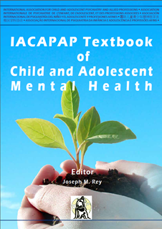
Parenting Programs
Thank You!

