Slide 1

EXTERNALISING DISORDERS
Chapter D.2
OPPOSITIONAL DEFIANT DISORDER
Katie Quy & Argyris Stringaris
DEPRESSION IN CHILDREN AND
ADOLESCENTS
Companion PowerPoint Presentation
Adapted by Julie Chilton

Slide 2

The “IACAPAP Textbook of Child and Adolescent Mental Health” is available at the IACAPAP website http://iacapap.org/iacapap-textbook-of-child-and-adolescent-mental-health
Please note that this book and its companion powerpoint are:
· Free and no registration is required to read or download it
· This is an open-access publication under the Creative Commons Attribution Non- commercial License. According to this, use, distribution and reproduction in any medium are allowed without prior permission provided the original work is properly cited and the use is non-commercial.

Slide 3


Oppositional Defiant Disorder
Outline
The Basics
Diagnosis
Epidemiology
Aetiology & risk factors
Assessment
Treatment
Notes:
By the end of this presentation, you should understand the following about ODD in children and adolescents

Slide 4
Oppositional Defiant Disorder
The Basics
“A persistent pattern of defiant, disobedient, and antagonistic behavior toward adults”
No antisocial or aggressive acts like the ones found in conduct disorder
Common
Substantial impairment
Poorer adjustment outcomes
Increased cost to society
Notes:
Disruptive behaviour disorders are common and are associated with substantial impairment for both children and their families, and with a range of poorer adjustment outcomes in later development (Ford et al,2003; Burke et al, 2005; Copeland et al, 2009; Kim-Cohen et al, 2003; Costello et al, 2003). Disruptive behaviour problems are also associated with increased cost to society: it is estimated that the costs arising for individuals with antisocial behaviours in childhood are at least 10 times higher than in non-antisocial individuals by the time they reach 28 years (Scott et al, 2001a).The two main classification systems, the Diagnostic and Statistical Manual of Mental Disorders, 4th Edition (DSM-IV; APA, 1994, 2000) and the International Classification of Diseases, 10th Revision (ICD-10; WHO, 1993) specify oppositional defiant disorder (ODD) as a persistent pattern of defiant, disobedient and antagonistic behaviour toward adults. This disorder is defined by the absence of the more serious acts of aggression or antisocial behaviour associated with conduct disorder.

Slide 5
Oppositional Defiant Disorder
Diagnosis
DSM-5: 4 or more of the following, not just with siblings, lasting greater than 6 months
  Often loses temper
  Often touchy or easily annoyed
  Often angry and resentful
  Often argumentative with adults/authority figures
  Often defies or doesn’t follow rules
  Often deliberately annoys others
  Often blames others
  Spiteful or vindictive 2 x in 6 months
ICD-10: persistent pattern of provocative, hostile and non-compliant behavior, with low temper threshold
Notes:
The DSM-IV criteria for ODD require four or more symptoms to be present for at least six months. Symptoms must occur at a level greater than in individuals of comparable age or developmental stage and must cause ‘significant’ impairment. A diagnosis of ODD must exclude conduct disorder. Key features of ODD highlighted by ICD-10 guidelines include a persistent pattern of provocative, hostile and non-compliant behaviour, characterised by low temper threshold.

Slide 6
Oppositional Defiant Disorder
Epidemiology
Prevalence: 2-10%
Boys>girls
Symptoms decline after age 10
Rarely diagnosed in older children
Estimates vary across countries
Majority do not develop conduct disorder
High rates of comorbidities
Notes:
ODD is a relatively common childhood disorder with an estimated prevalence of 2% to 10% (Maughan et al, 2004; Costello et al, 2003). Prevalence estimates may, however, vary depending on factors such as informant source (e.g.,parent vs. child) type of report (e.g., concurrent vs. retrospective) and whether or not children meeting criteria for conduct disorder are included. ODD is significantly more common in boys than girls. Symptoms are relatively stable between the ages of five and ten, but are thought to decline after that point. ODD is diagnosed more rarely in older children, partly in order to avoid labelling normative discord between children and their parents during adolescence.
The extent to which ODD and conduct disorder should be considered as separate or as a single disorder is the subject of some debate. This is reflected in existing classification systems: in DSM-IV the diagnosis of conduct disorder can include all of the features of ODD and it is treated as a precursor to conduct disorder. In ICD-10, ODD is thought to only be a milder form of conduct disorder, so the two are considered as a unique category, as they sometimes are in empirical research studies (Kim-Cohen et al, 2003). However, while ODD and conduct disorder have been found to have high levels of comorbidity, the majority of children diagnosed with ODD do not go on to develop conduct disorder (Roweet al, 2002), and the two disorders are distinguishable by a range of different correlates (Dick et al, 2005; Nock et al, 2007).
ODD is characteristically comorbid, in that it occurs together with or before a wide range of other disorders (Costello et al, 2003) including anxiety and depressive disorders (girls), conduct disorder and substance use disorders. Children with ADHD often go on to develop ODD. The wide range of associations between ODD and other disorders is depicted in Figure D.2.2.

Slide 7
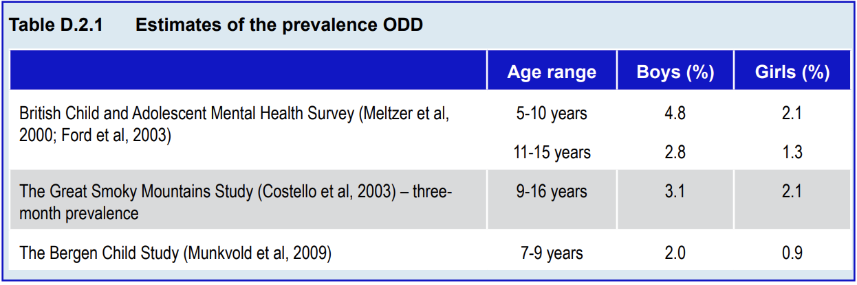
Oppositional Defiant Disorder
Epidemiology
Notes:
Table D.2.1 summarises prevalence rates from a number of large studies.

Slide 8
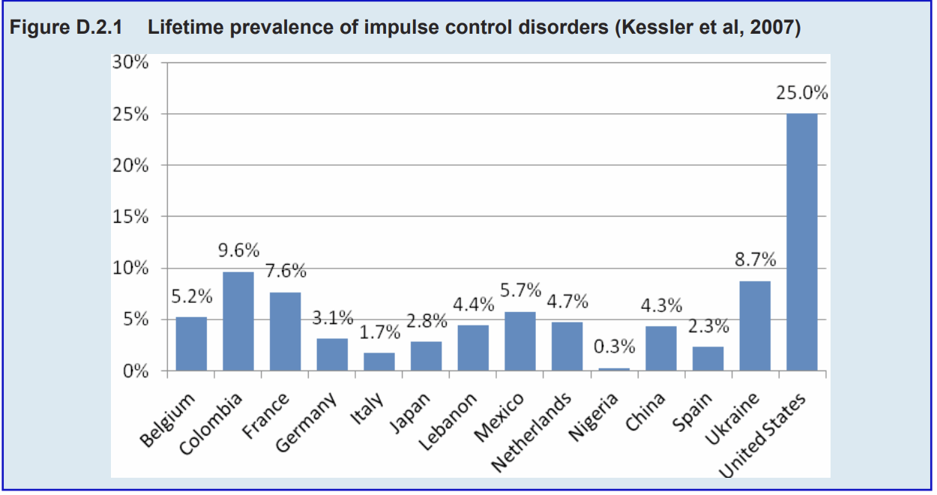
Oppositional Defiant Disorder
Epidemiology
Notes:
Cross-cultural differences in prevalence
Data drawn from World Health Organisation and World Mental Health surveys indicate that estimates of the prevalence of ODD vary widely across countries. For example, data from a large-scale international survey published by Kessler et al (2007) demonstrated marked variation in the lifetime prevalence of impulse control disorders (comprising intermittent explosive disorder, oppositional defiant disorder, conduct disorder, and attention-deficit/ hyperactivity disorder).

Slide 9
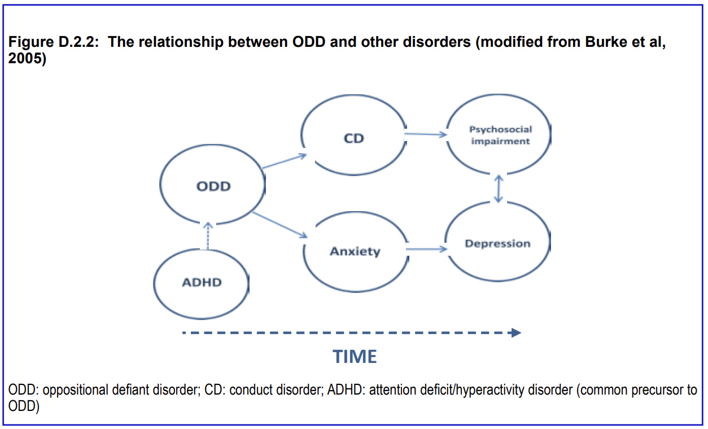
Oppositional Defiant Disorder
Comorbidity
Notes:
ODD is characteristically comorbid, in that it occurs together with or before a wide range of other disorders (Costello et al, 2003) including anxiety and depressive disorders (girls), conduct disorder and substance use disorders. Children with ADHD often go on to develop ODD. The wide range of associations between ODD and other disorders is depicted in Figure D.2.2.
ODD has consistently been found to predict later depression (Copeland et al, 2009; Burke et al, 2010; Burke et al, 2005) and anxiety (Maughan et al,2004). Most strikingly, Copeland et al (2009) found that childhood oppositional defiant disorder predicted young adult depression; young adult depression and anxiety disorders were often preceded by adolescent ODD, but not CD. The relationship between ODD and emotional problems is particularly puzzling –it has been suggested that it may be the affective aspects of ODD that predict emotional disorders such as anxiety and depression (Burke et al, 2005; Stringaris & Goodman, 2009b)
In an attempt to explain the heterogeneity of the associations between childhood ODD and adult disorders, Stringaris and Goodman (2009a, 2009b)proposed that the DSM-IV ODD criteria consist of three a priori specified dimensions described as “irritability,” “headstrong and “hurtful” behaviour. Others (Rowe et al, 2010) have identified only two dimensions – irritability and headstrong, while others have suggested slightly different partition of symptoms(Burke et al, 2010). The findings suggest that “irritable” mood is more strongly predictive of later emotional disorder (Stringaris et al, 2009), while “headstrong” and “hurtful” behaviours are more predictive of conduct problems. The clinical utility of these distinctions has yet to be established (Rowe et al, 2010; Burke et al,2010; Aebi et al, 2010).

Slide 10
Oppositional Defiant Disorder
Aetiology & Risk Factors
Genetics
Gene-environment interplay
Earlier age of onset of antisocial symptoms
Different temperamental routes
Rejection by non-deviant peers
Callous and unemotional traits
Social and economic disadvantage
Neighborhood violence
Negative parenting
“Coercive family processes”
Notes:
While no single cause of ODD has been identified, a number of risk factors and markers have been found to be associated with oppositional behaviour.
Genetics
Genetic effects contribute significantly to the development of ODD symptoms with heritability estimates exceeding 50%, with genetic factors accounting more than 70% of the variability in individual measures based on parent reports (Eaves et al, 1997). While some have suggested that ODD shares substantial genetic overlap with conduct disorder (Eaves et al, 2000), other studies have indicated unique effects for each (Rowe et al, 2008, Dick et al, 2005). In addition, it seems that genetic effects underlie the association between ODD and ADHD (Hewitt et al, 1997) as well as between ODD and depressive disorder (Rowe et al, 2008). In a twin study of adolescents, self-reported irritability symptoms of ODD shared genetic effects with depressive symptoms, whereas “headstrong/hurtful” symptoms of ODD shared genetic risk with delinquent symptoms (Stringaris et al, 2012).
Gene-environment interplay
The notion that the effects of exposure to an environmental factor (e.g. childhood maltreatment) on a child’s behaviour is conditional upon that child’s genetic make-up has face validity and biological plausibility (Rutter, 2006). In one of the pioneering studies in the field (Caspi et al, 2002), a functional polymorphism in the promoter region of the gene that codes for the neurotransmitter-metabolizing enzyme monoamine oxidase A (MAO-A) was found to moderate the effect of child maltreatment on future conduct and antisocial problems, although several later studies did not find such an interaction. Maltreated children with a genotype that leads to low levels of MAOA activity more often displayed conduct disorder and antisocial behaviours at follow up, than children with a high-activity MAOA genotype (Caspi et al, 2002). This will be discussed further in the chapter on conduct disorder (Chapter D.3).
Age of onset
The age of onset of antisocial symptoms (Moffitt, 1993) seems to be a good predictor of later outcome. Moffitt (1993) distinguishes between children whose symptoms first emerge in childhood and persist into adolescence (childhood onset persistent) compared to those whose symptoms first occur in adolescence. Individuals in the childhood onset persistent group have been found to have poorer adult outcomes when compared with non-disordered and adolescent-onset peers (Moffitt, 2003; Moffitt, 2006; Moffitt et al, 2002; Odgers et al, 2007; Farringtonet al, 2006). Age of onset as a predictor of later outcomes is discussed further in Chapter D.3.
Temperament
Temperamental factors in toddlerhood, such as irritability, impulsivity, and intensity of reactions to negative stimuli, may contribute to the development of a pattern of oppositional and defiant behaviour. It is possible that ODD is arrived at through different temperamental routes that could serve to explain its comorbidity. Stringaris et al (2010) showed that the comorbidity between ODD and internalizing disorders was more strongly associated with early temperamental emotionality, whereas the comorbidity between ODD and ADDH was better predicted by temperamental over activity.
Peer influences
Children who display oppositional behaviour are more inclined to experience disrupted or problematic peer relationships. Such children are commonly rejected by non-deviant peers, and tend instead to associate with other children who exhibit problem behaviour. It would appear likely that the relationship between peer rejection and childhood ODD symptoms is a bi-directional one, as is nicely illustrated in a series of studies about bullying (summarised in Arseneault et al,2010).
Callous and unemotional traits
The concept of psychopathy has been extended to young people in recent years (Frick et al, 1994) with a focus on callous and unemotional traits. While not all children diagnosed with conduct disorder have callous and unemotional traits (Frick et al, 2000), the presence of such traits appears to distinguish a subgroup of children with more serious conduct problems. Callous and unemotional traits seem to be highly heritable (Viding et al, 2005) and characterised by poor recognition of emotion (particularly fear) in facial expression (Blair et al, 2006; Dadds et al,2006). The importance of callous and unemotional traits is discussed further in Chapter D.3.
Neighbourhoods
The broader environment surrounding the child may also be a risk factor. Disruptive behaviour has consistently been associated with social and economic disadvantage and neighbourhood violence (Guerra et al, 1995; Rowe et al, 2002).
Family factors
The importance of the interplay between genes and family-level environmental factors has become increasingly clear in the aetiology of children’s disruptive behaviour problems (Moffitt, 2005). Evidence from adoption studies(O'Connor et al, 1998; Ge et al, 1996) shows that children at high genetic risk for antisocial behaviour were more likely to receive negative parenting from the adoptive parents than were children with low genetic risk for antisocial behaviour. Conversely, it is known from studies using a monozygotic twin design that family level effects contribute to children’s risk for externalising problems over and above children genetic effects (Jaffee et al, 2003; Caspi et al, 2004). In other words, parental behaviour towards children can be a true environmental risk.
Models of family influences
Patterson (1982) proposed a model about how parental behaviour may exacerbate children’s negative behaviour and result in what he designated as “coercive family processes”. His work has shown that parents of children with disruptive behaviour problems are more likely to be inconsistent in how they apply rules, and give commands that are either unclear or the result of their own current emotional state rather than contingent upon the child’s behaviour. A typical mutually coercive process would arise when a parent responds in an unduly harsh way to a child’s mildly disruptive behaviour, upon which the child may further escalate its oppositional behaviour. This in turn leads to yet harsher responses by the parent with further escalation. The result is that the parent may in the end give in, reinforcing the child’s negative behaviours. This paradoxical “reward” of a child’s negative behaviour may both increase and maintain oppositional behaviours and is the specific target of therapeutic interventions (see below).

Slide 11

Oppositional Defiant Disorder
Parental Influence: “coercive family processes”
Parents of children with disruptive behavior problems are more likely to be inconsistent in how they apply rules, and give commands that are either unclear or the result of their own current emotional state rather than contingent upon the child’s behavior
Gerald R Patterson
Founder of the Oregon
Social Learning Centre
Notes:
Patterson (1982) proposed a model about how parental behaviour may exacerbate children’s negative behaviour and result in what he designated as "coercive family processes”. His work has shown that parents of children with disruptive behaviour problems are more likely to be inconsistent in how they apply rules, and give commands that are either unclear or the result of their own current emotional state rather than contingent upon the child’s behaviour. A typical mutually coercive process would arise when a parent responds in an unduly harsh way to a child’s mildly disruptive behaviour, upon which the child may further escalate its oppositional behaviour. This in turn leads to yet harsher responses by the parent with further escalation. The result is that the parent may in the end give in, reinforcing the child’s negative behaviours. This paradoxical “reward” of a child’s negative behaviour may both increase and maintain oppositional behaviours and is the specific target of therapeutic interventions (see below).
Gerald R Patterson, founder of the Oregon Social Learning Centre, described the so called “coercive family processes” and their role in the development and maintenance of behavior problems

Slide 12
Oppositional Defiant Disorder
Assessment
Gather information from multiple sources
Assess comorbidities
Consider family, school and neighborhood
Watch for bullying or peer deviance
Assess for learning difficulties
Notes:
It is feasible to assess oppositional problems in children as young as 5 years of age (Kim-Cohen et al, 2005). A wide range of instruments is available to measure ODD symptoms and to assist in the diagnostic process and monitoring. Clinicians should always bear in mind that diagnosis is based on their judgment and integration of the information gathered by interviews, clinical examination, scales and other means (summarised in Table D.2.2).
Useful principles for assessing children with ODD include:
a) try to obtain information from as many different sources (parent, child, teacher) as possible;
b) assess comorbid psychiatric problems, particularly ADHD;
c) assess other risk factors at family, school and neighbourhood level. Children with disruptive behaviour problems often come from deprived backgrounds. It is important to identify factors (such as bullying or peer deviance) that maintain or increase oppositional behaviours. The same applies to performance at school: a child with reading difficulties or hyperactivity may be more likely to manifest oppositional behaviours at school.

Slide 13
Oppositional Defiant Disorder
Differential Diagnosis
Phobias
Other anxiety disorders
Obsessive Compulsive Disorder
ADHD
Autism
Depression
Notes:
Differential diagnosis
Oppositionality can be seen in many childhood conditions. It is important for the clinician to recognise those cases where other disorders may have given rise to it. For example, it is not uncommon for children who develop a specific phobia or other anxiety disorders (such as OCD) to become oppositional and uncooperative, particularly in situations in which they expect to be exposed to the feared situation. Clinicians treating children with OCD whose rituals are disrupted know this phenomenon all too well. In these cases, assigning a diagnosis of oppositional defiant disorder and failing to recognise and address the underlying anxiety disorder is counterproductive. The same applies to children with ADHD who often develop oppositionality. Indeed, oppositionality might be the main reason for the referral of such children. It is crucial for the clinician to be able to look for ADHD as a possible underlying issue of the disturbance, even when the parents’ chief worry is their child’s oppositionality. This has important treatment implications (see below). Similar situations can arise in children with autism, who can become particularly oppositional in the face of change of routine or due to sensory sensitivities. Here too, clinicians will want to recognise possible underlying problems and ensure that these are adequately treated.

Slide 14
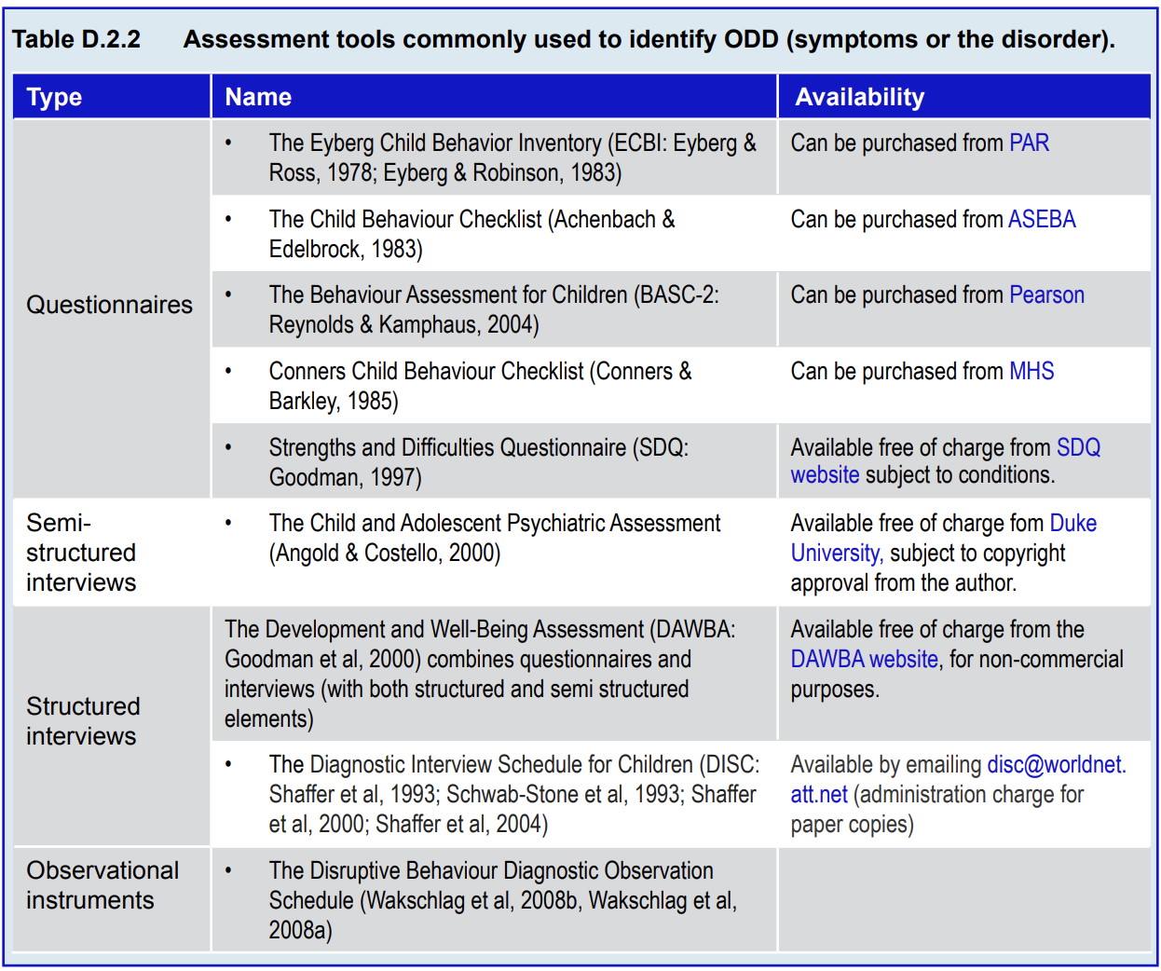
Notes:
It is feasible to assess oppositional problems in children as young as 5 years of age (Kim-Cohen et al, 2005). A wide range of instruments is available to measure ODD symptoms and to assist in the diagnostic process and monitoring. Clinicians should always bear in mind that diagnosis is based on their judgment and integration of the information gathered by interviews, clinical examination, scales and other means (summarised in Table D.2.2).

Slide 15
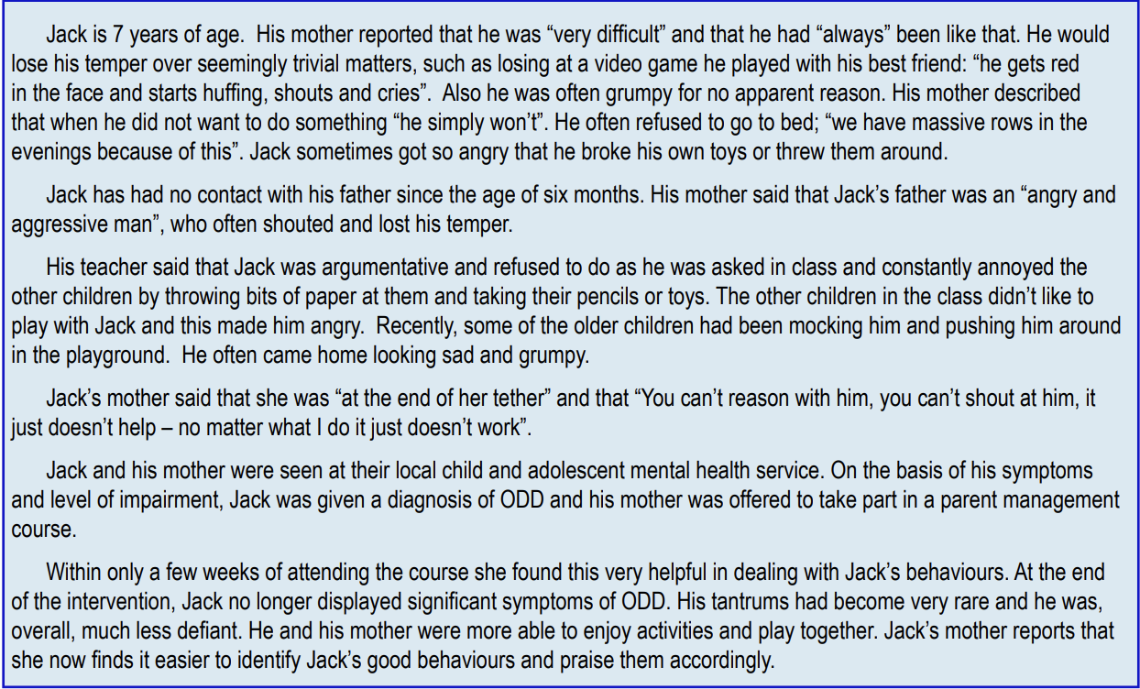

Slide 16
Oppositional Defiant Disorder
Treatment
Identify and treat comorbidities
Address modifiable risks
Parent management training (see Chapter A.12)
  The Incredible Years
  Triple P (Positive Parenting Program)
Alternative approaches
School-based interventions
Individual therapy (anger management)
Medication
Notes:
Some general principles apply to the treatment of oppositional problems as with other psychiatric disorder. Comorbidities should be identified as they are likely to require treatment in their own right. This is particularly true for ADHD and to a large extent also for childhood depression and anxiety. Other treatable or modifiable risks (e.g., ongoing bullying or failure at school due to learning difficulties) should always be assessed and addressed as part of the treatment package offered to the family. A number of treatments are available to clinicians, depending on the needs of the individual child and family. For example, behaviour occurring predominantly in either the home or school context may be best managed using a treatment designed to address context-specific issues. More pervasive problems may call for more intensive individual work (Moffitt & Scott, 2008).
Parent management training
Parent management training-based on principles of social learning theory is a key feature of treatment in ODD. Problematic parent-child interaction patterns have been implicated in the development and maintenance of oppositional behaviour and principles of social learning, particular in relation to operant conditioning (the role of reinforcement / consequences in altering behaviour), have been found to be useful in modifying behaviour in both parents and children (Feldman & Kazdin, 1995). Parent management training teaches parents to identify prosocial and problem behaviour and apply punishment and reinforcement techniques designed to increase the frequency of desired behaviours and decrease the frequency of undesired ones.
Examples of parenting programmes
Several programmes based on social learning theory have been found to be effective in addressing early onset antisocial behaviour, namely:
• The Incredible Years (Webster-Stratton, 1981)
• The Triple P—Positive Parenting Programme
Alternative approaches
Strategies have also been put forward to treat behaviour problems in families where such programmes have been unsuccessful. Scott and Dadds (2009)suggest a number of alternative ways of approaching intervention which may provide a framework to address factors which may limit the efficacy parent training programmes. They recommend taking account of attachment security and the parent-child relationship in considering intervention strategies, in order to allow for the impact which disrupted attachment may have on the meaning of expected reinforcers or punishments. In addition, they emphasise the importance of wider social contexts which may impact on the child, such as parent relationships, siblings, extended families and neighbourhoods. Finally, they encourage clinicians to consider beliefs held by parents about the child (or aspects of parenting) which may be interfering with treatment.
School-based interventions
Teachers may also be provided with additional tools to promote improvements in classroom behaviour. Social learning theory is also key in this approach. Moffitt and Scott (2008) identify four primary domains of functioning to be addressed: Promoting compliance and adherence to classroom rules and acceptable behaviours
Supporting the development of problem solving skills
Preventing problem behavior
Avoiding the escalation of oppositional behavior

Slide 17
Oppositional Defiant Disorder
Treatment Goals
Parents:
Improve positive parenting skills
Enhance problem solving, conflict resolution, communication skills
Child:
Develop effective communication, problem-solving and anger management skills
Family:
Family counseling and support
Classroom:
Social skills sessions from teacher or counselor
Notes:
Goals in managing ODD (from Fraser &Wray, 2008)
For parents
• Improve positive parenting skills
• Enhance skills in problem solving, conflict resolution and communication
For the child
• Development of effective communication, problem-solving and anger management skills
For the family
• Family counselling and support to deal with the stresses in their relationships and the home environment
In the classroom
• Encourage the teacher or school counsellor to provide social skills sessions to improve peer relationship.

Slide 18
Oppositional Defiant Disorder
Treatment: The Incredible Years
For parents, teachers, and children
3 programs: basic, advanced, partners
Basic:
  13-16 2 hour weekly sessions
  Videos of right vs wrong child management
  Topics: play, praise, rewards, limit-setting, handling misbehavior
  Discussions after with rehearsal
  Homework
  Telephone support
Multi-center controlled trial in 141 children age 3-8 with antisocial behavior utilizing Basic programme
  Decrease in antisocial behavior, hyperactivity, total number of problems per day, conduct problems, total deviance (SDQ), externalizing and total problem scores (CBCL), parent defined problems, and ICD 10 diagnoses of ODD
  Decrease in parents’ inappropriate commands
Notes:
One of the best validated is Webster-Stratton’s “Incredible Years”, a behaviourally-based training programme designed for use with parents (Webster-Stratton & Hammond, 1997; Webster-Stratton, 1982; WebsterStratton,1981), teachers and children (Webster-Stratton & Hammond,1997). Scott and colleagues (2001b) carried out a multi-centre controlled trial of the group parenting version in a sample of 141 (intervention group, n=90; waiting list control group, n=51) children aged 3 to 8 years who were referred for antisocial behaviour to their local multidisciplinary child and adolescent mental health service. They used the videotape-based “Basic” programme (Webster-Stratton & Hancock, 1998). This comprised 13-162-hour weekly sessions in which parents were shown video segments with scenes showing right and wrong ways to manage children. The programme covered play, praise and rewards, limit-setting, and handling misbehaviour. After watching the videos, parents were encouraged to discuss their own children’s behaviour and rehearsed different approaches to handling it. Parents were also given weekly activities to try at home (homework) and progress was supported by telephone contact. Programme costs were comparable with the cost of individual treatment. Substantial and statistically significant decreases in antisocial behaviour compared with controls were found in parents’ ratings of children’s conduct problems as well as hyperactivity; parent reports of total number of problems per day; conduct problems and total deviance as measured by the Strengths and Difficulties Questionnaire(Goodman, 1997); externalising and total problem scores as assessed by the Child Behaviour Checklist (Achenbach & Edelbrock, 1983); parent defined problems (the three problems parents identified as the ones they most wanted to see improved); and ICD10 diagnosis of oppositional defiant disorder. Parent behaviour was also measured and significant decreases were found in observations of parents’ inappropriate commands. Two further programmes have also been developed: the “Advance” programme, designed to manage parental relationships and the “Partners” programme, designed to support children’s academic learning and build up parent-teacher relationships. Integrating the three programmes has been found to achieve the most substantial improvements in behaviour.

Slide 19

Oppositional Defiant Disorder
Treatment: Triple P–Positive Parenting Program
Multiple levels:
Information on parenting issues for interested parents
Advice for specific problem behaviors
Brief programs for advice/training with minor behavioral problems
More intensive programs for persistent and pervasive behavioral problems
  mood management strategies
  Coping skills
  Partner support skills
Notes:
Triple P is an evidence based parenting and family support programme designed to prevent and manage behaviour problems in preadolescent children by enhancing parenting skills and improving parent-child relationships. The programme comprises multiple levels: universal intervention designed to provide information on parenting issues for interested parents; provision of advice for specific problem behaviours; brief programmes to provide advice and training parents dealing with minor behaviour problems; and more intensive programmes comprising training in mood management strategies, coping skills and partner support skills designed to address more persistent and pervasive behaviour problems. Triple P has been validated in a number of studies with a range of family types and cultural backgrounds (Graaf et al,1998, Bor et al, 2002).

Slide 20
Oppositional Defiant Disorder
Treatment: School-Based Interventions
Tools for teachers in 4 Primary Domains:
Promoting compliance and adherence to classroom rules and acceptable behaviors
Developing problem solving skills
Preventing problem behavior
Avoiding escalation of oppositional behavior
Notes:
Teachers may also be provided with additional tools to promote improvements in classroom behaviour. Social learning theory is also key in this approach. Moffitt and Scott (2008) identify four primary domains of functioning to be addressed:
1. Promoting compliance and adherence to classroom rules and acceptable behaviours
2. Supporting the development of problem solving skills
3. Preventing problem behavior
4. Avoiding the escalation of oppositional behaviour

Slide 21
Oppositional Defiant Disorder
Treatment: Individual therapy—Anger Management
CBT-based
Coping skills approach with stress inoculation
3 elements:
  Cognitive preparation
  Skill acquisition
  Application training
Role play
Notes:
Existing evidence indicates that CBT-based anger management training may be particularly helpful in treating anger (Beck & Fernandez, 1998; Lochman et al, 2011). This training uses a coping skills approach involving stress inoculation interventions comprising three elements: cognitive preparation‚ skill acquisition‚ and application training (Meichenbaum, 1996). In the first phase, cognitive preparation, the trainer works to establish a relationship with the patient. The patient is coached to reconceptualise stressors as potentially modifiable problems which can be managed using coping strategies. In the second phase, skill acquisition, the patient is taught specific coping strategies, such as emotional self-regulation, acceptance, problem-solving, and attention diversion procedures; systems which may be applied to particular problems experienced by the patient and their family. In the final phase, the patient is taught to apply these strategies in practice. Stressors are gradually introduced (using for example role playing techniques), until the patient can employ coping skills in real-life situations.

Slide 22
Oppositional Defiant Disorder
Treatment: Medication
No evidence for medication in ODD alone
Stimulants improve conduct and oppositional symptoms in ADHD
Sodium valproate may help with aggression in hospitalized children with ADHD if stimulants failed
No effects on severe irritability with Lithium
Evidence lacking for use of SSRI’s for anger in children
Anti-manic agents should not be given for ODD only
Dopamine antagonists: use short-term on a case by case basis
Notes:
Medication
There is no evidence that medication is effective for the treatment of ODD. In children with ADHD, treatment with stimulants is known to improve conduct and oppositional symptoms (NICE, 2008); however, there is not much evidence to support use of stimulants to treat oppositional problems in children without ADHD. A trial in children with ADHD (Blader et al, 2009) showed that sodium valproate may be useful for those children whose aggression did not respond to stimulants. However, these were hospitalized children and the results may not apply to the children commonly seen in outpatient samples. A trial of Lithium in children with severe irritability has shown no effects (Dickstein et al, 2009). It is far from clear that the effects of risperidone on the difficult behaviours of children with autism (McCracken et al, 2002) or developmental disability can be extrapolated to typically developing children. Serotonin reuptake inhibitors are sometimes used for the treatment of anger in adult populations but evidence for its effectiveness in youth is lacking. The dramatic increase in diagnosis of bipolar disorder, particularly in the US (Blader & Carlson, 2007; Moreno et al, 2007) over the last 10-15 years has been associated with an increase in the prescription of antipsychotic drugs for children (Olfson et al, 2006). It has been argued that cases with symptoms typical of ODD, such as irritability, have been misdiagnosed as suffering from bipolar disorder. There is no good evidence to support such expansion of the diagnostic boundaries of bipolar disorder (Leibenluft, 2011; Stringaris, 2011) and, on current evidence, anti-manic drugs should not be given to children with ODD alone (for a more detailed discussion of this issue see Chapter E.3). Judicious use of sedating agents in emergency settings or dopamine antagonists (e.g., risperidone)used short term for specific symptom control may be considered on a case-to-case basis. Clinicians using such medications will want to have informed parents and child fully about the reasons for their use (instead of alternatives) as well as of the potential side effects. Clear treatment goals (i.e., reduction/change in particular behaviours or rating scale-scores) should be agreed at the outset within the clinical team and with the patients and carers. The effects (and unwanted effects) of the treatment should be carefully and regularly reviewed.

Slide 23

Oppositional Defiant Disorder
Thank You!

