Slide 1
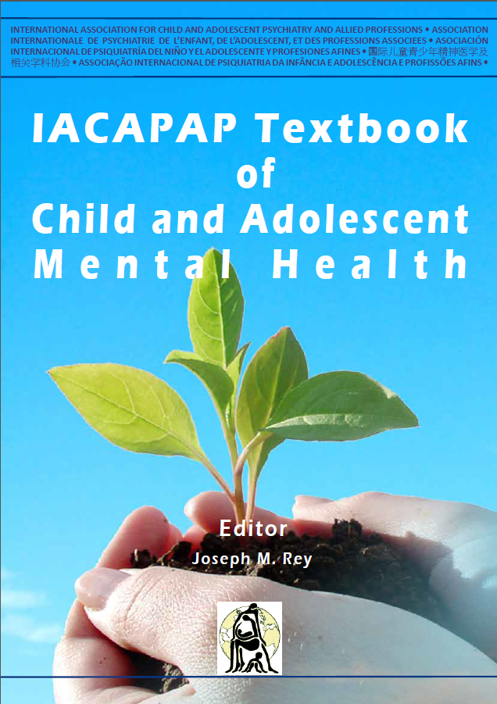
ANXIETY DISORDERS
Chapter F.4
Acute and Chronic Reactions to Trauma in Children and Adolescents
Eric Bui, Bonnie Ohye, Sophie Palitz, Bertrand Olliac, Nelly Goutaudier, Jean-Philippe Raynaud, Kossi B Kounou & Frederick J Stoddard Jr
Companion PowerPoint Presentation
Adapted by Henrikje Klasen & Julie Chilton

Slide 2
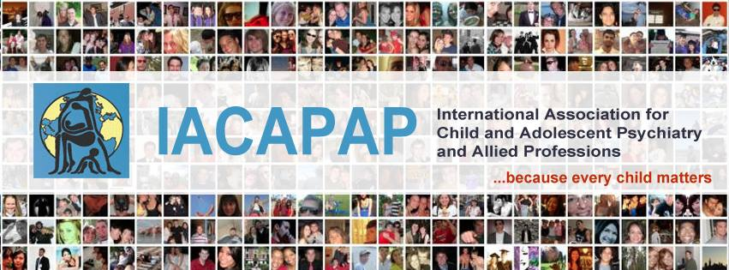
The “IACAPAP Textbook of Child and Adolescent Mental Health” is available at the IACAPAP website http://iacapap.org/iacapap-textbook-of-child-and-adolescent-mental-health
Please note that this book and its companion powerpoint are:
· Free and no registration is required to read or download it
· This is an open-access publication under the Creative Commons Attribution Non- commercial License. According to this, use, distribution and reproduction in any medium are allowed without prior permission provided the original work is properly cited and the use is non-commercial.

Slide 3

Acute and Chronic Reactions to Trauma
Learning objectives
Screen for mental health problems following trauma
Differentiate and diagnose
  Acute Stress Disorder and PTSD
  Other related problems
Treat or manage through:
  Psycho-education
  Psychological first aid
  Basic psycho-social interventions
  Pharmacotherapy
Know when to refer patient to a specialist
Notes:
At the end of this session you should be able to:
Screen for patients mental health following trauma
Differentiate and diagnose
Acute Stress Disorder and PTSD
Other related mental health problems
Treat or manage through:
Psycho-education
Psychological first aid
Basic psycho-social interventions
Pharmacotherapy
Know when to refer patient to a specialist
N.B. Exposure need not be direct!

Slide 4

Acute and Chronic Reactions to Trauma
Historical References
157-86 B.C. Caius Marius
was gripped with an “overpowering thought
of a new war, of fresh struggles, of terrors
known by experience to be dreadful”
and “was prey to nightly terrors and
harassing dreams”
Iranian soldier during Iran-Iraq War
Notes:
Although the past few decades have seen important advances in the understanding and treatment of traumatic stress conditions, psychological stress reactions to trauma have been described from antiquity (Birmes et al, 2010). In his biography of famous lives, Plutarch wrote that the general and Roman consul Caius Marius (157-86 BC), when presented with a reminder of one of his dreaded enemies, was gripped with an “overpowering thought of a new war, of fresh struggles, of terrors known by experience to be dreadful” and “was prey to nightly terrors and harassing dreams” (Plutarch, 1920).

Slide 5
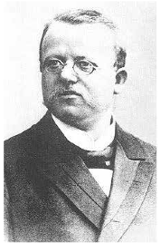
Acute and Chronic Reactions to Trauma
Historical References
1889 Hermann Oppenheim’s “Traumatic Neuroses”
Notes:
Deriving from the Greek τραῦμα meaning “wound,” the word “trauma” has been used for centuries as a medical term to designate “an injury to living tissue caused by an extrinsic agent.” Nonetheless, it was not until 1889 when Oppenheim first used the clinical descriptions of “traumatic neuroses” in victims of railroad accidents, that the word also encompassed a psychological meaning. Hermann Oppenheim was a German neurologist, and the first to conceptualize psychological trauma in his 1891 treatise on “traumatic neuroses” (Weitere Mitteilungen über die traumatischen Neurosen) based on clinical observations of railway, factory, and construction accident victims.

Slide 6
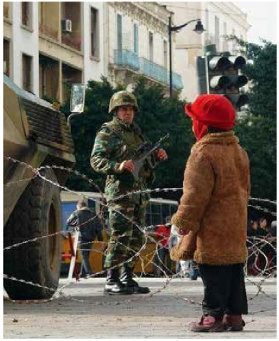
Acute and Chronic Reactions to Trauma
General Considerations
Trauma is defined as:
Sudden
Threat to life or physical integrity
Outside normal experiences
Two Types:
Type 1: single event
Type 2: long-standing/repeated
(not in DSM-5)
Notes:
Historically, a traumatic event has commonly been described as presenting three characteristics:
Sudden and unexpected occurrence
Association with a threat to life or to physical integrity, and
Being outside of the normal range of life experiences.
These three features differentiate “trauma” from other distressing events such as medical disease or relationship breakups. Lenore Terr defined two types of psychological trauma:
Type I, associated with a time-limited single traumatic event (accident, disaster, etc.), and
Type II, caused by long-standing or repeated exposure to traumatic events (abuse, torture, combat situation, etc.) (Terr, 1991).
N.B. Exposure need not be direct!

Slide 7
Acute and Chronic Reactions to Trauma
General Considerations
DSM 5 Changes:
Type 2 not included
No subjective reaction criterion
Exposure through close family or friend added
Extreme and repeated exposure to aversive details included
Only work-related exposure through media
For children “negative alterations in cognitions and mood”
Distinct category
New PTSD subcategory for children under 6
Notes:
DSM 5 Changes:
The evidence for a Type II trauma category was considered too weak to be included in the fifth edition of the Diagnostic and Statistical Manual of Mental Disorders (DSM-5) (American Psychiatric Association 2013; Resick et al, 2012). While in the fourth edition (DSM-IV) (American Psychiatric Association, 1994) traumatic events were defined as “events that involve actual or threatened death or serious injury, or a threat to the physical integrity of oneself or others” that are accompanied by a feeling of “intense fear, helplessness, or horror,” DSM-5 dropped the subjective reaction to the trauma required in DSM-IV (criterion A2) because evidence did not support the need for it to make a diagnosis of acute stress disorder (ASD) and posttraumatic stress disorder (PTSD) (Stoddard et al, in press). In the DSM-5 definition, traumatic events include not only direct exposure (i.e., being a victim) and witnessing a traumatic event, but also learning that the traumatic event(s) occurred to a close family member or close friend. The DSM-5 definition also includes extreme and repeated exposure to aversive details of the traumatic events (e.g., first responders collecting human remains), but excludes exposure through the media unless it is work related (e.g., police officers repeatedly viewing pictures and recordings of assault).
In relation to children, an important addition to DSM-5 is the new criterion: “negative alterations in cognitions and mood associated with the traumatic event(s).” The “intrusive”, “avoidance”, and “arousal” categories of PTSD symptoms are retained (see section on clinical features below and Table F.4.1).
ASD and PTSD are no longer listed under the chapter on anxiety disorders, but as a distinct category: Trauma and stressor-related disorders (see Chapter A.9). In addition to ASD and PTSD, this category includes reactive attachment disorder, disinhibited social engagement disorder, and quite importantly, adjustment disorder. Persistent complex bereavement disorder (also known as complicated grief or prolonged grief disorder) has been included in DSM-5 in the section on conditions for further study, but is also listed as a possible diagnosis as “specified trauma and stressor-related disorders” (APA, 2013).
The epidemiologic and clinical research data presented in this chapter is limited to studies utilizing DSM-IV or earlier criteria; little research using DSM-5 criteria is currently available.
Of significance in DSM-5 is the addition of the developmentally modified PTSD subcategory of posttraumatic stress disorder for children 6 years and younger, which differs in important ways from the PTSD criteria for children older than 6 years. Especially significant for the diagnosis of PTSD in children aged 6 years and younger is that instead of the 7 symptoms required in older children and adults, only 3 symptoms are required, one each from the “intrusion”, “avoidance or negative cognitions” or “arousal” group of symptoms (see Table F.4.1).

Slide 8

Acute and Chronic Reactions to Trauma
In Your World
What is the relevance ?
Any cases?
Do local people recognize it?
Other points to discuss?
Notes:
What is the relevance of (post-traumatic) stress in children and adolescents in your country/your personal experience ?
Tell us about any cases you encountered
Do local people recognize post-traumatic stress as a (medical) problem?
What do they call these problems?
How do they express stress?
How do they treat it?
Are there any other points you want to discuss?

Slide 9
Acute and Chronic Reactions to Trauma
Why Is This Important?
Trauma is common
About 20% of children develop PTSD after trauma
Untreated symptoms may become chronic
Some approaches may worsen PTSD
Notes:
Traumatic experiences are common
About 20% of children may suffer from PTSD following exposure to trauma
Untreated symptoms may become chronic, causing much distress and disability
You need to know how to deal with traumatized youths as some approaches may actually make matters worse.

Slide 10
Acute and Chronic Reactions to Trauma
The Basics: ASD/ASR and PTSD
Definition—according to duration of symptoms after the trauma:
Peri-traumatic:
  symptoms lasting minutes or hours
Acute Stress Disorder (ASD):
  symptoms lasting 2/3 days to 1 month
Post-Traumatic Stress Disorder (PTSD):
  Symptoms for more than 1 month
Notes:
Exposure to a traumatic event in this age group may lead to the development of various reactions ranging from relatively mild, causing minor disruptions in the child’s life, to severe and debilitating consequences. Most children and adolescents exposed to traumatic events will develop some psychological distress, which is generally short lived. In some, however, symptoms do not remit spontaneously and instead become clinically significant, persistent and impairing.
Reactions to trauma exposure are defined according to their timeframe: immediate or peri-traumatic (lasting minutes to hours), ASD (lasting between two days and one month), and PTSD (when symptoms persist for more than one month).

Slide 11
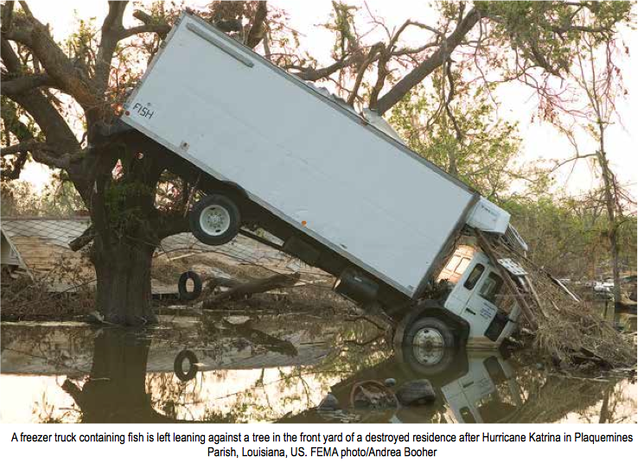
Acute and Chronic Reactions to Trauma
The Basics: Other Reactions to Trauma
Depression
Panic disorder
Specific phobias
Behavioral problems
Attentional problems
Regression
Notes:
Children and adolescents may develop other psychiatric conditions after trauma exposure including depression, panic disorder, specific phobias (distinctively related to some aspect of the trauma), as well as behavioral and attentional problems (e.g., oppositional defiant disorder). Among preschoolers, other clinical presentations include developmental problems such as loss of previously mastered skills (regression), as well as the onset of fears not specifically associated with aspects of the trauma.
Here you see a freezer truck containing fish is left leaning against a tree in the front yard of a destroyed residence after Hurricane Katrina in Plaquemines Parish, Louisiana, US. FEMA photo/Andrea Booher

Slide 12
Acute and Chronic Reactions to Trauma
Epidemiology
ASD:
  8-10% of exposed children
  17% mean prevalence of exposed adults
PTSD:
  16% exposed children
  5% prevalence in US adolescents
  7-10% lifetime prevalence in US adults
  Females>males
Notes:
ASD:
Across studies of trauma-exposed adults, reported prevalence of ASD ranges from 7% to 59% (Bryant et al, 2008; Elklit & Christiansen, 2010) with a mean prevalence of 17.4% (Bryant, 2011). These figures, however, are somewhat lower among children, with reported rates around 8-10% in industrialized countries (Kassam-Adams & Winston, 2004; Bryant et al, 2007; Dalgleish et al, 2008).
In the US, between 7% and 10% of individuals may suffer from PTSD in their lifetime, while reported 12-month prevalence among adults is approximately 4% (Kessler et al, 2005a; 2005b). In adults, incidence rate (percentage of new cases) of PTSD following a trauma vary greatly (Breslau et al, 1998), determined by a range of factors such as the type of trauma, trauma severity, previous exposure to trauma, the presence of prior mood or anxiety disorders, and elevated peri- traumatic reactions (Brewin et al, 2000; Ozer et al, 2003). Rates of PTSD among child and adolescent survivors of disasters vary widely depending on the studied population and the measures used to assess diagnosis, with rates ranging from 1% to 60% (Wang et al, 2013).
While prior data found that as many as 36% of children and adolescents exposed to a range of traumatic events were diagnosed with PTSD (Fletcher, 1996c), a recent meta-analysis reported that the rate of PTSD among children after trauma exposure is approximately 16% (Alisic et al, in press). A large epidemiological survey in the US found a lifetime prevalence rate for PTSD of 4.7% among adolescents (McLaughlin et al, 2013), with higher rates among females (7.3%) than males (2.2%).

Slide 13
Acute and Chronic Reactions to Trauma
Clinical Features: Peri-Traumatic Reactions
Minutes to hours after event
Increased likelihood of PTSD and ASD
  Peri-traumatic distress:
    Fear, horror, helplessness, sadness, guilt, shame, fright, loss of bowel/bladder control etc.
  Peri-traumatic dissociation:
    Blanking out, feeling on autopilot, time distortion, depersonalization, derealization, confusion, amnesia, reduced awareness
Notes:
When confronted with a traumatic event, children and adolescents often show immediate psychological responses. Reactions experienced during and immediately after trauma are called peritraumatic and have been identified as robust predictors of the development of PTSD in adults (Brewin et al, 2000; Ozer et al, 2003). Two types of peritraumatic reactions have been described: peritraumatic distress and peritraumatic dissociation.
Peritraumatic distress was introduced as a measure of the intensity of DSM- IV PTSD (Brunet et al, 2001), and indexes emotional (e.g., fear, horror) and physical (e.g., loss of bowel control) reactions experienced during or immediately after exposure to a traumatic event. Peritraumatic distress can be measured with the 13-item Peritraumatic Distress Inventory (PDI) (Brunet et al, 2001) that evaluates feelings of helplessness, sadness, guilt, shame, frustration, fright, horror, passing out, worry for others, loss of bowel and bladder control, physical reactions, and thoughts of dying (Appendix F.4.1).
Peritraumatic dissociation refers to alterations in the experience of time, place and persons during or immediately after exposure to trauma (Marmar et al, 1994) and is assessed by the 10-item Peritraumatic Dissociative Experiences Questionnaire (PDEQ). The PDEQ includes items measuring blanking out, a feeling that one is on autopilot, time distortion (“slow motion”), depersonalization (feeling of watching oneself act while having no control over the situation), derealization (a feeling of strangeness and unreality of the external world), confusion, amnesia, and reduced awareness (Appendix F.4.2).
Both the PDI and the PDEQ have been validated in children (Bui et al, 2011), and both peritraumatic distress and dissociation have been shown to be associated with the development of PTSD symptoms in children (Bui et al, 2010a).

Slide 14
Acute and Chronic Reactions to Trauma
Clinical Features: Acute Stress Reaction/Disorder
Symptoms 2-3 days to 1 month after trauma
Symptoms:
  Intrusion
  Dissociative symptoms
  Avoidance symptoms
  Arousal symptoms
Clinically significant distress or impairment
Notes:
Early psychological reactions to trauma exposure are described under the label “acute stress reaction” (ASR) in the 10th edition of the International Classification of Diseases (ICD-10) (World Health Organization, 1992), and under “acute stress disorder” (ASD) in DSM-5. While both ASR and ASD descriptions are similar, they differ slightly on their timeframe (onset two days post-trauma exposure for ASR, three days for ASD). We focus on ASD as research and evidence-based recommendations have been mostly conducted using DSM criteria.
ASD was introduced in DSM-IV in order to differentiate short-lived distressing and impairing reactions to trauma from PTSD (Koopman et al, 1995), as well as to identify individuals at risk for PTSD one month later (Spiegel et al, 1996). In DSM-5, a diagnosis of ASD requires exposure to a traumatic event (i.e., exposure to death or threatened death, actual or threatened serious injury, or actual or threatened sexual violation) and the main diagnostic criterion requires meeting 9 of 14 symptoms (in any particular cluster), including symptoms of intrusion (i.e., recurrent distressing dreams, recurrent distressing memories of the trauma, intense or prolonged distress upon exposure to reminders, and physiological reactions to reminders); dissociative symptoms (i.e., derealization, emotional numbing and inability to remember an aspect of the trauma (typically dissociative amnesia)); avoidance symptoms (i.e., avoidance of internal or external reminders that arouse recollections of the traumatic event(s)); and arousal symptoms (i.e., irritable or aggressive behavior, exaggerated startle response, sleep disturbance, hypervigilance, and problems with concentration). The duration of the symptoms may run from three days to four weeks after trauma exposure, with clinically significant distress or impairment (see Table F.4.1).

Slide 15

Acute and Chronic Reactions to Trauma
The Basics: PTSD
http://www.monkeysee.com/play/21549-non-military-ptsd
Notes:
Listen to a psychiatrist at Massachussetts General Hospital in the US talk about PTSD.

Slide 16
Acute and Chronic Reactions to Trauma
Clinical Features: PTSD
Debate over application of adult criteria
Exposure to death or threatened death, actual or threatened serious injury, actual or threatened sexual assault
  ONE symptom of intrusion (flashbacks, nightmares etc.)
  Persistent avoidance
  TWO symptoms of negative alterations in mood or cognition (e.g., blame, emotional numbing, withdrawal etc.)
  TWO symptoms of alterations in arousal or reactivity (e.g., startle, irritability, sleep disturbance)
Present more than 1 month
Significant distress or impairment
Notes:
The diagnosis of PTSD, initially reserved for adults, was extended to youth in 1987 with DSM-III. In DSM-IV, diagnostic criteria for PTSD for children and adolescents are identical to those used for adults with a few caveats. There has
been intense scientific debate over the use of adult DSM-IV criteria for PTSD in children and recent data suggest that youth might require fewer criteria based on functional impairment associated with PTSD symptoms, and may have somewhat different expressions of distress, especially in those who are very young (Scheeringa et al, 2003).
In DSM-5, the diagnosis of PTSD includes the same exposure criteria as ASD (i.e., exposure to death or threatened death, actual or threatened serious injury, or actual or threatened sexual violation). In addition, the adult and adolescent PTSD diagnosis requires:
One symptom of intrusion (criterion B) including recurrent distressing dreams, recurrent distressing memories of the trauma, dissociative reactions (e.g., flashbacks), or intense psychological or physiological reactivity to reminders of the trauma;
Persistent avoidance of internal or external stimuli associated with the trauma (criterion C);
Two symptoms of negative alterations in cognitions and mood associated with the trauma (criterion D) including persistent, distorted blame of self or others, persistent negative emotional state (e.g., fear, horror, anger, shame or guilt), diminished interest or participation in significant activities, detachment or estrangement from others, or persistent inability to experience positive emotions (e.g., emotional numbing); and
Two symptoms of alterations in arousal and reactivity (criterion E), including irritability or aggressive behavior, reckless or self-destructive behavior, hypervigilance, exaggerated startle, problems with concentration, or sleep disturbance.
The diagnosis also requires symptoms to last more than one month, to be associated with clinically significant distress or impairment, and not to be associated with the effects of a substance or medical condition. In addition, DSM- 5 includes a subtype of PTSD for preschool children aged six or younger that highlights significant differences including the still developing abstract cognitive and verbal expression capacities (Scheeringa et al, 2011a; Scheeringa et al, 2001b). Three main modifications are made for this subtype:
Changes in the re-experiencing symptoms include rewording the criterion B1 (i.e., recurrent and intrusive distressing recollections of the event) which does not require the recollections to be distressing, as a number of traumatized children feel either neutral or excited by the recollection.
With regard to avoidance symptoms and negative alterations in cognitions and mood, the criteria for preschool children only requires one symptom from these two clusters to be met, as it is usually difficult in this population to identify certain symptoms including “restricted range of affect” and “detachment from loved ones.” In addition, two symptoms were removed as they were not developmentally sensitive: “sense of a foreshortened future” and “inability to recall an important aspect of the event.” Finally, in this cluster, two symptoms were reworded to improve validity among preschool children: diminished interest in activities may take the form of constricted play, while feelings of detachment may manifest as social withdrawal.
With regards to hyperarousal, only one small change of wording was made with “irritability or outbursts of anger” being modified to include “extreme temper tantrums.” (Table F.4.1)

Slide 17
Acute and Chronic Reactions to Trauma
Risk Factors: PTSD
Pre-Trauma
Small to medium effect sizes:
Female gender
Low intelligence
Low SES
Pre-trauma life events
Pre-trauma low self-esteem
Pre-trauma psychological problems in youth
and parents
Post and Peri-Trauma
Medium to large effect sizes:
Peri-trauma fear
Perceived life threat
Low social support
Social withdrawal
Psychiatric comorbidity
Poor family functioning
Use of distraction and thought suppression
Notes:
A meta-analysis of 64 studies assessing risk factors for PTSD among children and adolescents aged 6 to 18 (Trickey et al, 2012) revealed that factors relating to the subjective experience of the event (including peri-trauma fear and perceived life- threat) and post-trauma variables (including low social support, social withdrawal, psychiatric comorbidity, poor family functioning, and the use of certain cognitive strategies such as distraction and thought suppression) accounted for medium-to- large effect sizes in the prediction of PTSD, while pre-trauma factors (including female gender, low intelligence, low socioeconomic status, pre-trauma life events, pre-trauma low self-esteem, pre-trauma psychological problems in the youth and parents) accounted for only small-to-medium effect sizes.

Slide 18
Acute and Chronic Reactions to Trauma
Differential Diagnosis/Co-Morbidity
Adjustment disorder *
Anxiety disorder
OCD
Depression
Dissociative disorders
Conversion disorder
Psychosis
Substance abuse
Traumatic brain injury
Notes:
PTSD shares symptoms with numerous other conditions, such substance intoxication, which should be ruled out as the cause or should be excluded from a PTSD diagnosis. Also, PTSD can present concurrently with mood and anxiety symptoms, and the presence of mood and anxiety disorders should be ascertained. The main differential diagnoses to be considered are:
Adjustment disorder
ASD
Anxiety disorder
OCD
Major depression
Dissociative disorders
Conversion disorder
Psychosis
Substance intoxication
Traumatic brain injury.
In contrast with PTSD, which requires symptoms to be present for at least one month after trauma exposure, ASD is diagnosed during the first month. In addition, PTSD diagnosis requires the presence of at least six symptoms from four clusters (re-experiencing, avoidance, persistent negative alterations in cognitions and mood, and hyperarousal), while ASD diagnosis requires only the presence of nine out of 14 symptoms (see Table F.4.1).
Similar to PTSD and ASD, adjustment disorders require exposure to a stressful event, which results in clinically significant distress or impairment. However, in adjustment disorders, the stressor does not need to be “traumatic” (i.e., as severe as for ASD or PTSD). FFurther, adjustment disorder does not specify required symptoms and the patient’s condition should not be explained by another disorder.
Although exposure to a traumatic event may precipitate the onset of a range of mood or anxiety disorders, these diagnoses are not as tightly conditioned by the traumatic event as is the case with ASD and PTSD. While ASD and PTSD share with anxiety disorders (including panic, general anxiety and social anxiety disorders) symptoms of hyperarousal and avoidance, the clinical presentation of ASD and PTSD includes both a focus around a traumatic event and re- experiencing emotions and images of the trauma. A major depressive episode triggered by a stressful experience may include concentration difficulties, insomnia, social withdrawal or detachment similar to those found in PTSD; however the clinical presentation of depression will lack re-experiencing the trauma or related avoidance.

Slide 19
Acute and Chronic Reactions to Trauma
Course
PTSD often improves during the first year after the event
When untreated, course can be chronic and disabling
There is limited data especially on children and adolescents
Notes:
It has been shown that PTSD symptoms in adults improve mostly during the first 12 months following the traumatic event (Bui et al, 2010b), however data suggest that the course of PTSD without treatment is largely a chronic one— individuals may experience significant levels of symptoms and impairment even decades later (e.g., O’Toole et al, 2009).
Similarly, data suggest that among pre-school children, the course of PTSD may be chronic, with limited improvement over the two years following the traumatic event (Scheeringa et al, 2004; 2005; 2006). Data among school- age children, however, are mixed with some reporting no long term impact of a disaster on PTSD rates (McFarlane & Van Hooff, 2009) and others reporting elevated rates (Morgan et al, 2003). Finally, the scarce data in adolescents also points to a possible chronicity of PTSD symptoms in this population (Yule et al, 2000).

Slide 20
Acute and Chronic Reactions to Trauma
Assessment & Diagnosis
Open ended questions (avoid leading questions)
Use play in younger children
Engage caregivers and form therapeutic alliance
Assess environment
Talk to child with parents AND
  on his/her own
Notes:
Evaluation of young persons with possible PTSD should generally begin with open-ended questions to elicit a narrative account of the trauma. For younger children this will often be in a play context, including drawings; for adolescents, in their own words with minimal input from the interviewer. While in adults this non-directive segment may be useful to minimize the risk of making an incorrect PTSD diagnosis in malingering individuals who want to achieve some gain (e.g., compensation), it can be helpful in young children also; it has been reported that children’s reports of exposure to trauma and symptoms may be influenced by the way questions are asked (Bruck & Ceci, 1999). In particular, this is important in the context of potential sexual or physical abuse, with significant legal implications. Thus, it is recommended when assessing possible sexual or physical abuse, to use open-ended questions, avoid suggesting answers, and avoid even asking the same question twice as children might change their answer believing they have answered incorrectly the first time. Videotaping interviews is often advised in cases of possible child abuse testimony for the clinician to show that questions were non-directive.
Children and adolescents are usually dependent on their parents to access clinical care. It is therefore important to engage and maintain a therapeutic alliance with caregivers. If caregivers are not aware the child has been exposed to trauma, they are unlikely to present the child for evaluation. Guidelines from the American Academy of Child and Adolescent Psychiatry (AACAP) have recommended that “Even if trauma is not the reason for referral, clinicians should routinely ask children about exposure to commonly experienced traumatic events (...), and if such exposure is endorsed, the child should be screened for the presence of PTSD symptoms” (Cohen et al, 2010).
As is the case for other mental disorders, children and adolescents’ posttraumatic symptoms influence and are influenced by the family and immediate environment. Assessment of posttraumatic symptoms in this age group should therefore include an assessment of their family (or environment). This is particularly important as other family members may have been exposed to the same traumatic event and may also be suffering from posttraumatic symptoms.
Finally, parents have been consistently found to under-report their children’s traumatic experiences and posttraumatic symptoms (Meiser-Stedman et al, 2007; Dyb et al, 2003; Shemesh et al, 2005) particularly among younger children (Dyb et al, 2003). It is therefore not only important but also necessary to directly assess children’s symptoms and behaviors and not to rely solely on parental reports of symptoms.

Slide 21
Acute and Chronic Reactions to Trauma
Cross-Cultural Differences
How do people in your country express stress and distress?

Slide 22
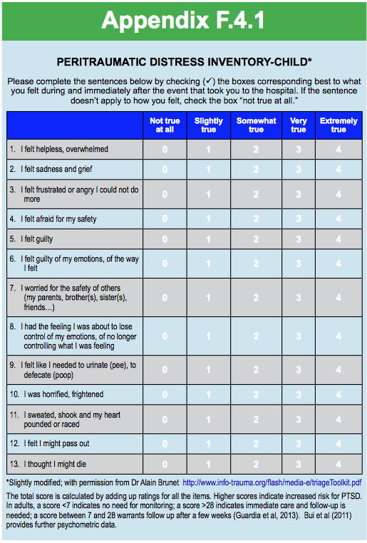
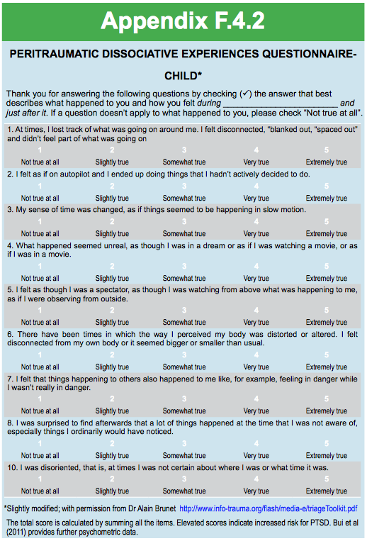
Acute and Chronic Reactions to Trauma
Free Rating Scales in Textbook Appendix
Peritraumatic Distress
Inventory
Peritraumatic Dissociative Experiences Questionnaire
Notes:
0-item Peritraumatic Dissociative Experiences Questionnaire (PDEQ). The PDEQ includes items measuring blanking out, a feeling that one is on autopilot, time distortion (“slow motion”), depersonalization (feeling of watching oneself act while having no control over the situation), derealization (a feeling of strangeness and unreality of the external world), confusion, amnesia, and reduced awareness (Appendix F.4.2).
13-item Peritraumatic Distress Inventory (PDI) (Brunet et al, 2001) that evaluates feelings of helplessness, sadness, guilt, shame, frustration, fright, horror, passing out, worry for others, loss of bowel and bladder control, physical reactions, and thoughts of dying (Appendix F.4.1).
Both the PDI and the PDEQ have been validated in children (Bui et al, 2011), and both peritraumatic distress and dissociation have been shown to be associated with the development of PTSD symptoms in children (Bui et al, 2010a).
Both available in IACAPAP chapter
Also available:
A number of assessment instruments are available to assist in the evaluation of ASD and PTSD in children and adolescents (Hawkins & Radcliffe, 2006; March et al, 2012), however some have the limitation of having been adapted from adult measures. Measures based on DSM-5 criteria are not yet available. A detailed review of these instruments is beyond the scope of this chapter. Table F.4.2 summarizes some of the more commonly used measures, whether they are freely available and where they can be found.
The most widely used instrument is the clinician-administered PTSD Scale for Children and Adolescents (CAPS-CA) (Nader et al, 1996), an interview-based instrument derived from the adult CAPS that is limited by the duration of the assessment and the requirement for the interviewer to receive training. Another option is the Child Stress Disorders Checklist (CSDC) (Saxe et al, 2003).
A few diagnostic interviews that assess a range of disorders are available and can be helpful in assessing PTSD (Scheeringa & Haslett, 2010; Egger et al, 2006). For example, the Preschool Age Psychiatric Assessment (Egger et al, 2006) or the Diagnostic Infant and Preschool Assessment Instruments may be used in preschoolers (Scheeringa & Haslett, 2010), while the Diagnostic Interview for Children and Adolescents (DICA) can be used for both children and adolescents (Reich, 2000).
See Table F.4.2

Slide 23
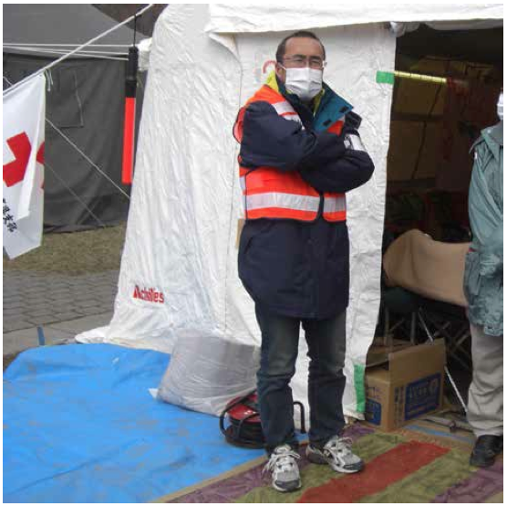
Acute and Chronic Reactions to Trauma
Aims of Treatment
Prevent ASD and PTSD
In PTSD:
  Reduce symptoms
  Reduce distress
  Reduce impairment
Dr. Yoshiro Ono, Japanese child psychiatrist in the aftermath of the 2011 tsunami
Notes:
Prevent development of ASD and PTSD
In PTSD:
Reduce symptoms
Reduce distress
Reduce impairment
IACAPAP’s Dr Yoshiro Ono, Japanese Child Psychiatrist providing help in the aftermath of the earthquake and tsunami that devastated Northern Japan on March 11, 2011

Slide 24
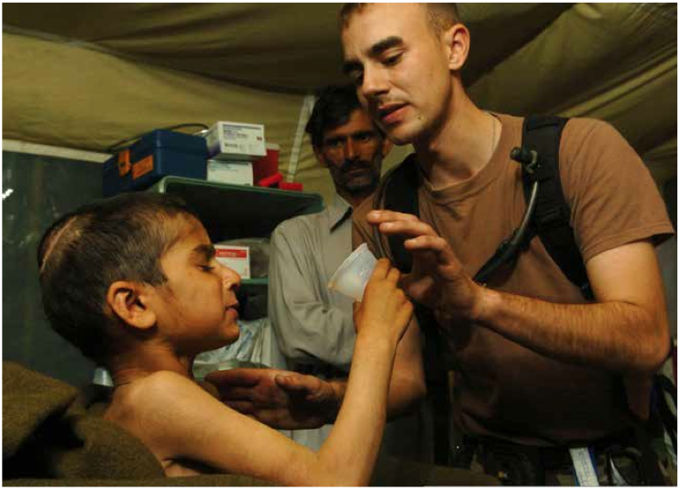
Acute and Chronic Reactions to Trauma
What Works in the Immediate Aftermath <24 hours?
Evidenced-Based Treatment: PTSD and ASD
Psychological first aid
  Education
  Meet medical and safety needs
  Increase social support
  Provide referral if necessary
Critical Incident Debriefing
  More harm than good
Exposure-based intervention
  Evidence in adults
Good pain management including opiates for injuries
  benzodiazepines may do more harm than good
Notes:
This is a picture of Muzaffarabad, Pakistan (Nov. 1, 2005) – U.S. Army 1st Lt. Tory Marcon, assigned to the 212th MASH unit, helps a Pakistani child drink a powered milkshake from a Meals Ready-to-Eat (MRE) in Muzaffarabad, Pakistan. The child has tetanus and the milkshake is the only food he can manage to swallow because of muscle spasms. The United States was participating in a multi-national assistance and support effort led by the Pakistani Government to bring aid to the victims of the devastating earthquake that struck the region on October 8th, 2005. U.S. Navy photo by Photographer’s Mate 2nd Class Eric S. Powell
Most children and adolescents will experience some psychological or somatic symptoms in the immediate aftermath of trauma. These symptoms do not necessarily indicate a need for intervention as they generally resolve spontaneously without professional help.
Critical incident debriefing, which requires individuals to discuss details of the trauma–sometimes in a group setting–has been found to provide very little or no benefit (Australian Centre for Posttraumatic Mental Health, 2013). Some data in adults suggest that group debriefing increases PTSD symptomatology and may even increase rates of PTSD (Rose et al, 2002; van Emmerik et al, 2002). Data from two randomized controlled trials among children revealed that debriefing was not superior to usual care in reducing rates of PTSD or other negative outcomes including behavioral problems, depression or anxiety (Stallard et al, 2006; Zehnder et al, 2010). Thus while children and adolescents in distress or seeking assistance should be offered the opportunity to ventilate individually about the trauma if they wish to do so, unrequested debriefing (in particular in a group setting) is not recommended.
Recent data suggest that a 3-session exposure-based intervention started in the emergency department within 12 hours of a traumatic event may be helpful in decreasing rates of PTSD among adults (Rothbaum et al, 2012), however, no data are yet available on children and adolescents.
In conclusion, debriefing should not be routinely provided to traumatized children and adolescents at risk for PTSD. Exposure-based interventions delivered immediately after trauma may help prevent PTSD in youth exposed to trauma, based on their efficacy in treating PTSD in children and adolescents (see below) and in preventing PTSD among adults. Finally, it is recommended to provide psychological first aid, including education about the usual course and normal reactions to trauma, and ensure that basic medical and safety needs are met, including shelter and food, increase social support, and provide appropriate referral.
A possible approach to the prevention of PTSD could be the administration of a medication immediately after trauma exposure; however, few data support the efficacy of any pharmacological agents for this indication. Immediate treatment with propranolol has yielded mixed results in adults (Vaiva et al, 2003; Pitman et al, 2002; Hoge et al, 2012), and a trial in children and adolescents was negative (Nugent et al, 2010). More promising, several studies of injured children and adults support the preventive benefit of higher levels of early post-injury administration of opiates for pain on later emergence of PTSD symptomatology (Saxe et al, 2001; Stoddard et al, 2009; Holbrook et al, 2010; Bryant et al, 2009).
Finally, despite their wide clinical use in seeking to relieve acute stress symptomatology, minimal evidence in the adult literature—but more in animal studies—suggests that benzodiazepines may not be helpful in the immediate aftermath of trauma and may even worsen outcomes in trauma-exposed individuals (Gelpin et al, 1996; Mellman et al, 2002). As a result, several guidelines recommend avoiding the use of benzodiazepines in the immediate aftermath of trauma.

Slide 25
Acute and Chronic Reactions to Trauma
What Works for ASD?
Evidence-Based Treatment: ASD
Most studies inconclusive
Maybe effective:
  Trauma-focussed CBT
  Narrative exposure
  Caregiver-child intervention
  Supportive counselling
Probably not effective: SSRIs
Notes:
For adults presenting with symptoms that do not remit rapidly, brief (four to five sessions) trauma-focused cognitive behavioral therapy (CBT) may be effective in treating ASD and in preventing the development of PTSD (Australian Centre for Posttraumatic Mental Health, 2013). These CBT interventions include education, breathing training, relaxation training, exposure-based exercises, and cognitive processing. In children and adolescents, these approaches may be useful as early psychological intervention for ASD based on their efficacy in treating PTSD. In any case, administration of these early psychological interventions is limited by the scarcity of professionals trained to administer them, particularly in low income countries.
Other early interventions tested among children with limited or inconclusive favorable results include self-help websites for children and information booklets for parents (Cox et al, 2010), narrative exposure therapy, and relaxation meditation (Catani et al, 2009). A study reported that a caregiver-child psychosocial and stress management intervention (child and family traumatic stress intervention) was superior to child supportive counselling and psychoeducation in reducing rates of PTSD and PTSD symptom severity among children with at least one cluster of traumatic stress symptoms (Berkowitz et al, 2011).
A trial of sertraline initiated in the hospital in the few days after trauma (and for a duration of 24 weeks) in burnt children and adolescents (Stoddard et al, 2011) yielded mixed results: no significant improvemnt in youth-rated PTSD symptoms but significant reduction on parental reports of children’s PTSD symptoms. Based on these as well as on the mixed results for antidepressants in the treatment of PTSD, antidepressants are not generally recommended for the treatment of ASD.

Slide 26
Acute and Chronic Reactions to Trauma
What Works for PTSD?
Evidence-Based Treatment: Psychopharmacology for PTSD
SSRIs
  evidence inconclusive in children
Benzodiazepines
  not recommended
Antipsychotics:
  some positive data from adults
  significant side effects
Anti-adrenergics:
  no RCTs
Mood stabilizers:
  one positive RCT for sodium valproate in adolescents
Notes:
No large or definitive pharmacological trials in pediatric PTSD are available to date. Overall, trauma-focused psychotherapeutic approaches should be favored in childhood PTSD.
Antidepressants
In adults, selective serotonin reuptake inhibitors (SSRIs) are the recommended first-line pharmacological treatment for PTSD. Their efficacy is well documented; they are usually well tolerated and may be useful in treating comorbid depression. However, there is little evidence to support their effectiveness in treating PTSD in the young. While the efficacy of sertraline and fluoxetine has been examined in young people, both failed to prove superior to placebo (Cohen et al, 2007; Robb et al, 2010; Robert et al, 2008). Thus, to date, evidence supporting the use of SSRIs for the treatment of PTSD in children and adolescents is lacking.
The effectiveness of other antidepressants has not been investigated in randomized controlled trials (e.g., serotonin–norepinephrine reuptake inhibitors) or trials yielded limited or inconclusive results (e.g., monoamine oxidase inhibitors). Given this lack of empirical evidence and their unfavorable side effect profile, including agitation and irritability, they are not recommended in the treatment of childhood PTSD.
Other pharmacological treatments
Although it might be tempting to prescribe benzodiazepines for PTSD because of their anxiolytic effects, there are no robust data supporting their efficacy. In addition, given that they may interfere with the extinction of learning processes— important for the effectiveness of cognitive behavioral therapy particularly when benzodiazepines are prescribed on an “as needed” basis—and that individuals with PTSD are at elevated risk for substance abuse and dependence, they are generally not recommended in the treatment of PTSD in the young.
Building on the fact that PTSD is associated with increased autonomic arousal, recent data suggest that anti-adrenergic medications including a- and ß-adrenergic receptor blockers, may be useful (Management of Post-Traumatic Stress Working Group, 2010). Results from open label studies conducted in children suggest that the a-adrenergic blocker clonidine (Harmon & Riggs, 1996), and the ß-adrenergic blocker propranolol (Famularo et al, 1988) might be effective in treating PTSD symptoms, although randomized controlled data is still needed.
Second generation antipsychotics have been studied with regards to their potential efficacy in treating PTSD in adults; a review suggests they may have a modest benefit (Ahearn et al, 2011). However to date, no randomized controlled data support their use in children with PTSD and their side effects are significant.
Finally, several controlled trials of antiepileptic mood stabilizers on PTSD have been conducted in adults. Overall, results have been mixed. Lamotrigine may have some benefit (Hertzberg et al, 1999), but topiramate, tiagabine, and divalproex have not been shown to be effective (e.g., Tucker et al, 2007; Hamner et al, 2009). Data for children are more limited; so far only one randomized controlled trial has shown some efficacy of sodium valproate for PTSD symptoms in adolescents with comorbid conduct disorder (Steiner et al, 2007).
In summary, although the field has seen important advances in the pharmacological treatment of adults with PTSD, to date there are no data supporting the use of psychotropic medications in the management of PTSD in children and adolescents.

Slide 27
Acute and Chronic Reactions to Trauma
What Works for PTSD?
Evidence-Based Treatment: Psychotherapy for PTSD
Trauma-Focused CBT
  best evidence
  12-16 sessions
  mainly targeting cognitive processing and avoidance
  treat co-morbidity
  involve parents
  model available for pre-school age children
EMDR
  appears effective in adults
  scarce data for children
Notes:
The most effective psychotherapeutic approaches to the treatment of PTSD symptoms are those based on cognitive-behavioral principles, specifically exposure and remodeling of cognitive processes. Treatments specifically designed for children and teens first became available in the late 1990s, and have been shown in randomized controlled studies to be more effective than supportive and non- directive therapies (Gerson & Rappaport, 2013; Schneider et al, 2013).
The best studied and most widely used is Trauma-Focused Cognitive Behavioral Therapy (TF-CBT) (Schneider et al, 2013). TF-CBT has been shown to reduce PTSD symptoms, trauma-related depression, and improve adaptive functioning in a variety of populations, including children and teens traumatized by sexual abuse, terrorism, domestic and community violence, and traumatic loss (Kowalik et al, 2011; Cary & McMillen, 2012). An adaptation of TF-CBT (Pre- School PTSD Treatment) has been tested in a sample of children ages three to six, with positive results (Scheeringa et al, 2011a).
TF-CBT is a time-limited (12-16 sessions) therapy that combines exposure, cognitive processing remodeling and enhancement of coping skills, delivered sequentially in 10 components: psycho-education, parenting skills (parent), relaxation skills, affect regulation skills, cognitive coping skills, trauma narrative, processing cognitive distortions, in vivo mastery of trauma triggers, parent-child sessions, and skills to increase safety from future exposures to trauma. Pre-School PTSD Treatment consists of 12 conjoint child-parent sessions and uses drawing as a developmentally appropriate expressive modality for the child to identify thoughts and feelings and to process the child’s trauma narrative (see Box in page F.4.20).
As with adults, young people with PTSD may have co-occurring mental health conditions such as substance abuse, aggression, delinquency, and psychosis. TF-CBT may be effectively combined with substance abuse treatment to reduce PTSD symptoms in adolescents abusing drugs or alcohol (Cohen et al, 2006; 2010). There are no data currently to guide psychotherapeutic treatment for children or adolescents with PTSD and comorbid conduct, bipolar, or psychotic disorder. Practice guidelines (e.g., Cohen et al, 2010) recommend integrating the treatment for both the PTSD and the co-occurring condition.
In contrast to adult psychotherapy, psychotherapies for children and adolescents raise the question of whether to involve the parents in the treatment. Evidence suggests that, when compared with treatment of the child or adolescent alone, parental involvement leads to better outcomes (Cohen et al, 2010). Further, parents’ involvement may reduce drop-outs (Chowdhury & Pancha, 2011) and provide children an ally when completing homework assignments, in maintaining a positive outlook, and practicing skills to maintain gains post-treatment. Parent involvement in the treatment of younger children is critical since an empathic, emotionally attuned relationship to parents or other primary caregivers is essential to a child’s recovery from trauma (Lieberman et al, 2011).
Finally, although the mechanism of action is unclear, eye movement desensitization and reprocessing (EMDR) has been found to be effective in adult PTSD. EMDR integrates elements of psychodynamic, cognitive-behavioral, cognitive, interpersonal, systems, and body-oriented therapies, as well as a bilateral brain stimulation component (e.g., eye movements). The current literature suggests that EMDR is effective in adult PTSD (Bisson et al, 2007). In youth, the evidence for the effectiveness of EMDR is not as strong as it is for CBT (Gillies et al, 2012).

Slide 28
Acute and Chronic Reactions to Trauma
Components of Trauma-Focused CBT
Psycho-education
Parenting skills
Relaxation training
Affect regulation
Cognitive coping skills
Trauma narrative
Processing cognitive distortions
In vivo mastery of trauma triggers
Increase safety for the future
Parent-child sessions

Slide 29




Acute and Chronic Reactions to Trauma
Further Resources
AACAP PTSD Practice Parameter
http://www.jaacap.com/article/S0890-8567(10)00082-1/pdf
Health Care Toolbox
https://www.healthcaretoolbox.org
International Society for Traumatic Stress Studies
http://www.istss.org/home.aspx
Australian Guidelines
http://www.phoenixaustralia.org

Slide 30

Medication:
ADHD
Acute and Chronic Reactions to Trauma
Thank You!
Notes:
--American Academy of Child and Adolescent Psychiatry has an excellent ADHD Resource center

